Slide 1


Data Analysis of Social Buzz

Slide 2


TODAY'S AGENDA:
Project recap
Problem
The Analytics team
Process
Insights
Summary

Slide 3

Social Buzz is a fast-growing technology company and requires adaptation to the global scale.
Accenture is focused on these tasks for next three months:
Audit of Social Buzz Big Data practice.
Recommendation for successful IPO.
Analysis to find Social Buzz top 5 most popular categories of content.
PROJECT RECAP

Slide 4

PROBLEM
MAJOR PROBLEM IS:
Perform Data Analysis and find top 5 most popular categories of Social Buzz.

Slide 5



THE ANALYTICS TEAM

Slide 6

PROCESS
1
Data Understanding
2
Data Cleaning
3
Data Modelling
4
Data Analysis
5
Share Insights

Slide 7

Insights
16
UNIQUE CATEGORIES
1897
REACTION TO THE MOST POPULAR CATEGORIES
JANUARY
MONTH WITH THE HIGHEST NUMBER OF POSTS

Slide 8
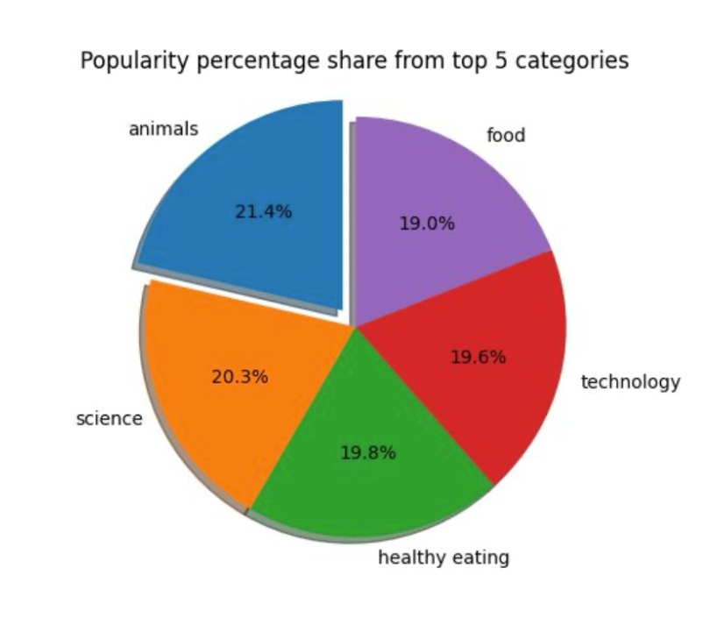

Slide 9
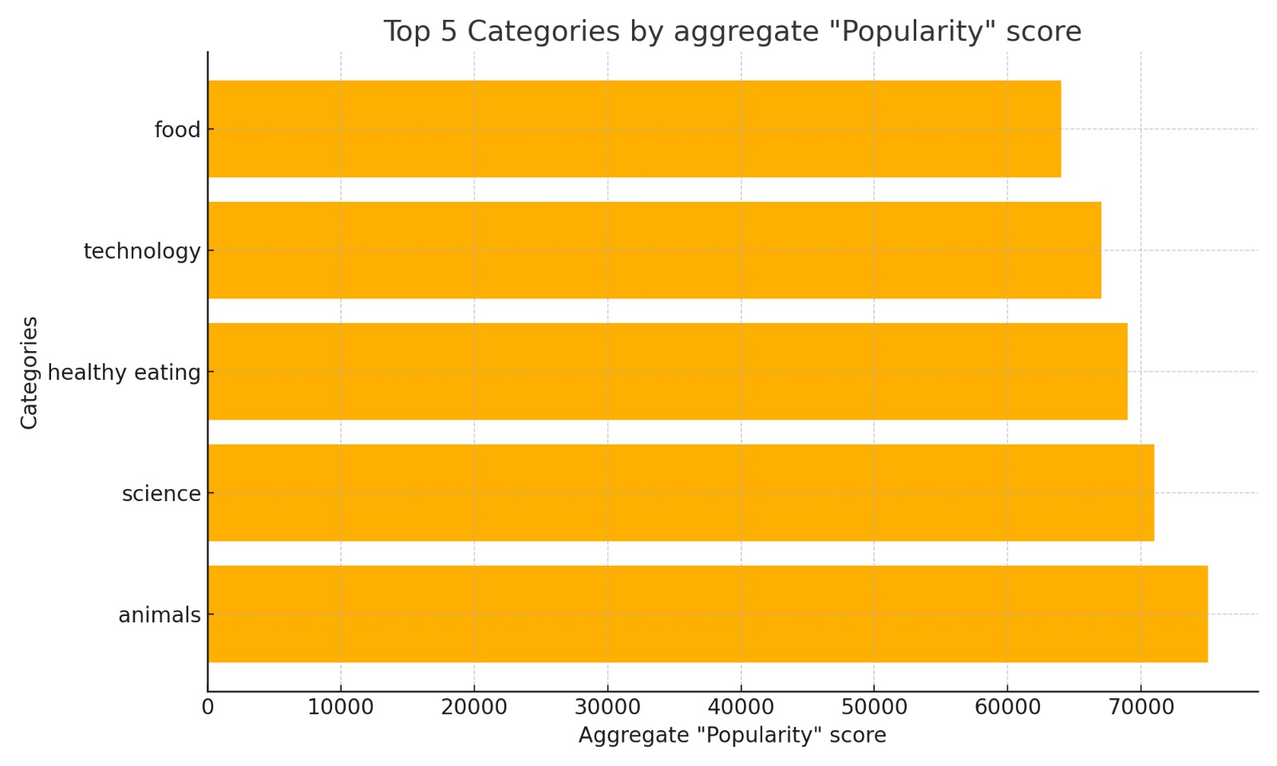

Slide 10

Summary
ANALYSIS
Animals and science are the two most popular categories of content, showing that people enjoy “real life” and “factual” content the most.
INSIGHT
Food is a common theme with the top 5 categories with “Healthy Eating” ranking the highest. This may give an indication to the audience within your user base. You could use this insight to create a campaign and work with healthy eating brands to boost user engagement.
NEXT STEPS
This ad-hoc analysis is insightful, but it’s time to take this analysis into large scale production for the real-time understanding of your business. We can show you how to do this.

Slide 11
THANK YOU!
ANY QUESTIONS?

