Slide 1
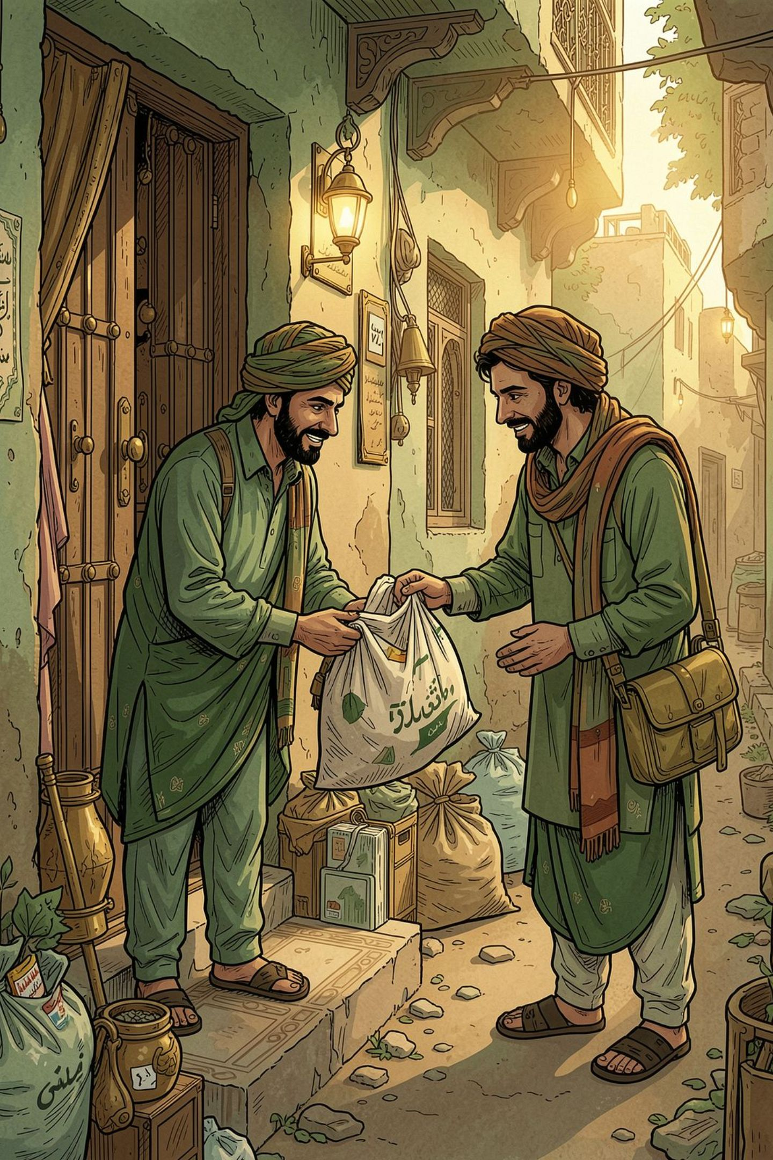
Raddi
Doorstep Scrap Pickup, Made Simple
A digital platform connecting households with scrap collectors across Pakistan. Hassan Javed — SMIT Batch 18 — Capstone Presentation
Live prototype: raddi-app.vercel.app/

Slide 2
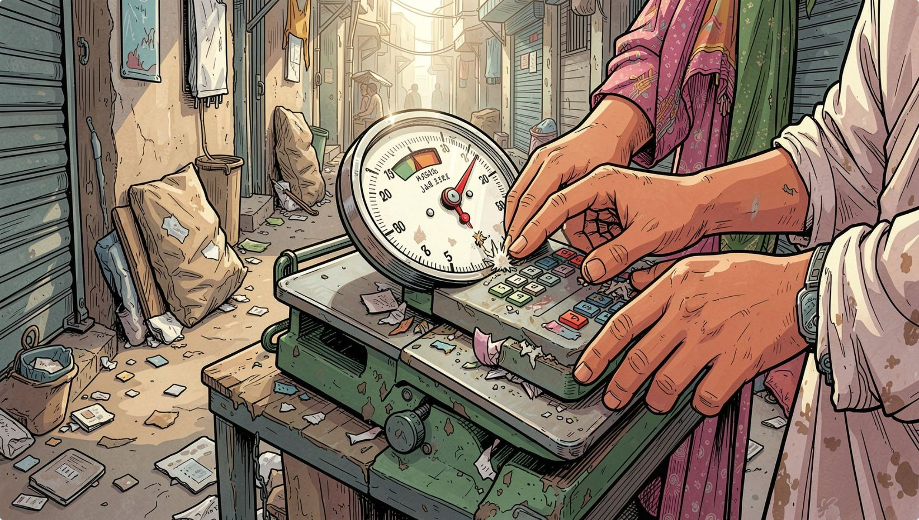
The Problem
Unclear pricing
Households often don’t know prevailing scrap rates — bargaining happens in-person with inconsistent quotes.
Trust in weighing
Customers worry the final weigh or scale reading may be inaccurate or disputed.
No convenient scheduling
Pickups are ad-hoc — customers wait at home or miss unpredictable visits.
No digital record
Transactions are cash-based with no receipts, making follow-up or reconciliation difficult.
What if selling household scrap could be as easy as booking a pickup from your phone?

Slide 3
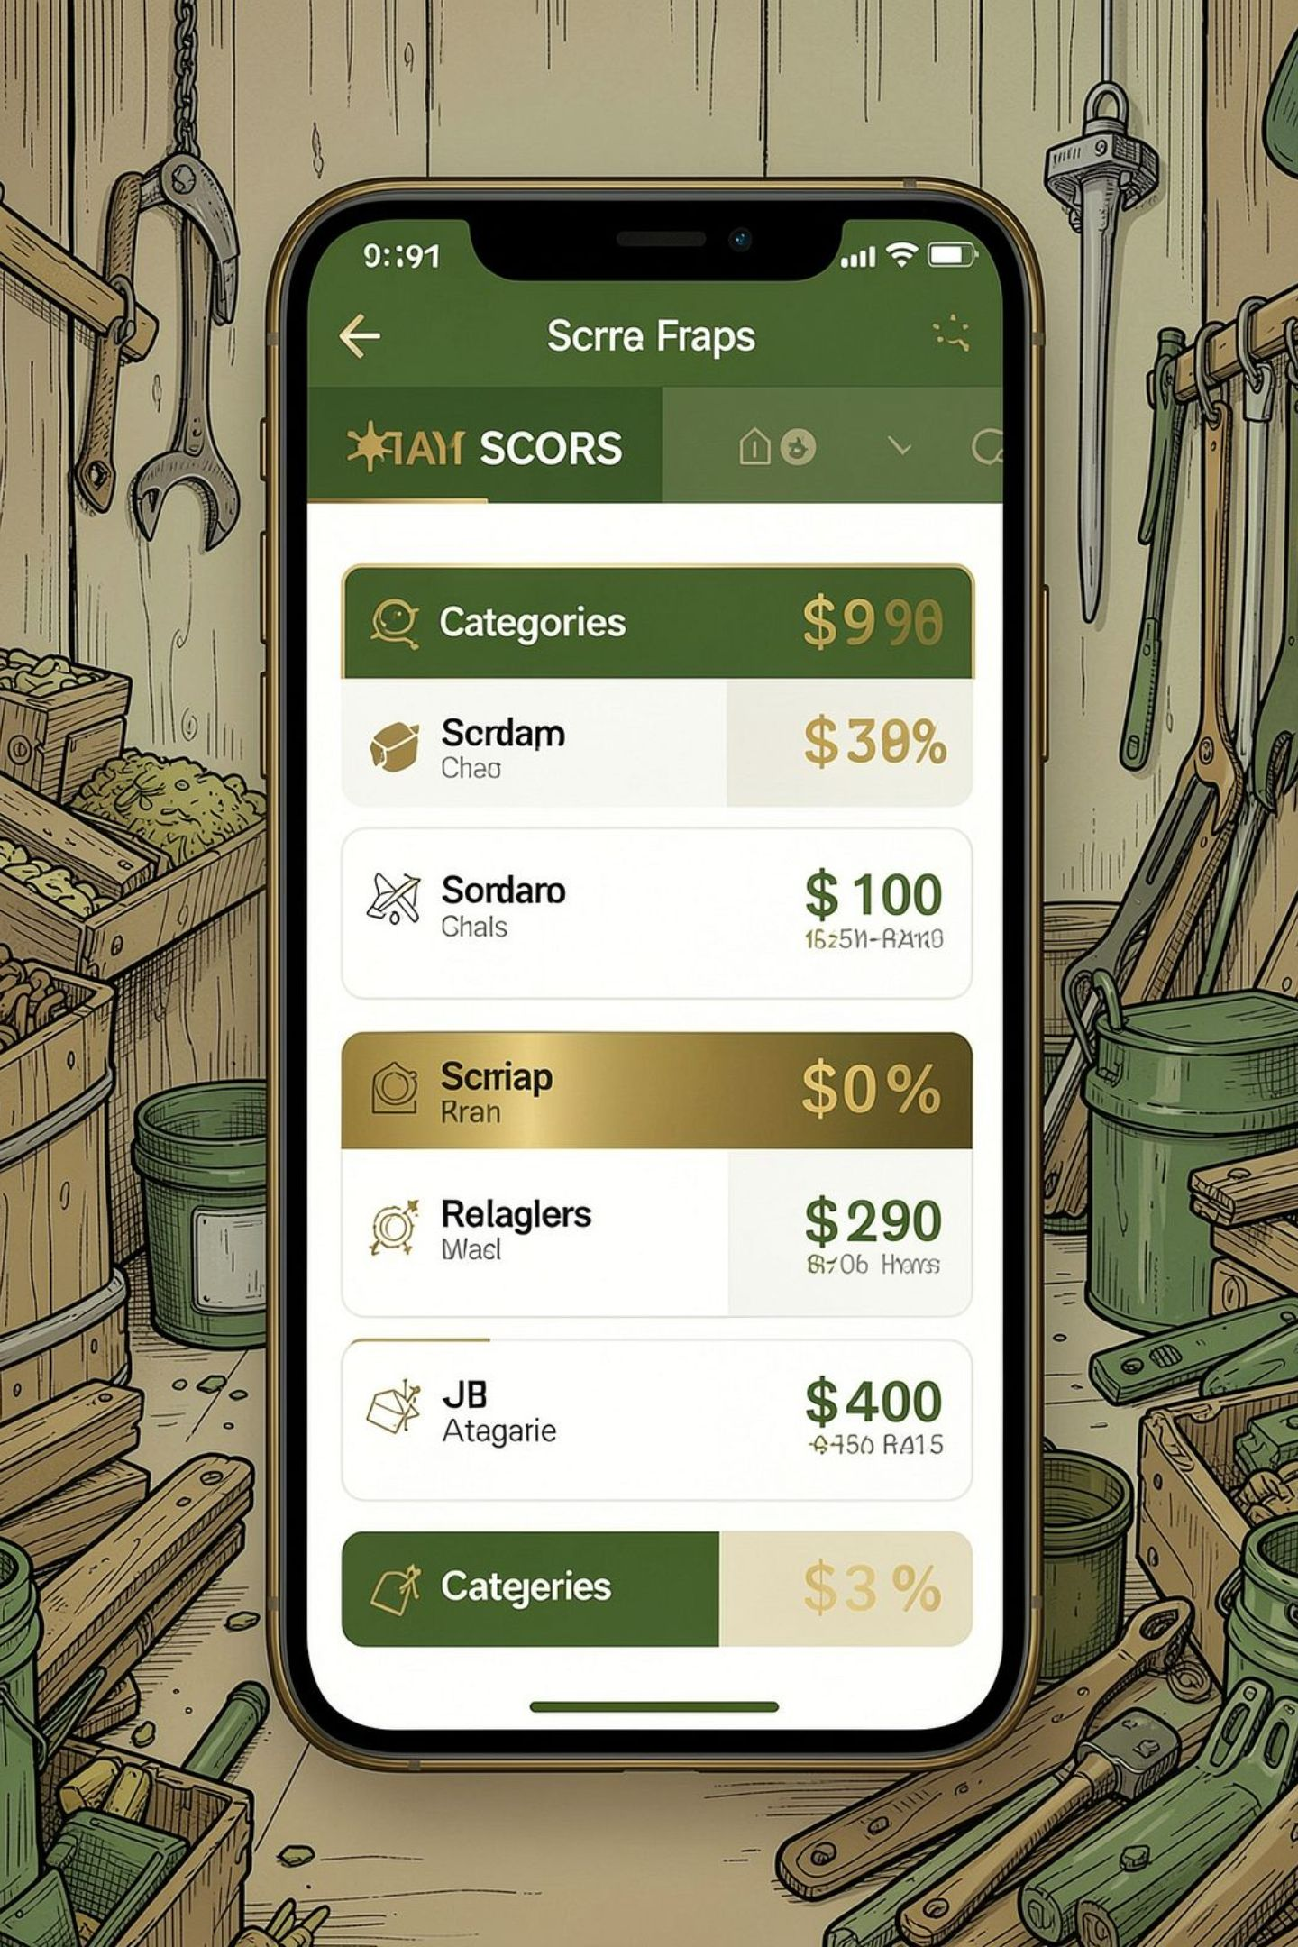
Introducing Raddi
A lightweight digital layer for the existing scrap ecosystem. The prototype demonstrates a simple customer flow:
Select scrap category and rate
Enter quantity to estimate weight & payout
Choose a pickup slot
Book and receive a collector assignment
Final weigh and payout on collection
Start with Karachi → validate the model → expand across Pakistan.

Slide 4
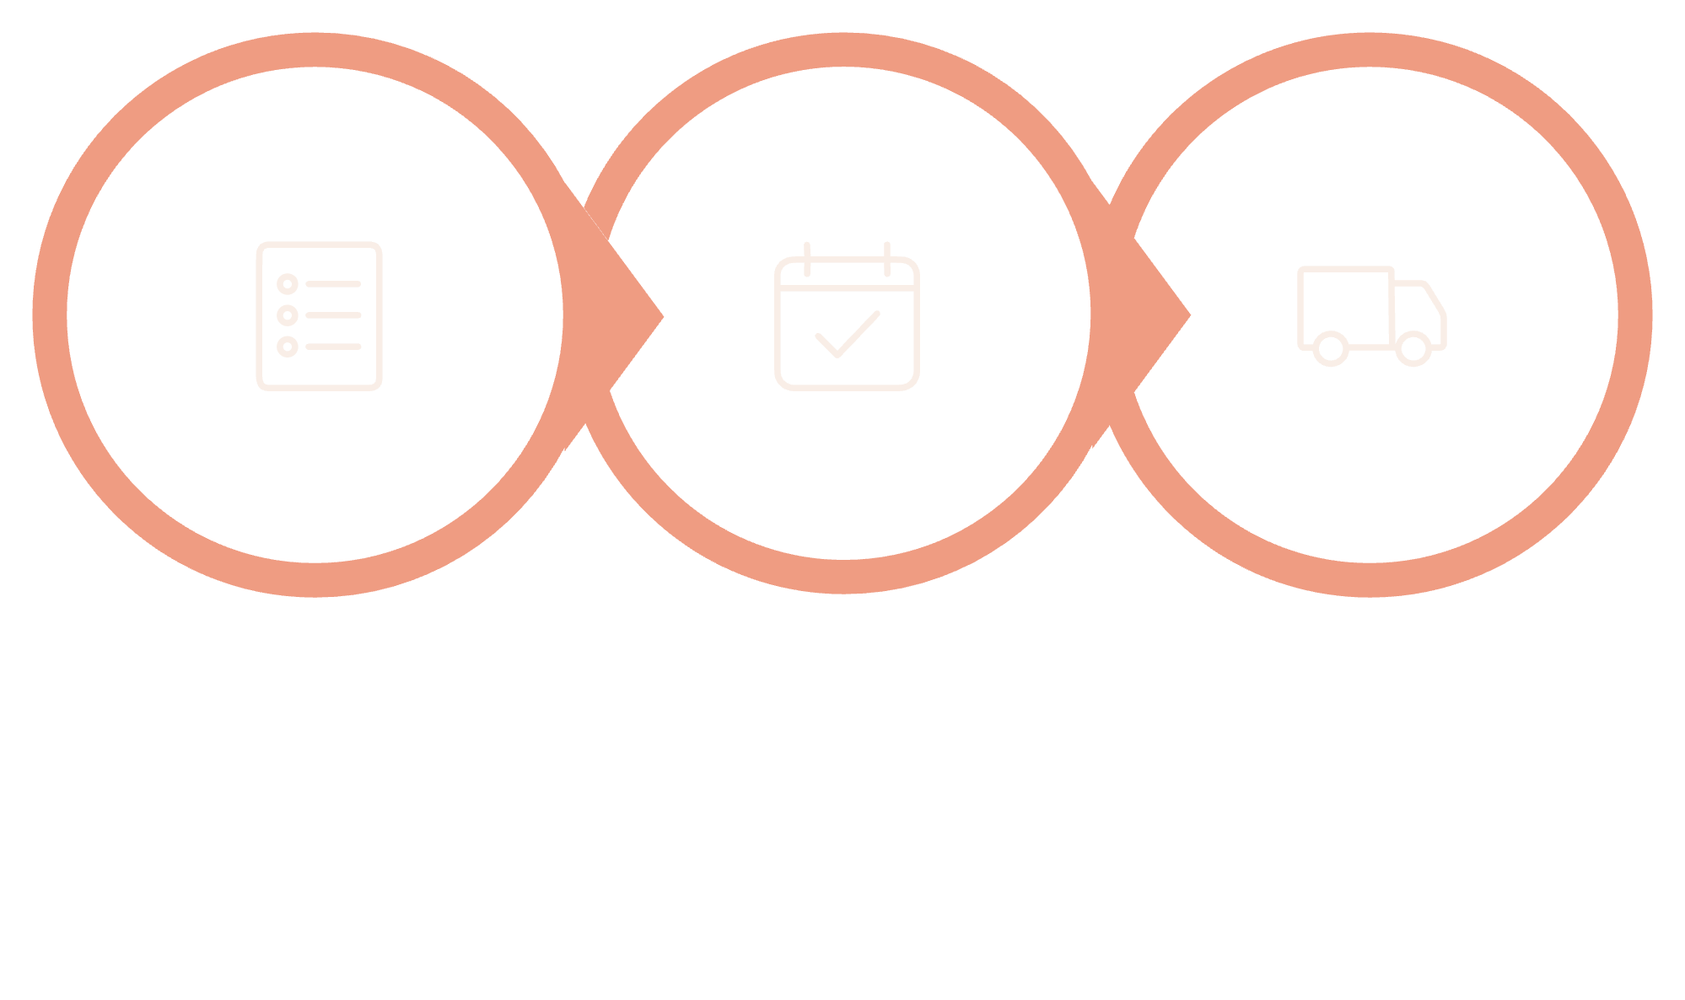
How It Works
Select
Book
Collect
Example scrap categories in the prototype: Paper, Plastic, Metal (copper/iron), Glass. Collector card shows: name, rating, vehicle, service area and ETA estimate.

Slide 5
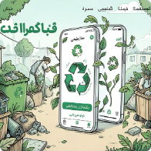
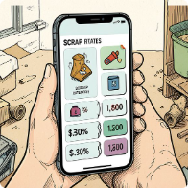
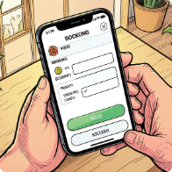
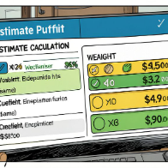

What I Built — Frontend MVP
Collector matching (mock)
Assignment & confirmation
Mock collector pool drives simulated matching and assignment results.
Assigned collector card with name, rating, vehicle and arrival estimate. Loading and toast confirmation states implemented.
Responsive landing page
Scrap categories & today's rates ticker
Interactive booking form & pickup slots
Weight & estimated payout calculation
Polish
Tech stack
Responsive animations with Framer Motion; toast notifications for feedback.
React 19 · Vite · Tailwind CSS · Framer Motion · React Icons · React Hot Toast
Collector assignment is currently simulated with mock data — no backend or real collector accounts yet.

Slide 6
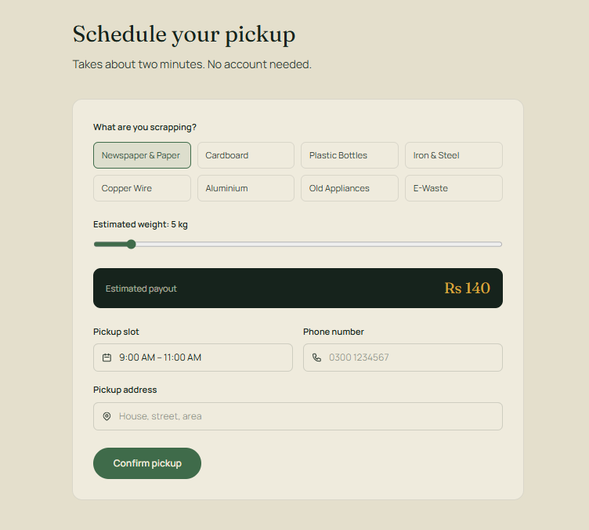
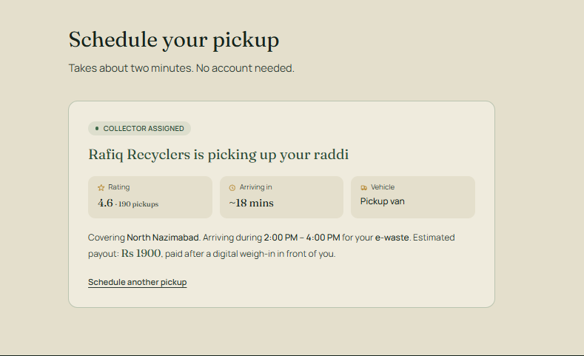
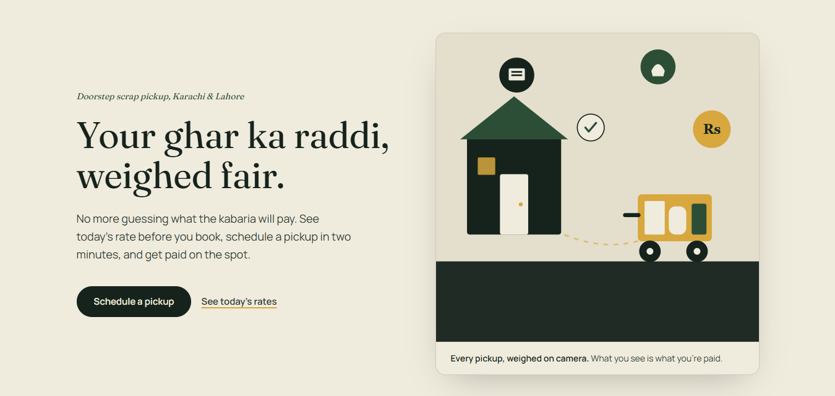
See It Live
The actual working demo — not a mockup.
Landing page
Booking flow
Collector assigned
6 / 9

Slide 7

The Digital Layer
Traditional
Raddi
Wait for collector; manual price discussion; manual weighing; no scheduled slot; limited records.
Book pickup from phone; indicative rate shown; weight & payout estimated; choose a slot; digital record planned.
Raddi does not replace the existing scrap ecosystem — it provides a transparent, convenient digital layer to modernise interactions.

Slide 8
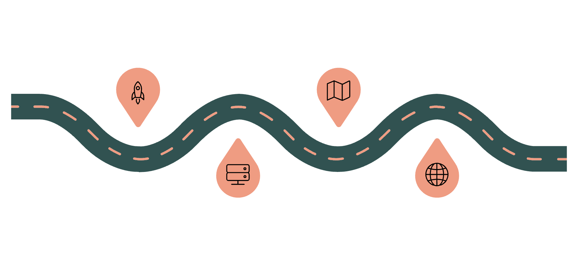
From Prototype to Real Product
Revenue streams
Immediate next milestone
Pickup margin on collected scrap
B2B subscriptions for regular scrap-generating businesses
Bulk resale to recycling partners
NOW
LATER
Build Express backend + MongoDB, create collector accounts, validate booking flow with pilot users in Karachi.
Frontend MVP launched
Location match, notifications, receipts, payments
NEXT
FUTURE
Backend, MongoDB, collector accounts
Karachi pilot then Pakistan expansion

Slide 9
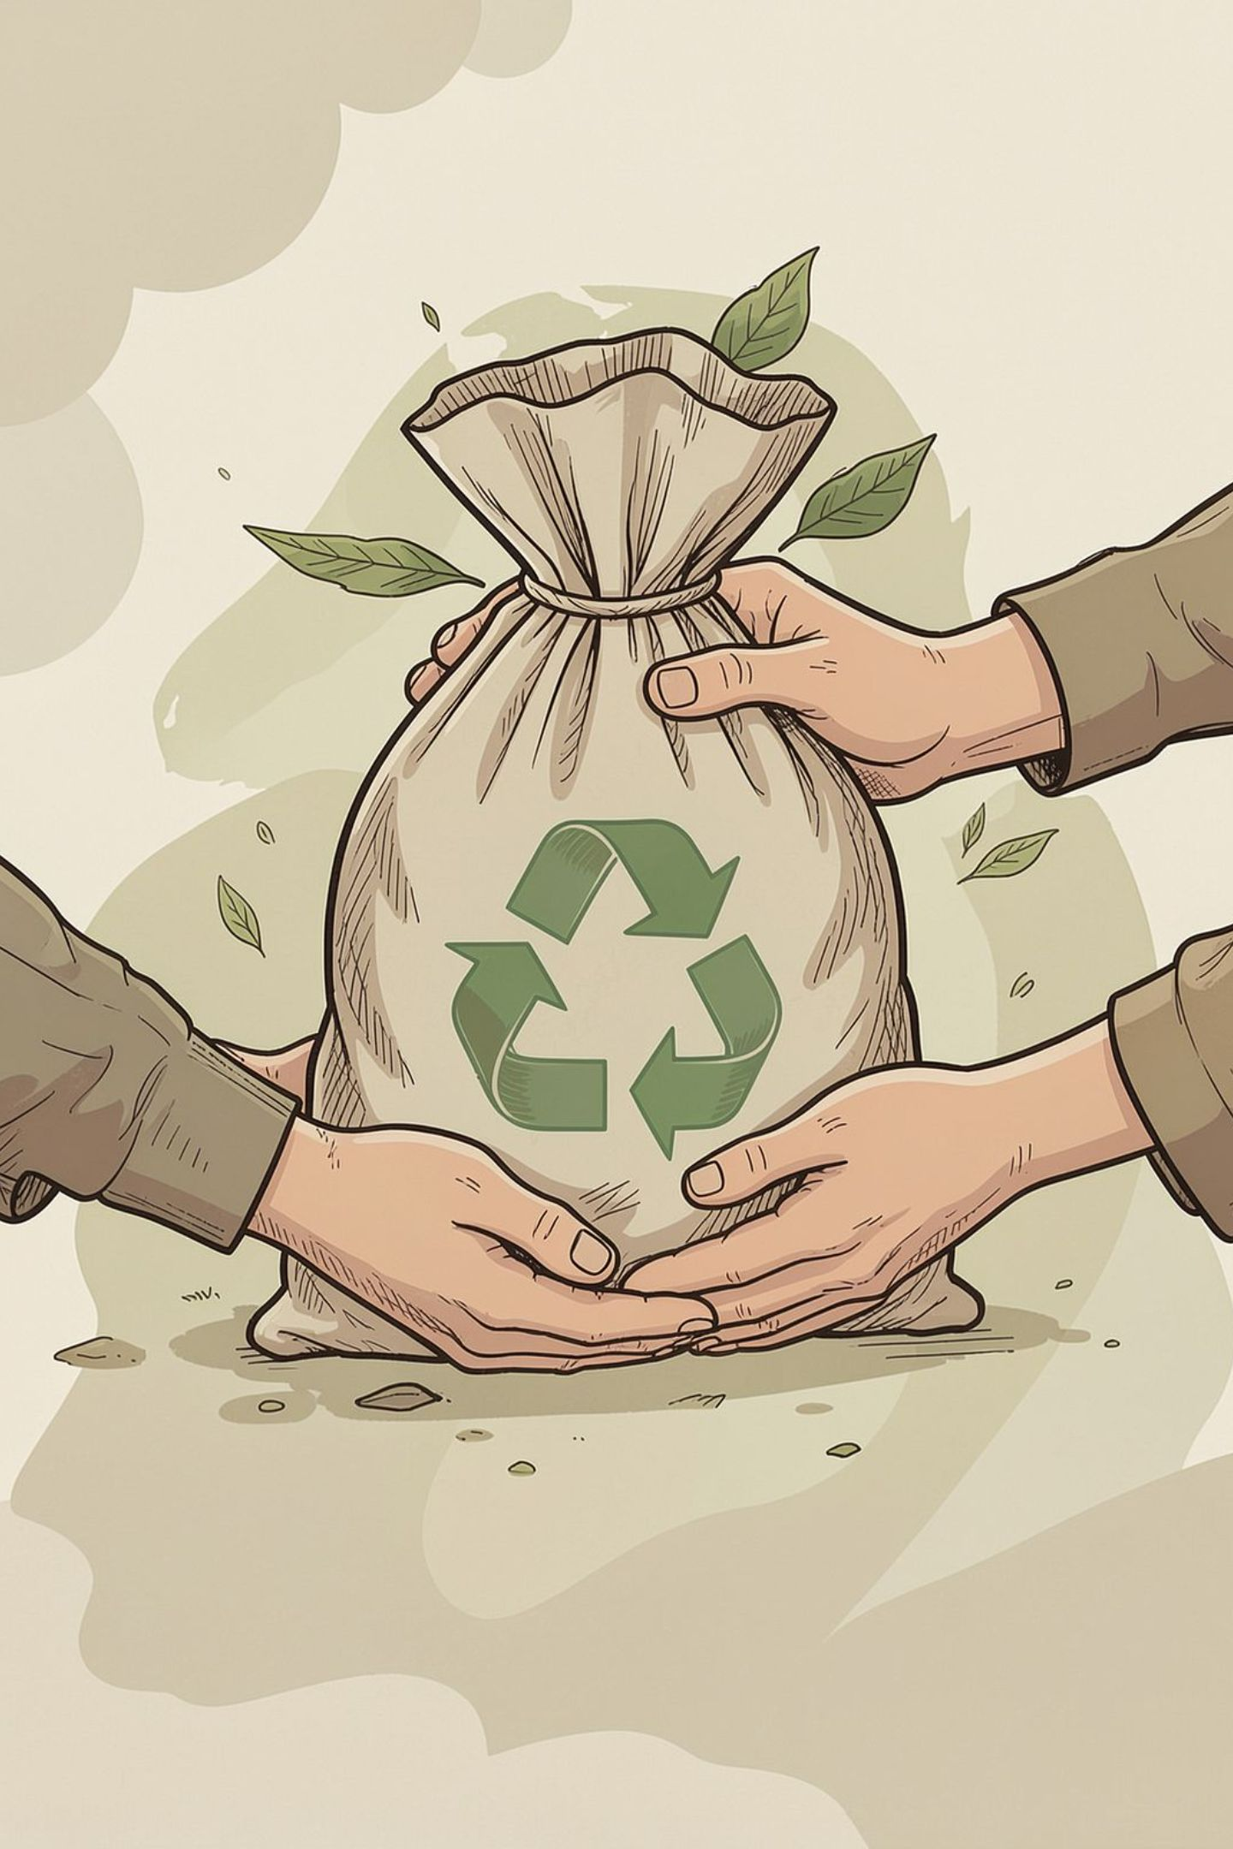
Raddi
Turning an informal process into a simple digital experience
Current status: Interactive frontend MVP (React prototype). Next milestone: Backend & pilot validation with real users and collectors in Karachi.
Thank you — Hassan Javed, SMIT Batch 18
Live prototype: raddi-app.vercel.app

