Slide 1



Week 5: Static variables and methods, Enum types,
week5
Ozacar Kasim, PhD | Assist. Prof. | Computer Engineering Department

Slide 2
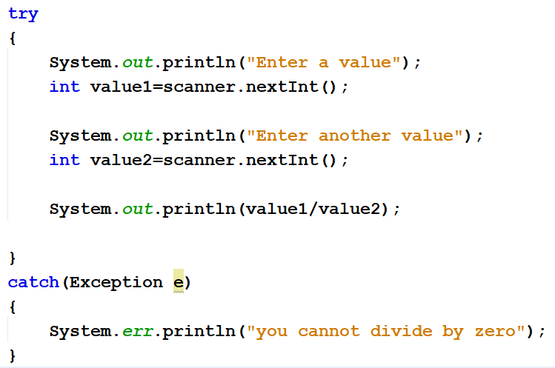
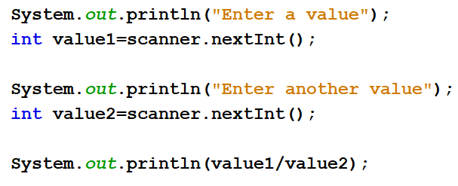
Exception Handling
Previously on OOP
Summary: week4
SYNTAX
USAGE
try{
//statements may cause an exception
}
catch (Exception(type) e(object))‏
{
//error handling code
}

Slide 3
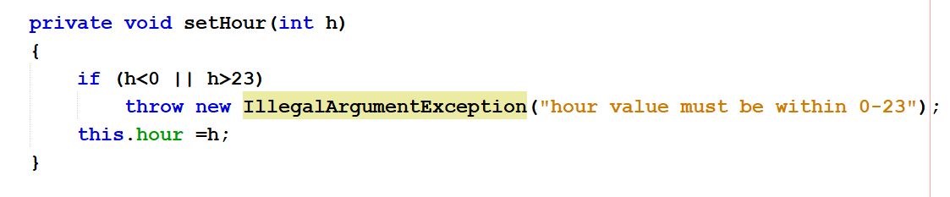
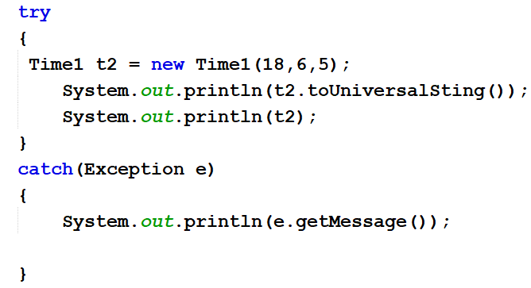
Throw a new custom Exception
Previously on OOP
Summary: week4
Time1Class
MainClass (Week4ThuDayClass)

Slide 4

Week 5: Static variables and methods, Enum types,
week5
Ozacar Kasim, PhD | Assist. Prof. | Computer Engineering Department

Slide 5
Static keyword
The static keyword is a non-access modifiers and used in java mainly for memory management. It is used with variables, methods, blocks and nested classes.
It is a keyword that is used for sharing the same variable or method of a given class among all the objects created from it.
This is used for a constant variable or a method that is the same for every instance of a class.
Simply, if you want your all objects share the same variable or method, use static

Slide 6
Stack memory
Heap memory
class Circle{
int X; //4bytes
int Y;//4bytes
static int z; //4bytes
}
A
X=5
Y=7
Circle a
Z=10
B
X=15
Y=4
Circle b
Circle a = new Circle(); //8bytes for x and y in heap
Circle b = new Circle() //8bytes
for x and y in heap
Here z is static variable: it belongs to class, not an object. Its shared by all the objects created by this class.
//4bytes for z in class area
In total 8 +8+4 = 20bytes

Slide 7
Static variable
If any variable, we declared as static is known as static variable.
Static variable is used for fulfill the common requirement. For Example, college name of students etc. Name of the college is common for all students.
The static variable allocate memory only once in class area at the time of class loading.
Using static variable we make our program memory efficient (i.e it saves memory).

Slide 8
When and why we use static variable?
Suppose we want to store record of all employee of any company, in this case employee id is unique for every employee but company name is common for all. So, use static variable to store the company name.
When we create a static variable as a company name then only once memory is allocated otherwise it allocate a memory space each time for every employee object.

Slide 9
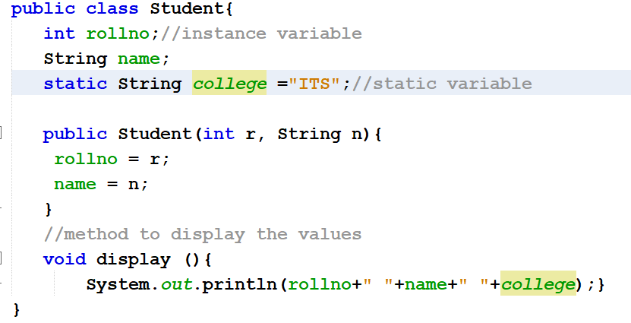
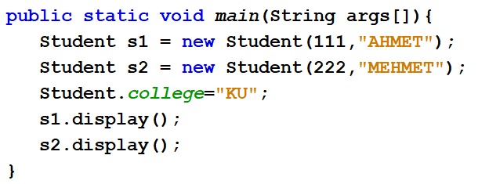
Static variable: An example

Slide 10
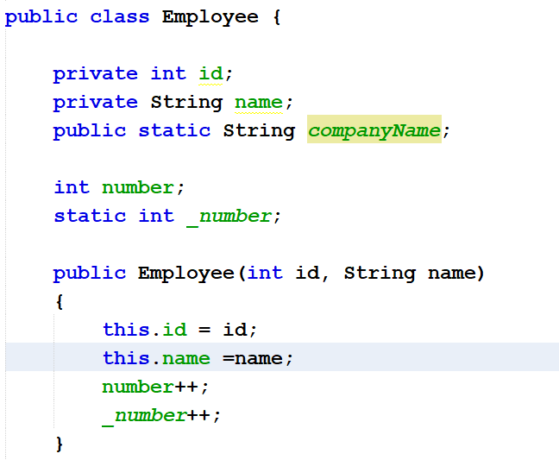
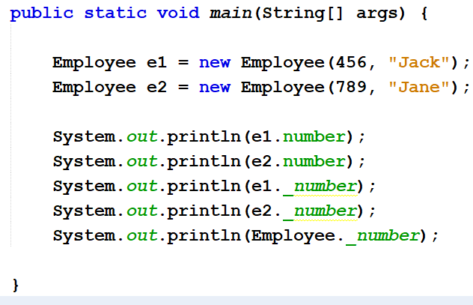
Static variable: An Exercise

Slide 11
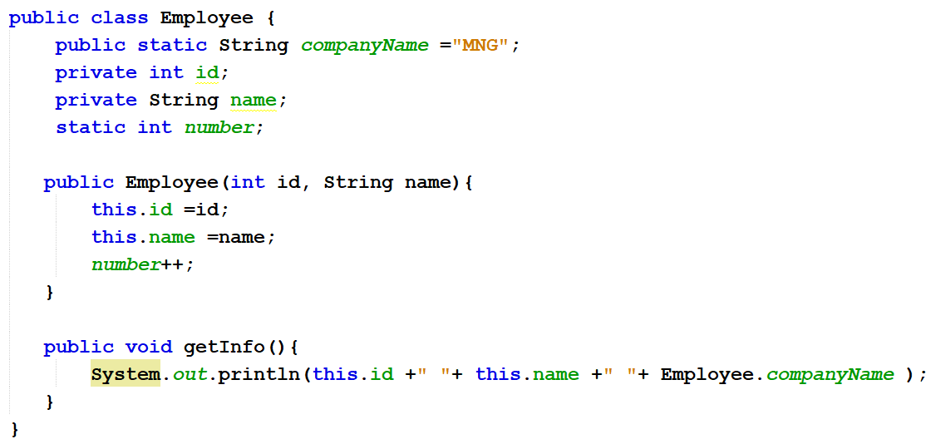
An example of static keyword

Slide 12
final Keyword
static keyword always fixed the memory that means that will be located only once in the program
final keyword always fixes the value that means it makes variable values constant
Note: As for as real time statement there concern every final variable should be declared the static but there is no obligation that every static variable declared as final.

Slide 13
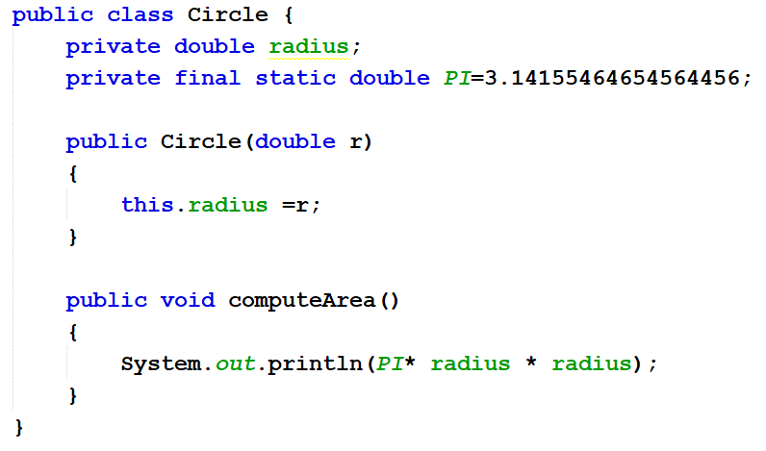
Java Constants : final Keyword for variables
Previously on OOP
PI
When a variable is declared with final keyword, its value can’t be modified, essentially, a constant.
This also means that you must initialize a final variable.
If you cannot change it then you must initialize it, right!
initializing
Summary: week5

Slide 14
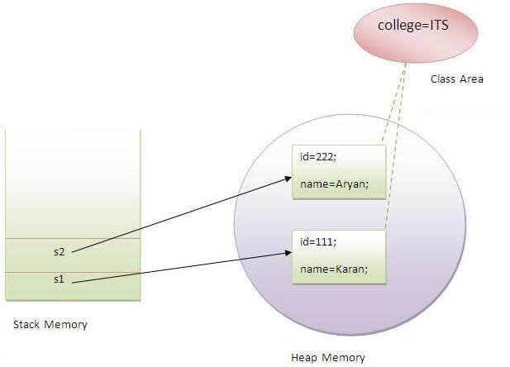
Visualization of static variable
Previously on OOP
Summary: week4
Notes:
Static variables are initialized before any object of that class is created. A static variable is initialized only, when the class is first loaded into the JVM, which happens the first time it is referenced in code, not when the instance is created.

Slide 15
What is Static Method in Java?
Static method is a method which belongs to the class and not to the object(instance)
A static method can access only static data. It can not access non-static data (instance variables)
A static method can call only other static methods and can not call a non-static method from it.
A static method can be accessed directly by the class name and doesn’t need any object
A static method cannot refer to "this“ keyword.

Slide 16
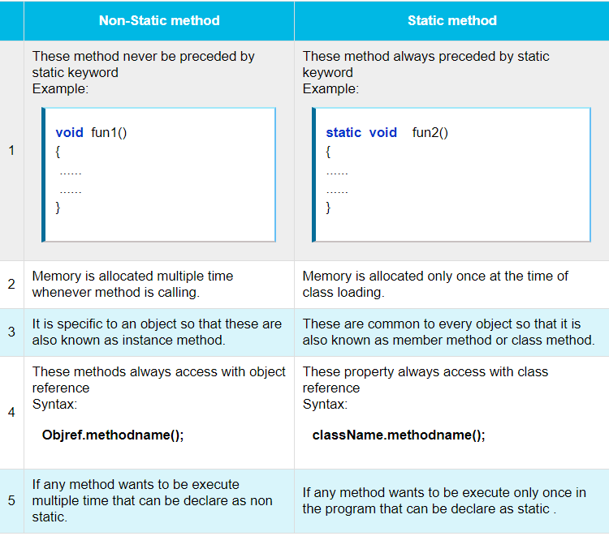
Notes:
Static methods are stored in Metaspace space of heap as they are associated to the class

Slide 17
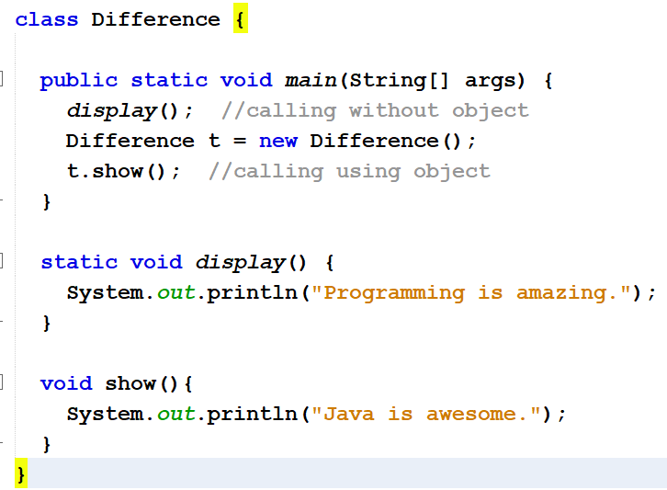
Static Method vs Non-Static (Instance) Method

Slide 18
Another Example
class MyClass{
private static int data;
public static void setData(int d) {
data = d;
}
public static int getData() {
return data;
}
}
public class JavaApp {
public static void main(String[] args) {
MyClass.setData(50);
System.out.println(MyClass.getData());
}
}
No need to create an object

Slide 19
We know the static keyword now.
So, why is the main method static?
public static void main(String[] args) {
…
}
Notes:
because keyword static allows main to be called without creating an object of the class in which the main method is defined.

Slide 20
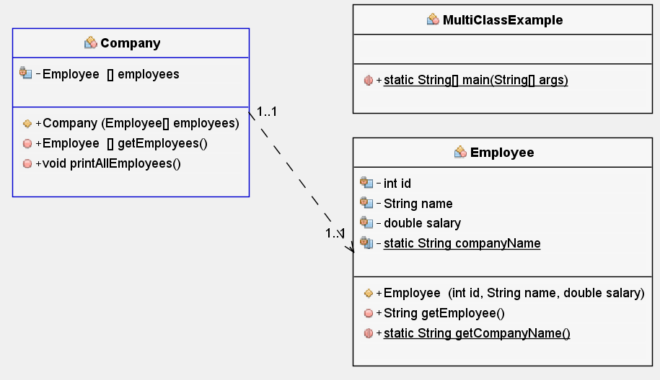
Multi-class Example: Using one object in another class as an attribute

Slide 21
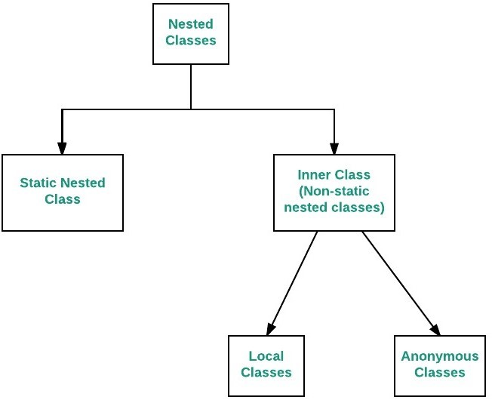
Nested Classes
The Java allows you to define a class within another class. Such a class is called a nested class
Nested classes are divided into two categories:
non-static. Non-static nested classes are called inner classes.
Static: Static nested classes are called static nested classes
class OuterClass {
...
static class StaticNestedClass {
...
}
}
class OuterClass {
...
class InnerClass {
...
}
}

Slide 22
Inner class
As with instance methods and variables, an inner class is associated with an instance of its enclosing class and has direct access to that object's methods and variables.
Also, because an inner class is associated with an instance, it cannot define any static members itself.
class OuterClass {
...
class InnerClass {
...
}
}
Inner classes
OuterClass outerObject = new OuterClass(); //you need to create an object first
OuterClass.InnerClass innerObject = outerObject.new InnerClass();

Slide 23
Static Nested Classes
As with class methods and variables, a static nested class is associated with its outer class.
And like static class methods, a static nested class cannot refer directly to instance variables or methods defined in its enclosing class: it can use them only through an object reference.
class OuterClass {
...
static class StaticNestedClass{
...
}
}
Static nested classes
//you do not need to create and object from OuterClass
OuterClass.StaticNestedClass nestedObject = new OuterClass.StaticNestedClass();

Slide 24
Why Use Nested Classes?
If a class is useful to only one other class, then it is logical to embed it in that class and keep the two together.
It increases encapsulation:
It can lead to more readable and maintainable code:
https://docs.oracle.com/javase/tutorial/java/javaOO/nested.html
Notes:
If a class is useful to only one other class, then it is logical to embed it in that class and keep the two together.
It increases encapsulation:
Consider two top-level classes, A and B, where B needs access to members of A that would otherwise be declared private. By hiding class B within class A, A's members can be declared private and B can access them. In addition, B itself can be hidden from the outside world.
It can lead to more readable and maintainable code:
Nesting small classes within top-level classes places the code closer to where it is used.

Slide 25
Inner Class
class OuterClass {
int x = 10;
class InnerClass {
int y = 5;
}
}
public class MyMainClass {
public static void main(String[] args) {
OuterClass myOuter = new OuterClass();
OuterClass.InnerClass myInner = myOuter.new InnerClass();
System.out.println(myInner.y + myOuter.x);
}
}
//what if this is private?

Slide 26
Static nested Class
class OuterClass {
int x = 10;
static class InnerClass {
int y = 5;
}
}
public class MyMainClass {
public static void main(String[] args) {
OuterClass.InnerClass myInner = new OuterClass.InnerClass();
System.out.println(myInner.y);
}
}

Slide 27
Enum Types
Syntax
An enum type is a special data type that enables for a variable to be a set of predefined constants.
The variable must be equal to one of the values that have been predefined for it.
Common examples include compass directions (values of NORTH, SOUTH, EAST, and WEST), the days of the week and so on.
enum Day {
SUNDAY,
MONDAY,
TUESDAY,
WEDNESDAY,
THURSDAY,
FRIDAY,
SATURDAY
}
//simple enum

Slide 28
Enum Types with Constructor
A Java enum type can have a private constructor that can be used to initialize instance variables(attributes).
public enum Branch {
MATH(001),
PHYSICS(002),
GEOMETY(003)
private int fieldId;
Branch(int fieldId){
this.fieldId =fieldId;
}
}
values() method can be used to return all values present inside enum
Looping through enum items
Branch[] brunches= Branch.values() ;
for(Branch b : brunches) {
System.out.println(b);
}

Slide 29
Enum types with Classes: Making CompanyName
enum CompanyName{
GOOGLE(1995, "Google was founded in 1998 by Larry Page and Sergey Brin while"),
MICROSOFT(1975, "Microsoft Corporation is a technology company with headquarters in Redmond, Washington");
final private String description;
private int createdYear;
private CompanyNames(int cYear, String desc) {
this.description = desc;
this.createdYear = cYear;
}
public String getDescription(){
return this.description;
}
}

Slide 30
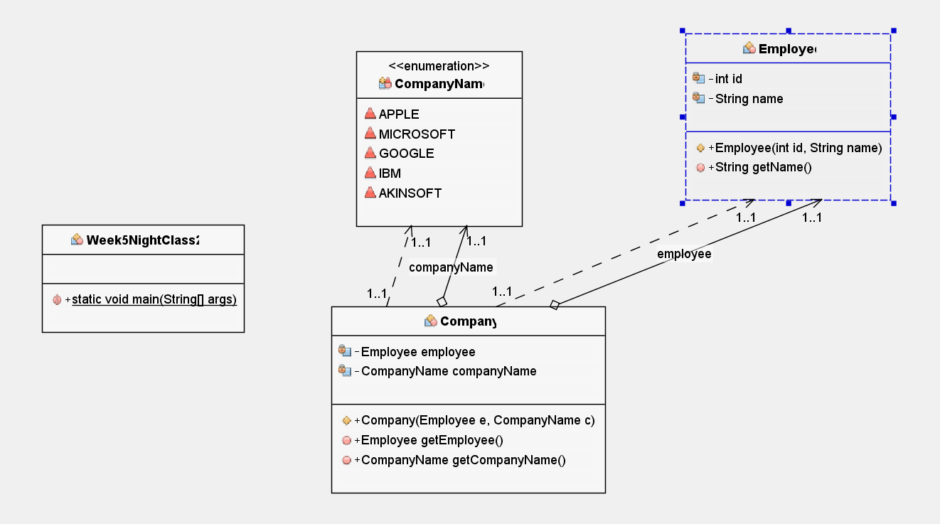
Example: Lets move to NetBeans!
Employee[] employees
Company(CompanyName cName, Employee[] emps)

Slide 31
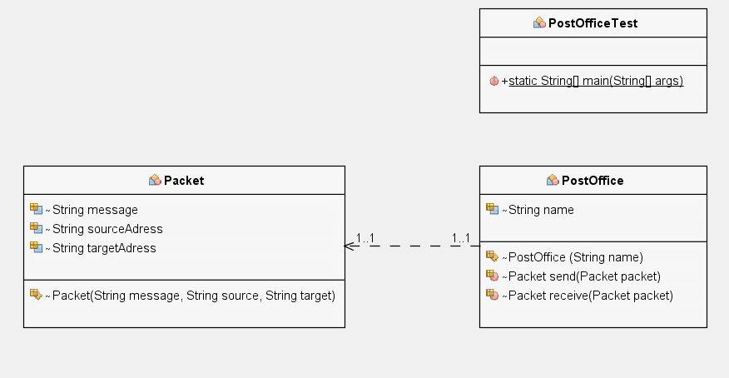
HW: Working with multiple object types
Post
Post send(Post post)
Post
Post receive(Post post)
HW: First create PostOffice and Post Classes. Then, create two-postOffice objects from PostOffice class. Then, create a post object in order to send it from PostOffice. send() post using a post office; and the other postoffice will receive() it

Slide 32
Lab Exercise-1: static keyword
Create a Circle class where
declare a private constant double variable PI has value of 3,141519
declare a private variable called double radius.
class constructor will have an argument to set radius.
declare a method called computeArea() to compute area of a circle object.
create 3 different circle instances, with radiuses 5, 10, 15.
print all the areas using a foreach loop.

Slide 33
Lab Exercise-2: Enum types
Create Branch Enum type will contain following branches
MATH(“information regarding math”)
PHYSICS(“information regarding physics”)
CS(“information regarding cs”)
ENG(“information regarding eng”)
Create a Teacher Class which contains id (int), and branch (Enum) attributes. The class must have a constructor with these two parameters.
Create four teacher objects; each has different branch.
Put them all in an array, and print their branches using for loop.

