Slide 1



Week 6: Deeper in classes: this() & toString() + Alpha
Week 6
“practice makes perfect”
Ozacar Kasim, PhD | Assist. Prof. | Computer Engineering Department

Slide 2
Previously on OOP
Summary: week5
Static methods
Nested Classes
Enum types

Slide 3
What is Static Method in Java?
Summary: week5
memory for static method is allocated only once at the time of class loading.
Static method in Java is a method which belongs to the class and not to the object
A static method can access only static data
A static method can be accessed directly by the class name and doesn’t need any object. So there is no need to create an object.

Slide 4
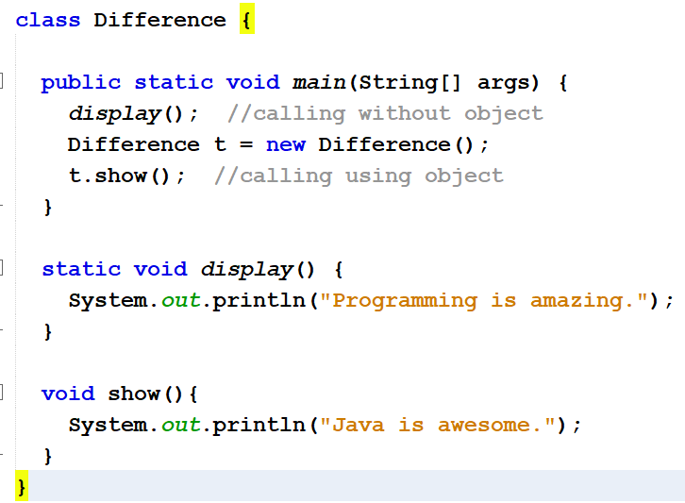
Static Method Usages
Summary: week5

Slide 5
Exercise
Summary: week5
class Student {
int a; //initialized to zero
static int b; //initialized to zero only when //class is loaded not for each object created.
Student(){
b++;
}
public void showData(){
System.out.println("Value of a = "+a);
System.out.println("Value of b = "+b);
}
}
public class Demo{
public static void main(String args[]){
Student s1 = new Student();
s1.showData();
Student s2 = new Student();
s2.showData();
Student.b++;
s1.showData();
}
}

Slide 6
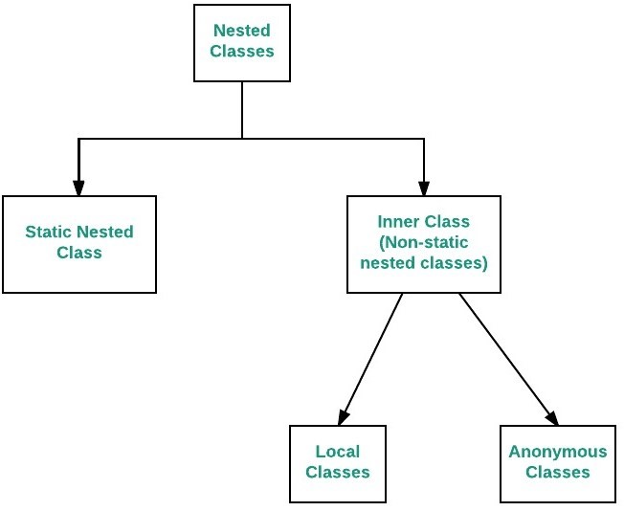
Nested Classes
The Java allows you to define a class within another class. Such a class is called a nested class
Nested classes are divided into two categories:
non-static. Non-static nested classes are called inner classes.
Static: Static nested classes are called static nested classes
class OuterClass {
...
static class StaticNestedClass {
...
}
}
class OuterClass {
...
class InnerClass {
...
}
}

Slide 7
Enum Types
Summary: week5
An enum type enables for a variable to be a set of predefined constants.
Constructor in enum can be used to initialize instance variables(attributes).
Just like classes, enums can have variables and methods
enum Branch {MATH,PHYSICS, GEOMETY}
enum Branch {
MATH(001),
PHYSICS(002),
GEOMETY(003);
private int fieldId;
Branch(int fieldId){
this.fieldId =fieldId;}
}
values() method can be used to return all values present inside enum
Looping through enum items
for(Branch b : Branch.values()) {
System.out.println(b);
}

Slide 8
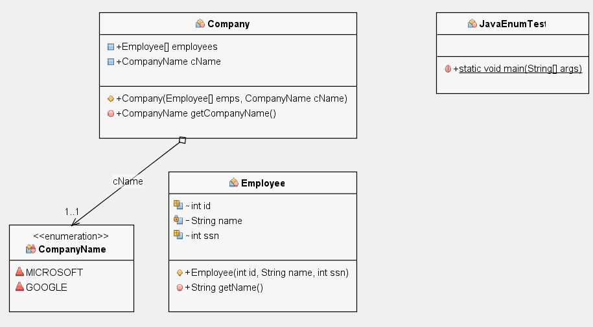
Example: Using multiple classes + Enum Types
Summary: week5

Slide 9
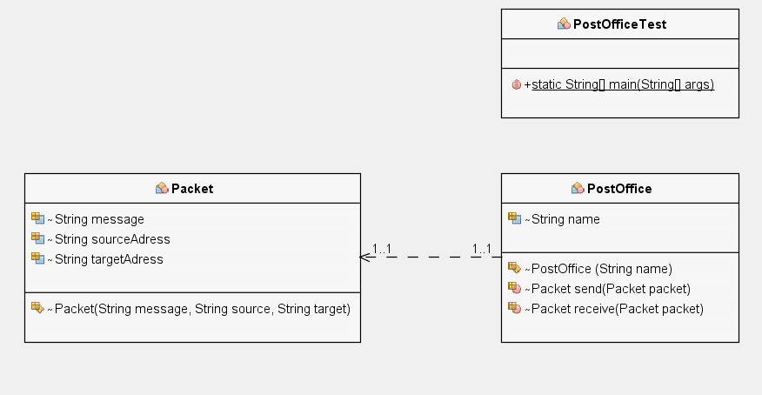
Summary: week5
HW: First create PostOffice and Post Classes.
Then, create two-postOffice objects from PostOffice class.
Then, create a post object in order to send it from PostOffice.
send() post using a post office; and the other postoffice will receive() it
Post
Post send(Post post)
Post
Post receive(Post post)

Slide 10
Table of Contents
Using this() methods
Using toString() methods
Exercise
Rock Scissor Paper Game

Slide 11
Using this() methods
public class Rectangle {
private int x, y;
private int width, height;
public Rectangle() { //to create a unit rectangle(a square) at origin
this.x = 0; //user-defined rectangle at specific coordinates.
this.y = 0;
this.width = 1;
this.height = 1;
}
public Rectangle(int width, int height) { // to create user-defined this.x = 0; //user-defined rectangle at specific coordinates.
this.y = 0;
this.width = width;
this.height = height;
}
public Rectangle(int x, int y, int width, int height) { //to create a this.x = x; //user-defined rectangle at specific coordinates.
this.y = y;
this.width = width;
this.height = height;
}
}
.(0,0)
1
1
.(0,0)
height
width
.(0,0)
.(x,y)
height
width
11
THIS WAY OF WRITING IS NOT GOOD

Slide 12
Calling a Constructor From a Constructor
this() constructors are used to call (invoke) an alternate constructor of the same class.
public class Rectangle {
private int x, y;
private int width, height;
public Rectangle() { //to create a unit rectangle(a square) at origin
this(0, 0, 1, 1);
}
public Rectangle(int width, int height) { // to create user-defined this(0, 0, width, height); // rectangle at origin
}
public Rectangle(int x, int y, int width, int height) { //to create a this.x = x; //user-defined rectangle at specific coordinates.
this.y = y;
this.width = width;
this.height = height;
}
}
.(0,0)
.(0,0)
height
width
.(0,0)
.(x,y)
height
width

Slide 13
toString() method
class Student{
int rollno;
String name;
Student(int rollno, String name){
this.rollno=rollno;
this.name=name;
}
public String toString(){
return rollno+" "+name+" "+city;
}
public static void main(String args[]){
Student s1=new Student(101,“Jack",“Sparrow");
Student s2=new Student(102,“Johnny",“Cash");
System.out.println(s1); //compiler writes here s1.toString()
System.out.println(s2); //compiler writes here s2.toString()
}
}
OUTPUT:
If you want to represent any object as a string, toString() method comes into existence.
toString() returns a string representation of the object.
In general, the toString method returns a string that "textually represents" this object.
If you print any object, java compiler internally invokes the toString() method on the object.
We will mention it again in polymorphism.

Slide 14
Garbage Collection
Every object uses system resources, such as memory.
Wee need to give resources back to the system when they’re no longer needed; otherwise, “resource leaks” might occur. (OutOfMemoryErrors)
In C/C++, programmer is responsible for both creation and destruction of objects.
[int *ptr; ptr = (int *)malloc(sizeof(int)); *ptr = 25; free(ptr); ]
But, The JVM performs automatic garbage collection to destroys the objects no longer in use.
When there are no more references to an object, the object is eligible to be collected. Collection typically occurs when the JVM executes its garbage collector.
Main objective of Garbage Collector is to free heap memory by destroying unreachable objects.

Slide 15
stack
heap
RAM
new Student
Name=“salih”
Id=45
Mid=89
Final=51
Student s1
Student s1 = new Student(); //name=“Salih”…
S1=null;

Slide 16
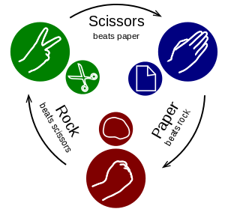
Yet Another Exercise: Rock Scissor Paper Game

Slide 17
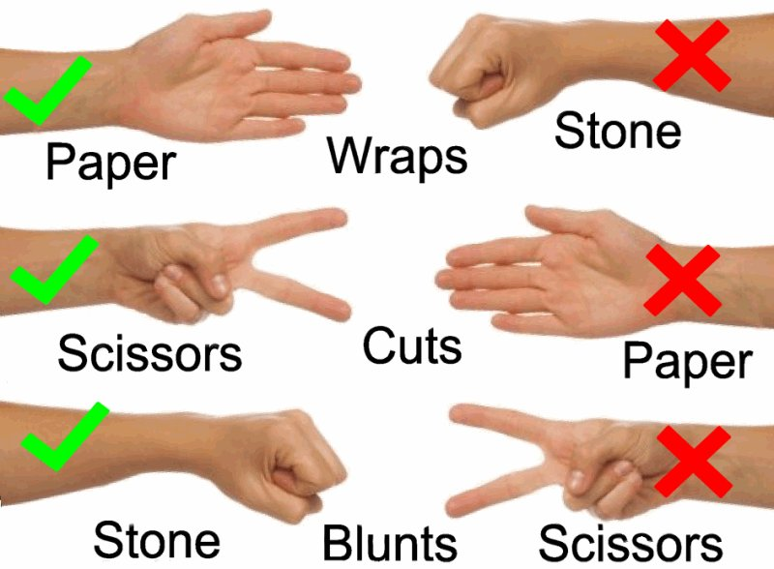
Game Rules
Rock Scissor Paper Game
If the pair is player1 is paper and player2 is rock, then player1 wins
If the pair is player1 is scissors and player2 is paper, then player1 wins
If the pair is player1 is rock and player2 is scissors, then player1 wins
If Player1 is same as player2, then draw!
Else player2 wins
Player 1
Player 2
Rock
Rock

Slide 18
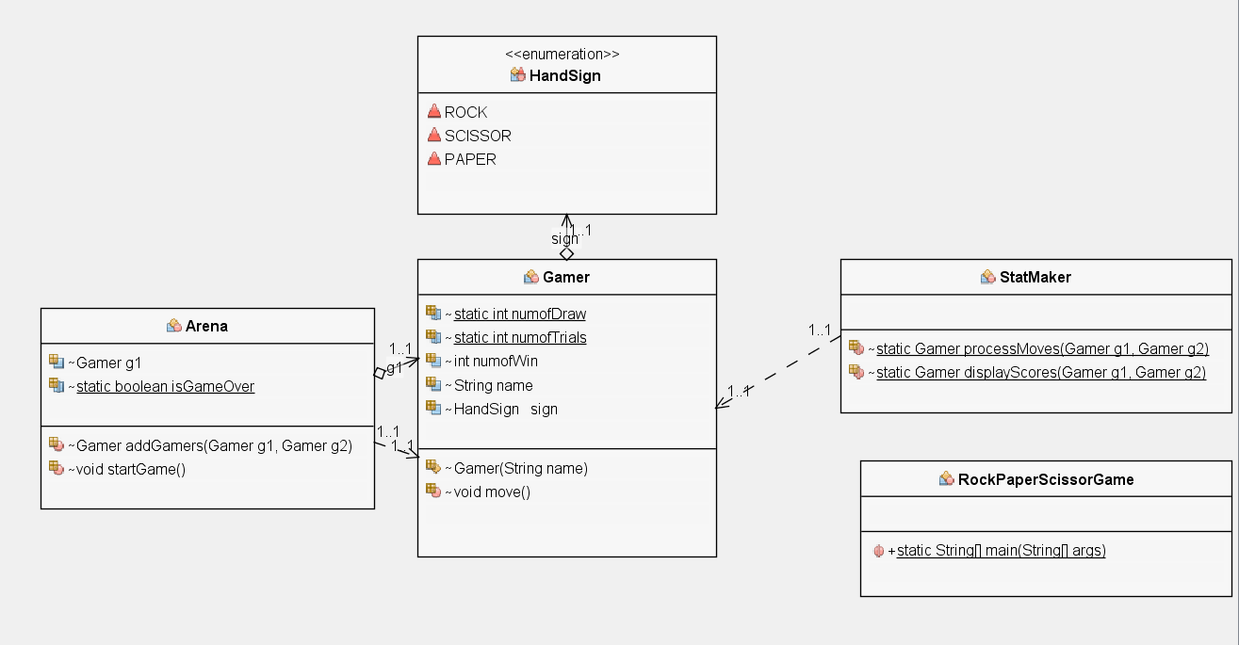
What we need are…
Rock Scissor Paper Game
, g2
void
void
void

Slide 19
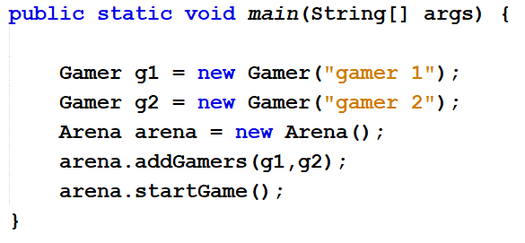
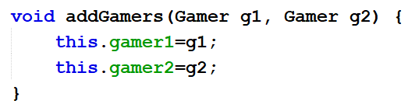
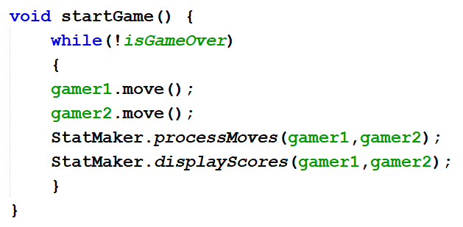
Game Logic
Rock Scissor Paper Game
RockScissorPaper Class (main class)
Arena Class

Slide 20
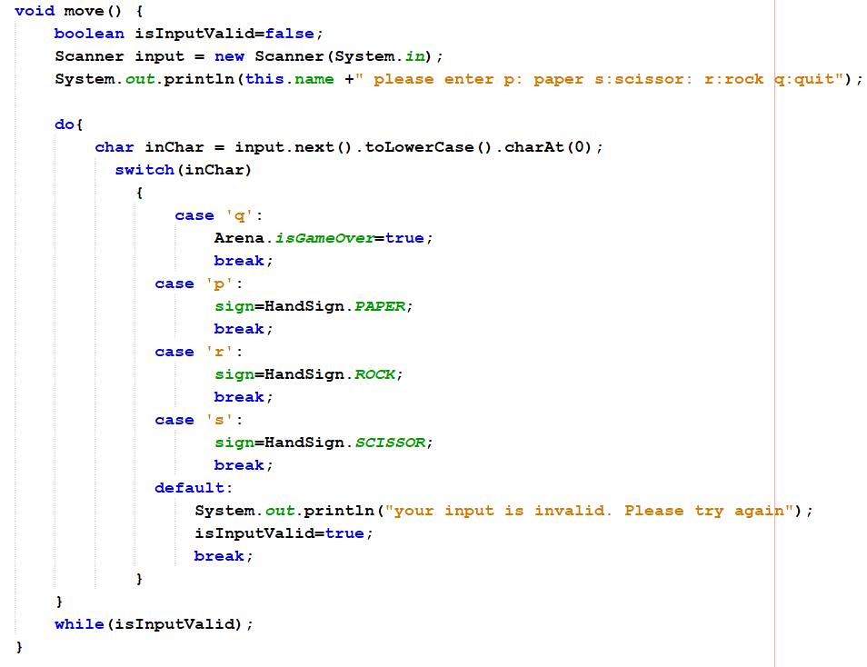
Game Logic
Rock Scissor Paper Game
Gamer Class

Slide 21
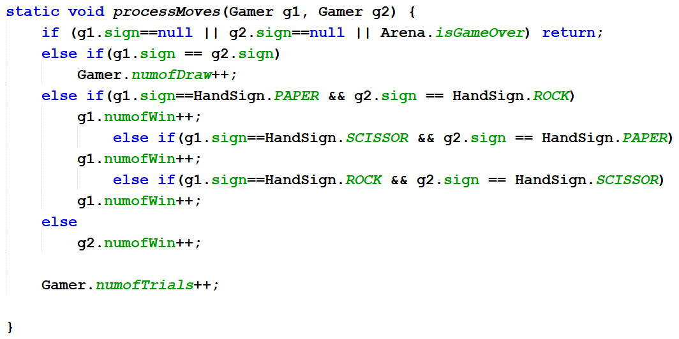
Rock Scissor Paper Game
StatMaker Class
Gamer 1
Gamer 2
Rock
Rock
Let's make this game.

Slide 22
Lab exercise : Calling a Constructor From a Constructor
Create a class called Person where, id, firstName, lastName, and age attributes are declared.
Create four constructors
In first, set all attributes;
In the second, set only first and last names, automatically increment id and set age to zero;
In the third, only set id, and set rest to default values;
Int the last only increment id, set the rest to default values.

Slide 23
fix
Run appdata
Go to roaming
Go to unity –> editor 5.x -> preferences -> layouts ->default
Open Default.wlt using word.
Copy all in the file.
Save it CurrentLayout-defauly.dwlt in Library folder of your project

