Slide 1
Database Systems
Khwaja Fareed University of Engineering & IT
Lecture 5
SQL Queries

Slide 2

SQL (Structured Query Language)
is the standard language for commercial DBMSs
SEQUEL (Structured English QUEry Language)
was originally defined by IBM for SYSTEM R
  mid 1970s
  unofficial pronunciation (see-kwuhl) still sometimes used
standardization of SQL began in the 80s
current standard is SQL-99
  subsequent revisions are not fully accepted by all vendors
SQL is more than a query language:
it includes a DDL, DML and admin commands

Slide 3

Administration:
  CREATE DATABASE
  CREATE SCHEMA
  SET ROLE
  GRANT PRIVILEGES
Data Definition:
  CREATE TABLE
  ALTER TABLE
  DROP TABLE
  CREATE VIEW
Data Modification:
  INSERT
  DELETE
  UPDATE
Queries:
  SELECT
48 commands listed in
SQL in a Nutshell

Slide 4

Queries in SQL are variations
of the SELECT command
Basic SQL queries correspond to
the following relational algebra operations:
  select σ
  project π
  cross product X
  joins must be expressed as σ and X

Slide 5

project π
SELECT <attribute list>
FROM <table list>
WHERE <condition>;
cross product X
select σ

Slide 6

π_{Ssn} (σ_{Salary > 60000} (EMPLOYEE) )
SELECT Ssn
FROM EMPLOYEE
WHERE Salary > 60000;
π_{City,State} (σ_{Airport_code = ‘SFO’} (AIRPORT) )
SELECT City, State
FROM AIRPORT
WHERE Airport_code = ‘SFO’;

Slide 7

In the basic SELECT/FROM/WHERE form,
joins must be expressed as using σ and X
π_{Lname, Dname} (EMPLOYEE ⋈ _{Ssn=Mgr_ssn} DEPARTMENT)
π_{Lname, Dname} (σ _{Ssn=Mgr_ssn} (EMPLOYEE X DEPARTMENT) )
SELECT Lname, Dname
FROM EMPLOYEE, DEPARTMENT
WHERE Ssn = Mgr_ssn;

Slide 8

Retrieve the name and address of all employees who work
for the 'Research' department.
  SELECT FNAME, LNAME, ADDRESS
  FROM EMPLOYEE, DEPARTMENT
  WHERE DNAME='Research' AND DNUMBER=DNO
selection
condition
join
condition

Slide 9
For every project located in 'Stafford', list the project number,
the controlling department number, and
the department manager's last name, address, and birthdate.
SELECT PNUMBER, DNUM, LNAME, BDATE, ADDRESS
FROM PROJECT, DEPARTMENT, EMPLOYEE
WHERE DNUM=DNUMBER AND MGRSSN=SSN
AND PLOCATION='Stafford’
join
DEPARTMENT and EMPLOYEE
join
PROJECT and DEPARTMENT
select

Slide 10

We can give names to the tuples coming
from each of the input relations
This can disambiguate common attribute names
and improve readability
SELECT E.Lname, D.Dname
FROM EMPLOYEE E, DEPARTMENT D
WHERE E.Ssn = D.Mgr_ssn;

Slide 11

Attributes can also be renamed in the FROM clause
  similar to alternate rename syntax in the algebra
SELECT Fn, Ln
FROM EMPLOYEE E(Fn, Mi, Ln, Bd, Ad, Sx, Sl, Sssn, Dn)
WHERE Dn = 4;

Slide 12

For each employee, retrieve the employee's name,
and the name of his or her immediate supervisor.
SELECT E.FNAME, E.LNAME, S.FNAME, S.LNAME
FROM EMPLOYEE E, EMPLOYEE S
WHERE E.SUPERSSN=S.SSN
Aliases are necessary for this query
Think of E and S as two different copies of EMPLOYEE
  E represents employees in role of supervisees and
  S represents employees in role of supervisors

Slide 13

Can also use the AS keyword to specify aliases
Can also simply use the relation names
(when non-ambiguous)
SELECT E.FNAME, E.LNAME, S.FNAME, S.LNAME
FROM EMPLOYEE AS E, EMPLOYEE AS S
WHERE E.SUPERSSN=S.SSN
SELECT EMPLOYEE.Lname, DEPARTMENT.Dname
FROM EMPLOYEE, DEPARTMENT
WHERE EMPLOYEE.Ssn = DEPARTMENT.Mgr_ssn;

Slide 14

If there are no selection (or join) conditions,
the WHERE clause can be omitted
Two or more relations in FROM clause
with no join is a CROSS PRODUCT
SELECT Ssn
FROM EMPLOYEE
π_{Ssn} EMPLOYEE
SELECT Lname, Dname
FROM EMPLOYEE, DEPARTMENT
π_{Lname, Dname} (EMPLOYEE X DEPARTMENT)

Slide 15

To retrieve all the attribute values of the selected tuples,
use *, which stands for all the attributes
SELECT *
FROM EMPLOYEE
WHERE DNO=5
SELECT *
FROM EMPLOYEE, DEPARTMENT
WHERE DNAME='Research' AND DNO=DNUMBER

Slide 16

SQL does not treat a relation as a set;
duplicate tuples can appear
To eliminate duplicate tuples in a query result,
the keyword DISTINCT is used
  SELECT SALARY
  FROM EMPLOYEE
  SELECT DISTINCT SALARY
  FROM EMPLOYEE
may contain duplicates
duplicates eliminated

Slide 17

union operation (UNION)
intersection (INTERSECT)
set difference (MINUS, sometimes called EXCEPT)
  some implementations of SQL do not support all set operations
Set operation results are sets of tuples
duplicate tuples are eliminated from the result
The set operations apply only to union compatible relations:
the two relations must have the same attributes and
the attributes must appear in the same order

Slide 18

List project numbers for all projects that involve
an employee whose last name is 'Smith' as a worker
or as a manager of the department that controls the project.
  (SELECT PNAME
  FROM PROJECT, DEPARTMENT, EMPLOYEE
  WHERE DNUM=DNUMBER AND MGRSSN=SSN AND LNAME='Smith')
  UNION
  (SELECT PNAME
  FROM PROJECT, WORKS_ON, EMPLOYEE
  WHERE PNUMBER=PNO AND ESSN=SSN AND NAME='Smith')

Slide 19

UNION ALL, INTERSECT ALL, EXCEPT ALL
Multiset operation results are multisets of tuples
duplicate tuples are not eliminated
  (SELECT PNAME
  FROM PROJECT, DEPARTMENT, EMPLOYEE
  WHERE DNUM=DNUMBER AND MGRSSN=SSN AND LNAME='Smith')
  UNION ALL
  (SELECT PNAME
  FROM PROJECT, WORKS_ON, EMPLOYEE
  WHERE PNUMBER=PNO AND ESSN=SSN AND NAME='Smith')

Slide 20

WHERE clause is a general boolean expression
Boolean operators:
AND, OR, NOT
Comparison operators:
=, <, <=, >, >=, <>
String comparison operators:
LIKE
Parentheses can be used to set precedence
String literals can be enclosed in "…" or '…'

Slide 21

The LIKE comparison operator
is used to compare partial strings
Two wildcard characters are used:
'%' replaces an arbitrary number of characters
'_' replaces a single arbitrary character

Slide 22

Retrieve all employees
whose address is in Houston, Texas.
The value of the ADDRESS attribute must
contain the substring “Houston, TX”.
  SELECT FNAME, LNAME
  FROM EMPLOYEE
  WHERE ADDRESS LIKE '%Houston, TX%'
zero or more characters, before and after substring

Slide 23
Retrieve all employees who were born during the 1960s.
  ‘6' must be the 3rd character of the 10 character date string
SELECT FNAME, LNAME
FROM EMPLOYEE
WHERE BDATE LIKE '_ _ 6 _ _ _ _ _ _ _'
  Following would also work:
SELECT FNAME, LNAME
FROM EMPLOYEE
WHERE BDATE LIKE '_ _ 6 %'
assumes date format is YYYY-MM-DD

Slide 24

The standard arithmetic operators '+', '-'. '*', and '/'
can be applied to numeric values in an SQL query result
Show the effect of giving all employees who work
on the 'ProductX' project a 10% raise.
SELECT FNAME, LNAME, 1.1*SALARY
FROM EMPLOYEE, WORKS_ON, PROJECT
WHERE SSN=ESSN AND PNO=PNUMBER AND PNAME='ProductX’

Slide 25

Aggregate functions are applied to result attributes
COUNT, SUM, MAX, MIN, and AVG
Find the maximum salary, the minimum salary,
and the average salary among all employees.
  SELECT MAX(Salary), MIN(Salary), AVG(Salary)
  FROM EMPLOYEE
Find the total salary paid to employees
who work for the 'Research' department.
  SELECT SUM(Salary)
  FROM EMPLOYEE, DEPARTMENT
  WHERE Dno=Dnumber AND Dname='Research'

Slide 26
Retrieve the total number of employees in the
company and the number of employees in the
Research' department.
  SELECT COUNT (*)
  FROM EMPLOYEE
  SELECT COUNT (*)
  FROM EMPLOYEE, DEPARTMENT
  WHERE DNO=DNUMBER AND DNAME='Research’

Slide 27

mysql> SELECT * FROM r;
+---+------+
| x | y |
+---+------+
| 3 | 4 |
| 5 | 6 |
| 7 | 8 |
| 9 | 6 |
+---+------+
mysql> SELECT * FROM s;
+---+------+
| a | b |
+---+------+
| 2 | 3 |
| 4 | 7 |
+---+------+
mysql> SELECT * FROM r,s WHERE y=a;
+---+------+---+------+
| x | y | a | b |
+---+------+---+------+
| 3 | 4 | 4 | 7 |
+---+------+---+------+
R ⋈ _{y=a} S
σ _{y=a} (R X S)

Slide 28

Joins can be explicitly stated in the FROM clause.
SELECT * FROM (r JOIN s ON y=a);
+---+------+---+------+
| x | y | a | b |
+---+------+---+------+
| 3 | 4 | 4 | 7 |
+---+------+---+------+
R ⋈ _{y=a} S

Slide 29

SELECT * FROM (r LEFT JOIN s ON y=a);
+---+------+------+------+
| x | y | a | b |
+---+------+------+------+
| 3 | 4 | 4 | 7 |
| 5 | 6 | NULL | NULL |
| 7 | 8 | NULL | NULL |
| 9 | 6 | NULL | NULL |
+---+------+------+------+
SELECT * FROM (r RIGHT JOIN s ON y=a);
+------+------+---+------+
| x | y | a | b |
+------+------+---+------+
| NULL | NULL | 2 | 3 |
| 3 | 4 | 4 | 7 |
+------+------+---+------+

Slide 30

SELECT * FROM r FULL OUTER JOIN s ON y=a;
mysql doesn’t support full outer join,
so we’ll substitute an equivalent query:
(SELECT * FROM r LEFT JOIN s ON y=a) UNION
(SELECT * FROM r RIGHT JOIN s ON y=a);
+------+------+------+------+
| x | y | a | b |
+------+------+------+------+
| 3 | 4 | 4 | 7 |
| 5 | 6 | NULL | NULL |
| 7 | 8 | NULL | NULL |
| 9 | 6 | NULL | NULL |
| NULL | NULL | 2 | 3 |
+------+------+------+------+

Slide 31

An ORDER BY clause can be added
to order the result tuples
SELECT * FROM t
ORDER BY j;
+----+--------+
| i | j |
+----+--------+
| 11 | eleven |
| 4 | four |
| 10 | ten |
| 20 | twenty |
+----+--------+
SELECT * FROM t
ORDER BY i;
+----+--------+
| i | j |
+----+--------+
| 4 | four |
| 10 | ten |
| 11 | eleven |
| 20 | twenty |
+----+--------+
SELECT * FROM t;
+----+--------+
| i | j |
+----+--------+
| 10 | ten |
| 11 | eleven |
| 20 | twenty |
| 4 | four |
+----+--------+

Slide 32

order by Lname first,
then by Fname if Lname is the same:
order by Lname in ascending order,
then by salary in descending order
SELECT Lname, Fname
FROM Employee
WHERE salary > 60000
ORDER BY Lname, Fname
SELECT Lname, salary
FROM Employee
WHERE salary > 60000
ORDER BY Lname ASC, salary DESC

Slide 33

Forms groups (subsets) of result tuples
before applying aggregate functions
Example: count the number of employees
in each department
(group employees by DNO, then count tuples in each group)
+-----+--------+
| Dno | COUNT |
+-----+--------+
| 8 | 120 |
| 22 | 238 |
| 7 | 82 |
| 20 | 169 |
+-----+--------+
SELECT Dno, COUNT(*)
FROM Employee
GROUP BY Dno
  _{DNO} ℱ_{COUNT *} (EMPLOYEE)

Slide 34

For each project, get the project name,
project number and the number of employees
working on that project
SELECT Pnumber, Pname, COUNT(*)
FROM PROJECT, WORKS_ON
WHERE Pnumber = Pno
GROUP BY Pnumber, Pname
Attributes in SELECT clause must be aggregates
or must appear in the GROUP BY clause

Slide 35

We can throw away some groups
by adding a condition in a HAVING clause
example:
for each project that has more than two employees,
get the project name, project number and
the number of employees working on that project
SELECT Pnumber, Pname, COUNT(*)
FROM PROJECT, WORKS_ON
WHERE Pnumber = Pno
GROUP BY Pnumber, Pname
HAVING COUNT(*) > 2

Slide 36

SELECT COUNT(*) FROM e
GROUP BY dept;
+----------+
| count(*) |
+----------+
| 3 |
| 3 |
| 1 |
+----------+
SELECT * FROM e;
+-----+--------+-------+
| eid | salary | dept |
+-----+--------+-------+
| E01 | 65000 | ADMIN |
| E12 | 58400 | ENGR |
| E08 | 76900 | ENGR |
| E23 | 63800 | ADMIN |
| E07 | 56900 | ADMIN |
| E27 | 76400 | ENGR |
| E14 | 48000 | TEST |
+-----+--------+-------+
SELECT dept, COUNT(*)
FROM e GROUP BY dept;
+-------+----------+
| dept | count(*) |
+-------+----------+
| ADMIN | 3 |
| ENGR | 3 |
| TEST | 1 |
+-------+----------+

Slide 37
SELECT dept, COUNT(*)
FROM e
GROUP BY dept
HAVING COUNT(*) > 1;
+-------+----------+
| dept | count(*) |
+-------+----------+
| ADMIN | 3 |
| ENGR | 3 |
+-------+----------+
SELECT dept, AVG(salary)
FROM e
GROUP BY dept
HAVING COUNT(*) > 1;
+-------+-------------+
| dept | AVG(salary) |
+-------+-------------+
| ADMIN | 61900 |
| ENGR | 70566.66667 |
+-------+-------------+

Slide 38

Nested queries can be used as set values
in the WHERE clause
Set comparison operators
  IN – set membership (“is in”, ∈)
  EXISTS – set not empty (∃)
  ALL – applies to all set members (∀)
  ANY – applies to any set member
  CONTAINS – proper superset

Slide 39
find all employees who work on
a project with John Smith
SELECT Lname, Fname
FROM EMPLOYEE E1, WORKS_ON W1
WHERE E1.SSN = W1.ESSN
AND W1.Pno IN (SELECT Pno
FROM EMPLOYEE E2, WORKS_ON W2
WHERE E2.SSN = W2.ESSN
AND E2.Fname = “John”
AND E2.Lname = “Smith”)

Slide 40
find the highest paid employee in department 5
SELECT Lname, Fname
FROM EMPLOYEE E1
WHERE E1.Dno=5
AND E1.Salary > ALL (SELECT E2.Salary
FROM EMPLOYEE E2
WHERE E2.Dno=5)

Slide 41
List names of managers who have dependents
SELECT Lname, Fname
FROM EMPLOYEE E1
WHERE EXISTS (SELECT *
FROM DEPENDENT D1
WHERE E1.Ssn = D1.Essn)
AND
EXISTS (SELECT *
FROM DEPARTMENT D2
WHERE E1.Ssn = D2.Mgr_ssn)
This is an example of a correlated nested query,
since the nested queries refer to the relations in the outer query.

Slide 42
List names of employees who work on
all projects controlled by department 5
SELECT Lname, Fname
FROM EMPLOYEE E
WHERE (SELECT W.Pno
FROM WORKS_ON W
WHERE E.Ssn = W.Essn)
CONTAINS
(SELECT P.Pnumber
FROM PROJECT P
WHERE P.Dnum=5)

Slide 43
List names of all projects controlled
by department 5 or department 7
SELECT P.Pname
FROM PROJECT P
WHERE P.Dnum IN (5,7)
explicit set of values

Slide 44

SELECT <attribute and function list>
FROM <table list>
WHERE <condition>
GROUP BY <grouping attributes>
HAVING <group condition>
ORDER BY <attribute list>
required
optional

Slide 45

FROM: cross product of tables
WHERE: select tuples
GROUP BY: group tuples
HAVING: filter groups
SELECT: project attributes and apply aggregates
ORDER BY: sort the tuples
This is not an efficient way to execute the query,
simply a way to define the meaning of the query conceptually.

Slide 46

First and last name of employees who have no supervisor.
First and last name of employees supervised
by Franklin Wong.
Last name of employees who have dependents.
Last name of employees who have daughters.
Last name of employees in department 5 who
work more than 10 hours/week on ProductX.
Last name of supervisors of employees in department 5
who work more than 10 hours/week on ProductX.
First and last names of all department managers.
Salaries of all employees
who have worked on the Reorganization project.
SSN of all employees who have worked on a project
that is controlled by a department different
than the department that they are assigned to.
Last name of all employees who are not married.

Slide 47

List all airplane types that can land
at any airport in San Francisco.
List the ids and number of seats for all airplanes
that can land at any airport in Chicago.
List the name and phone number of all customers
with a seat reserved on a flight
that leaves Chicago O’Hara airport (ORD)
on October 31, 2008.
List all airlines that have seats available for flights
leaving Los Angeles (LAX) on September 25, 2008.
List all airlines that operate
at San Jose International Airport (SJC).

Slide 48

Count the number of overdue books.
How many books by author Harry Crews are in the
database?
Determine the number of library cards assigned
to each borrower phone number.
Find names of all borrowers
who do not have any book loans.
Do any library branches have every book?

Slide 49

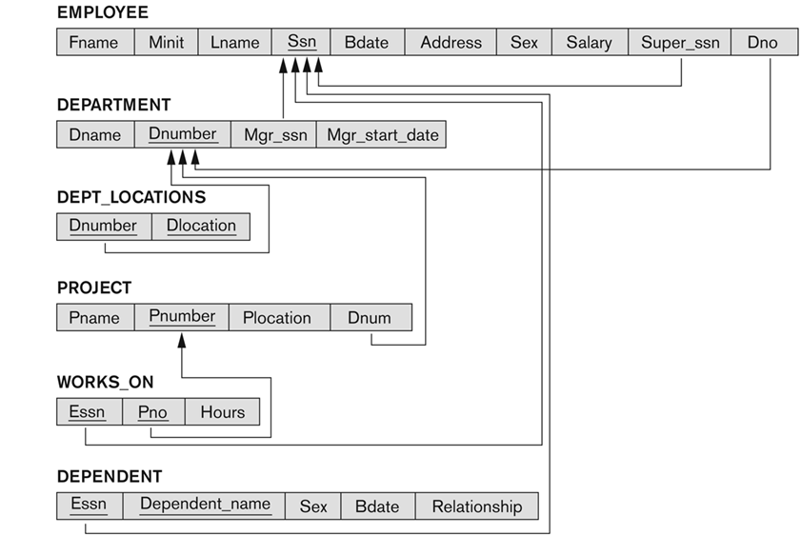

Slide 50
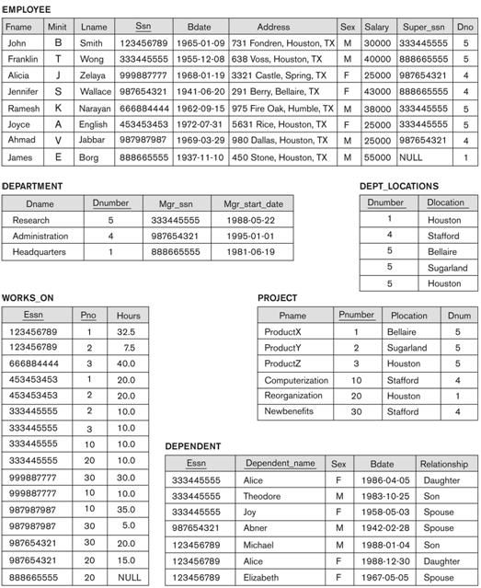


Slide 51

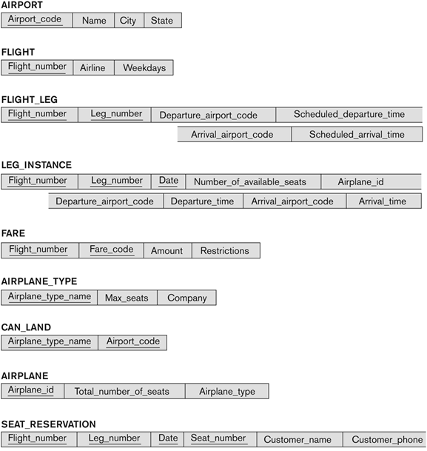

Slide 52
