Slide 1
Database Systems
Khwaja Fareed University of Engineering & IT
Lecture 3
The Relational Algebra

Slide 2

Information is extracted from a database
by writing queries
  query inputs: relations
  query result: relation
queries are read-only operations
The SQL command for queries select

Slide 3

attributes to extract
SELECT name
FROM Customer
WHERE zipcode='95211'
input relations
conditions used
to filter tuples

Slide 4

The relational algebra defines
mathematical operations on relations
  provides a solid theory for dealing with queries
These operations define the meaning of SQL queries
  think in terms of the algebra operators
  translate the algebra to SQL syntax
Query optimization:
  SQL queries are translated to expression trees
  containing algebraic operators
  expression trees are reorganized
  to optimize the order of operations

Slide 5

set theoretic:
  union, intersection, difference, cross-product
  usual mathematical meaning
relational database unique:
  select, project: extraction from a single relation
  join: combining two relations

Slide 6

SELECT extracts tuples from a relation
  result has same relation schema as operand
SELECT requires a selection condition
  selection condition is a boolean expression
  to filter tuple values
Syntax:
σ_{<selection condition>} (R)
Selection condition may contain
AND, OR, NOT, =, <, ≤, >, ≥, ≠

Slide 7

< "S002", "I065", 120 >,
< "S333", "I954", 198 >,
< "S047", "I099", 267 >,
< "S047", "I954", 300 >
r₂(STORESTOCK) =
σ_{StoreId = "S047"} (STORESTOCK)
< "S047", "I099", 267 >,
< "S047", "I954", 300 >
σ_{quantity < 200} (STORESTOCK)
< "S002", "I065", 120 >,
< "S333", "I954", 198 >

Slide 8

PROJECT extracts attributes from a relation
  result schema attributes are a subset
  of the operand schema
PROJECT requires a attribute list
Syntax:
π_{<attribute list>} (R)
Duplicates are not kept in result
  result is a relation, which is a set

Slide 9

< "S002", "I065", 120 >,
< "S333", "I954", 198 >,
< "S047", "I099", 267 >,
< "S047", "I954", 300 >
r₂(STORESTOCK) =
π_{StoreId, Item} (STORESTOCK)
< "S002", "I065" >,
< "S333", "I954" >,
< "S047", "I099" >,
< "S047", "I954" >

Slide 10
r(STOCKITEM) =
< "I075", "Ice Cream", $1.49, false >,
< "I345", "Cupcakes", $1.99, false >,
< "I333", "Twinkies", $1.98, false >
π_{Description, Price} (STOREITEM)
< "Ice Cream", $1.49 >,
< "Cupcakes", $1.99 >,
< "Twinkies", $1.98 >

Slide 11

r(STOCKITEM) =
< "I075", "Ice Cream", $1.49, false >,
< "I345", "Cupcakes", $1.99, false >,
< "I333", "Twinkies", $1.98, false >
π_{Price} ( σ_{Description="Ice Cream"} (STOREITEM))
SELECT result:
< "I075", "Ice Cream", $1.49, false >
PROJECT result:
< $1.49 >

Slide 12

JOIN combines tuples from two tables based
on values of related attributes (usually a FK)
JOIN requires a join condition
  boolean expression comparing attributes from each operand
Syntax:
R⋈ _{<join condition>} S
The join condition may contain
AND, =, <, ≤, >, ≥, ≠

Slide 13

STORESTOCK( StoreId, Item, Quantity )
STOCKITEM( ItemId, Description, Price, Taxable )
< "I075", "Ice Cream", $1.49, false >,
< "I345", "Cupcakes", $1.99, false >,
< "I333", "Twinkies", $1.98, false >
r(STOCKITEM) =
< "S002", "I075", 120 >,
< "S047", "I333", 267 >
r(STORESTOCK) =
STORESTOCK ⋈_{<Item = ItemId>} STOCKITEM

Slide 14
RESULT( StoreId, Item, Quantity, ItemId, Description, Price, Taxable )
r(RESULT) =
< "S002", "I075", 120, "I075", "Ice Cream", $1.49, false >,
< "S047", "I333", 267, "I333", "Twinkies", $1.98, false >
STORESTOCK ⋈_{<Item = ItemId>} STOCKITEM

Slide 15

STORESTOCK
StoreId
Item
Quantity
Query:
Get the Description and Price
for all Items stocked
by Store S002
S002
I075
120
S047
I333
267
S002
I333
1200
STOCKITEM
ItemId
Description
Price
Taxable
result only
includes tuples
with
certain ItemIds
I075
Ice Cream
$1.49
FALSE
I345
Cup Cakes
$1.99
FALSE
I333
Twinkies
$1.98
FALSE
result has these attributes

Slide 16
STORESTOCK
Query:
Get the Description and Price
for all Items stocked
by Store S002
StoreId
Item
Quantity
S002
I075
120
S047
I333
267
We need a join
to merge data
across relations
S002
I333
1200
STOCKITEM
ItemId
Description
Price
Taxable
I075
Ice Cream
$1.49
FALSE
I345
Cup Cakes
$1.99
FALSE
I333
Twinkies
$1.98
FALSE

Slide 17
STORESTOCK ⋈_{<Item = ItemId>} STOCKITEM
StoreId
Item
Quantity
ItemId
Description
Price
Taxable
S002
I075
120
I075
Ice Cream
$1.49
FALSE
S047
I333
267
I333
Twinkies
$1.98
FALSE
S002
I333
1200
I333
Twinkies
$1.98
FALSE
Query:
Get the Description and Price
for all Items stocked
by Store S002
Now we can select and project
to extract the information we want

Slide 18
R1 = STORESTOCK ⋈_{<Item = ItemId>} STOCKITEM
StoreId
Item
Quantity
ItemId
Description
Price
Taxable
S002
I075
120
I075
Ice Cream
$1.49
FALSE
S047
I333
267
I333
Twinkies
$1.98
FALSE
S002
I333
1200
I333
Twinkies
$1.98
FALSE
R2 = σ_{StoreId = "S002"} (R1)
StoreId
Item
Quantity
ItemId
Description
Price
Taxable
S002
I075
120
I075
Ice Cream
$1.49
FALSE
S002
I333
1200
I333
Twinkies
$1.98
FALSE

Slide 19
R2 = σ_{StoreId = "S002"} (R1)
StoreId
Item
Quantity
ItemId
Description
Price
Taxable
S002
I075
120
I075
Ice Cream
$1.49
FALSE
S002
I333
1200
I333
Twinkies
$1.98
FALSE
R3 = π_{<Description, Price>} (R2)
Description
Price
Ice Cream
$1.49
Twinkies
$1.98

Slide 20

Since the operands and results of every query are relations, we can compose or chain queries.
R1 = STORESTOCK ⋈_{<Item = ItemId>} STOCKITEM
R2 = σ_{StoreId = "S002"} (R1)
R3 = π_{<Description, Price>} (R2)
π_{<Description, Price>}(σ_{StoreId = "S002"} (STORESTOCK ⋈_{<Item = ItemId>} STOCKITEM))

Slide 21

Relational algebra queries are easily translated to SQL queries
(more on this later)
π_{<Description, Price>}(σ_{StoreId = "S002"} (STORESTOCK ⋈_{<Item = ItemId>} STOCKITEM))
SELECT Description, Price
FROM STORESTOCK, STOCKITEM
WHERE StoreId='S002'
AND STORESTOCK.Item = STOCKITEM.ItemId

Slide 22

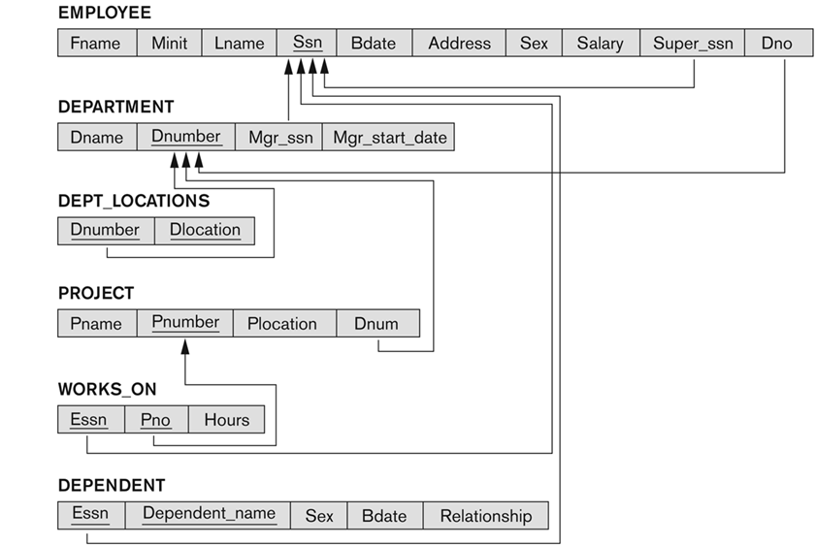

Slide 23

Express the following queries in the algebra:
First and last name of employees
who have no supervisor.
First and last name of employees
supervised by Franklin Wong.
Last name of employees who have dependents.
Last name of employees who have daughters.
Last name of employees in department 5 who
work more than 10 hours/week on ProductX.
Last name of supervisors of employees
in department 5 who work more than
10 hours/week on ProductX.

Slide 24

UNION: R ⋃ S
  all tuples in either R or S
INTERSECTION: R ⋂ S
  all tuples in both R and S
DIFFERENCE: R - S
  all tuples in R but not in S
CROSS-PRODUCT or CARTESIAN PRODUCT: R  S
  pair all tuples in R with all tuples in S
⋃ ⋂ -
operands must be
union compatable
(same attribute types)

Slide 25

STORESTOCK
WAREHOUSESTOCK
StoreId
Item
Quantity
StoreId
Item
Quantity
S002
I075
120
W998
I075
1200
S047
I333
267
W087
I001
5000
S002
I333
267
W222
I188
11500
W023
I075
300
STORESTOCK ⋃ WAREHOUSESTOCK
Id
Item
Quantity
S002
I075
120
S047
I333
267
S002
I333
267
W998
I075
1200
W087
I001
5000
W222
I188
11500
W023
I075
300

Slide 26

STORESTOCK
WAREHOUSESTOCK
StoreId
Item
Quantity
StoreId
Item
Quantity
S002
I075
120
W998
I075
1200
S047
I333
267
W087
I001
5000
S002
I333
267
W222
I188
11500
W023
I075
300
π_{ItemID} (STORESTOCK) ⋂ π_{Item} (WAREHOUSESTOCK)
Item
Item
⋂
I075
=
Item
I075
I001
I075
I333
I188

Slide 27

STOCKITEM
STORESTOCK
ItemId
Description
Price
Taxable
StoreId
Item
Quantity
I075
Ice Cream
$1.49
FALSE
S002
I075
120
I345
Cup Cakes
$1.99
FALSE
S047
I333
267
I333
Twinkies
$1.98
FALSE
S002
I333
267
π_{ItemID} (STOCKITEM) - π_{Item} (STORESTOCK)
ItemId
-
Item
=
Item
I075
I075
I345
I345
I333
I333

Slide 28

STOCKITEM
STORESTOCK
ItemId
Description
Price
Taxable
StoreId
Item
Quantity
I075
Ice Cream
$1.49
FALSE
S002
I075
120
I345
Cup Cakes
$1.99
FALSE
S047
I333
267
I333
Twinkies
$1.98
FALSE
STOCKITEM  STORESTOCK
ItemId
Description
Price
Taxable
StoreId
Item
Quantity
I075
Ice Cream
$1.49
FALSE
S002
I075
120
I345
Cup Cakes
$1.99
FALSE
S002
I075
120
I333
Twinkies
$1.98
FALSE
S002
I075
120
I075
Ice Cream
$1.49
FALSE
S047
I333
267
I345
Cup Cakes
$1.99
FALSE
S047
I333
267
I333
Twinkies
$1.98
FALSE
S047
I333
267

Slide 29

CROSS PRODUCT is also called CROSS JOIN
  a JOIN with no join condition
XPROD brings together all possible information
from two relations
XPROD can result in very large relations
  if R has i tuples and S has j tuples,
  then R  S has i*j tuples
In real applications, avoid XPROD
whenever possible
  Database equivalent of a brute-force nested loop
  massive unnecessary memory usage

Slide 30

STORESTOCK ⋈ _{<Item = ItemId>} STOCKITEM
ItemId
Description
Price
Taxable
StoreId
Item
Quantity
I075
Ice Cream
$1.49
FALSE
S002
I075
120
I333
Twinkies
$1.98
FALSE
S047
I333
267
σ_{ItemId=Item} (STOCKITEM  STORESTOCK)
ItemId
Description
Price
Taxable
StoreId
Item
Quantity
I075
Ice Cream
$1.49
FALSE
S002
I075
120
I345
Cup Cakes
$1.99
FALSE
S002
I075
120
I333
Twinkies
$1.98
FALSE
S002
I075
120
I075
Ice Cream
$1.49
FALSE
S047
I333
267
I345
Cup Cakes
$1.99
FALSE
S047
I333
267
I333
Twinkies
$1.98
FALSE
S047
I333
267

Slide 31
Relational algebra queries are easily translated to SQL queries
π_{<Description, Price>}(σ_{StoreId = "S002"} (STORESTOCK ⋈_{<Item = ItemId>} STOCKITEM))
π
X
SELECT Description, Price
FROM STORESTOCK, STOCKITEM
WHERE StoreId='S002'
AND STORESTOCK.Item = STOCKITEM.ItemId
σ condition
⋈ condition

Slide 32

Queries are declarative, not procedural.
These queries specify the information we want, in terms of mathematical operations … but not how to compute it.
Does not say “compute a cross-product, then select …”,
rather give me something “equivalent to cross-product, select …”
π_{<Description, Price>}(σ_{StoreId = "S002"} (STORESTOCK ⋈_{<Item = ItemId>} STOCKITEM))
π
X
SELECT Description, Price
FROM STORESTOCK, STOCKITEM
WHERE StoreId='S002'
AND STORESTOCK.Item = STOCKITEM.ItemId
σ condition
⋈ condition

Slide 33

A complete set of operations
is a subset of all operations that is sufficient to
express all queries expressible by all operators
  any operators outside a complete set can be expressed as combinations of operators in the complete set
Complete Set: { σ, π, ⋃, -,  }
Operators outside a complete set are not necessary,
but they are generally convenient
  JOIN: A⋈_{C} B = σ_{C}(A  B)
  INTERSECTION: A ⋂ B = (A ⋃ B) – ((A – B) ⋃ (B – A))

Slide 34

There are some queries in commercial languages
(i.e. SQL) that cannot be expressed
in the basic relational algebra
A few additional operations handle most of these
  aggregation: apply a function to a collection of values
  OUTER JOINS and OUTER UNIONS: null values are used to keep data that would otherwise be discarded

Slide 35
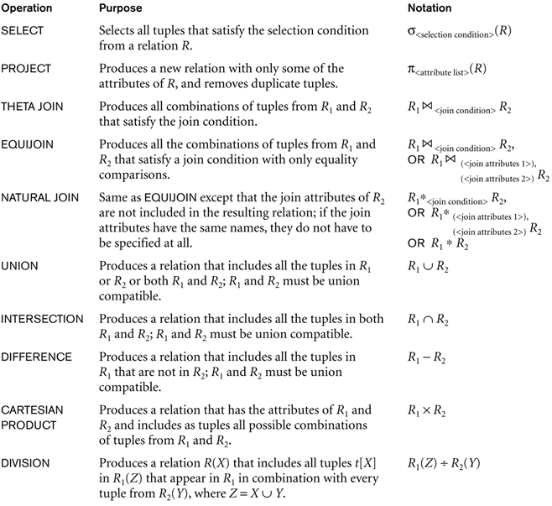

Slide 36

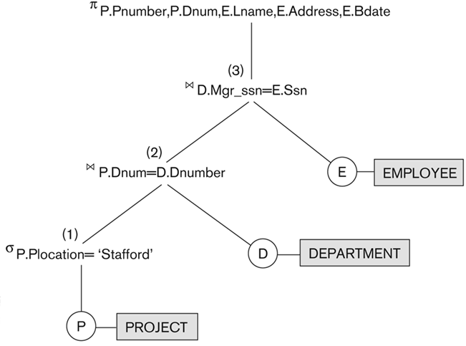
Query trees are representations of queries that can be manipulated by query optimizers, according to mathematical properties of the operators.
(Chapter 15)

Slide 37


Slide 38

First and last names
of all department managers.
Salaries of all employees
who have worked on the Reorganization project.
SSN of all employees who have worked on a project
that is controlled by a department different
than the department that they are assigned to.
Last name of all employees who are not married.

Slide 39

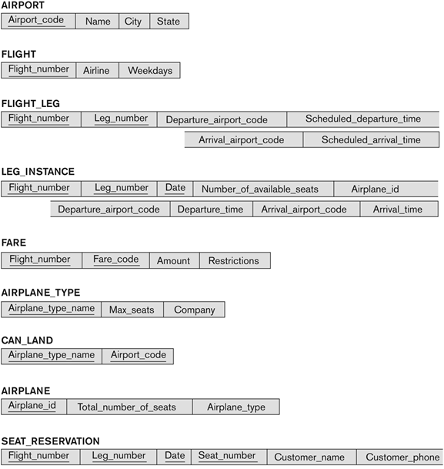

Slide 40

List all airplane types that can land
at any airport in San Francisco.
List the ids and number of seats for all airplanes
that can land at any airport in Chicago.
List the name and phone number of all customers
with a seat reserved on a flight
that leaves Chicago O’Hara airport (ORD)
on October 31, 2008.
List all airlines that have seats available for flights
leaving Los Angeles (LAX) on September 25, 2008.
List all airlines that operate
at San Jose International Airport (SJC).

