Slide 1
Database Systems
Khwaja Fareed University of Engineering & IT
Lecture 1
Fundamental Database Concepts

Slide 2

A database is any collection of data.
A DBMS is a software system
designed to maintain a database.
We use a DBMS when
  there is a large amount of data
  security and integrity of the data are important
  many users access the data concurrently

Slide 3

Consider a Phone Company, such as AT&T
Kinds of information they deal with:
customer records
employee records
billing information
management records
switching and wiring diagrams
customer service orders

Slide 4

With all that data,
AT&T must be concerned with questions such as:
  Where is the information kept?
  How is the data structured?
  How is the data kept consistent?
  How is the data described?
  How is the data kept secure?
  How do different pieces of data interrelate?

Slide 5


Without a DBMS, we'd have:
Access by a collection
of ad hoc programs
in C++, Java, PHP, etc.
users of
the data
There is no control or
coordination of what
these programs do
with the data
data stored as bits on disks
organized as files

Slide 6
With a DBMS, we have:
applications
DBMS
users of
the data
DBMS provides control
and coordination to
protect the data.
data stored as bits on disks
organized as files

Slide 7

application
program(s)
application
program(s)
application
program(s)
application
program(s)
users of
the data
external/application view
internal/implementation view
query processor
security manager
concurrency manager
index manager
DBMS
software
components
data
definition
processor
data
description
data
dictionary
data

Slide 8

application
program(s)
application
program(s)
application
program(s)
DML: data manipulation language
application
program(s)
users of
the data
QL: query language
GPL: general purpose languages
query processor
security manager
concurrency manager
index manager
system
configuration
languages
DDL:
data
definition
language
data
definition
processor
data
dictionary
data

Slide 9

Anything you can do with a DBMS,
you can do with a file system, a network
and a heap of C code
So why spend the money to buy a DBMS?
  there is a well defined collection of capabilities common to a certain class of applications
  for applications in this class, the DBMS already has these capabilities and probably does them better than you could with home-brewed code

Slide 10
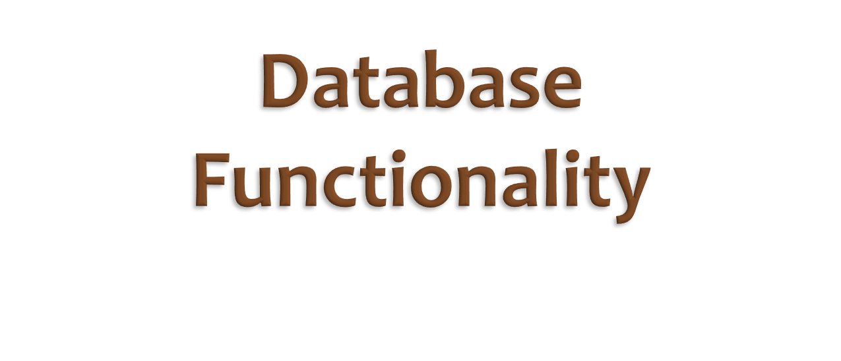

Slide 11
application
program(s)
application
program(s)
application
program(s)
application
program(s)
users of
the data
query processor
security manager
concurrency manager
index manager
software operating
between the data and
the applications can
provide many
capabilities
in a generic way
data
definition
processor
data
dictionary
data

Slide 12

A DBMS provides
persistent objects, types and data structures
  persistent = having a lifetime longer than
  the programs that use the data
  any information that fits the data model
  of a particular DBMS
  can be made persistent with little effort
  data model = concepts that can be used to describe the data

Slide 13

A DBMS supports access by concurrent users
  concurrent = happening at the same time
  concurrent access, particularly writes (data changes),
  can result in inconsistent states
  (even when the individual operations are correct)
  the DBMS can check the actual operations of concurrent users, to prevent activity that will lead to inconsistent states

Slide 14

A DBMS can restrict access to authorized users
  security policies often require control that is more fine-grained than that provided by a file system
  since the DBMS understands the data structure, it can enforce fairly sophisticated and detailed security policies
    on subsets of the data
    on subsets of the available operations

Slide 15

A DBMS can assist in controlling redundancy
  redundancy = multiple copies of the same data
  with file storage, it's often convenient to store multiple copies of the same data, so that it's "local" to other data and applications
  this can cause many problems:
    wasted disk space
    inconsistencies
    need to enter the data multiple times

Slide 16

A DBMS supports representation
of complex relationships and integrity constraints
  the semantics (meaning) of an application often
  includes many relationships and rules
  about the relative values of subsets of the data
  these further restrict the possible instances of the database
  relationships and constraints can be defined as part of the schema

Slide 17

A DBMS can provide backup and recovery
  backup = snapshots of the data particular times
  recovery = restoring the data to a consistent state
  after a system crash
  the higher level semantics (relationships and constraints)
  can make it difficult to restore a consistent state
  transaction analysis can allow a DBMS to reconstruct a consistent state from a number of backups

Slide 18

A DBMS can support
multiple user interfaces and user views
  since the DBMS provides a well-defined data model and a persistent data dictionary, many different interfaces can be developed to access the same data
  data independence ensures that these UIs will not be made invalid by most changes to the data
  new user views can be supported as new schemas defined against the conceptual schema

Slide 19
persistent objects, types and data structures
control of concurrent users
controlling of redundancy
restricting access (security)
representation of complex relationships
and integrity constraints
backup and recovery
multiple user interfaces and user views

Slide 20
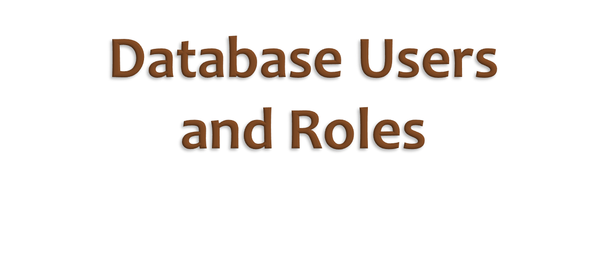

Slide 21

application
program(s)
application
program(s)
application
program(s)
application
program(s)
application developers
users of
the data
query processor
security manager
concurrency manager
index manager
DBMS
system
developers
system
administrator
(and DB
designer)
database
designer
data
definition
processor
data
dictionary
data

Slide 22
Actors On the Scene
(people interested in the actual data):
  database administrators
  database designers
  systems analysts and application programmers
  end users

Slide 23

Database Administrators
  acquiring a DBMS
  managing the system
  acquiring HW and SW to support the DBMS
  authorizing access (security policies)
  managing staff, including DB designers

Slide 24
Database Designers
  identifying the information of interested
  in the Universe of Discourse (UoD)
  designing the database conceptual schema
  designing views for particular users
  designing the physical data layout and logical schema
  adjusting data parameters for performance

Slide 25
Systems Analysts and Application Programmers
(generic database developers)
  provide specialized knowledge to optimize database usage
  provide generic (canned) application programs

Slide 26
End Users
  casual users: ad-hoc queries
  naïve or parametric users: canned queries such as menus for a phone company customer service agent
  sophisticated users: people who understand the system and the data and use it in many novel ways
  standalone users: people who use personal easy-to-use databases for personal data

Slide 27
Actors Behind the Scene:
people who maintain the environment
but aren't interested in the actual data
  DBMS designers and implementers
  tools developers
  operators and maintenance personnel
  database researchers

Slide 28

DBMS designers and implementers
  work for the company that supplies the DBMS
  (i.e. Microsoft , Oracle, Sybase, MySQL …)
  programmers and engineers
  design and implement the DBMS

Slide 29
Tools Developers
  design and implement DBMS add-ons or plug-ins
  may work for DBMS supplier or be independent
  kinds of tools: database design aids, performance monitoring tools, user and designer interfaces

Slide 30
Operators and maintenance personnel
  run and maintain the computer environment in which a DBMS operates
  probably work for the database administrator (DBA)

Slide 31
Database Researchers
  academic or industrial researchers
  develop new theory, new designs, new data models and new algorithms to improve future database management systems

Slide 32


Slide 33

A database instance is the collective values of
all database objects at some point in time
  also called the (data) instance or (database) state
A schema describes the database and
defines the possible instances
  also called the data definition, data dictionary, or meta-data

Slide 34

A data model describes the possible schemas
(essentially the meta-schema)
A DBMS is designed around a particular data model
  this is what allows all system components (and humans)
  to understand the schema and data
possible data models
  relational,
  object-oriented, object-relational,
  entity-relationship,
  semantic, network, hierarchical, etc.

Slide 35

A physical data model describes the way
in which data is stored in the computer
  typically only of interest to database designers, implementers and maintainers …not end users
  must provide a well-defined structure that can be mapped to the conceptual schema
  allows optimization strategies to be defined generically

Slide 36








user-specific
views
External View
External View
External View
Conceptual Schema
generic view
Internal Schema
physical view

Slide 37

physical data independence
  conceptual and external schema are defined
  in terms of the data model,
  rather than the actual data layout
  ensures that conceptual and external schemas
  are not affected by changes to the physical data layout
logical data independence
  ensures that changes to the conceptual schema
  don't affect the external views
  (this is not always achievable)

