Slide 1
Database Systems
Khwaja Fareed University of Engineering & IT
Lecture 4
More Relational Algebra

Slide 2

Unary Relational Operations
    SELECT (symbol: σ (sigma))
    PROJECT (symbol: π (pi))
    RENAME (symbol: ρ (rho))
Relational Algebra Operations From Set Theory
    UNION ( ∪ ), INTERSECTION ( ∩ ), DIFFERENCE (or MINUS, – )
    CARTESIAN PRODUCT ( x )
Binary Relational Operations
    JOIN (several variations of JOIN exist)
    DIVISION
Additional Relational Operations
    OUTER JOINS, OUTER UNION
    AGGREGATE FUNCTIONS (SUM, COUNT, AVG, MIN, MAX)

Slide 3

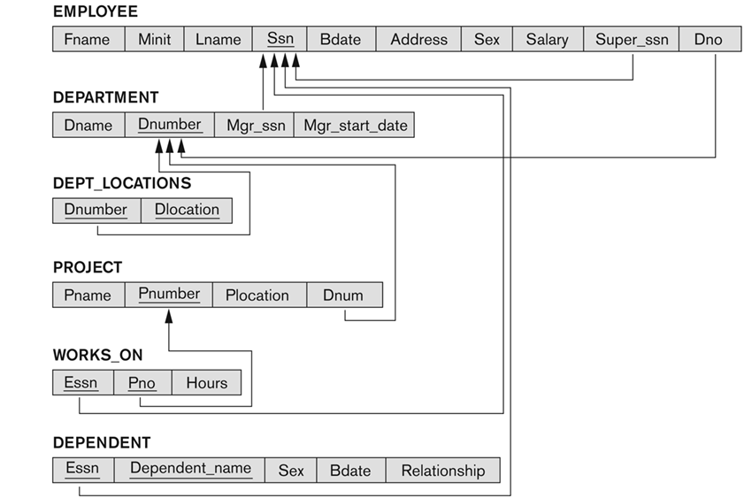

Slide 4

First and last names
of all department managers.
Salaries of all employees
who have worked on the Reorganization project.
SSN of all employees who have worked on a project
that is controlled by a department different
than the department that they are assigned to.
Last name of all employees who are not married.

Slide 5

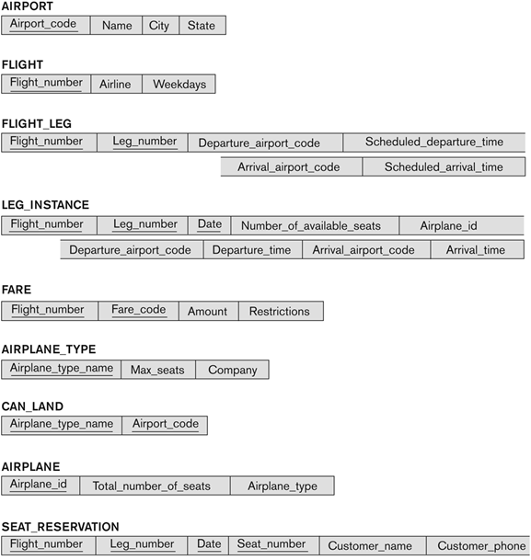

Slide 6

List all airplane types that can land
at any airport in San Francisco.
List the ids and number of seats for all airplanes
that can land at any airport in Chicago.
List the name and phone number of all customers
with a seat reserved on a flight
that leaves Chicago O’Hara airport (ORD)
on October 31, 2008.
List all airlines that have seats available for flights
leaving Los Angeles (LAX) on September 25, 2008.
List all airlines that operate
at San Jose International Airport (SJC).

Slide 7

Rename the attributes of a relation
or change the relation name
The general RENAME operation ρ:
  ρ_{S (B1, B2, …, Bn )}(R) changes both:
    the relation name to S, and
    the column (attribute) names to B1, B1, …..Bn
  ρ_{S}(R) changes:
    the relation name only to S
  ρ_{(B1, B2, …, Bn )}(R) changes:
    the column (attribute) names only to B1, B1, …..Bn

Slide 8

shorthand for renaming attributes :
  R1 ← π _{FNAME, LNAME, SALARY} (DEP5_EMPS)
  R1 has same attribute names as DEP5_EMPS
  R2 ← ρ _{(F,L,S)} (π _{FNAME, LNAME, SALARY} (DEP5_EMPS))
  R2 has attributes renamed to F, L and S
  R3 (F,L,S) ← π _{FNAME, LNAME, SALARY} (DEP5_EMPS)
  R3 also has attributes renamed to F, L and S

Slide 9

Aggregate functions apply
mathematical operations to a collection of values.
Examples:
  compute average salary for all employees
  compute maximum salary for all managers
  count number of airports
Common aggregate functions:
  SUM
  AVERAGE
  MAX
  MIN
  COUNT

Slide 10

Symbol for aggregate functions is ℱ
  ℱ_{MAX Salary} (EMPLOYEE)
  retrieves the maximum salary value from the EMPLOYEE relation
  ℱ_{MIN Salary} (EMPLOYEE)
  retrieves the minimum Salary value from the EMPLOYEE relation
  ℱ_{SUM Salary} (EMPLOYEE)
  retrieves the sum of the Salary from the EMPLOYEE relation
  ℱ_{COUNT SSN, AVERAGE Salary} (EMPLOYEE)
  computes the number of employees and their average salary

Slide 11

Grouping can be combined with Aggregate Functions
Example:
  For each department, retrieve the DNO, COUNT SSN, and AVERAGE SALARY
  _{DNO} ℱ_{COUNT SSN, AVERAGE Salary} (EMPLOYEE)
Group employees by DNO,
then compute aggregate functions on each group

Slide 12
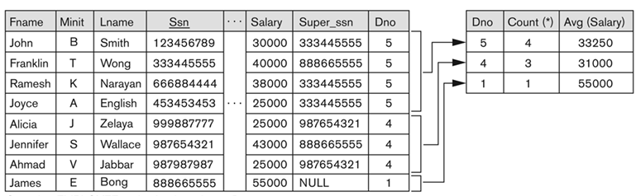
  _{DNO} ℱ_{COUNT SSN, AVERAGE Salary} (EMPLOYEE)

Slide 13

Example:
  Retrieve names of employees who work on
  all projects that John Smith works on.
R = S ÷ T
x ϵ R, iff for every y ϵ T, <x,y> ϵ S
The tuples in R come from the tuples in S
that match every tuple in T

Slide 14

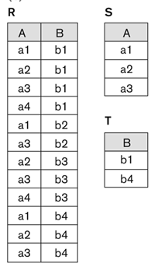
T = R ÷ S
T has all attributes of R that are not in S.
Find tuples in R that match every tuple in S.
Project the attributes that are not in S.

Slide 15
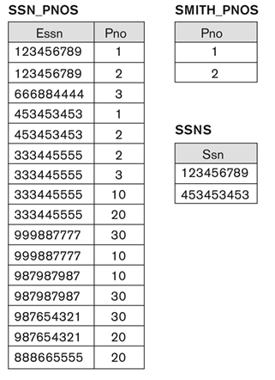
  SSNS = SSN_PNOS ÷ SMITH_PNOS
  Retrieve names of employees who work on
  all projects that John Smith works on.

Slide 16
R = S ÷ T can be computed as
R1 = π_{Y}(S)
R2 = π_{Y}((T X R1) – S)
R = R1 – R2

Slide 17

Equijoin
Natural join
Outer join
Outer union

Slide 18

Theta Join is the general case
STORESTOCK ⋈_{<Item = ItemId>} STOCKITEM
  The join condition is called theta
Join condition can be any Boolean expression
on the attributes of R and S
  R.Ai<S.Bj AND (R.Ak=S.Bl OR R.Ap<S.Bq)
Most join conditions involve one or more
equality conditions, connected with AND
  R.Ai=S.Bj AND R.Ak=S.Bl AND R.Ap=S.Bq

Slide 19

The most common use of join involves
join conditions with equality comparisons only
When the only comparison operator used is =,
we call it an EQUIJOIN
  In the result of an EQUIJOIN we always have one or more pairs of attributes (whose names need not be identical) that have identical values in every tuple.

Slide 20

NATURAL JOIN removes the superfluous attributes
in an EQUIJOIN
  The standard definition of natural join requires that the two join attributes, or each pair of corresponding join attributes, have the same name in both relations
  If this is not the case, a renaming operation is applied first.
Operator for NATURAL JOIN is *
R * S joins R and S with equality tests
on all common attributes,
then removes duplicate attributes

Slide 21
Q ← R(A,B,C,D) * S(C,D,E)
  The implicit join condition includes each pair of attributes with the same name, connected by AND
    R ⋈_{R.C = S.C AND R.D = S.D} S
  Result keeps only one attribute of each such pair:
    Q(A,B,C,D,E)

Slide 22

THETA JOIN, NATURAL JOIN and EQUIJOIN,
eliminate tuples without a matching (related) tuple
  Tuples with null in the join attributes are also eliminated
  This amounts to loss of information.
OUTER JOINs keep the unmatched tuples
and match them with NULLs
  LEFT OUTER JOIN (=⋈): keep all tuples from left relation
  RIGHT OUTER JOIN (⋈=): keep all tuples from right relation
  FULL OUTER JOIN (=⋈=): keep all tuples from both relations

Slide 23

S
T
R1 = S =⋈ _{B=C} T (left join)
A | B
1 | 4
2 | 5
3 | 6
C | D
5 | 8
5 | 9
7 | 10
A | B | C | D
1 | 4 | NULL | NULL
2 | 5 | 5 | 8
2 | 5 | 5 | 9
3 | 6 | NULL | NULL
R2 = S ⋈= _{B=C} T (right join)
R3 = S =⋈= _{B=C} T (full join)
A | B | C | D
2 | 5 | 5 | 8
2 | 5 | 5 | 9
NULL | NULL | 7 | 10
A | B | C | D
1 | 4 | NULL | NULL
2 | 5 | 5 | 8
2 | 5 | 5 | 9
3 | 6 | NULL | NULL
NULL | NULL | 7 | 10
notice that R3 = R1 U R2

Slide 24

OUTER UNION computes
the union of tuples from two relations
when the relations are not type compatible
  Tuples are included for all tuples from either relation that do not match a tuple in the other relation
  Tuples are also included for pairs of tuples from each attribute that do match on common attributes
  Remaining attribute values from both relations are kept
  Missing values are replaced with NULL

Slide 25
Example: OUTER UNION of
STUDENT(Name, SSN, Department, Advisor) and
INSTRUCTOR(Name, SSN, Department, Rank)
  Tuples from the two relations are matched based on having the same combination of values of the shared attributes:
  Name, SSN, Department
  The result relation will have the following attributes:
  STUDENT_OR_INSTRUCTOR (Name, SSN, Department, Advisor, Rank)
  If a student is also an instructor, both Advisor and Rank will have a value; otherwise, one of these two attributes will be null

