Slide 1
Predictive Kickback Monitoring in Table Milling Machines
Speaker: Muhammad Aziz Hassan
Supervisor: Sven Jacob

Slide 2
Motivation
Unexpected kickback event
Convention Methods
  Manual control
  Insufficient time to react
Can we control this behavior by using AI Methods?

Slide 3
AI Methods
Convolutional neural networks (Sequential)
  1D CNN (binary classification)
Recurrent neural networks
  Hybrid 1D CNN + LSTM with Attention mechanism (binary classification)
  Improved lstm (binary classification)

Slide 4
Data
Received 144 csv files from fraunhofer which contains sensor values
Data set was further divided by 4 Parameters
  Workpiece (Soft wood)
  Milling depth
  Milling height
  Speed
Signals used for analysis
  TRIAX X Zeitsignal, TRIAX Y Zeitsignal, TRIAX Z Zeitsignal
  Analog Input #14 P Backhoff Track
  Leistung_230, U1, I1

Slide 5
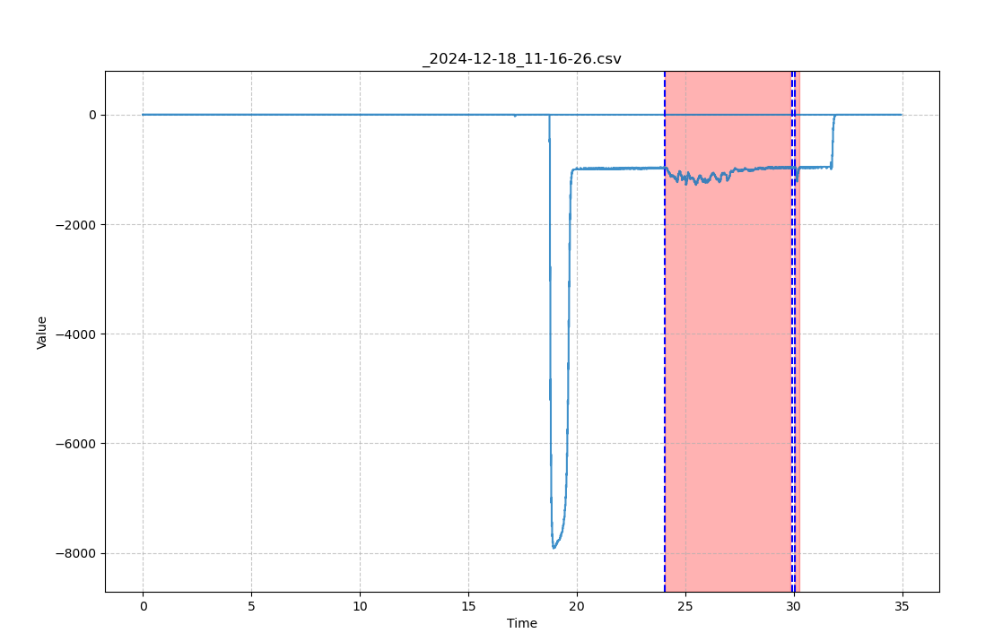
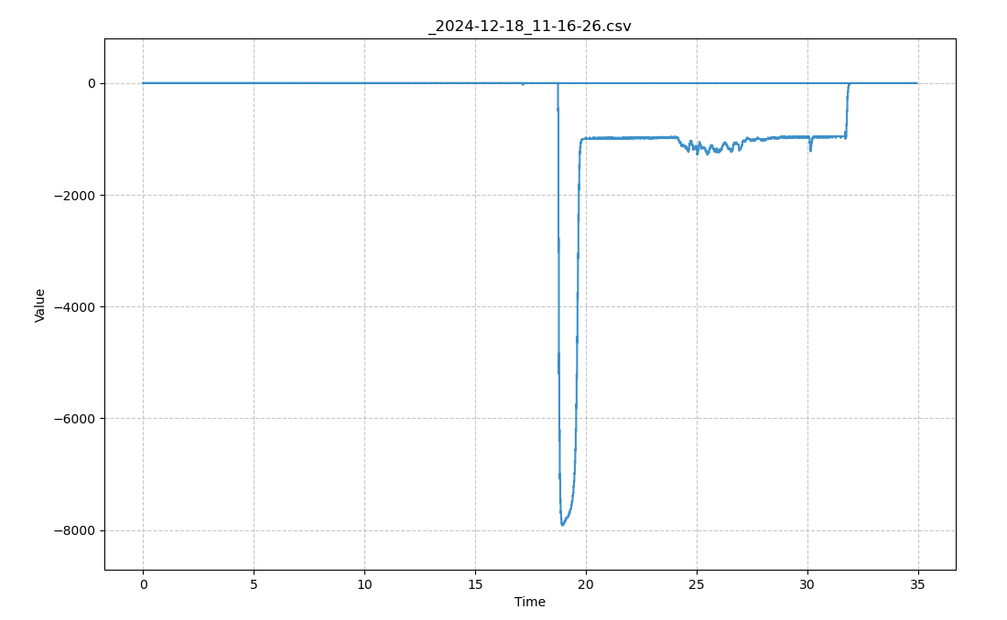
Annotating the data
Analog Input #14 P Backhoff Track

Slide 6
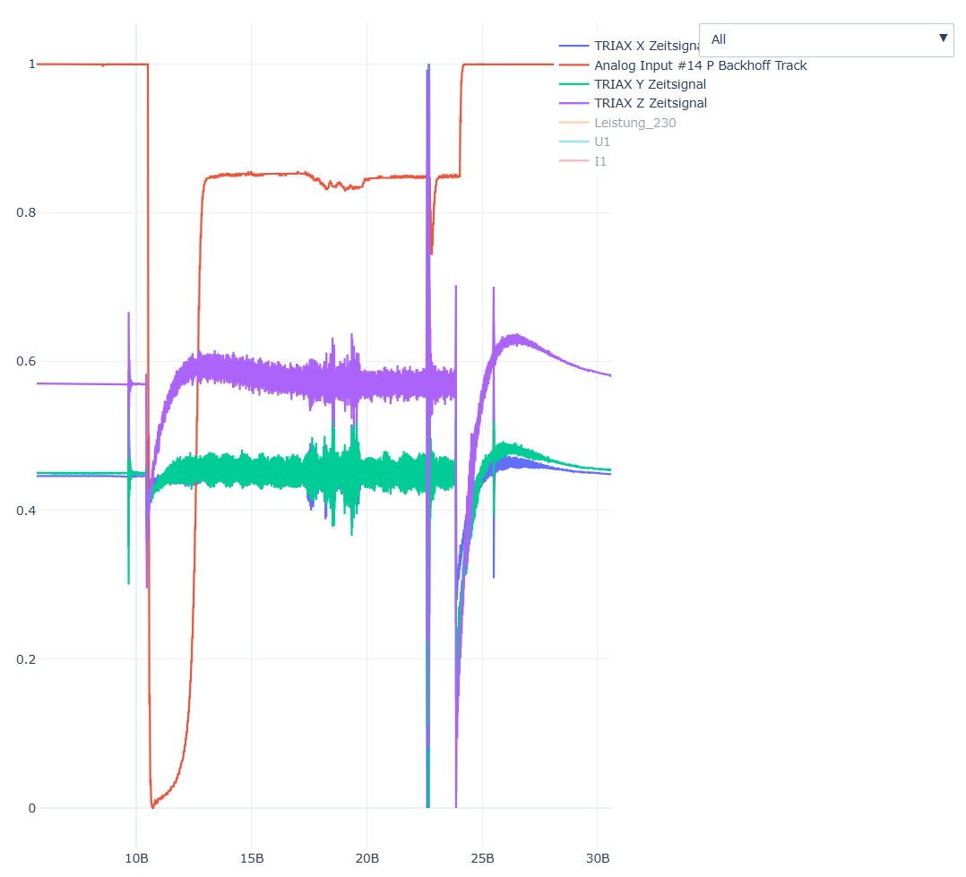
Orignal Signal

Slide 7
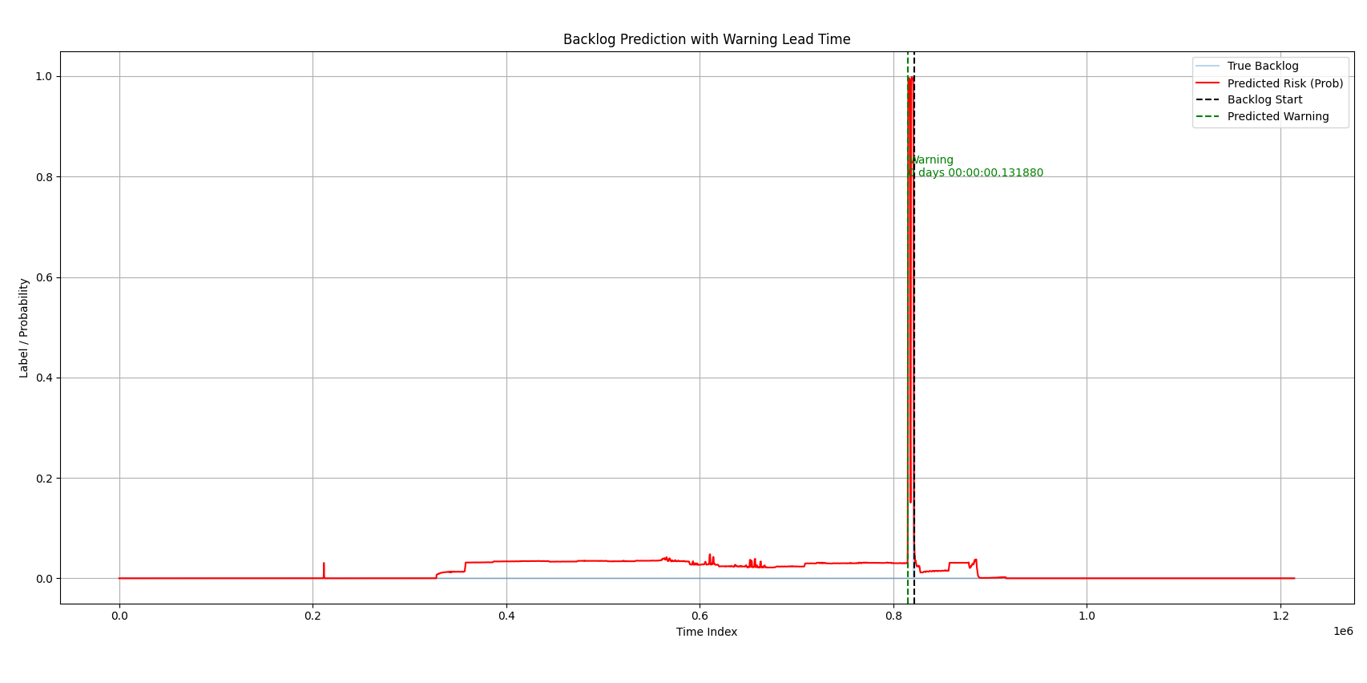
Convolutional neural networks (Sequential )
131.880 ms predicted
before the kick back event
96% accuracy

Slide 8
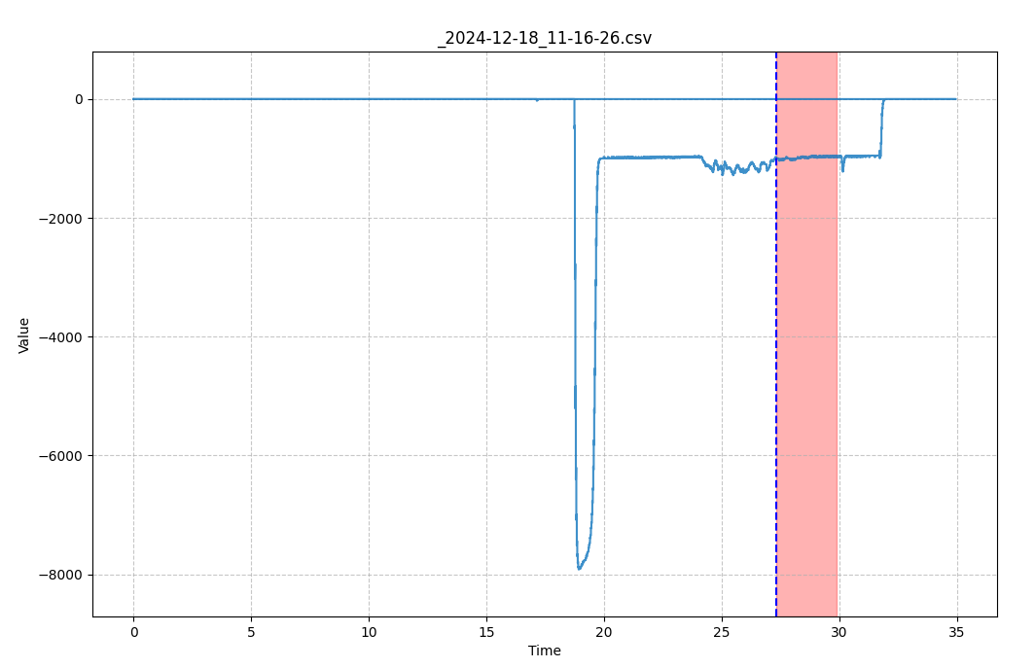
Improved Annotation
Analog Input #14 P Backhoff Track

Slide 9
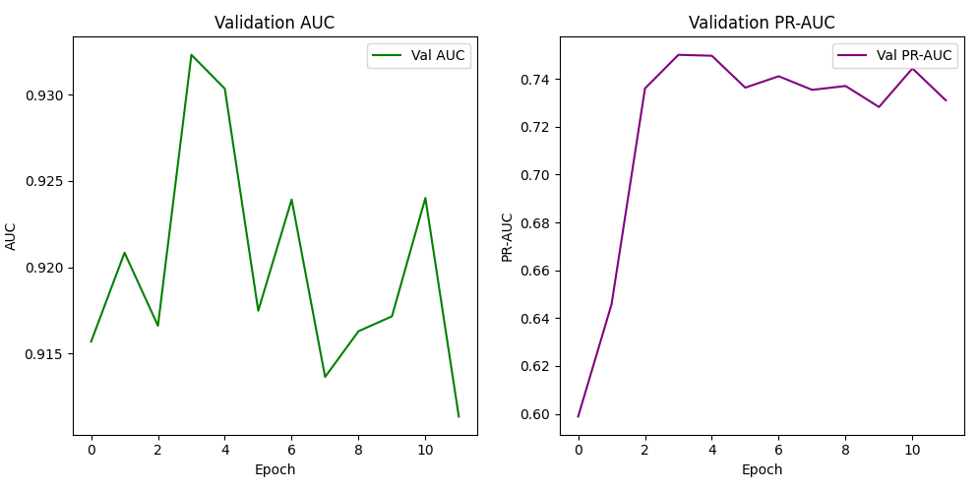
Recurrent neural networks
Hybrid 1D CNN + LSTM with Attention mechanism (7 files )
  accuracy 0.88
  ROC AUC: 0.9323
  PR AUC: 0.7501

Slide 10
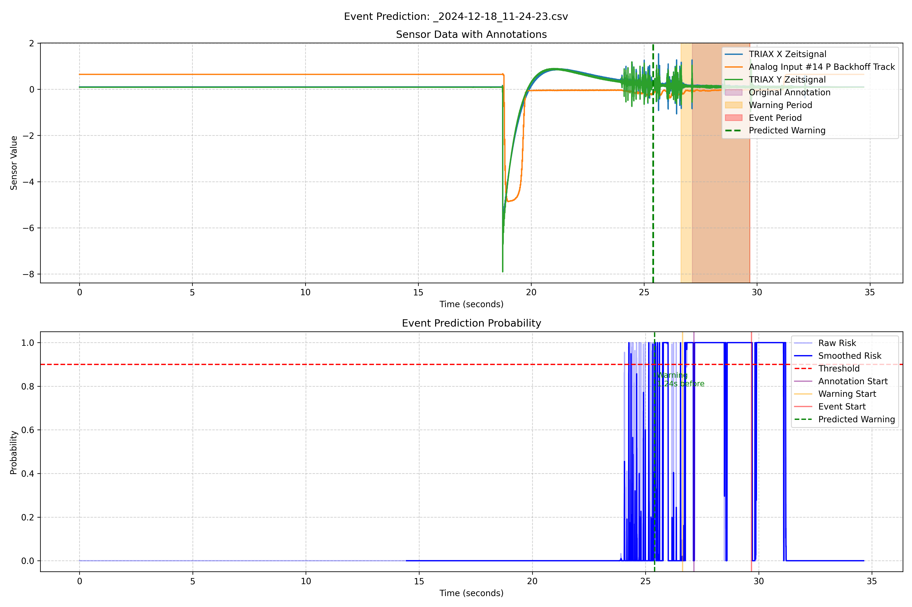

Slide 11
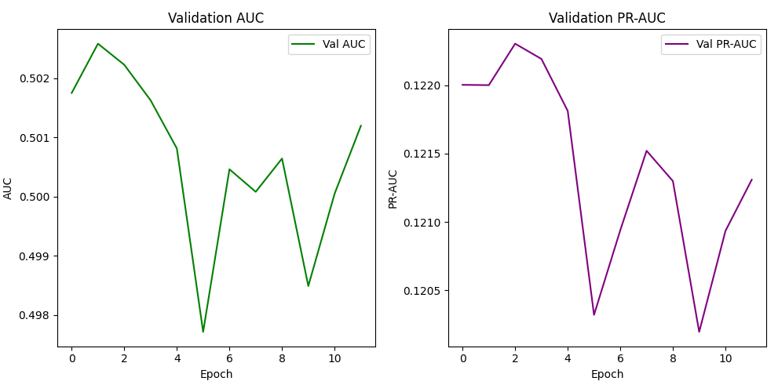
Recurrent neural networks
Hybrid 1D CNN + LSTM with Attention mechanism (64 files (16 were skipped due to no significant kick back observed and 64 were skipped due to limited_memory))
  accuracy 0.50
  ROC AUC: 0.101
  PR AUC: 0.1212

Slide 12
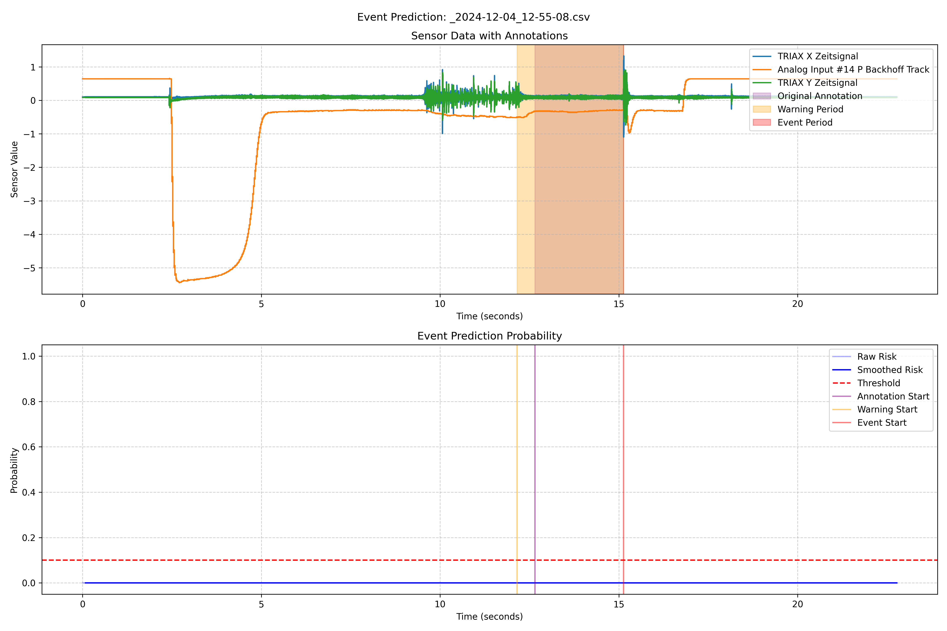

Slide 13
Recurrent neural networks (Improved lstm)
Improved lstm (64 files (16 were skipped due to no significant kick back observed and 64 were skipped due to limited_memory))
  auc: 0.8941
  pr_auc: 0.4168
  roc_auc: 0.5106
Cannot get interferance results, because of memory issue

Slide 14
Overall Results
Metrics | Recurrent Neural Network (files with same parameter) | Recurrent Neural Network (file with all parameters) | Improved Recurrent Neural Network (file with all parameters)
Accuracy | 0.88 | 0.50 | 0.8941
PR AUC | 0.75 | 0.101 | 0.4168
ROC_AUC | 0.93 | 0.1212 | 0.5106

Slide 15
Conclusion
LSTM-based methods demonstrate strong performance in early event detection.
LSTMs are effective when key parameters remain consistent.
Scenarios involving variable parameters, further research is required to identify optimal solutions.
Overall, LSTMs shows promising result but require careful tuning for broader applicability.

