Slide 1

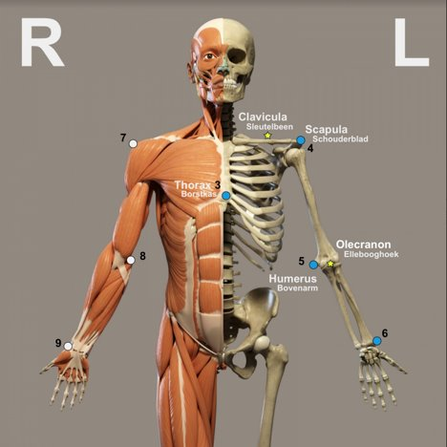

Ortho Eyes
Dr. Tony Andrioli​
Raphael, Brice, Eddie, Hassan, Arjun, Lennart, Rachelle
Notes:
Raphi

Slide 2
Data processing
Hassan Ali

Slide 3
Data processing for Machine learning model
General Steps:
How did we get 650 columns?
Read in a csv file
Read in patient folder with multiple exercises and save path of all exercises
Read in one category folder ,multiple exercises
folder with multiple categories and saving data
cross joining exercises and creating 650 columns.
3
1/12/2020
Notes:
Raphi

Slide 4

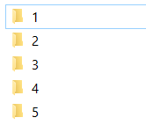
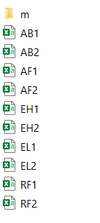
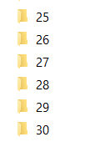
The data
Category_folder
Patientgroup
Patientfolder (csvfiles)
4
1/12/2020
Notes:
Raphi

Slide 5
Read in a csv file: Class exercises
Read data from csv files and save the data as a pandas Dataframe
Rename column names
Save data in numpy array
Getting metadata from exercises (exercises type, category, etc)
data = pd.read_csv("filename.csv")
data.rename(columns= colnames)
data = pd.read_csv("filename.csv")
os.path.split(exercisepath)
‘CODE\data2.0\Catagory_1\1\AB1.csv’

Slide 6
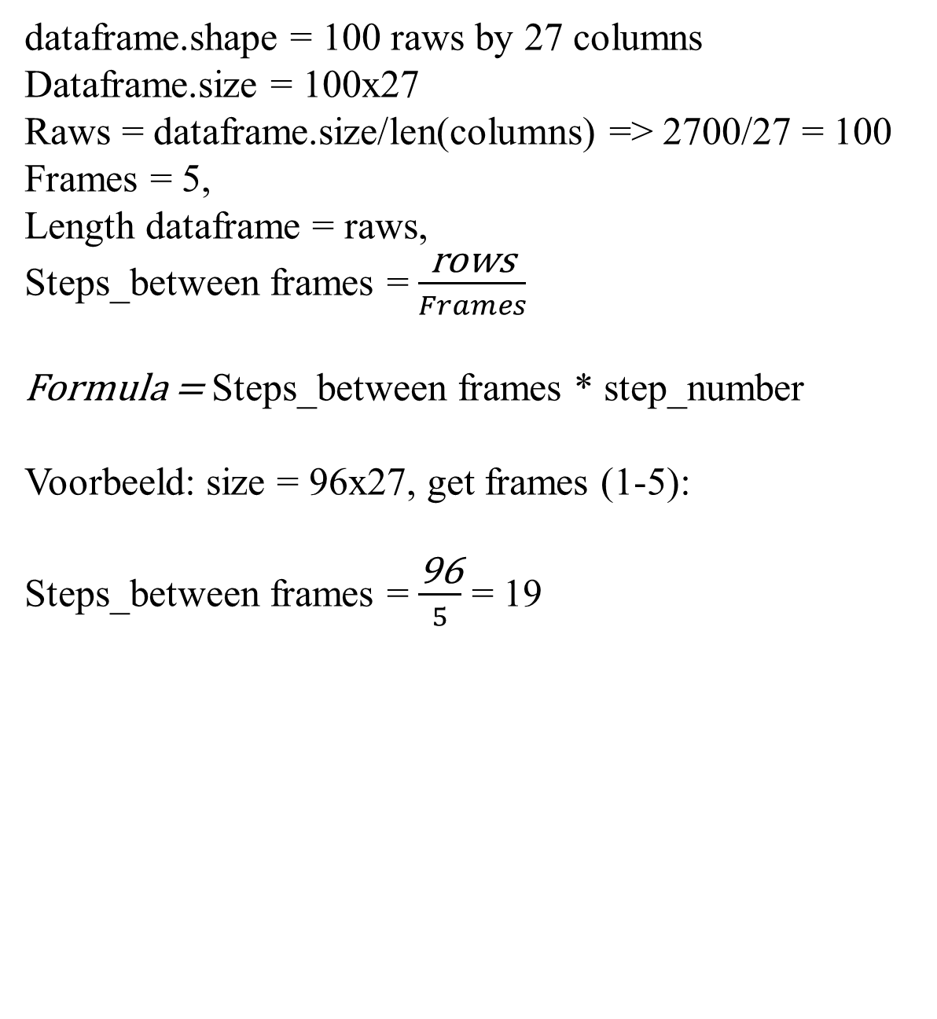
Get frames (5 rows only)
dataframe.shape = 100 raws by 27 columns
Dataframe.size = 100x27
Raws = dataframe.size/len(columns) => 2700/27 = 100
Frames = 5,
Length dataframe = raws,
Steps_between frames = $\frac{\text{rows}}{Frames}$
Formula = Steps_between frames * step_number
Voorbeeld: size = 96x27, get frames (1-5):
Steps_between frames = $\frac{\text{96}}{5}$ = 19

Slide 7
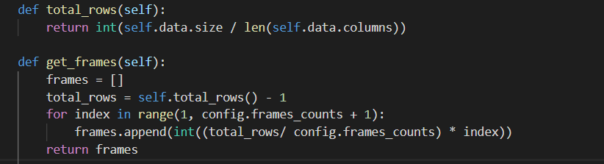
Voorbeeld get frames
Step: No: | Calculation | Frames
1 | 1*19 | 19
2 | 2*19 | 38
3 | 3*19 | 57
4 | 4*19 | 76
5 | 5*19 | 95
dataframe_2 = dataframe.iloc[get_frames()]
Frames | thorax_r_x | thorax_r_y | thorax_r_z | . | humerus_l_y | humerus_l_z | ellebooghoek_l
19 | 4,281002 | -4,902092 | -3,568476 | . | 49,40454 | 1,703396 | 361,781
38 | 3,983373 | -5,070366 | -6,898982 | . | 140,0478 | -14,25236 | 361,6263
57 | 7,701193 | -4,54045 | -7,870923 | . | 133,0988 | -11,46238 | 369,8746
76 | 7,036899 | -5,193945 | -4,345288 | . | 43,63235 | -7,319636 | 361,6309
95 | 7,796869 | -3,205833 | -0,6876775 | . | 15,97036 | 50,46438 | 403,7818

Slide 8
Patient
Patient Catagory_1\1
Find if it’s a csv file: endswith ‘.csv’
csvfile = os.path.join(self.path, filename)
Initiate class Exercises with path as csvfile.
Create a list of reverences of all exercises with the path to an individual exercise

Slide 9
Patientgroup
Patientgroup
Find name folder = os.listdir (path)
Patientpath = os.path.join(self.path, name)
Initiate class patient with path as Patientpath.
Create a list of reverences of all patients from a category with the path to an individual patient

Slide 10
What do we have!
Read in a csv of an exercise :- 5 frames
A reference to all exercises of a patient
A reference to all patients from a category

Slide 11
Patientgroups
Create an empty list of patientgrougs
Get grouppath by looping through folder containing patietgroups and get the groupID.
Initiate class patientgroup with path as patientID.
Create a list of reverences of all patientgroups with the path to an all patients
To access an exercises is then as easy as:
patient_group[0].patients[0].exercises[0].dataframe
CODE\\data2.0\\Catagory_{groupid}

Slide 12
Create a patient data
Categories
patients
patient
Patient_data
Loop through each and get the patient data and sort it out.
Use the key exercise.exercisegroup to get the name of the exercise
AB1 | AB2
AF1 | AF2
EL1 | EL2
RF1 | RF2
EH1 | EH2

Slide 13
Cross-joining exercises
Generate more data by creating possible combinations for a patient.
Example in test.py
Patient_data
Restults = list(itertools.product (patient_data[‘AB’], Patient_data[‘AF’] ))
[('AB1' 'AF1') ('AB1' 'AF2') ('AB2' 'AF1') ('AB2' 'AF2’)]
Now results data is 2x more than the original patient_data
Working with references to files instead of dataframes: see code
AB | AB1 | AB2
AF | AF1 | AF2

Slide 14
Splitting test & train data
Randomly select patients by their id’s for test in data
If patient id is in test then it’s patient_data from results goes to the test data
Else it’s a train data. See code

Slide 15
Getting the 650 columns!
Loop through the patient data and get the data of each exercises => save this in an empty array
Save the array in a combination_array with 650 columns => see code
Combinations
Exercise combinations
exercise
data
Combination
array

Slide 16
Getting the group of each exercise combinations
Getting the group number:
This will be the answer for our model, de y

Slide 17
Questions & feedback moment

