Slide 1
Helm The package manager for Kubernetes
From zero to hero
Daniel Hasselwander

Slide 2


Goals for this session
Recap to Kubernetes

Slide 3
https://forms.gle/9vZcF8EGpfD5zRdk6

Slide 4
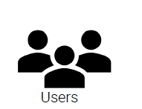

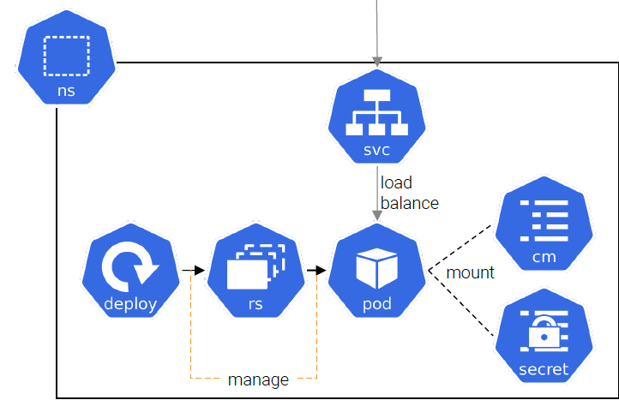
Typical application
Notes:
Kubectl ist dein Freund -> Autocompletion Tipp
Imperativ links
Declarativ rechts hier ein yAml

Slide 5

Kubernetes Objects– Namespace
logical group for ressources
Notes:
Logische Gruppe Azure Ressource Group

Slide 6

Kubernetes Objects – POD
smallest unit
maintain >= 1 Container
container share network
Notes:
Kubectl ist dein Freund -> Autocompletion Tipp
Imperativ links
Declarativ rechts hier ein yAml

Slide 7

Kubernetes Objects – Replica Set
control the number of pods
secure the avaibility
Notes:
Kubectl ist dein Freund -> Autocompletion Tipp
Imperativ links
Declarativ rechts hier ein yAml

Slide 8

Kubernetes Objects – Deployment
control update strategies
manage templates of the pods
Notes:
Kubectl ist dein Freund -> Autocompletion Tipp
Imperativ links
Declarativ rechts hier ein yAml

Slide 9

Kubernetes Objekte – Services
load balancer
Implementation of layer 4
Mapping Adress => Pods
Notes:
Kubectl ist dein Freund -> Autocompletion Tipp
Imperativ links
Declarativ rechts hier ein yAml

Slide 10
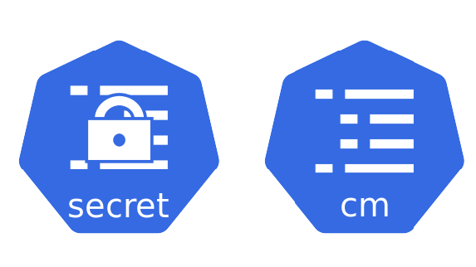
Kubernetes Objects – Secrets and Config
Config Maps = Configurations
Secrets = Base64 encoded Config Maps
Key-Value based

Slide 11



Kubernetes Objekte – Storage / Volume Mounts
Objekt zum Mounten von Speicher
Volume Mount
PVC = Abstraktion
Wirkliches Volume

Slide 12
Kubernetes Objects – Ingress
Implementation of layer 7
Mapping url => service
Notes:
An API object that manages external access to the services in a cluster, typically HTTP.
Ingress may provide load balancing, SSL termination and name-based virtual hosting
Mapping from url to service
example.com => service A
example2.com => service B

Slide 13
Typical application
Notes:
Kubectl ist dein Freund -> Autocompletion Tipp
Imperativ links
Declarativ rechts hier ein yAml

Slide 14
Kubernetes Objects – Jobs / CronJobs
Abstraction for one time or regular actions
Like Functions
Notes:
An API object that manages external access to the services in a cluster, typically HTTP.
Ingress may provide load balancing, SSL termination and name-based virtual hosting
Mapping from url to service
example.com => service A
example2.com => service B

Slide 15
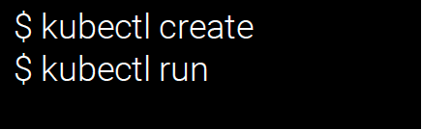
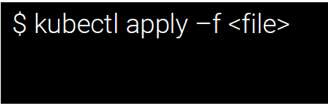
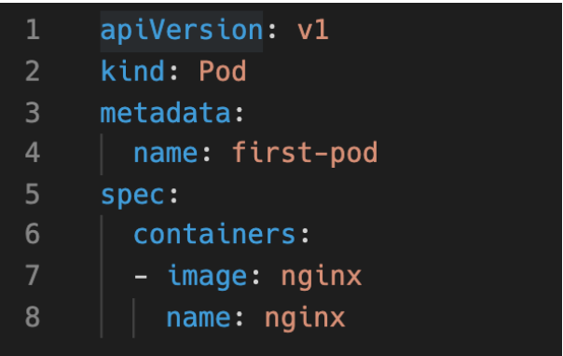
How you can interact with kubernetes ?
Notes:
Kubectl ist dein Freund -> Autocompletion Tipp
Imperativ links
Declarativ rechts hier ein yAml

Slide 16
Questions ?

Slide 17
Goals for this session
Recap to Kubernetes

Slide 18
Credits
Kubernetes Fundamentals Slides from Marc Menzinger
Kubernetes icons © Community & Linux Foundation, distributed under CC-BY-4.0 https://github.com/kubernetes/community/tree/master/icons
Kubernetes docs © Documentation Authors, distributed under CC-BY-4.0 https://kubernetes.io/docs/home/

