Slide 1
Helm The package manager for Kubernetes
From zero to hero
Daniel Hasselwander

Slide 2


Goals for this session
First steps with helm cli
Where you can find helm charts

Slide 3
Connect with your Cluster
You got your kube config ?
Everyone can access to their k8s-cluster ?
export KUBECONFIG=/path/to/your/kubeconfig

Slide 4
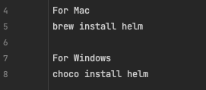

Install helm on your environment
https://helm.sh/docs/intro/install/

Slide 5
Make the setup for your cluster

Slide 6
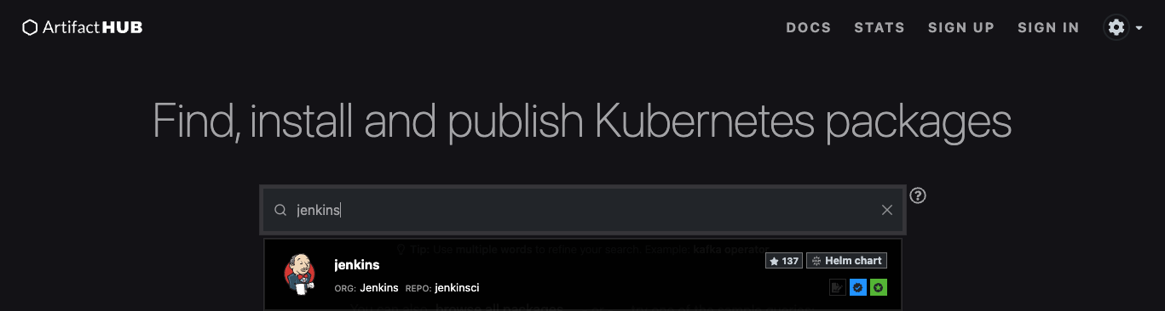


Install a example Helm Chart in your cluster
Search at the artifact hub
Add Repo
Install a Chart

Slide 7
Helm works in the actual namespace

Slide 8
Create a namespace in your cluster with name test
Install a the bitnami wordpress chart in your cluster
Search on artifacthub.io for a chart

Slide 9
Solution
helm repo add my-repo https://charts.bitnami.com/bitnami
helm install my-release my-repo/wordpress

Slide 10
Cli - Commands
List all installed releases in the namespace
List all installed releases in the cluster

Slide 11
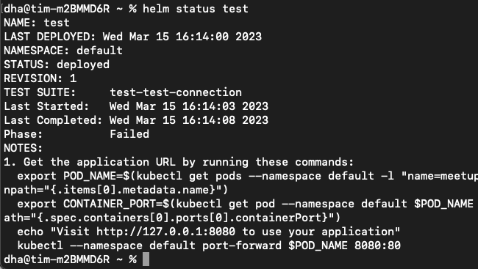
Try it! Check the status of your release
Check Status of a release
Output

Slide 12
Check the status of your Release and Save the output in a file

Slide 13
helm status my-release
helm status my-release > status.txt

Slide 14
Try it! Check the status of your release
upgrade a release to a specific version
rollback automaticlly to the previous release

Slide 15
Upgrade your wordpress chart to the specific version 15.2.58 and compare the status of the release with your old saved status
Then rollback to the old version
Which Revision Number do you have ?

Slide 16
helm upgrade my-release my-repo/wordpress –version=«15.2.58»
helm status my-release -> status_2.txt
helm rollback my-release
helm status my-release
Revision Number 3

Slide 17
Remove all your resources which are created from the helm release with one command.
Use the helm doku to find the commands.
Which commands do you use ?
Notes:
Helm and Logo
Package Manager for Kubernetes like Package manager Npm, nuget etc.
Maintaned by Helm Community
2 Parts Client Software and Library
The Helm Library provides the logic for executing all Helm operations. It interfaces with the Kubernetes API server and provides the following capability:
Combining a chart and configuration to build a release
Installing charts into Kubernetes, and providing the subsequent release object
Upgrading and uninstalling charts by interacting with Kubernetes
The standalone Helm library encapsulates the Helm logic so that it can be leveraged by different clients.
Client command-line client for end users
Local chart development
Managing repositories
Managing releases
Interfacing with the Helm library
Sending charts to be installed
Requesting upgrading or uninstalling of existing releases

Slide 18
helm uninstall my-release my-repo/wordpress

