Slide 1
Helm The package manager for Kubernetes
From zero to hero
Daniel Hasselwander

Slide 2


Goals for this session
Structure of a chart
How to setup a local devolpment environment
Build your first own chart

Slide 3
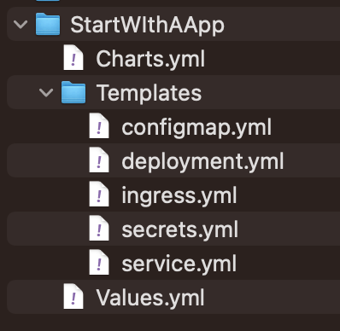
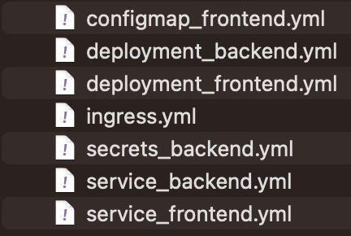
Helm – Chart - Definition
Chart
Release
Templates + Values
Notes:
CLI chart = Templates Files
Local chart development
Managing repositories
Managing releases
Interfacing with the Helm library
Sending charts to be installed
Requesting upgrading or uninstalling of existing releases

Slide 4
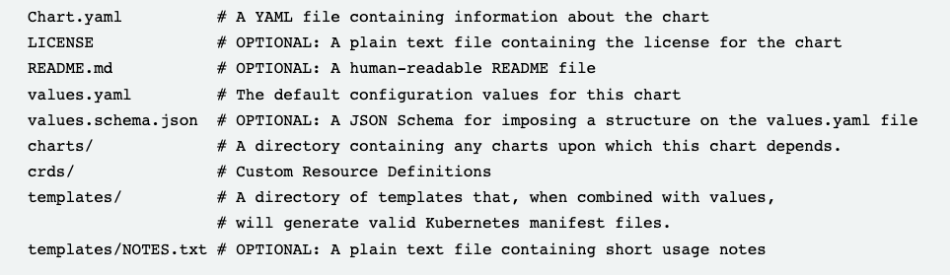
Helm – Chart – Folder Structure
Helm uses a packaging format called charts
Notes:
CLI chart = Templates Files
Local chart development
Managing repositories
Managing releases
Interfacing with the Helm library
Sending charts to be installed
Requesting upgrading or uninstalling of existing releases

Slide 5
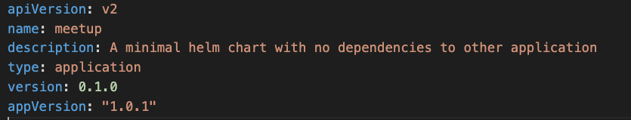
Helm – Chart.yml
explanations
apiVersion that is used from helm = should be v2 for Helm 3
type=application => no helm dependecies
version=version number of the chart
appVersion: Version of the application that is deployed
Notes:
CLI chart = Templates Files
Local chart development
Managing repositories
Managing releases
Interfacing with the Helm library
Sending charts to be installed
Requesting upgrading or uninstalling of existing releases

Slide 6
Helm – Chart.yml
version and appVersion are not related
Notes:
CLI chart = Templates Files
Local chart development
Managing repositories
Managing releases
Interfacing with the Helm library
Sending charts to be installed
Requesting upgrading or uninstalling of existing releases

Slide 7

Helm – values.yml
Your inputs that you will use in your templates with a default value
Notes:
CLI chart = Templates Files
Local chart development
Managing repositories
Managing releases
Interfacing with the Helm library
Sending charts to be installed
Requesting upgrading or uninstalling of existing releases

Slide 8
Helm – value.yml
The variables can be overwritte with two methods variable replicaCount
Notes:
CLI chart = Templates Files
Local chart development
Managing repositories
Managing releases
Interfacing with the Helm library
Sending charts to be installed
Requesting upgrading or uninstalling of existing releases

Slide 9
Helm – value.yml
CLI-Only
Notes:
CLI chart = Templates Files
Local chart development
Managing repositories
Managing releases
Interfacing with the Helm library
Sending charts to be installed
Requesting upgrading or uninstalling of existing releases

Slide 10
Helm – value.yml
CLI-Only
Notes:
CLI chart = Templates Files
Local chart development
Managing repositories
Managing releases
Interfacing with the Helm library
Sending charts to be installed
Requesting upgrading or uninstalling of existing releases

Slide 11

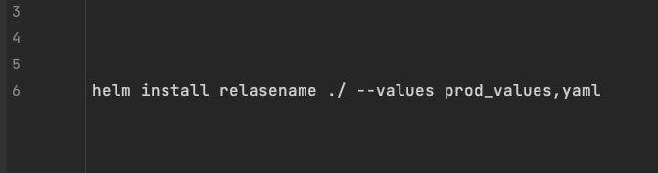
Helm – Template deployment.yml
Create a yml file
Helm install
Notes:
CLI chart = Templates Files
Local chart development
Managing repositories
Managing releases
Interfacing with the Helm library
Sending charts to be installed
Requesting upgrading or uninstalling of existing releases

Slide 12
Helm – value.yml
The mechanism merge your injected values with the variables in values.yml
Notes:
CLI chart = Templates Files
Local chart development
Managing repositories
Managing releases
Interfacing with the Helm library
Sending charts to be installed
Requesting upgrading or uninstalling of existing releases

Slide 13
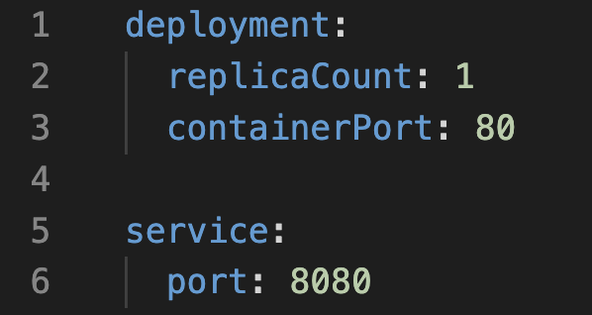
Helm – values.yml
Your inputs that you will use in your templates with a default value
Your inputs can also be hierarchy
Notes:
CLI chart = Templates Files
Local chart development
Managing repositories
Managing releases
Interfacing with the Helm library
Sending charts to be installed
Requesting upgrading or uninstalling of existing releases

Slide 14
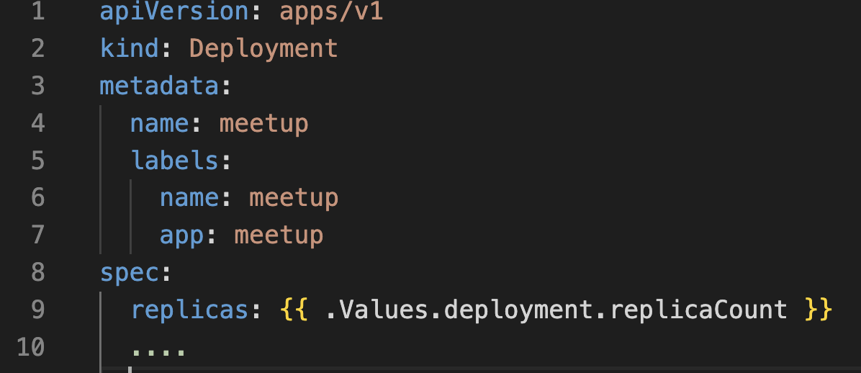
Helm – Template deployment.yml
Can use a Value from values.yml with a Template Style
{{ .Values.nameOfObject.nameOfVariable }}
Notes:
CLI chart = Templates Files
Local chart development
Managing repositories
Managing releases
Interfacing with the Helm library
Sending charts to be installed
Requesting upgrading or uninstalling of existing releases

Slide 15
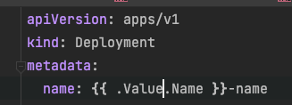
Helm – Template deployment.yml
String Interpolation is also possible
{{ .Values.nameOfObject. }}
Notes:
CLI chart = Templates Files
Local chart development
Managing repositories
Managing releases
Interfacing with the Helm library
Sending charts to be installed
Requesting upgrading or uninstalling of existing releases

Slide 16
Practice Time and i will show it to you Example Nginx How we create a minimal version of a chart with a deployment that use the nginx image. The replica count of the deployment should be set with templating from values.yml

Slide 17
Practice 02 Frontend

Slide 18
Helm – Chart – Built-In-Objects
Notes:
CLI chart = Templates Files
Local chart development
Managing repositories
Managing releases
Interfacing with the Helm library
Sending charts to be installed
Requesting upgrading or uninstalling of existing releases

Slide 19
Helm – Built In Objects
Can use some built in objects without doing something manual
Begins with a uppercase in templates
Documentation which are implemented
Helm | Built-in Objects
Notes:
CLI chart = Templates Files
Local chart development
Managing repositories
Managing releases
Interfacing with the Helm library
Sending charts to be installed
Requesting upgrading or uninstalling of existing releases

Slide 20



Helm – Built In Objects
Release => The instance as itself
Values => Injected Values
Chart => Values from the chart
Files => Access to files from chart
Capabilities => capabilities from chart
Template => template that is used
Notes:
CLI chart = Templates Files
Local chart development
Managing repositories
Managing releases
Interfacing with the Helm library
Sending charts to be installed
Requesting upgrading or uninstalling of existing releases

Slide 21
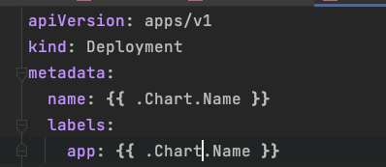
Helm – Built In Objects Usage
Notes:
CLI chart = Templates Files
Local chart development
Managing repositories
Managing releases
Interfacing with the Helm library
Sending charts to be installed
Requesting upgrading or uninstalling of existing releases

Slide 22
Helm – Built In Objects
Can use a Value from values.yml with a Template Style
{{ .Values.nameOfObject.nameOfVariable }}
Notes:
CLI chart = Templates Files
Local chart development
Managing repositories
Managing releases
Interfacing with the Helm library
Sending charts to be installed
Requesting upgrading or uninstalling of existing releases

Slide 23
Practice 03 Frontend

Slide 24
Helm – Chart – Functions & Pipelines
Notes:
CLI chart = Templates Files
Local chart development
Managing repositories
Managing releases
Interfacing with the Helm library
Sending charts to be installed
Requesting upgrading or uninstalling of existing releases

Slide 25


Helm –Functions and Pipelines
Functions can use for actions
Functions can be used as a pipeline
https://helm.sh/docs/chart_template_guide/function_list/
Notes:
Description about our chart

Slide 26
Helm –Functions and Pipelines
Functions can use for actions
Functions can be used as a pipeline
https://helm.sh/docs/chart_template_guide/function_list/
Notes:
Description about our chart

Slide 27
Helm – Chart - Types
Application Chart
=
1 Application
Umbrella Chart
=
X Applications
Can also update the values of it´s subcharts
Library Chart
=
Contains Helper Code
Must be a dependency of a other chart
App
App
SQL-DB
Notes:
CLI chart = Templates Files
Local chart development
Managing repositories
Managing releases
Interfacing with the Helm library
Sending charts to be installed
Requesting upgrading or uninstalling of existing releases

Slide 28
Go's New Brand - The Go Programming Language
Helm
Cloud Native Computing Foundation (cncf.io)
Microservices architecture on AKS - Azure Architecture Center | Microsoft Learn

