Slide 1
Helm The package manager for Kubernetes
From zero to hero
Daniel Hasselwander

Slide 2


Goals for this session
Use functions and pipelines
Use Pipelines

Slide 3

Helm –Functions
Functions can use for logical implementation in your templates
Structure = {{ function inputForFunction }}
https://helm.sh/docs/chart_template_guide/function_list/
Notes:
Description about our chart

Slide 4

Helm –Pipelines
Every function can use as a pipeline
Inspired from bash
If the function need only one argument than the left value is the functionInput. If it is need two than the left value is the first input
Structure = {{ value | function functionInput }}
Notes:
Description about our chart

Slide 5

Helm – My Mention
Use on method of then
See mostly more pipelines then function
Function
Pipeline
Notes:
Description about our chart

Slide 6
Helm – Practice 5
Notes:
Description about our chart

Slide 7
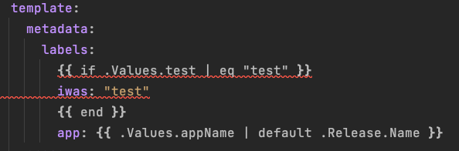
Helm – Chart – Flow Control If-Else
Notes:
Description about our chart

Slide 8
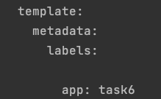
Helm – Chart – Flow Control If-Else
Notes:
Description about our chart

Slide 9
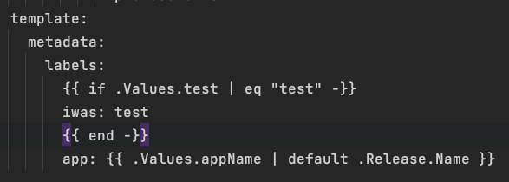
Helm – Chart – Minus
Add a minus two remove whitespaces
Notes:
Description about our chart

Slide 10
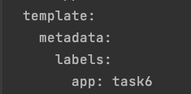
Helm – Chart –Result Yaml
Notes:
Description about our chart

Slide 11
Helm – Chart
Practice 6
Notes:
Description about our chart

Slide 12
Helm – Chart – Flow Control With
With is used like a foreach loop
Notes:
Description about our chart

Slide 13
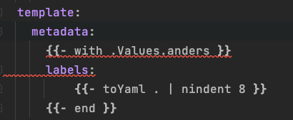
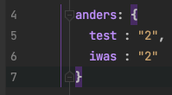
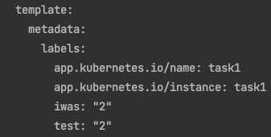
Helm – Chart – Flow Control With
values.yaml
template
Result.yaml
Notes:
Description about our chart

Slide 14
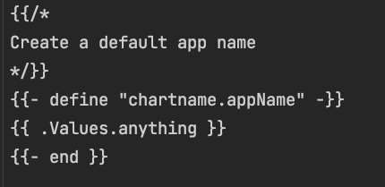
Helm – Chart – Templating define blocks
helper.tpl
deplyoment.yaml
Notes:
Description about our chart

Slide 15


Helm – Chart – Tests
Folder
Test-connection.yaml
Helm cli

Slide 16
Helm – Chart
Practice 8
Notes:
Description about our chart

Slide 17
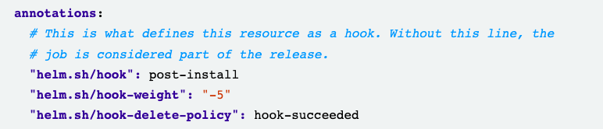
Helm – Chart – Hooks
Implement some time dependency in the creation of our kubernetes resources
Set with annotations
Deployment.yaml

Slide 18
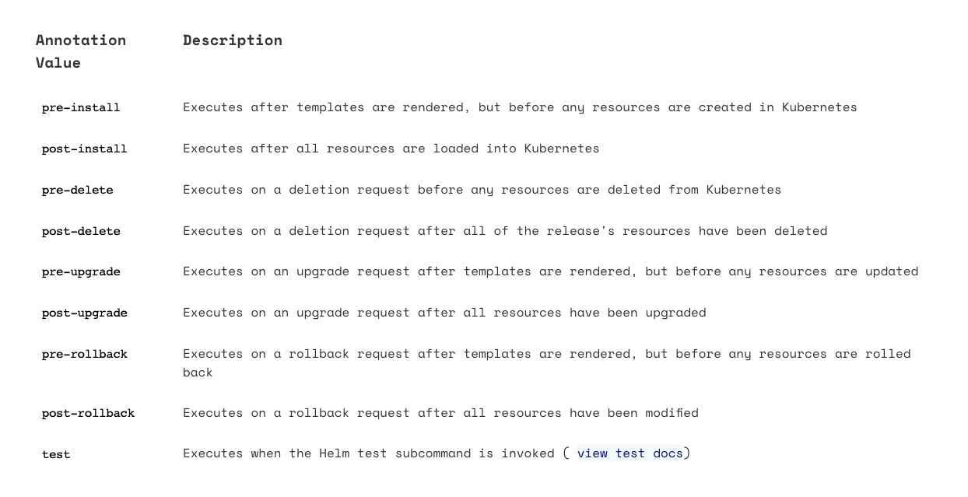
Helm – Chart – Hooks

Slide 19
Helm – Chart
Practice 9
Notes:
Description about our chart

