Slide 1
Helm The package manager for Kubernetes
From zero to hero
Daniel Hasselwander

Slide 2


Goals for this session
Use Template files
Types of charts

Slide 3
Helm – Chart – Template Files .tpl
Can create template files to exclude logic from your kubernetes template ressources
Like Functions
Notes:
Description about our chart

Slide 4
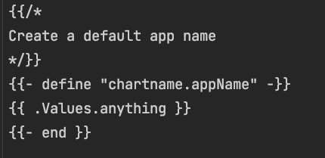
Helm – Chart – Template Files .tpl
helper.tpl
deplyoment.yaml
Notes:
Description about our chart

Slide 5
Helm – Chart - Types
Application Chart
=
1 Application
Umbrella Chart
=
X Applications
Library Chart
=
Contains Helper Code
Must be a dependency of a other chart
App
App
SQL-DB
App
Lib
Notes:
CLI chart = Templates Files
Local chart development
Managing repositories
Managing releases
Interfacing with the Helm library
Sending charts to be installed
Requesting upgrading or uninstalling of existing releases

Slide 6
Helm – Umbrella Example
Umbrella Chart
=
X Applications
Can also update the values of it´s subcharts
App
Nginx
Notes:
CLI chart = Templates Files
Local chart development
Managing repositories
Managing releases
Interfacing with the Helm library
Sending charts to be installed
Requesting upgrading or uninstalling of existing releases

Slide 7

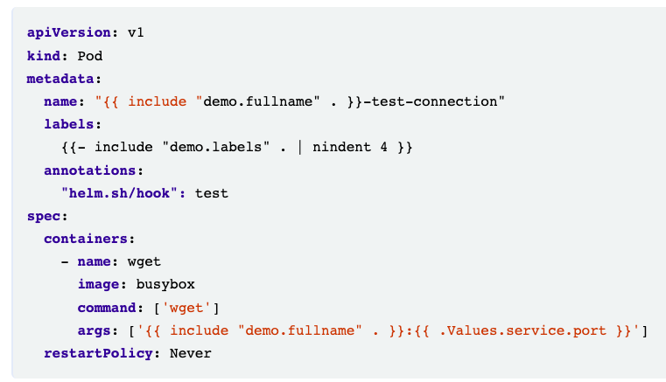
Helm – Chart – Tests
Folder
Test-connection.yaml

Slide 8

Helm – Chart – Tests
Folder
Test-connection.yaml
Helm cli

Slide 9
Helm – Chart – Tests
Helm cli

Slide 10
Helm – Chart – Tests –Plugin Advanced
Not for today
helm-unittest/helm-unittest: BDD styled unit test framework for Kubernetes Helm charts as a Helm plugin. (github.com)

Slide 11
Helm – Chart
Practice 8
Notes:
Description about our chart

Slide 12
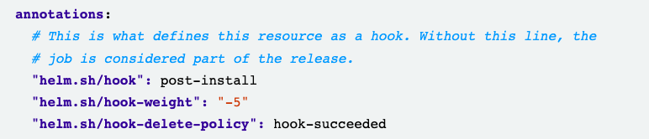
Helm – Chart – Hooks
Implement some time dependency in the creation of our kubernetes resources
Set with annotations
Deployment.yaml

Slide 13
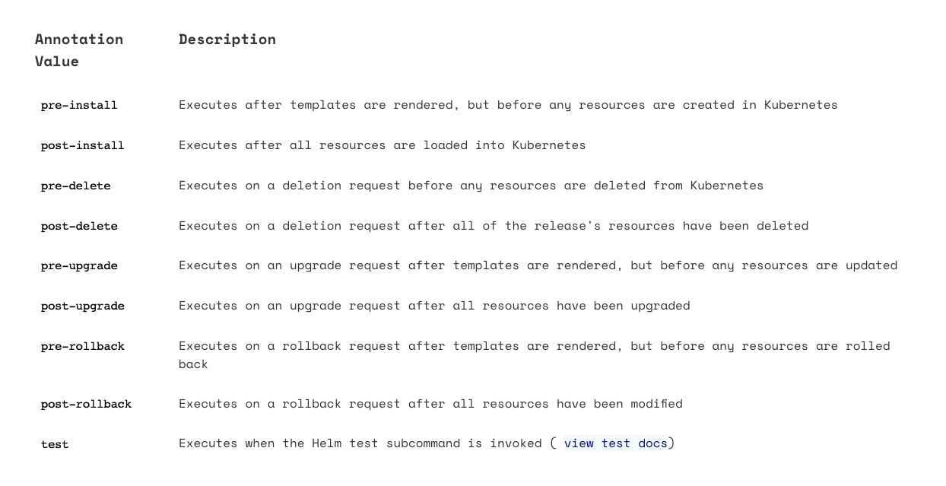
Helm – Chart – Hooks

Slide 14
Helm – Chart
Practice 9
Notes:
Description about our chart

