Slide 1
Helm The package manager for Kubernetes
From zero to hero
Daniel Hasselwander

Slide 2


Goals for this session
Use functions
Use pipelines

Slide 3

Helm –Functions
Functions can use for logical implementation in your templates
Structure = {{ function inputForFunction }}
https://helm.sh/docs/chart_template_guide/function_list/
Notes:
Description about our chart

Slide 4

Helm –Pipelines
Every function can use as a pipeline
Inspired from bash
If the function need only one argument than the left value is the functionInput. If it is need two than the left value is the first input
Structure = {{ value | function functionInput }}
Notes:
Description about our chart

Slide 5

Helm – My Mention
Use on method of then
See mostly more pipelines then function
Function
Pipeline
Notes:
Description about our chart

Slide 6
Helm – Practice 5
Notes:
Description about our chart

Slide 7
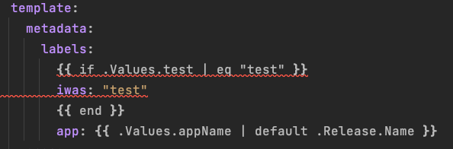
Helm – Chart – Flow Control If-Else
Notes:
Description about our chart

Slide 8
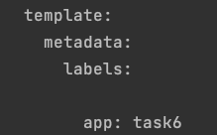
Helm – Chart – Flow Control If-Else
Notes:
Description about our chart

Slide 9
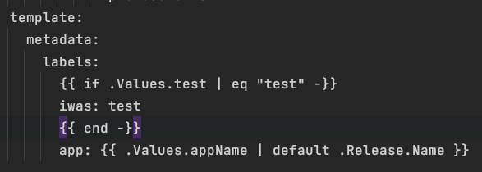
Helm – Chart – Minus
Add a minus two remove whitespaces
Notes:
Description about our chart

Slide 10
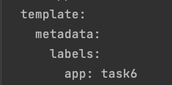
Helm – Chart –Result Yaml
Notes:
Description about our chart

Slide 11
Helm – Chart
Practice 6
Notes:
Description about our chart

Slide 12
Helm – Chart – Flow Control With
With is used like a foreach loop
Notes:
Description about our chart

Slide 13
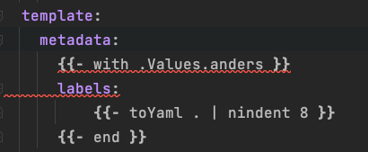
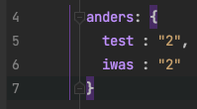
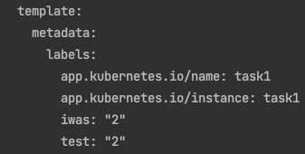
Helm – Chart – Flow Control With
values.yaml
template
Result.yaml
Notes:
Description about our chart

Slide 14
Helm – Chart
Practice Task with Challenge
Notes:
Description about our chart

