Slide 1
Helm The package manager for Kubernetes
From zero to hero
Daniel Hasselwander

Slide 2


Goals for this session
First steps with helm cli
Where you can find helm charts

Slide 3
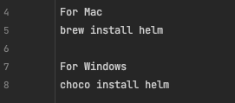
Helm
Install it with a package manager

Slide 4
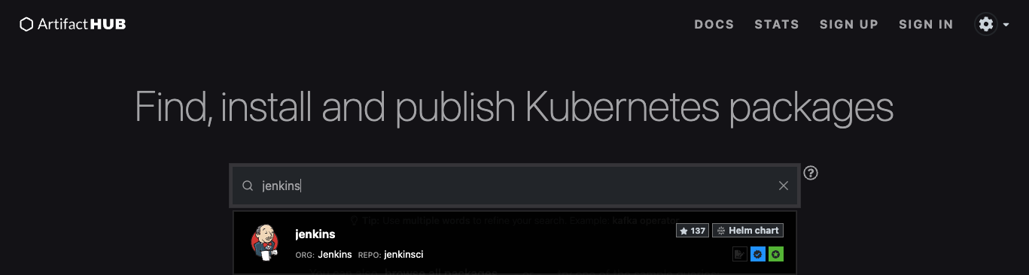


Try it! Install a Helm Chart in your cluster
Search at the artifact hub
Add Repo
Install a Chart

Slide 5
Try it! Check the status of your release
Check Status
Upgrade a release to a specific version
Rollback to the previous Release

Slide 6
Work with Helm – Practice - Time
Notes:
Helm and Logo
Package Manager for Kubernetes like Package manager Npm, nuget etc.
Maintaned by Helm Community
2 Parts Client Software and Library
The Helm Library provides the logic for executing all Helm operations. It interfaces with the Kubernetes API server and provides the following capability:
Combining a chart and configuration to build a release
Installing charts into Kubernetes, and providing the subsequent release object
Upgrading and uninstalling charts by interacting with Kubernetes
The standalone Helm library encapsulates the Helm logic so that it can be leveraged by different clients.
Client command-line client for end users
Local chart development
Managing repositories
Managing releases
Interfacing with the Helm library
Sending charts to be installed
Requesting upgrading or uninstalling of existing releases

