Slide 1
Helm The package manager for Kubernetes
From zero to hero
Daniel Hasselwander

Slide 2


Goals for this session
Write your own helm chart
Use functions

Slide 3
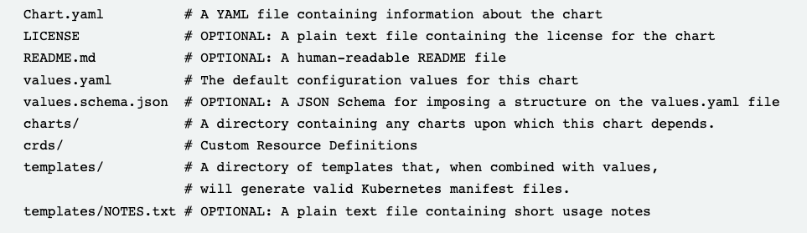
Helm – Chart – Folder Structure
Helm uses a packaging format called charts
Notes:
CLI chart = Templates Files
Local chart development
Managing repositories
Managing releases
Interfacing with the Helm library
Sending charts to be installed
Requesting upgrading or uninstalling of existing releases

Slide 4

Helm – Chart –First Chart
Create structure of a helm chart
Notes:
CLI chart = Templates Files
Local chart development
Managing repositories
Managing releases
Interfacing with the Helm library
Sending charts to be installed
Requesting upgrading or uninstalling of existing releases

Slide 5
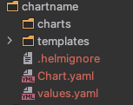
Helm – Chart – Folder Structure
Notes:
Create template with nginx

Slide 6
Helm – Chart – Folder Structure
Create structure of a helm chart
Change the folder and switch into the chart folder
Install the helm chart from your local folder
Notes:
CLI chart = Templates Files
Local chart development
Managing repositories
Managing releases
Interfacing with the Helm library
Sending charts to be installed
Requesting upgrading or uninstalling of existing releases

Slide 7
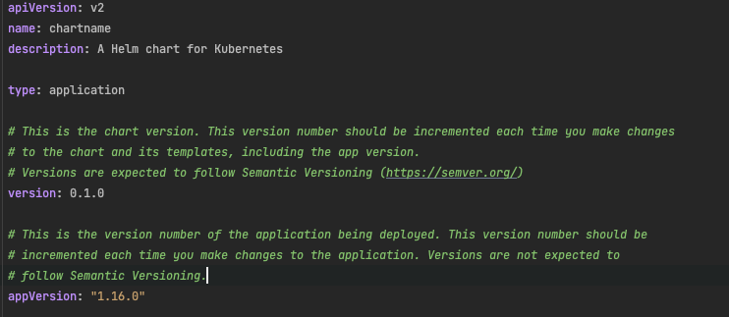
Helm – Chart – Chart.yaml
Helm uses a packaging format called charts
Notes:
Description about our chart

Slide 8
Helm – Chart
Example 1
Notes:
Description about our chart

Slide 9

Helm – Chart – Templating
Values.yaml
deployment.yaml
Notes:
Description about our chart

Slide 10
Helm – Chart – Built In Objects
Objects are passed into a template from the template engine
Values
Files
Capabilities …
https://helm.sh/docs/chart_template_guide/builtin_objects/#helm
Notes:
Description about our chart

Slide 11
Helm – Chart
Practice 3 & 4
Notes:
Description about our chart

Slide 12


Helm – Chart – Functions and Pipelines
Functions can use for actions
Functions can be used as a pipeline
https://helm.sh/docs/chart_template_guide/function_list/
Notes:
Description about our chart

Slide 13
Helm – Chart
Practice 5 & 6
Notes:
Description about our chart

Slide 14
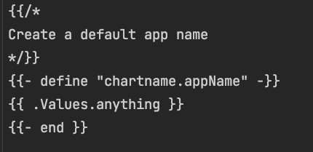
Helm – Chart – Templating define blocks
helper.tpl
deplyoment.yaml
Notes:
Description about our chart

Slide 15
Helm – Chart
Practice 7
Notes:
Description about our chart

Slide 16


Helm – Chart – Tests
Folder
Test-connection.yaml
Helm cli

Slide 17
Helm – Chart
Practice 8
Notes:
Description about our chart

Slide 18
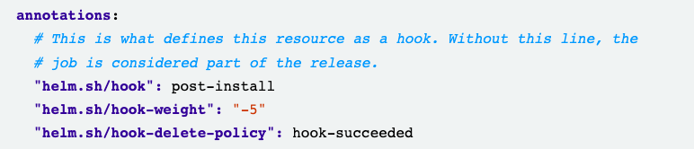
Helm – Chart – Hooks
Implement some time dependency in the creation of our kubernetes resources
Set with annotations
Deployment.yaml

Slide 19
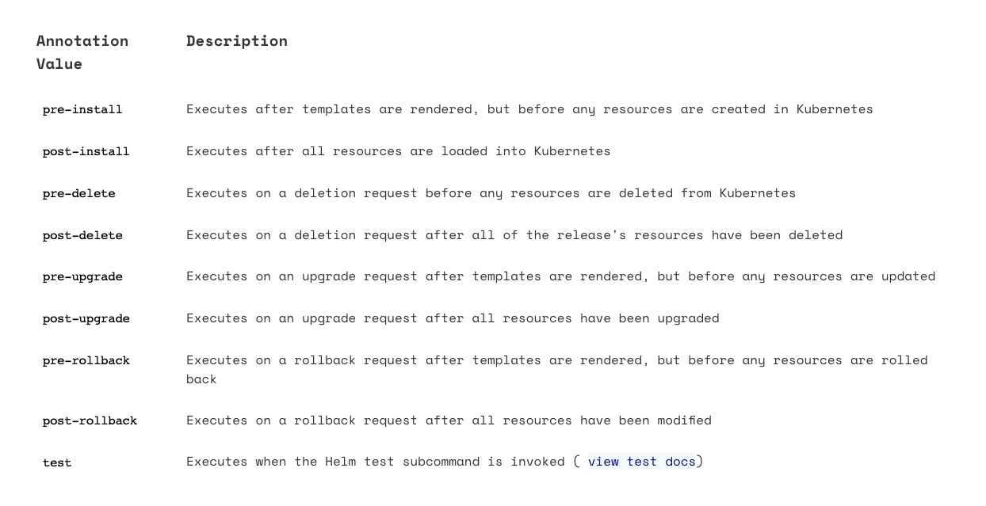
Helm – Chart – Hooks

Slide 20
Helm – Chart – Hooks

Slide 21
Helm – Chart
Practice 9
Notes:
Description about our chart

