Slide 1
Infrastructure as Code
From zero to hero
Daniel Hasselwander

Slide 2


Goals for this session
Understand how to integrate azuread provider
Understand how to use random provider

Slide 3
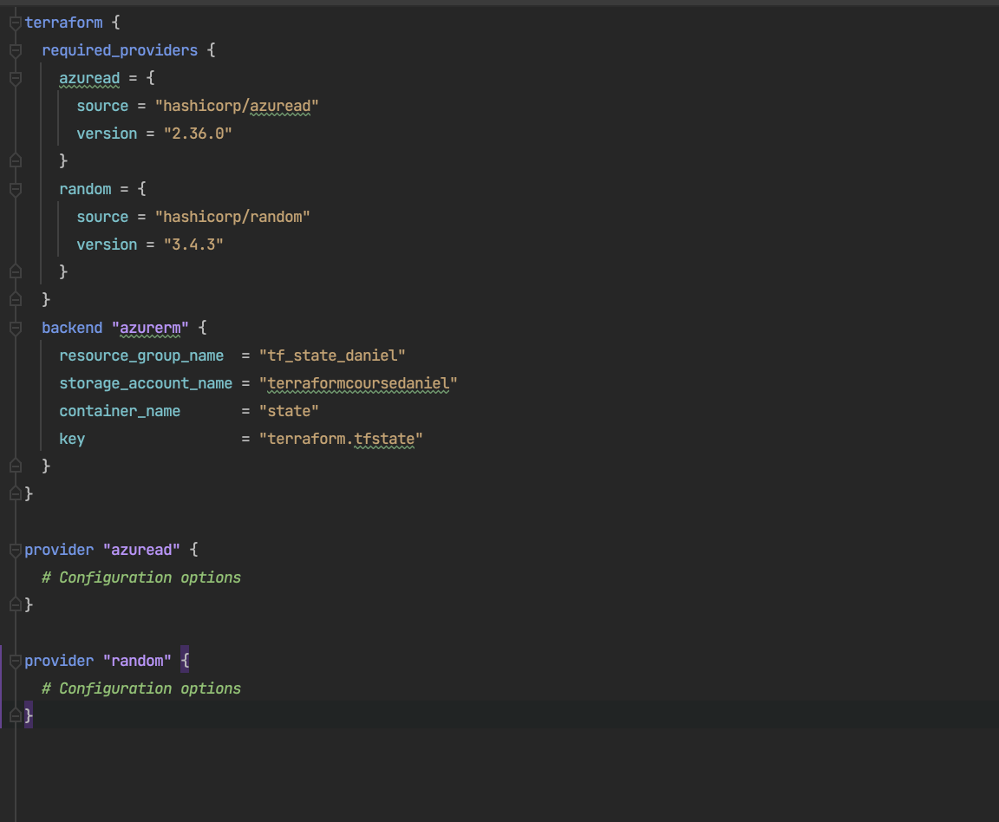
How to integrate random and azuread provider?

Slide 4
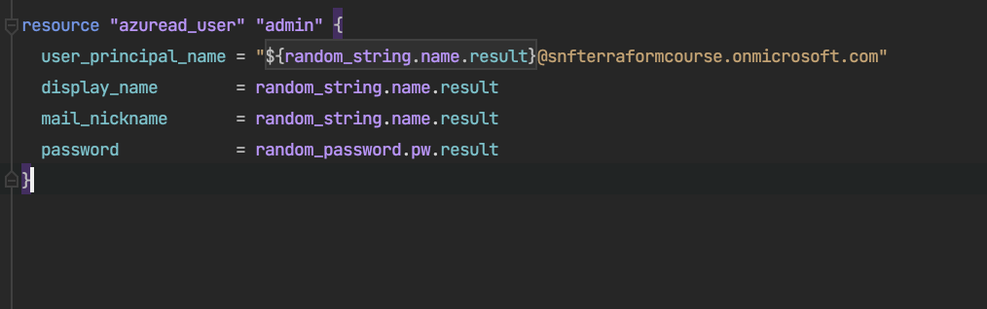
How to create a user in our tenant?
Write the ressource to your main.tf

Slide 5
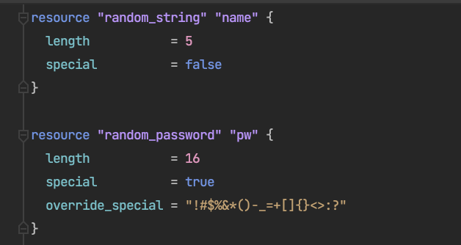
How to generate random things?
Write the ressource to your main.tf

Slide 6
Practice07
Practice08

Slide 7
Practice06

