Slide 1
Infrastructure as Code
From zero to hero
Daniel Hasselwander

Slide 2


Goals for this session
Understand how to import existing ressource into your terraform state
Understand how to destroy every ressource

Slide 3
How to destroy your ressource?
Execute the destroy command
terraform apply -destroy

Slide 4
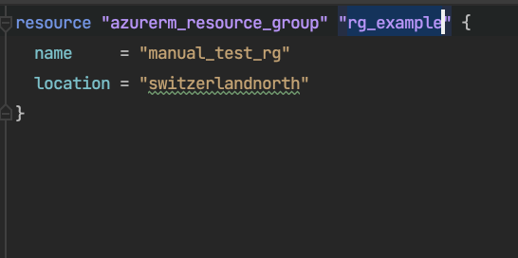
How to Import a ressource?
Write the ressource to your main.tf
Execute the import command

Slide 5
Practice07
Practice08

Slide 6
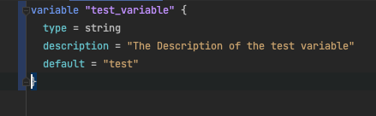
Variable Structure
Keyword
Name of variable
Properties
Types and Values - Configuration Language | Terraform | HashiCorp Developer

Slide 7
Cli Command for injection
- Add Cli Option to your plan and apply command

Slide 8
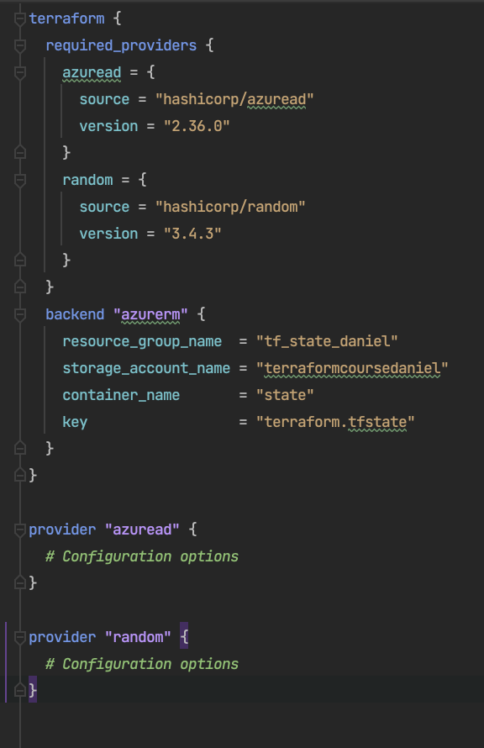
How to use it in your files

Slide 9
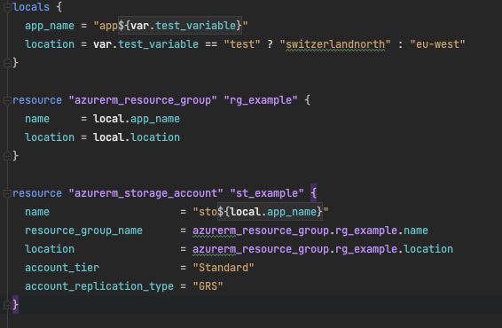
local variables
Write it to your main.tf

Slide 10
Practice06

