Slide 1
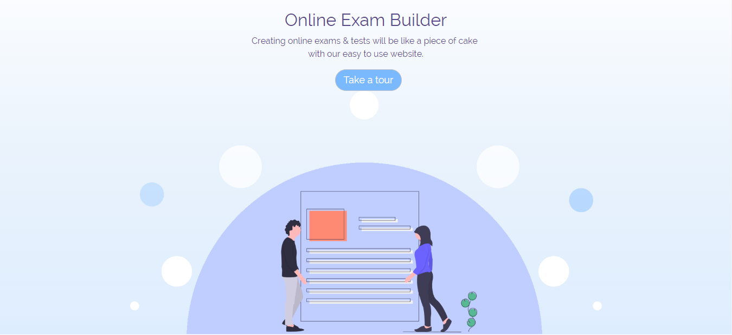
EXAMICA

Slide 2
Team Members
Omar Zayed (Team Leader)
Aya ElNahas
Dina Gamal
Fatma Alaa
Hassnaa Ayman
Sara Elsayed

Slide 3
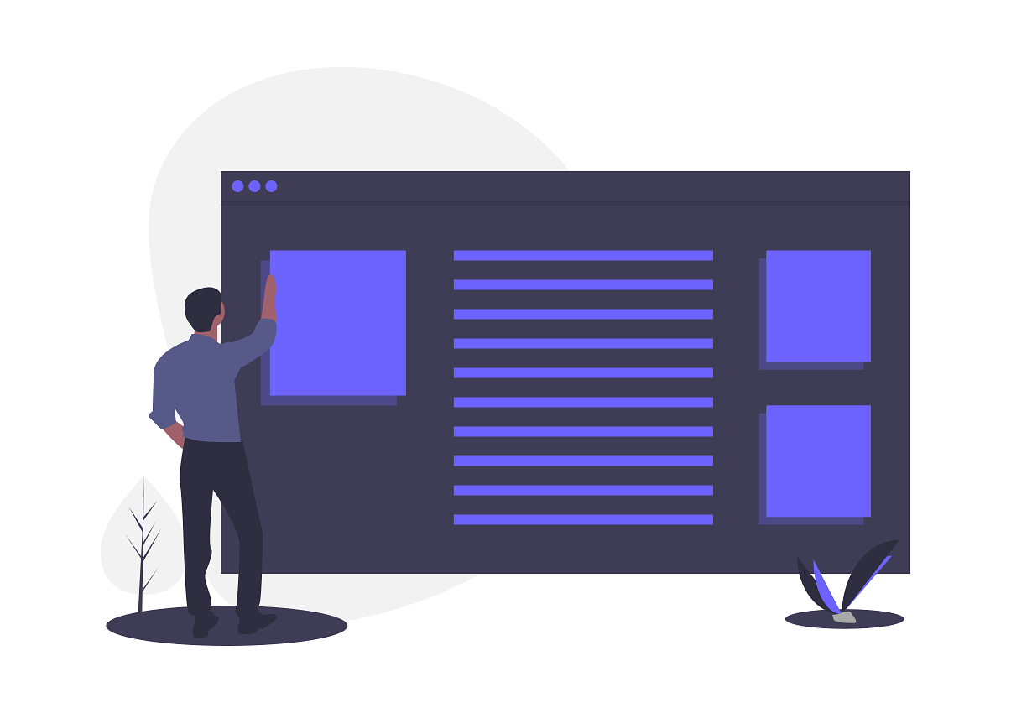
Problem!
As exams are an essential part of the educational process
Big number of examinees (High school, admission system- ITI, technical test for jobs)
Appearance of human factor
Drop happened in the high school system
Opportunity!
Technologies are being dominant
Using AI in system adaptation (TOEFL)
Scalability

Slide 4
Competitors
MyQTest
Easy LMS
Pros
Multiple Question Types
Questions Bank
Cons
Not user friendly
Hard to navigate
http://www.myqtest.com/web/Contact.html
https://www.onlineexambuilder.com/

Slide 5
Solution
The project will help create exams with all types of questions.
Will be a good solution for testing a patch of users at once.
Will generate reports for evaluation.
Will automatically correct the exams which will eliminate human factor as much as possible.
Save time and effort.
User friendly.

Slide 6
What is Examica?
It’s a software service that enables you as an organization to easily setup a customized exam with multiple question types and invite the users you want to test to take it, it also auto correct the exams for you and hands out endless number of certificates.

Slide 7
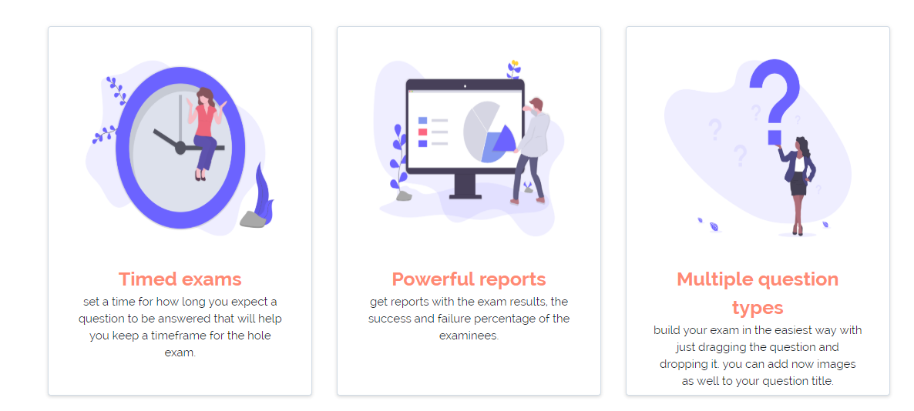
Features

Slide 8
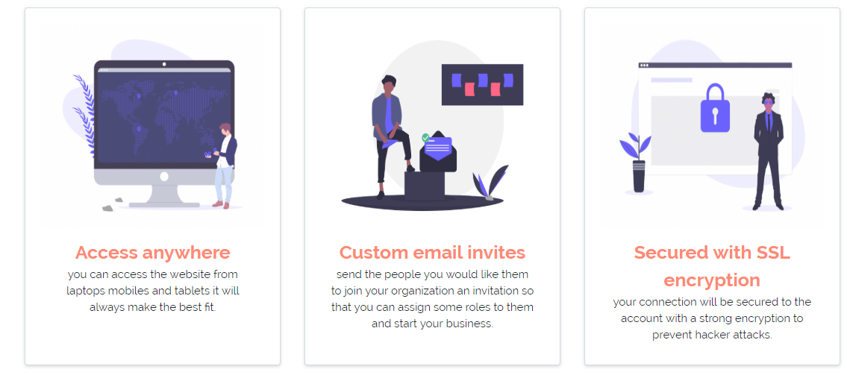
Continue features..

Slide 9
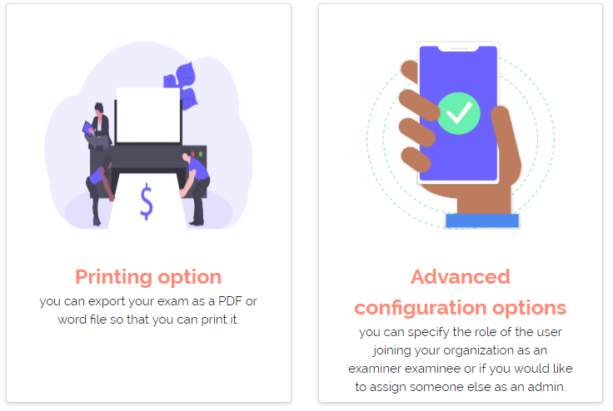
Continue features..

Slide 10

Scenarios
Anonymous
Logged-In User

Slide 11
Anonymous User
Navigate in public pages
Free trial
Sign up first

Slide 12
Logged-In User
Owner
Register one or more organizations.
Assign roles.
Examiner
Add exams.
Examinee
Take exams.
Edit his profile.
Admin
Assign roles except for owner
Edit organization details.
Add questions to the pool.

Slide 13
TEAMWORK SUMMARY

Slide 14

TEAMWORK
Defining requirements:
Dividing application into features:
Creating GitHub repositories:
Contains two branches (Backend and Frontend)
Working by feature:
Testing the final output:
After finishing we tested all functionalities manually for all possible end-user scenarios and handling weird cases.

Slide 15
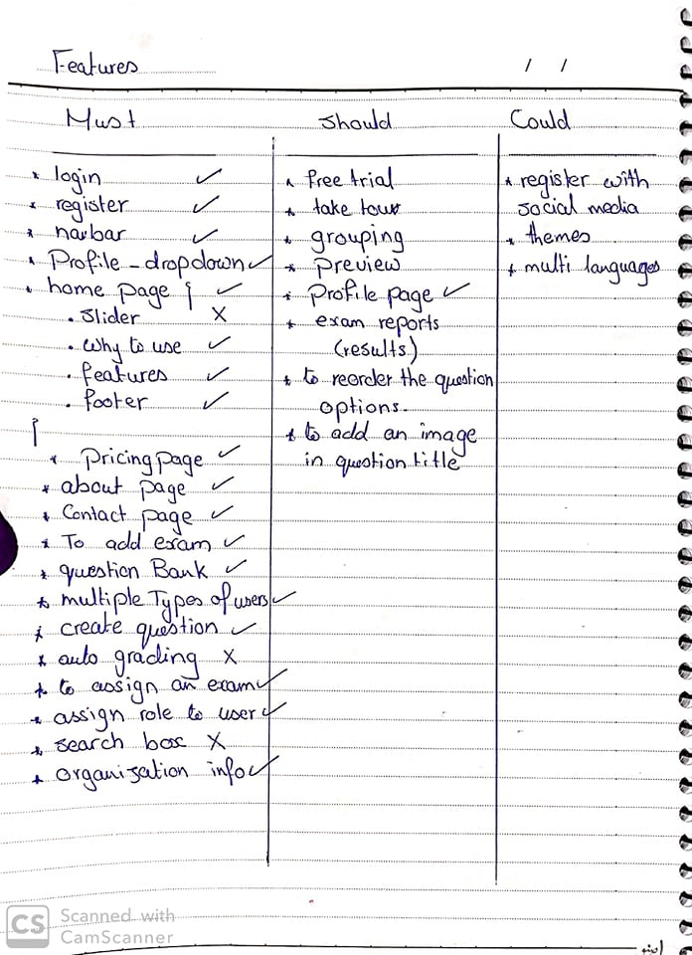

Slide 16
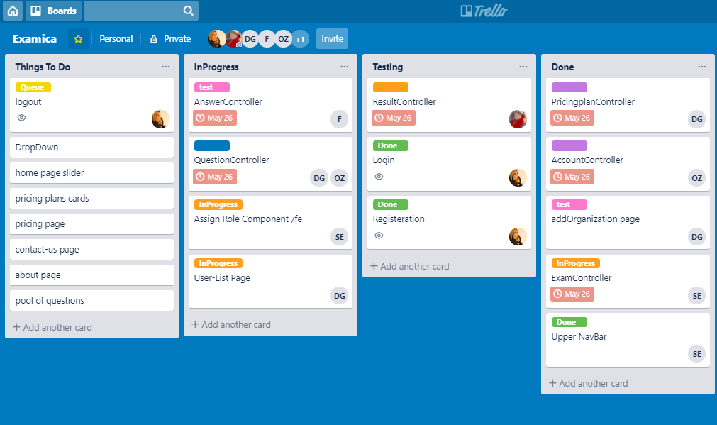
Trello

Slide 17


TECHNICAL DESIGN
Back End
Structure:
Project is separated into 2 parts Model and API to leverage usability and OOP.
Design/Architectural Pattern:
Model: Repository with Unit Of Work DP
API: ASP .NET Core API
Front End
React JS:
Create React App (CRA).
React Router Dom.
Element UI.

Slide 18



USED TOOLS
Development Tools:
Visual Studio 2017
SQL Server Management Studio
Visual Studio Code
For Communications:
GitHub
Zoom Meeting
Trello (Agile)

Slide 19
AREAS OF ENHANCEMENTS
Add more question types with images titles along with texts.
Generate Reports.
Auto generated exams with random questions.
Add Observer role to correct the essay questions.

Slide 20


Slide 21


