Slide 1
ALIBABA CLOUD AI HACKATHON PAKISTAN 2026
Karobaar AI
Financial evidence from the business records merchants already create
Financial Inclusion track
Voice and receipts become merchant-confirmed records, grounded answers and financing next steps.
TEAM KAROBAAR AI
Notes:
Project sources: Project Github/README.md and context/KAROBAAR_AI_FROM_SCRATCH_CONTEXT.md.

Slide 2
KAROBAAR AI
02
Presentation overview
01
Problem and audience
04
Need and impact
Where everyday business evidence gets lost
How evidence improves financial conversations
02
Karobaar solution
05
Innovation and technology
How activity becomes a trusted ledger
Why the numbers remain trustworthy
03
Product experience
06
Feasibility and roadmap
What the merchant can do today
What works now and what comes next
Alibaba Cloud AI Hackathon Pakistan 2026
Notes:
The structure follows the judging criteria supplied by the hackathon organizers.

Slide 3
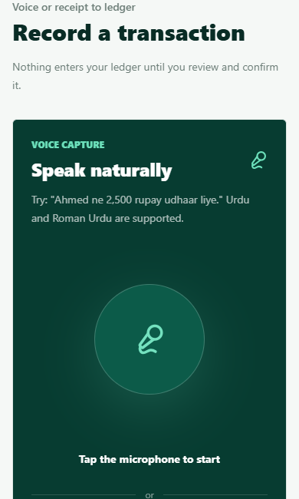
KAROBAAR AI
03
The gap in everyday business records
Small merchants already create useful financial activity every day. Much of it remains in memory, paper receipts and informal conversations.
Who this affects
Kiryana stores, tailors, mechanics and other owner-operated businesses
Merchants who use Urdu or Roman Urdu more comfortably than accounting software
Businesses that need clearer evidence when speaking with a lender
Alibaba Cloud AI Hackathon Pakistan 2026
Notes:
Source: context/KAROBAAR_AI_FROM_SCRATCH_CONTEXT.md. The audience examples come from the project definition; no market-size statistic is claimed.

Slide 4
KAROBAAR AI
04
The Karobaar solution
AI captures and explains. Deterministic ledger logic computes every number.
1
2
3
4
5
Capture
Review
Confirm
Understand
Act
Voice note or receipt
Merchant corrects the draft
Trusted event enters the ledger
Dashboard and grounded answers
Evidence and reminder draft
The result remains evidence for a financing conversation. The financing institution makes the decision.
Alibaba Cloud AI Hackathon Pakistan 2026
Notes:
Source: Project Github/README.md and Backend/README.md. Karobaar does not issue credit scores or approve financing.

Slide 5
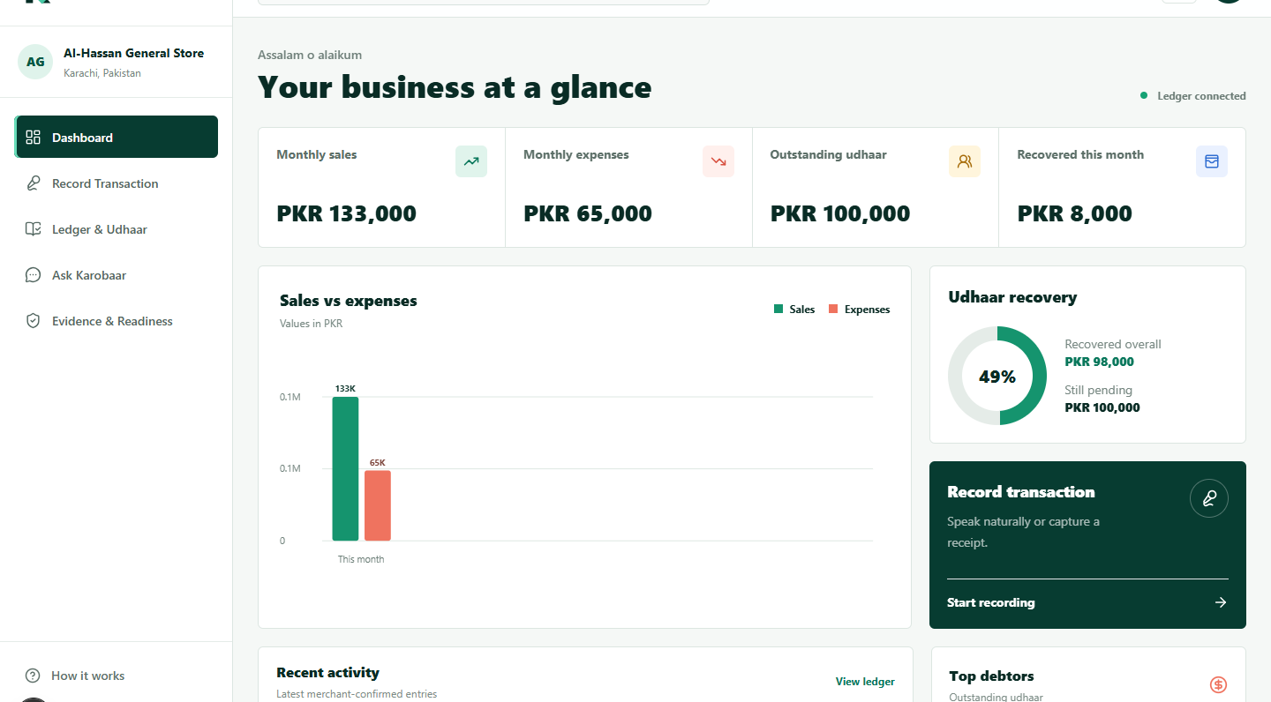
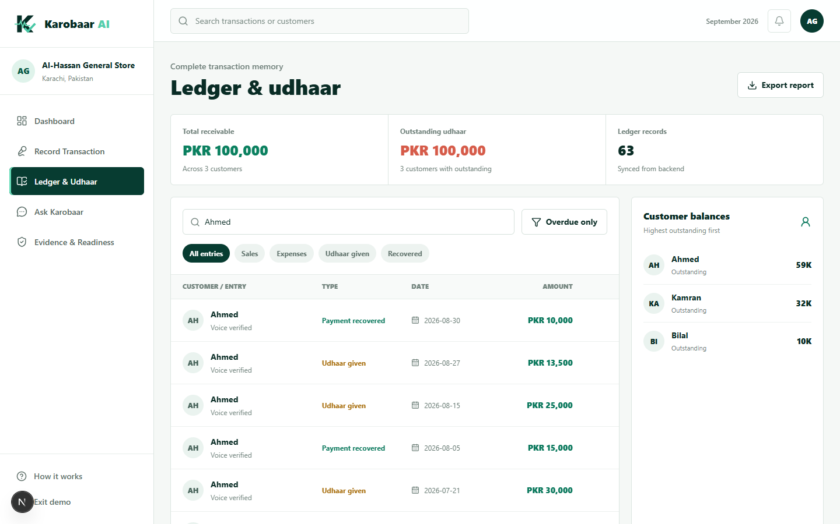
KAROBAAR AI
05
A working merchant journey
The dashboard summarizes confirmed activity
The ledger stays searchable
In the seeded demo
63
confirmed records across four months
Alibaba Cloud AI Hackathon Pakistan 2026
Notes:
Screenshots captured from the running local application on 7 September 2026. Seed data contains 63 confirmed records across four months.

Slide 6
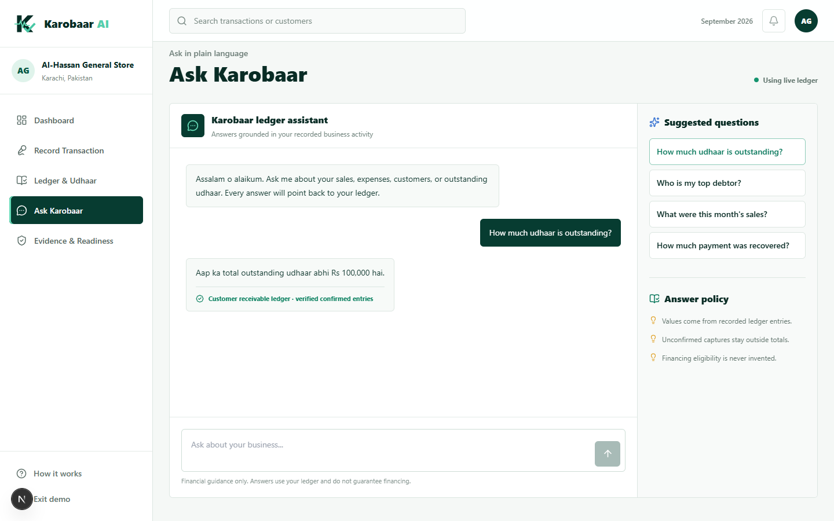
KAROBAAR AI
06
Need and expected impact
A merchant gains
01
A clear view of sales, expenses and udhaar without accounting terminology
02
A source-linked business history that grows through normal daily activity
03
A more informed financing conversation based on published requirements
Karobaar supports the conversation. It does not replace lender checks.
Alibaba Cloud AI Hackathon Pakistan 2026
Notes:
Source: product implementation and context/KAROBAAR_AI_FROM_SCRATCH_CONTEXT.md. Impact statements describe the product mechanism, not measured field outcomes.

Slide 7
KAROBAAR AI
07
Innovation and technology
Trust comes from the boundary between AI and financial truth
Merchant experience
Next.js 16, React 19, responsive voice and receipt workflow
Design decisions
The model produces reviewable drafts instead of authoritative records
Five supported Ask tools retrieve numbers from the ledger
Evidence remains qualitative and explains every gap
Receipt files require an authenticated ownership check
AI interpretation
Groq first, Gemini fallback, deterministic demo provider
Trusted domain layer
Merchant confirmation, integer paisa, FIFO udhaar settlement
Data and identity
FastAPI, SQLAlchemy, verified Supabase identity, merchant scoping
The demo remains usable without external AI credentials through a deterministic fallback.
Alibaba Cloud AI Hackathon Pakistan 2026
Notes:
Technical sources: Project Github/Backend/README.md, app/auth.py, app/services/ledger.py and app/ai. The architecture reflects the current repository.

Slide 8
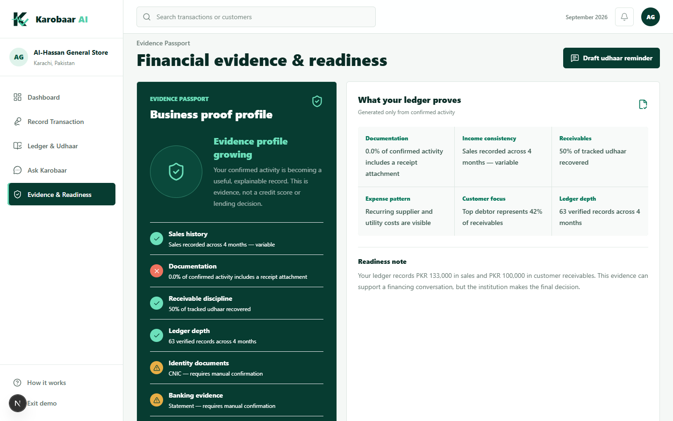
KAROBAAR AI
08
What we have actually built
5
working product surfaces
5
source-backed financing programs
74
automated backend tests passing
0
production dependency vulnerabilities
Verified locally on desktop and mobile. The frontend production build and complete merchant journey pass.
Alibaba Cloud AI Hackathon Pakistan 2026
Notes:
Verification performed on 7 September 2026: 74 backend tests, frontend production build, production npm audit, and desktop/mobile browser journeys. Financing sources: https://pmybals.pmyp.gov.pk/ ; https://akhuwat.org.pk/programs/loan/products ; https://www.bop.com.pk/BOPEBusinessQarza ; https://www.meezanbank.com/sme-banking/ ; https://www.hbl.com/business/sme-banking/sme-banking/hbl-small-business-finance

Slide 9
KAROBAAR AI
09
Roadmap
Submission ready
Next stage
Complete capture, confirmation, ledger and Ask flow
Responsive product interface and deterministic demo data
Secure merchant boundaries and protected evidence files
Persistent PostgreSQL and managed receipt storage
Rate limits, file lifecycle controls and production monitoring
Pilot feedback from merchants and financing partners
Karobaar turns everyday business activity into evidence a merchant can understand and use.
TEAM KAROBAAR AI
Notes:
Roadmap items are future work and are not presented as completed capabilities.

