Slide 1
An introduction to 3D web programming
Hastings Hackers Meetup

Slide 2
About Me
Gareth Marland (@garethmarland)
From Stafford
Spent 10 years living in North America
Work mainly against Autodesk Revit Server

Slide 3




Slide 4
Moving from 2D to 3D
Traditional 2D web development is like creating a shareable document
3D web development is like creating a shareable movie scene

Slide 5
Creating your scene
The light source
The camera
The renderer

Slide 6
Example 1

Slide 7
The light source
Ambient Light
Applies a light globally. To every object in the scene
Point Light
Shines light in all directions and lights up anything that is in range
Directional Light
The most commonly used lighting
Works like a spotlight, in a position and shines in a direction

Slide 8
Light source examples
Ambient Light
var ambLight = new THREE.AmbientLight(0x404040);
scene.add(ambLight);
Point Light
var pointLight = new THREE.PointLight(0x0033ff, 3, 150);
pointLight.position.set(70, 5, 70);
scene.add(pointLight);
Directional Light
var dirLight = new THREE.DirectionalLight(0xffffff, 1);
dirLight.position.set(100, 100, 50);
scene.add(dirLight);

Slide 9
The camera
Orthographic Camera
Does not take a objects distance from the camera into account when drawing
Created with top, bottom, left, right, near and far
Perspective Camera
The most commonly used
Takes an objects distance from he camera into account
Created with fov, aspect ratio, near and far

Slide 10
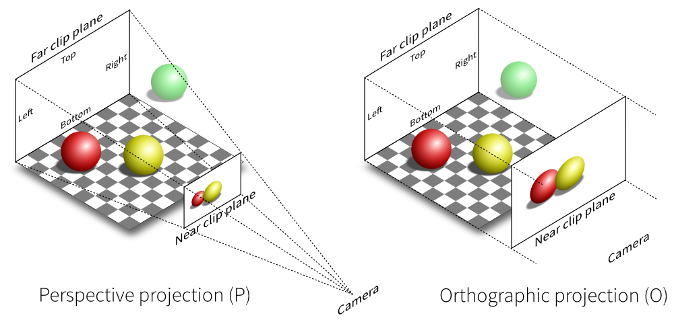
The camera

Slide 11
The renderer
Draws the scene
Can be set up to loop in order to animate
Needs to be attached to an HTML element
var renderer = new THREE.WebGLRenderer({ antialias: true });
renderer.setSize(containerWidth, containerHeight);
document.getElementById(“container”).appendChild(renderer.domElement);
var renderScene = function () {
requestAnimationFrame( renderScene );
renderer.render(scene, camera);
};
renderScene();

Slide 12
Putting it together
var scene = new THREE.Scene();
var camera = new THREE.PerspectiveCamera(75, containerWidth/containerHeight, 0.1, far);
scene.add(camera);
var pointLight = new THREE.PointLight(0xffffff, 1);
pointLight.position.set(0,5,5);
scene.add(pointLight);
var renderer = new THREE.WebGLRenderer({ antialias: true });
renderer.setSize(containerWidth, containerHeight);
document.getElementById(“container”).appendChild(renderer.domElement);
var renderScene = function () {
requestAnimationFrame( renderScene );
renderer.render(scene, camera);
};
renderScene();

Slide 13
Creating an object
Define the geometry
Use a predefined three.js object
Define your own vertices
Use a modelling tool
Define the material
Basic
Lambert
Phong
Custom
Create the mesh
Add it to the scene

Slide 14
Example 2

Slide 15
Animating an object
Should be updated within the rendering method
The rendering only needs to be called when a change needs to be made
var updateScene = function() {
// Do your updates to the object here
}
var renderScene = function () {
requestAnimationFrame( renderScene );
updateScene();
renderer.render(scene, camera);
};
renderScene();

Slide 16
Example 3

Slide 17
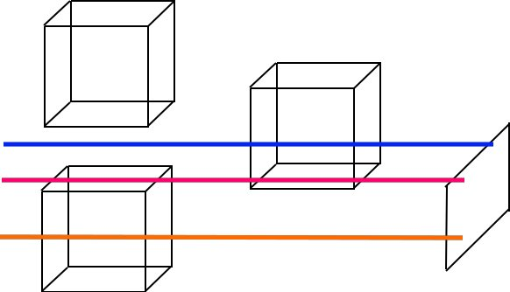
Selecting objects
Selecting needs to work differently in 3D
We using something called “raycasting”
It's basically shooting lazers in space and seeing what we hit!

Slide 18
Selecting objects example
var mousePosition = new THREE.Vector2();
mousePosition.x = 2 * (mouseEvent.x / renderer.domElement.clientWidth) - 1;
mousePosition.y = 1 - 2 * (mouseEvent.y / renderer.domElement.clientHeight );
var raycaster = new THREE.Raycaster();
raycaster.setFromCamera(mousePosition, camera);
var intersected = raycaster.intersectObject(scene, true);

Slide 19
Example 4

Slide 20
Controlling the camera
Bind the camera to a mouse event
Include a library such as OrbitControls.js

Slide 21
Example 5

Slide 22
Advantages of the medium
Can be opened in a browser
Can be mixed and matched with other web based technologies
Websockets
HTML Canvas
Fairly easy to understand

Slide 23
fin

