Slide 1
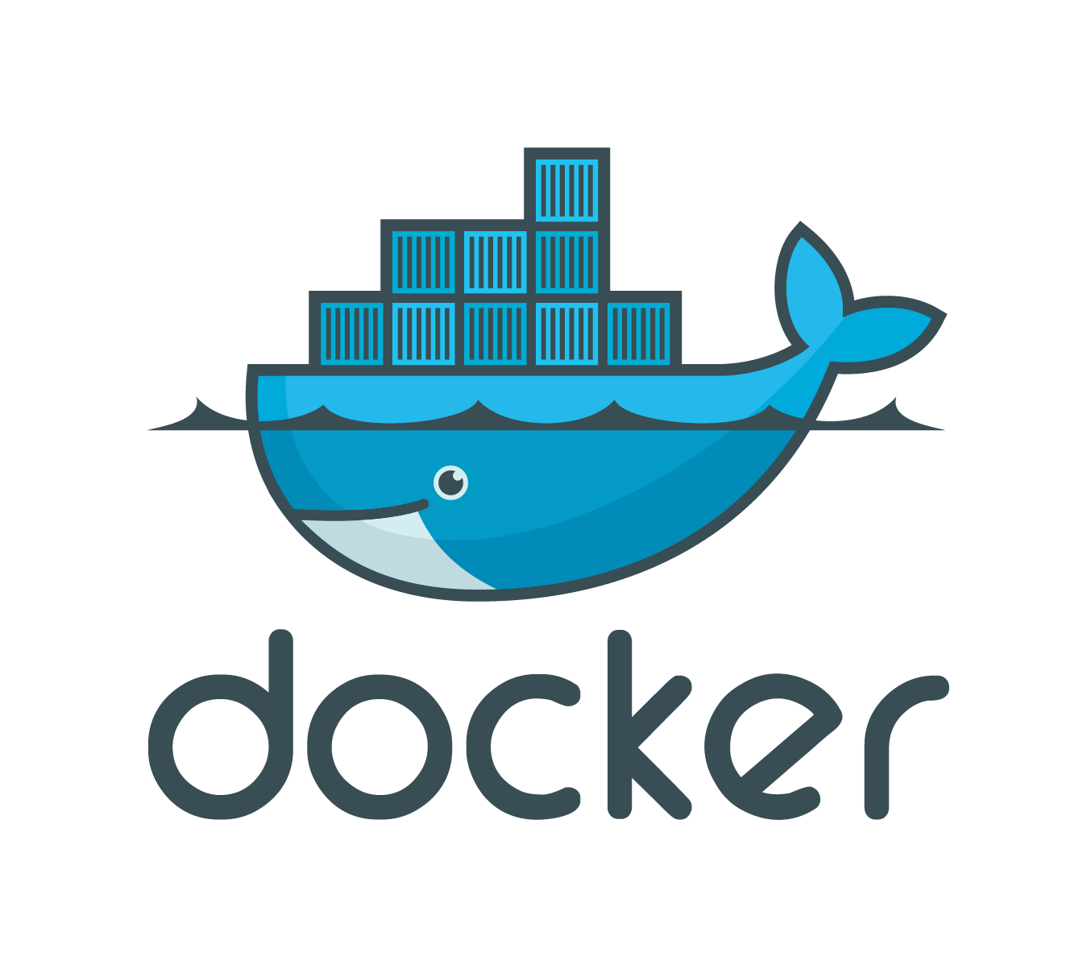

Intro to Docker … on Windows
Dr Jon Nicholson
Full-Stack Developer Assembly
Written for HastingsHackers 26-09-2018

Slide 2
I’ll try to answer:
What is Docker?
Why Containers over Virtual Machines?
But Linux containers on Windows?
How do I get a Docker and *nix tools dev environment in Windows?
How can I use Docker to fake Amazon S3?
But I am no expert!
Been using Docker for about 6 months
I’m still learning!

Slide 3
What is Docker?
Docker is a container platform to develop, deploy, and run applications
Containers are not new, but their use for easily deploying applications is
Increasingly popular because containers are:
Flexible: Even the most complex applications can be containerized
Lightweight: Containers leverage and share the host kernel
Interchangeable: You can deploy updates and upgrades on-the-fly
Portable: You can build locally, deploy to the cloud, and run anywhere
Scalable: You can increase and automatically distribute container replicas
Stackable: You can stack services vertically and on-the-fly
https://docs.docker.com/get-started/

Slide 4
Some terminology
An image is an executable package
Includes everything needed to run an application--the code, a runtime, libraries, environment variables, and configuration files
A container is a runtime instance of an image
I.e. the image in memory with state
A volume is mounted data available to the container
Independent of the image, so data can be retained between rebuilds

Slide 5
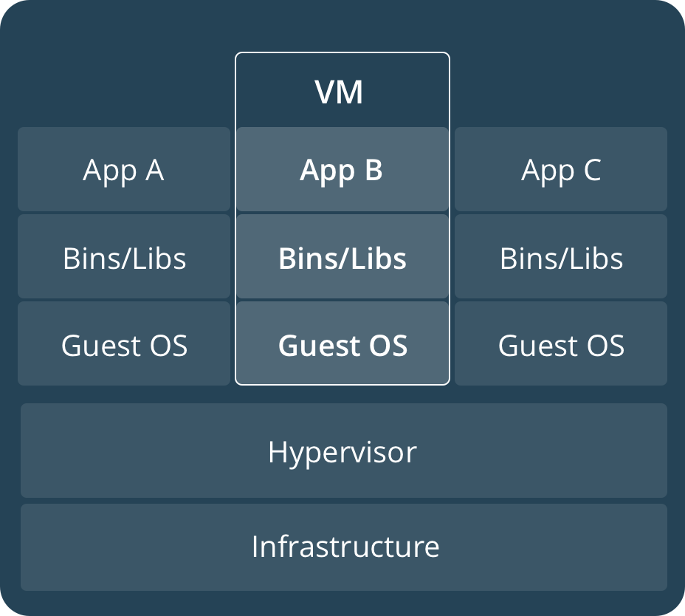
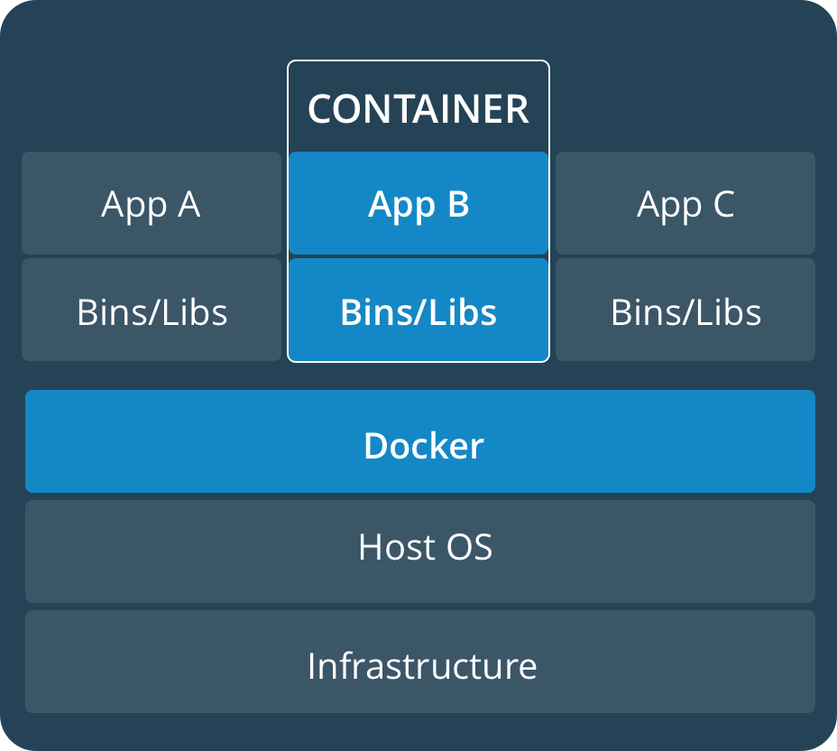
Why Containers over Virtual Machines?
Primarily: performance
Containers only use the resources the app needs, making them very lightweight

Slide 6
But Linux containers on Windows?
Infrastructure
Hypervisor (Hyper-V)
Windows
MobyLinuxVm
Bins/Libs
Bins/Libs
Bins/Libs
App A
App B
Dev tools
Moby Linux is very lightweight, but still it’s not as ideal as running Docker on Linux/Mac

Slide 7
How do I get a Docker and *nix tools dev environment in Windows?
AKA What the fuck is the Windows Subsystem for Linux (WSL)?
From the Wiki:
WSL provides a Linux-compatible kernel interface
Developed by Microsoft, and contains no Linux kernel code
Can run a GNU user space on top of it, such as Ubuntu
Gives Windows users access to native GNU/Linux tools
It can be considered as the Wine counterpart
Unfortunately we can’t install Linux Docker into WSL (yet?)
But we can make the Linux Docker tools talk to Windows Docker
The best of both worlds! Well, better than running Windows in a VM anyway!
https://en.wikipedia.org/wiki/Windows_Subsystem_for_Linux

Slide 8
How do I get a Docker and *nix tools dev environment in Windows?
Very broadly the steps are to:
Install necessary Windows components
Install Docker for Windows and configure it
Install a Linux distro (e.g. Ubunutu) and set it up
Install Docker Compose into WSL and make it point at the engine running in windows
Run some stuff
I’ve tried to script a lot of this…

Slide 9
Install necessary Windows components
Main Windows features
Write-Host "Enabling windows features..."
Enable-WindowsOptionalFeature -Online -FeatureName Containers
Enable-WindowsOptionalFeature -Online -FeatureName Microsoft-Hyper-V-All
Enable-WindowsOptionalFeature -Online -FeatureName HypervisorPlatform
Enable-WindowsOptionalFeature -Online -FeatureName Windows-Defender-Default-Definitions
Enable-WindowsOptionalFeature -Online -FeatureName Microsoft-Windows-Subsystem-Linux
Enable-WindowsOptionalFeature -Online -FeatureName Printing-PrintToPDFServices-Features
Write-Host "Disable fast-boot"
reg add "HKEY_LOCAL_MACHINE\SYSTEM\CurrentControlSet\Control\Session Manager\Power" /v HiberbootEnabled /t reg_dword /d 0 /f
Write-Host "Showing hidden files..."
$key = "HKCU:\Software\Microsoft\Windows\CurrentVersion\Explorer\Advanced"
Set-ItemProperty $key Hidden 1
Write-Host "Disabling hiding extensions for known file types..."
$key = "HKCU:\Software\Microsoft\Windows\CurrentVersion\Explorer\Advanced"
Set-ItemProperty $key HideFileExt 0
Write-Host "Restarting explorer shell to apply registry changes..."
Stop-Process -processname explorer
Stop Windows hiding useful information!

Slide 10
Install Docker for Windows …
# Install Chocolatey
Set-ExecutionPolicy Bypass -Scope Process -Force; iex ((New-Object System.Net.WebClient).DownloadString('https://chocolatey.org/install.ps1'))
# Add access to windows update needed by some packages
Install-Module PSWindowsUpdate -MaximumVersion 1.5.2.6
# Add Powershell Package Providers
Install-PackageProvider -Name NuGet -MinimumVersion 2.8.5.201 -Force
Install-PackageProvider -Name Chocolatey -Force
# Install from packages.config
choco install Packages.config --force -y
# Refresh environment
refreshenv
Installs Chcolatey
Edit Package.config to add more stuff!
I install it with Chocolatey… yum yum

Slide 11
Packages.config (abstracted)
<?xml version="1.0" encoding="utf-8"?>
<packages>
<!-- Chocolatey -->
<package id="chocolatey" />
<package id="chocolatey-core.extension" />
<package id="chocolateygui" />
<!-- System -->
<package id="hyper" />
<!-- Source Control -->
<package id="git.install" installArguments="/WindowsTerminal"/>
<!-- Developer Tools -->
<package id="vscode" />
<!-- Docker -->
<package id="docker-for-windows" />
</packages>
There it is!
Install all the things with https://chocolatey.org/

Slide 12
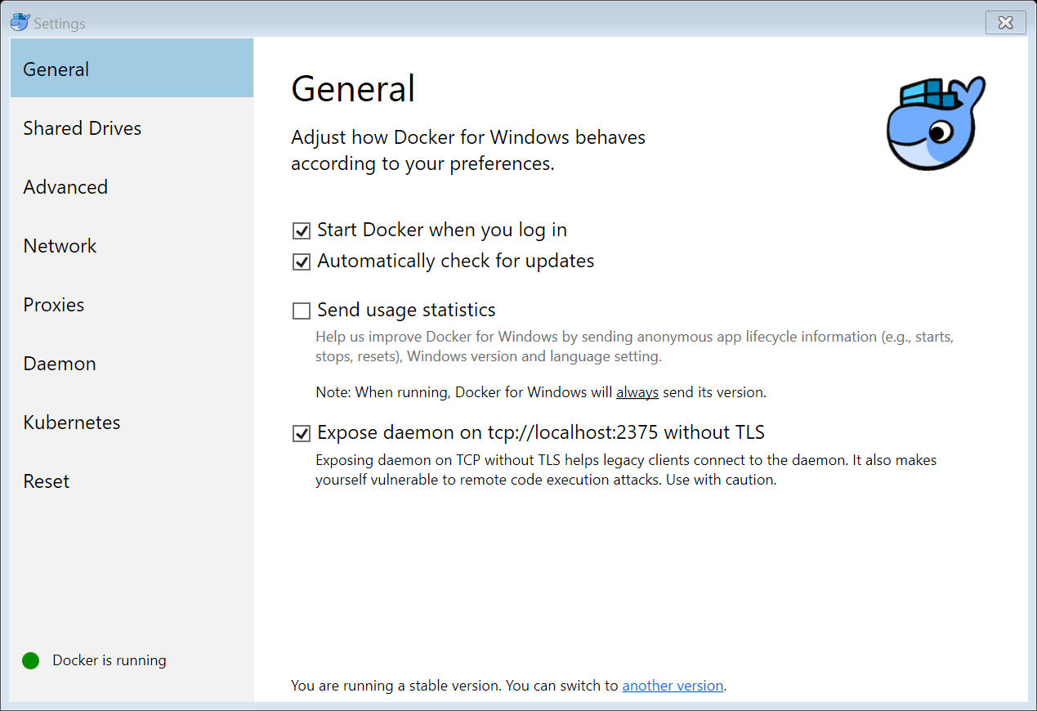
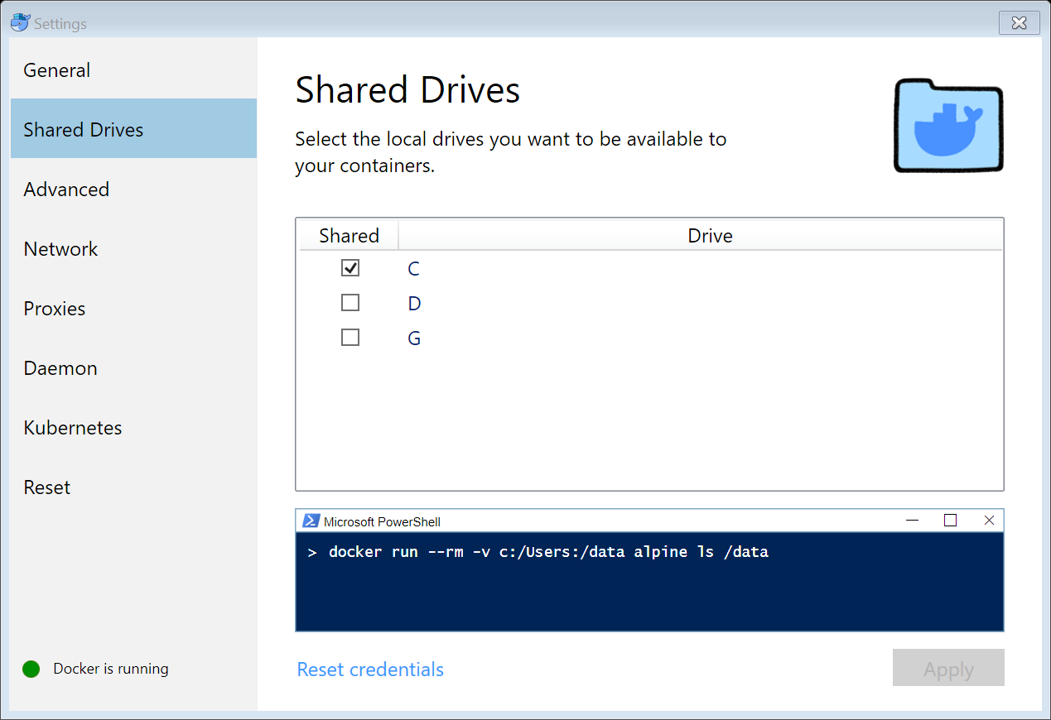
… and configure it
Expose yourself…
Allow access to your C drive

Slide 13
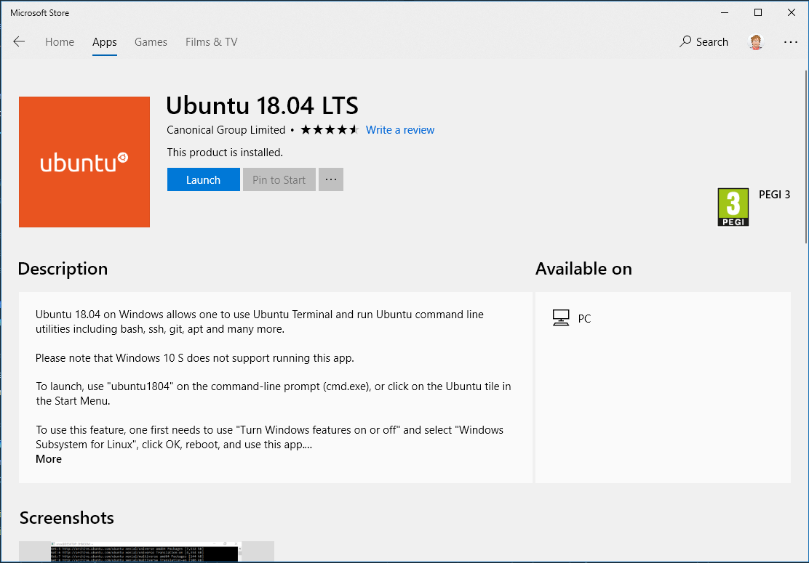
Install a Linux distro (e.g. Ubunutu)…

Slide 14
… and set it up (step 1 - Basics)
#!/bin/bash
sudo tee /etc/wsl.conf <<EOL
[automount]
root = /
options = "metadata"
EOL
# Install loads of stuff
sudo apt-get update
sudo apt-get -y upgrade
sudo apt-get -y install automake autoconf make libtool build-essential apt-transport-https ca-certificates software-properties-common libncurses-dev libncurses5-dev libncursesw5-dev libpq-dev libyaml-dev libssl-dev zlib1g-dev libbz2-dev libxslt-dev libreadline-dev libsqlite3-dev unixodbc-dev wget curl llvm xz-utils tk-dev libffi-dev libnss3 libgmp3-dev git debhelper dh-make dwz gettext-doc libasprintf-dev libgettextpo-dev zsh vim
# Install asdf (extensible version manager) for node, python, ruby, java, etc
git clone https://github.com/asdf-vm/asdf.git ~/.asdf --branch v0.5.1
# Fix name server issues
sudo mv /etc/resolv.conf /etc/resolv.old.conf
sudo tee /etc/resolv.conf <<EOL
nameserver 8.8.8.8
nameserver 8.8.4.4
EOL
# Switch shell to zsh
chsh -s /bin/zsh
sh -c "$(curl -fsSL https://raw.githubusercontent.com/robbyrussell/oh-my-zsh/master/tools/install.sh)"
Docker expects files in /c/… not /mount/c/…
Super cool tool for versioning tools per project
ZSH will supercharge our boring old Bash shell
Restart WSL / your computer

Slide 15
… and set it up (step 2 - Git)
#!/bin/bash
# Set up Git
export WIN_USER="$(echo -e `powershell.exe '$env:UserName'` | sed -e 's/^[[:space:]]*//' -e 's/[[:space:]]*$//')"
cp "/c/Users/${WIN_USER}/.gitconfig" "/home/${USER}/.gitconfig"
sudo mkdir -p "/c/Users/${WIN_USER}/.ssh"
ln -sf "/c/Users/${WIN_USER}/.ssh" "/home/${USER}/"
if [ -f "/c/Users/${WIN_USER}/.ssh/id_rsa.pub" ]; then
echo "Found SSH key!"
else
echo "No SSH key found, creating..."
ssh-keygen -t rsa -b 4096 -C "${GIT_EMAIL}"
eval $(ssh-agent -s)
ssh-add "/home/${USER}/.ssh/id_rsa"
echo "Add this to GIT SSH:"
echo "---"
cat "/home/${USER}/.ssh/id_rsa.pub"
echo "---"
read -n1 -r -p "Press any key to continue..." key
fi
WSL allows Linux to call Windows programs, and Windows programs call Linux ones, which is just way too awesome
This will copy your Windows user’s settings to your Linux user, and make sure you have an SSH key

Slide 16
… and set it up (step 3 – oh-my-zsh)
#!/bin/bash
### PowerLevel9K
git clone git@github.com:bhilburn/powerlevel9k.git ~/.oh-my-zsh/themes/powerlevel9k
### Nerd Fonts
git clone --depth 1 git@github.com:ryanoasis/nerd-fonts.git /tmp/nerd-fonts
/tmp/nerd-fonts/install.sh --ttf --clean && fc-cache -f -v
mkdir -p /c/dev/fonts/NerdFonts
cp $HOME/.local/share/fonts/NerdFonts/*.ttf /c/dev/fonts/NerdFonts && rm -rf /tmp/nerd-fonts
### Configure oh-my-zsh
if grep -q 'POWERLEVEL9K_MODE' $HOME/.zshrc; then
sed -i 's/POWERLEVEL9K_MODE="[^"]*"/POWERLEVEL9K_MODE="nerdfont-complete"/' $HOME/.zshrc
else
sed -i '/ZSH_THEME="[^"]*"/iPOWERLEVEL9K_MODE="nerdfont-complete"' $HOME/.zshrc
fi
sed -i 's/ZSH_THEME="[^"]*"/ZSH_THEME="powerlevel9k\/powerlevel9k"/' $HOME/.zshrc
sed -i '/ git/a\ dotenv\n docker\n asdf' $HOME/.zshrc
tee -a $HOME/.zshrc <<EOL
. $HOME/.shellrc
EOL
tee -a $HOME/.bashrc <<EOL
if [ -t 1 ]; then
exec zsh
fi . $HOME/.shellrc
EOL
tee $HOME/.shellrc <<EOL
# Include .local/bin in path
export PATH="$HOME/.local/bin:$PATH" # Connect Docker to Windows Host
export DOCKER_HOST=tcp://0.0.0.0:2375
EOL
. $HOME/.shellrc
You don’t need to set up a oh-my-zsh theme if you don’t want to, but it doesn’t half make for a pretty CLI
Make sure to install the NerdFonts into Windows too…
Note the DOCKER_HOST url!

Slide 17
… and set it up (step 4 – Docker Compose, finally!)
#!/bin/bash
# Install Docker
export DOCKER_CHANNEL=edge
export DOCKER_COMPOSE_VERSION=1.22.0
sudo apt-get update
sudo apt-get install apt-transport-https ca-certificates curl software-properties-common
curl -fsSL https://download.docker.com/linux/ubuntu/gpg | sudo apt-key add -
sudo apt-key fingerprint 0EBFCD88
sudo add-apt-repository "deb [arch=amd64] https://download.docker.com/linux/ubuntu $(lsb_release -cs) ${DOCKER_CHANNEL}"
sudo apt-get update
sudo apt-get -y install docker-ce
sudo usermod -aG docker $USER
sudo curl -L https://github.com/docker/compose/releases/download/${DOCKER_COMPOSE_VERSION}/docker-compose-`uname -s`-`uname -m` -o /usr/local/bin/docker-compose
sudo chmod +x /usr/local/bin/docker-compose

Slide 18
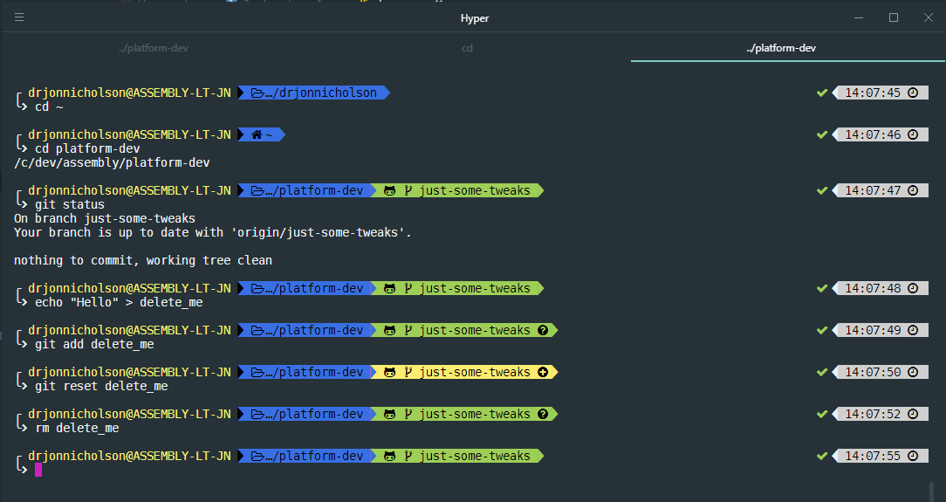
So how do I get a pretty console like this?

Slide 19
Get Hyper!
https://hyper.is/ is a HTML/JS based terminal
Edit ~/.hyper.js and change these settings:
fontFamily: '"DejaVuSansMono Nerd Font", "DejaVu Sans Mono", Consolas, "Lucida Console", monospace',
shell: 'C:\\WINDOWS\\System32\\wsl.exe’,
plugins: [
'hyper-material-theme'
],

Slide 20
There are some silly plugins…. Like HyperPower

Slide 21
How do I use Docker to fake Amazon S3?
Well, there’s a tool called FakeS3 for that
There are numerous Docker Images available to do this, but let’s make our own, for the laughs
We will need:
A docker-compose.yml file, which defines what services will be run
A Dockerfile, which defines how the FakeS3 image will be made

Slide 22
docker-compose.yml
version: ‘3’
services:
s3:
build:
context: .
dockerfile: fakes3.dockerfile
environment:
- FAKE_S3_LICENSE_KEY=$FAKE_S3_LICENSE_KEY
networks:
default:
aliases:
- s3.lvh.me
ports:
- "8000:8000"
volumes:
- s3_data:/fakes3_data
volumes:
s3_data:
I have a FAKE_S3_LICENSE_KEY variable in my .env file (loaded by zsh)
This service will be available at s3.lvh.me:8000
It’ll cache it’s data between executions in a volume

Slide 23
fakes3.dockerfile
FROM alpine:3.6
ENV FAKES3_VERSION=2.0.0
ENV FAKES3_LICENSE=DUMMY_LICENSE
ENV FAKES3_HOST=s3.lvh.me
WORKDIR /fakes3_data
EXPOSE 8000
CMD ["fakes3", "server", "--root", ".", "--port", "8000", "--hostname", "$FAKES3_HOST", "--license", "$FAKES3_LICENSE"]
RUN apk add --no-cache ruby ruby-io-console
RUN gem install fakes3 -v $FAKES3_VERSION --no-doc
RUN mkdir -p /fakes3_data && chown nobody:nobody /fakes3_data && chmod 0750 /fakes3_data
USER nobody
VOLUME /fakes3_data

Slide 24
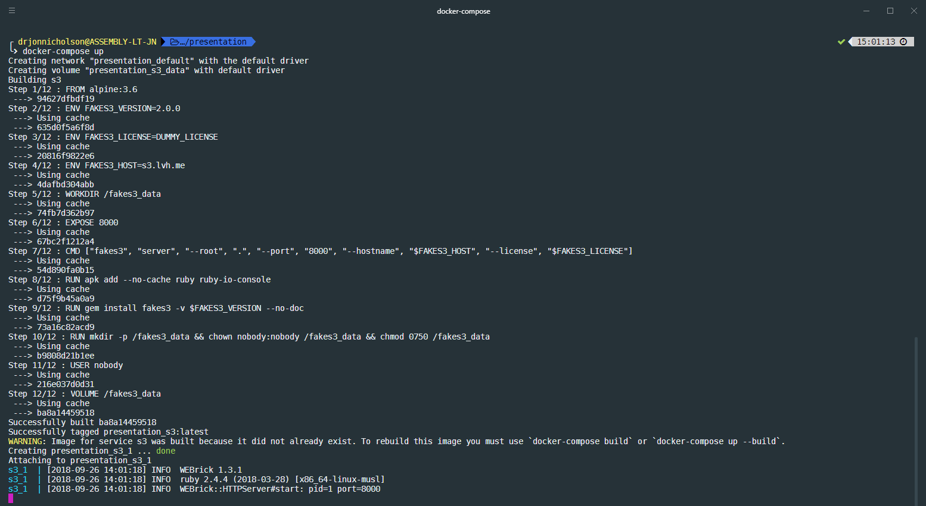
Starting the FakeS3 service
Builds the image off the Alpine base image and spins it up. Image is then cached ☺
Ctrl-C to terminate the service
Or start with -d/--detach to spin up a detached process

Slide 25
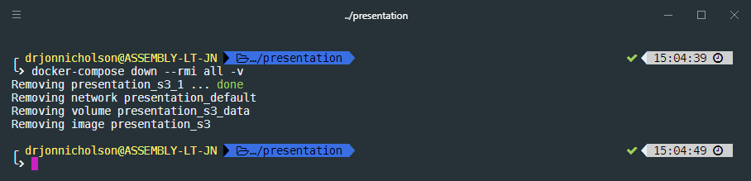
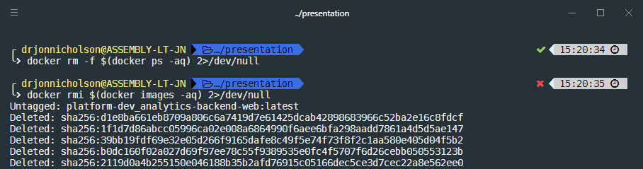
Down… Tearing it down…. Burn it all
The down command stops the (detached) services, but we can also kill volumes etc at the same time (tearing it down)
Or we can burn it all…
Crap I just killed everything I was using for work…

Slide 26
Thanks for listening
Let’s share some best practices!
And maybe a pint?

