Slide 1
Please, add your figure here
See examples in the two following slides

Slide 2
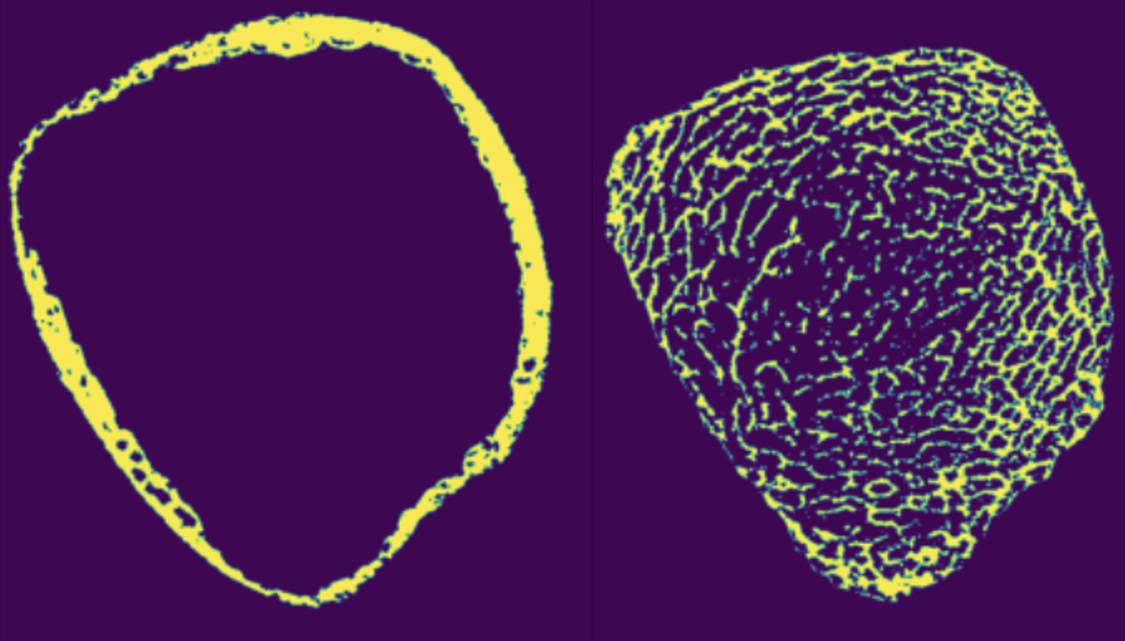
Example 1

Slide 3
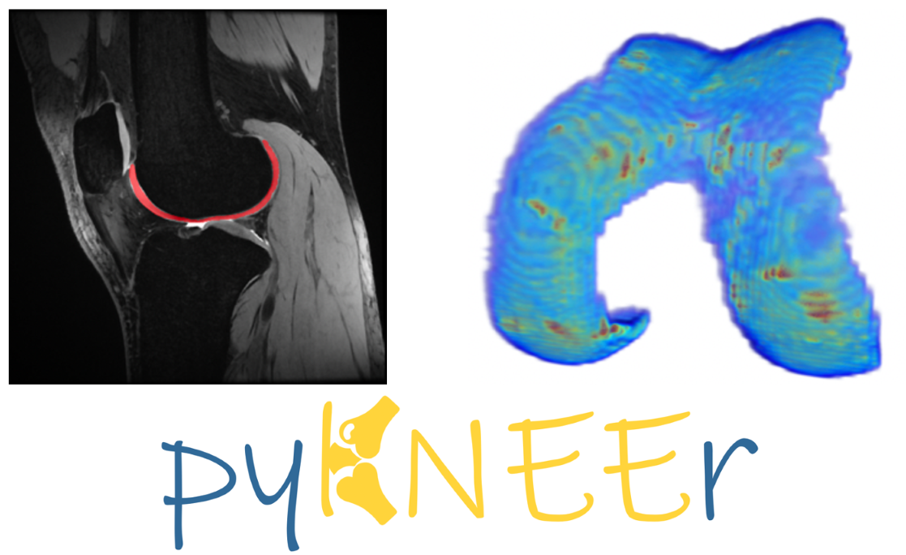
Example 2

