Slide 1
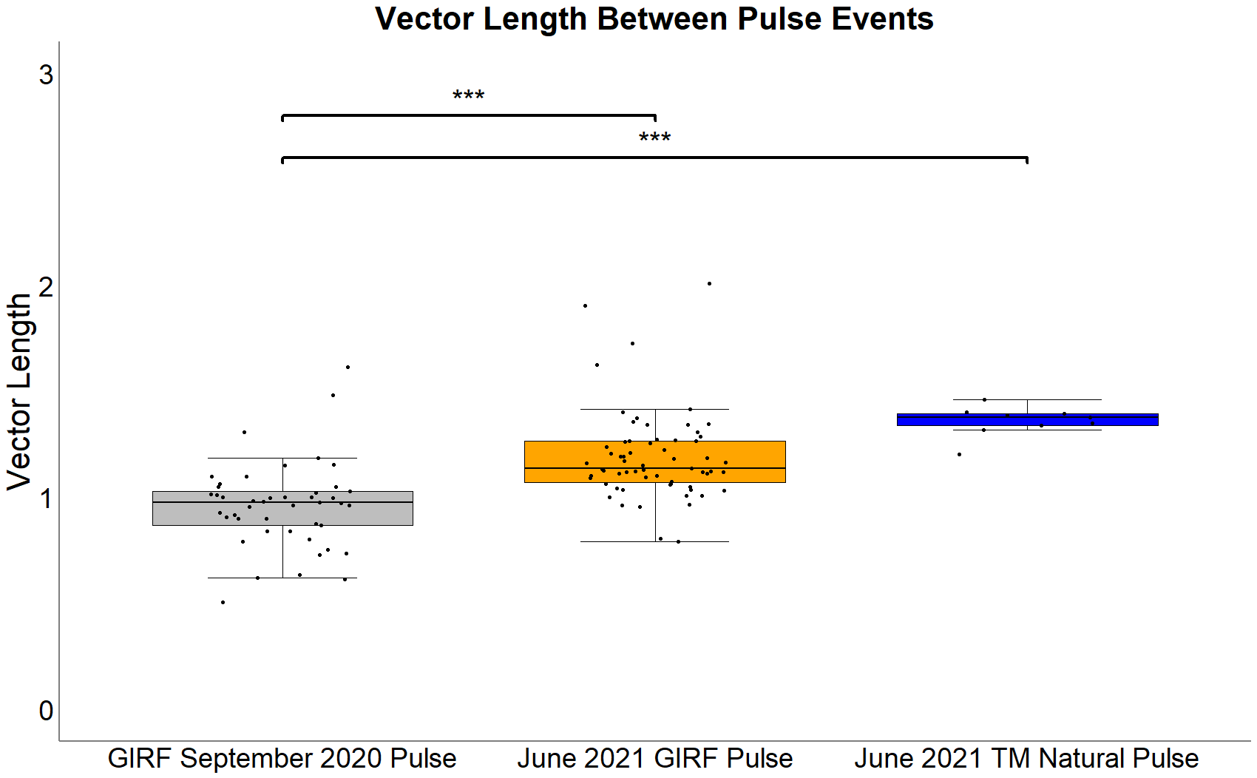
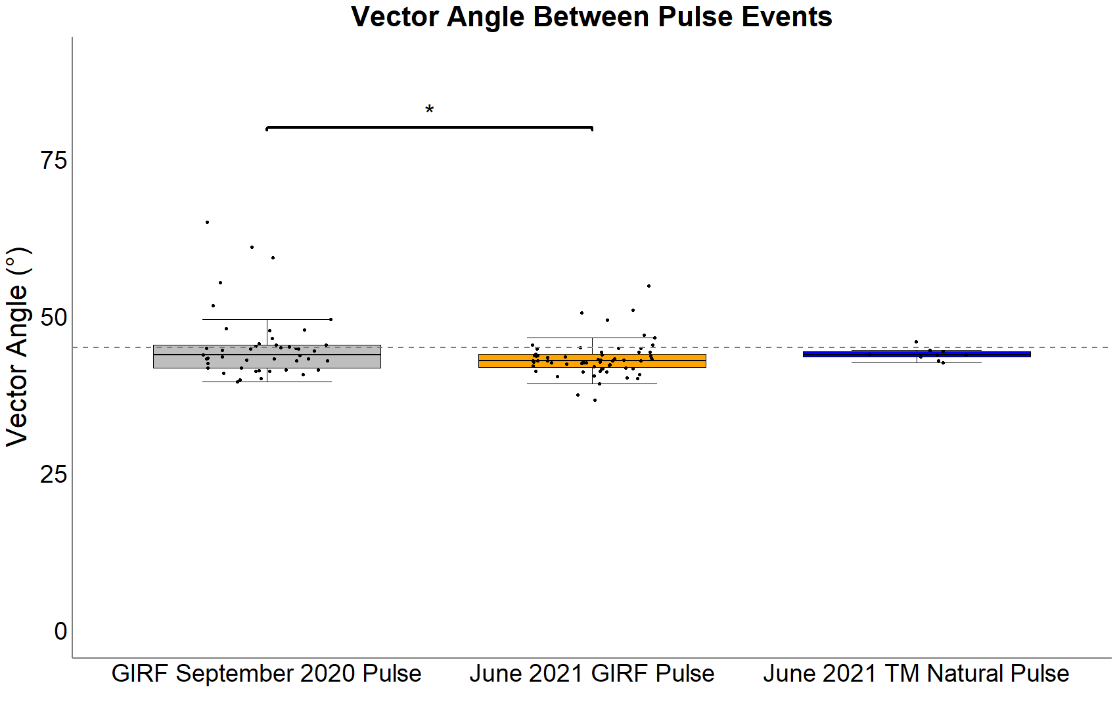
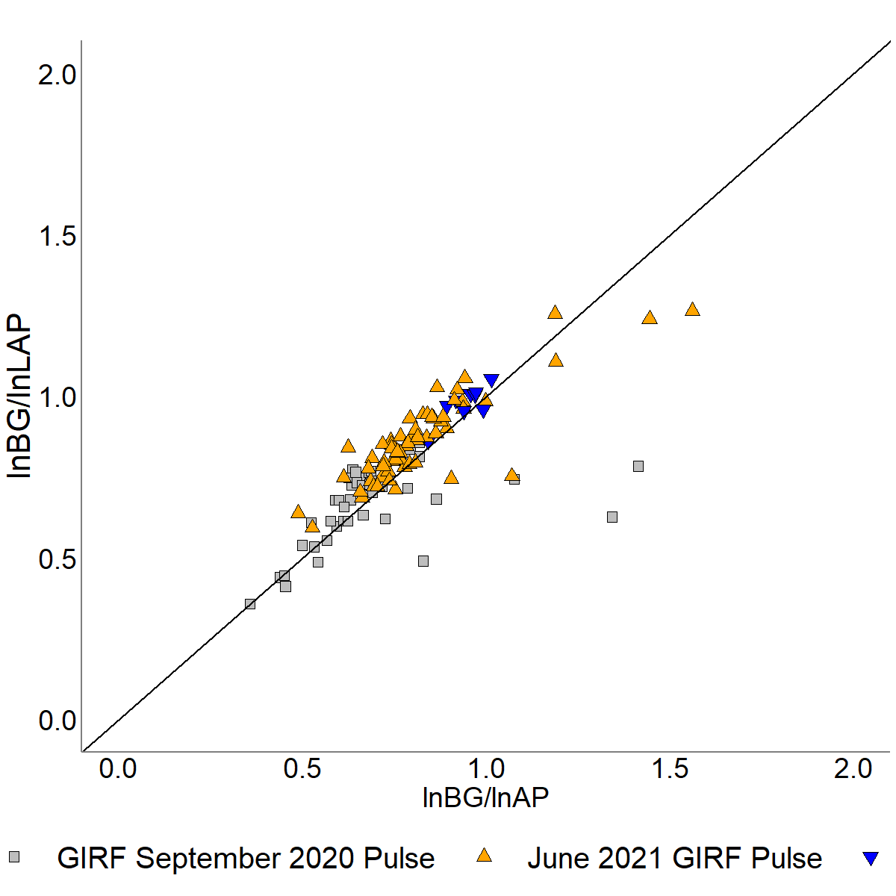
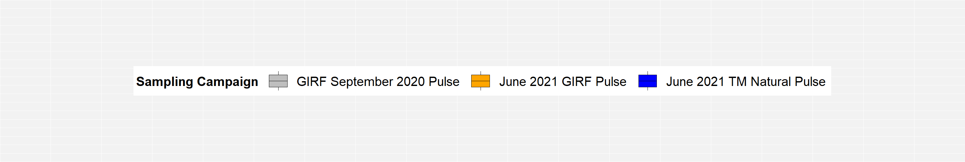
A
B
***
***
*
P Limitation
- Relative C Limitation +
N Limitation
C
1:1 Line
P Limitation
N Limitation
Relative C Limitation
Length
Angle

