Slide 1
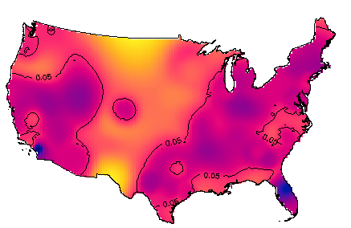
W9 Exercise: Kernel Density Estimation
Basics, bandwidth, and background
alexander.hohl@geog.utah.edu

Slide 2
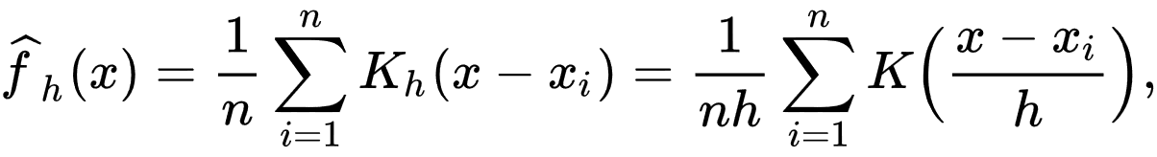
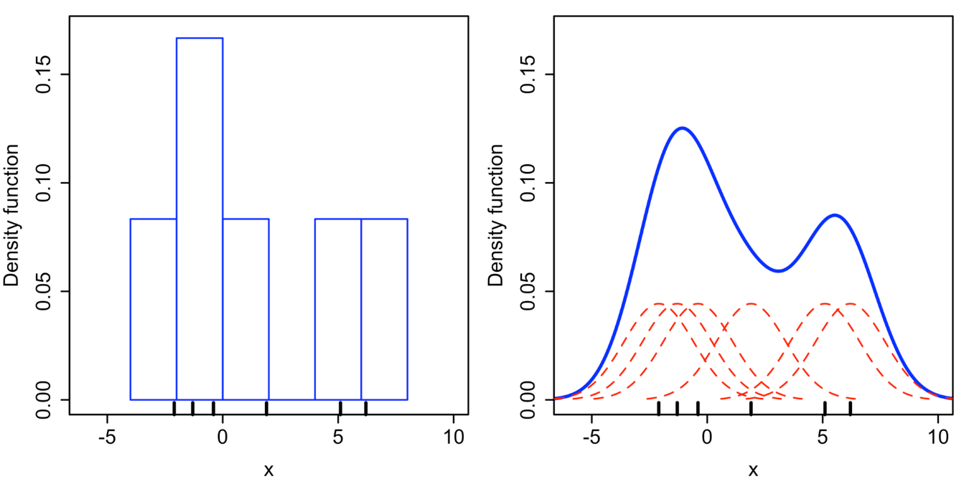
Kernel Density Estimation
Non-parametric way to estimate the probability density function of a random variable
Notes:
Formula:
f: density estimate
h: bandwidth
x: all locations (discretized space)
K: kernel function

Slide 3
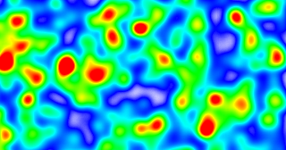
Kernel Density Estimation
1. Point pattern
2. Impose grid
3. Compute densities
3. Compute densities
4. Density surface
Notes:
Sick people in a room (respiratory disease, black dots); where is risk of infection greatest (candidate locations, red squares)?
Check every location. Discretize space into regular grid of cells.
For each cell, search for surrounding points, compute density
Density surface allows for knowing where infection risk is greatest (red areas).

Slide 4
Kernel Density Estimation
Geographer’s view
Statistician’s & Computer Scientist’s view
h_{s}
h_{s}
Close proximity = high weight
Distant proximity = low weight
Outside circle = zero weight
Notes:
Geographers vs. statisticians: Center kernel on grid points or on data points?
Tangent: Computational perspective: Algorithm (draw circles around grid points) is slow. Better to draw circles around black dots. Use spatial indexing to calculate density contribution of each black dot to its surrounding cells. Use spatial indexing.

Slide 5
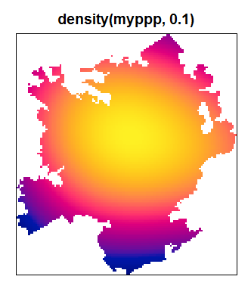
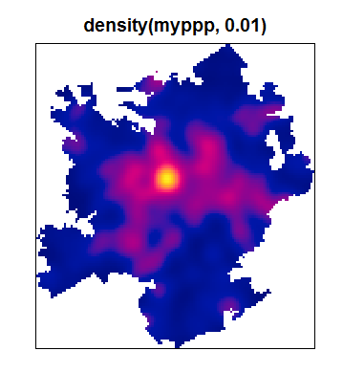
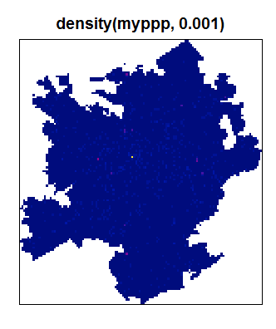
Bandwidth Selection
Too large
Just right
Too small
https://stats.stackexchange.com/questions/156762/selecting-kernel-bandwidth-in-practice
Notes:
Too large: Oversmoothing, detailed patterns are hidden, only large-scale trend revealed
Too small: Undersmoothing, spiky surface, large-scale trends hidden

Slide 6
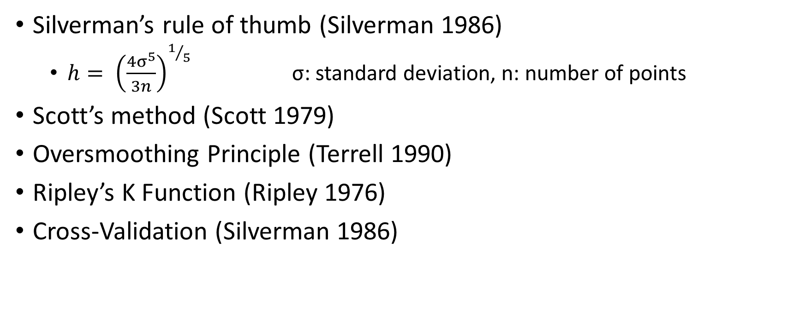
Bandwidth Selection Methods
Silverman’s rule of thumb (Silverman 1986)
$h= {\left(\frac{4σ^{5}}{3n}\right)}^{1/5}$ σ: standard deviation, n: number of points
Scott’s method (Scott 1979)
Oversmoothing Principle (Terrell 1990)
Ripley’s K Function (Ripley 1976)
Cross-Validation (Silverman 1986)
Notes:
There is no shame in trying out different values for bandwidth and choosing the one that looks best.

Slide 7
Bandwidth Regime
The case for adaptive bandwidths
Inhomogeneous intensity of point process → Clustered point pattern
Fixed bandwidths may oversmooth clustered areas
Fixed
Adaptive
Notes:
Fixed bandwidth: constant areal support (area of circles constant), advantage over choropleth mapping, where areal units vary.
Adaptive bandwidth: give up constant areal support for some other desirable property, e.g. constant neighboring case support.

Slide 8
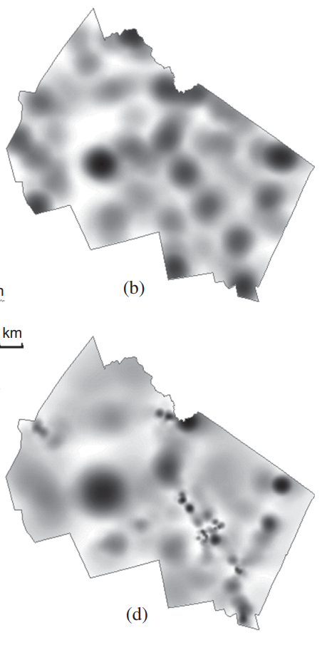
Bandwidth Regime
Static
Adaptive
Shi 2010

Slide 9
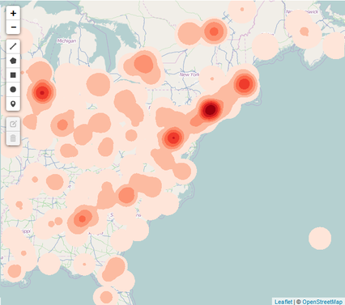
KDE in Human Geography
Visualizing Social Media Sentiment in Disaster Scenarios (Lu et al. 2015)

Slide 10
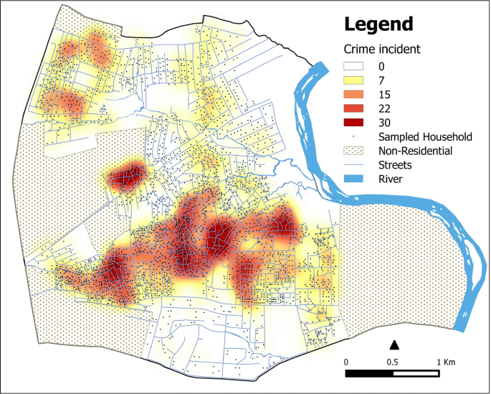
KDE in Human Geography
Assessing the Spatial Concentration of Urban Crime: An Insight from Nigeria (Umar, Johnson and Cheshire, 2020)

Slide 11
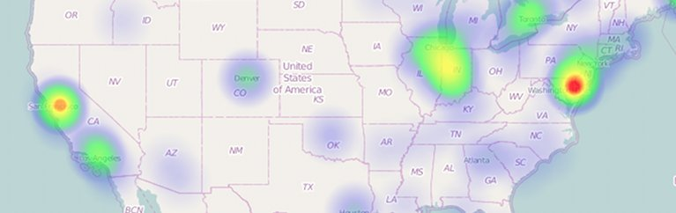
KDE in Human Geography
https://www.patrick-wied.at/static/heatmapjs/plugin-leaflet-layer.html

Slide 12
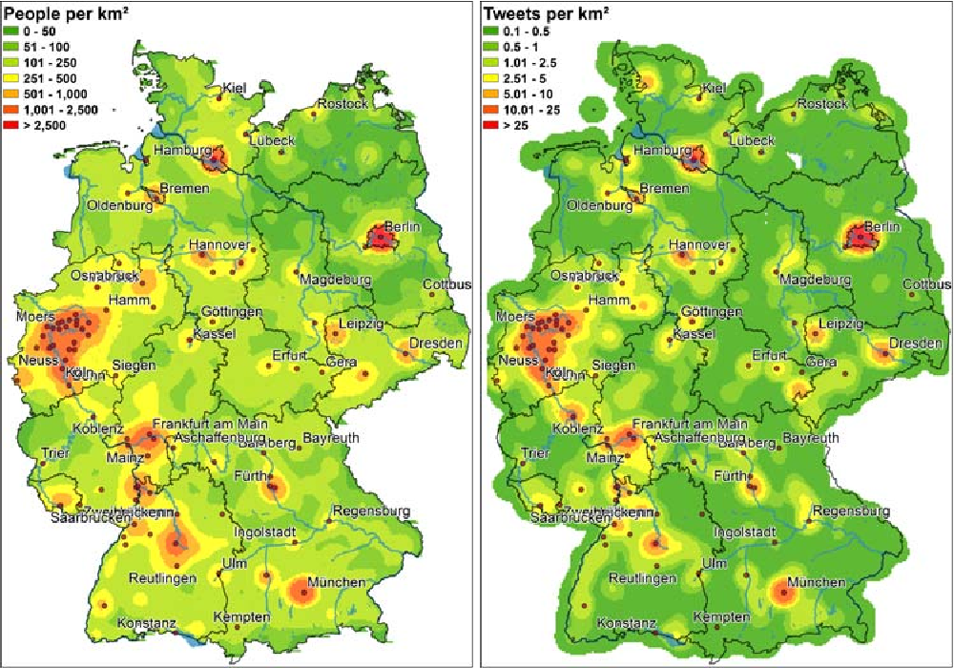
KDE in Human Geography
Twitter location (sometimes) matters: Exploring the relationship between georeferenced tweet content and nearby feature classes (Hahmann, Purves and Burghardt 2014)

Slide 13
Kernel Ratio
Geographic phenomena (“events”) emerge out of a population which needs to be accounted for in our analyses.
Tweets, disease, crime
You expect more “events” where there is more population.

Slide 14

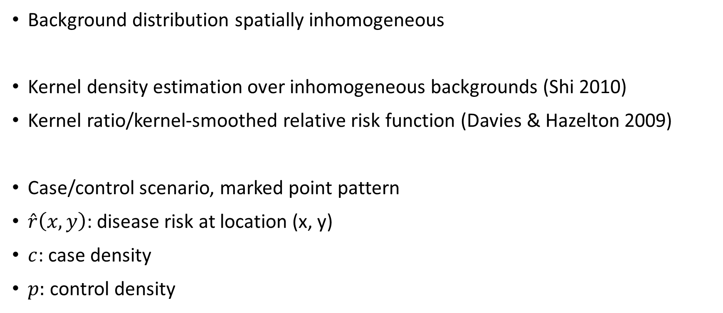
Kernel Ratio
Background distribution spatially inhomogeneous
Kernel density estimation over inhomogeneous backgrounds (Shi 2010)
Kernel ratio/kernel-smoothed relative risk function (Davies & Hazelton 2009)
Case/control scenario, marked point pattern
$\hat{r}\left(x,y\right)$: disease risk at location (x, y)
$c$: case density
$p:$ control density

Slide 15
Bandwidth Selection for Kernel Ratio
Fixed bandwidths:
Individually selecting optimal bandwidths using established techniques (i.e. Silverman 1986) does not produce good estimates (Davies, Jones & Hazelton 2016)
Use same bandwidths for case- and control densities
Recommendation: Select optimal pooled (case & control) bandwidth
or try a couple of different values

Slide 16
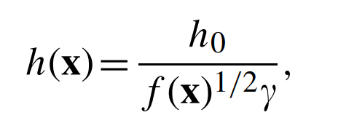
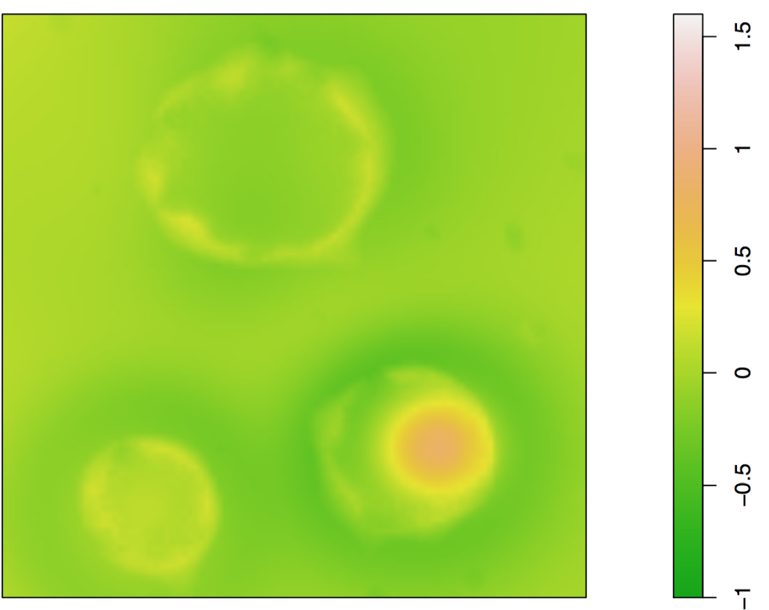
Bandwidth Selection for Kernel Ratio
Adaptive bandwidths
Optimal adaptive bandwidth selection
h0: global bandwidth
γ: geometric mean
f(x): pilot estimate
Individually selecting optimal (case- and control) bandwidths is not recommended (halos; Davies, Jones & Hazelton 2016)
3 options:
Symmetric pooled adaptive
Symmetric case adaptive
Symmetric control adaptive
Notes:
Case adaptive: Establishes constant case support, suitable for communicable disease (COVID-19)
Control adaptive: Establishes constant population support, suitable for chronic disease (cancer)

Slide 17
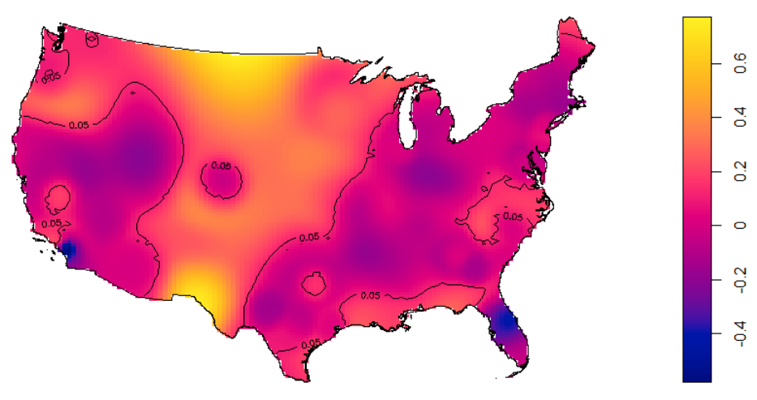
Tolerance Contours
Delineate clusters of statistically elevated risk
Pointwise p-value surface
H₀: risk = 0, H_{A}: risk > 0
At significance level p = 0.05
Fixed bandwidth context: Monte Carlo Simulation, permutation of case & control labels
Adaptive bandwidth context: z-test statistic based on asymptotic properties of estimator

Slide 18
References
Silverman, B.W. (1986), Density Estimation for Statistics and Data Analysis, Chapman & Hall, New York.
Terrell, G.R. (1990), The maximal smoothing principle in density estimation, Journal of the American Statistical Association, 85, 470-477.
Ripley, B. D. (1976). The second-order analysis of stationary point processes. Journal of applied probability, 13(2), 255-266.
Scott, D. W. (1979). On optimal and data-based histograms. Biometrika, 66(3), 605-610.
Shi, X. (2010). Selection of bandwidth type and adjustment side in kernel density estimation over inhomogeneous backgrounds. International Journal of Geographical Information Science, 24(5), 643- 660.
Lu, Y., Hu, X., Wang, F., Kumar, S., Liu, H., & Maciejewski, R. (2015, May). Visualizing social media sentiment in disaster scenarios. In Proceedings of the 24th international conference on world wide web (pp. 1211- 1215).
Umar, F., Johnson, S.D. & Cheshire, J.A. Assessing the Spatial Concentration of Urban Crime: An Insight from Nigeria. J Quant Criminol (2020). https://doi.org/10.1007/s10940-019-09448-3
Davies, T. M., & Hazelton, M. L. (2010). Adaptive kernel estimation of spatial relative risk. Statistics in Medicine, 29(23), 2423-2437.
Davies, T. M., Jones, K., & Hazelton, M. L. (2016). Symmetric adaptive smoothing regimens for estimation of the spatial relative risk function. Computational Statistics & Data Analysis, 101, 12-28.

