Slide 1
Data-Driven Disease Prognosis Analysis
Project Statement
Group 6

Slide 2
目录
01
Background
02
Introduction to the dataset
课程背景
03
Data processing and Feature Engineering
04
Model training
05
Areas for Improvement and Future Prospects

Slide 3
Background

Slide 4
Background
When individuals experience discomfort or illness, seeking medical attention is a common recourse. However, diagnosis based solely on verbal communication during consultations may not always provide a comprehensive understanding of the patient's condition. In such cases, additional diagnostic measures, particularly medical examinations, become essential. This is particularly crucial in the context of serious illnesses like cancer, where early detection is often challenging.
This project focuses on leveraging machine learning techniques to assist in the diagnosis of patients based on the data obtained from medical examinations. The aim is to train a model using a dataset comprising various physiological indicators derived from these examinations. The significance of this research lies in the potential to enhance diagnostic accuracy and help to find the most significant medical examinations for patients.

Slide 5
Introduction to the dataset

Slide 6
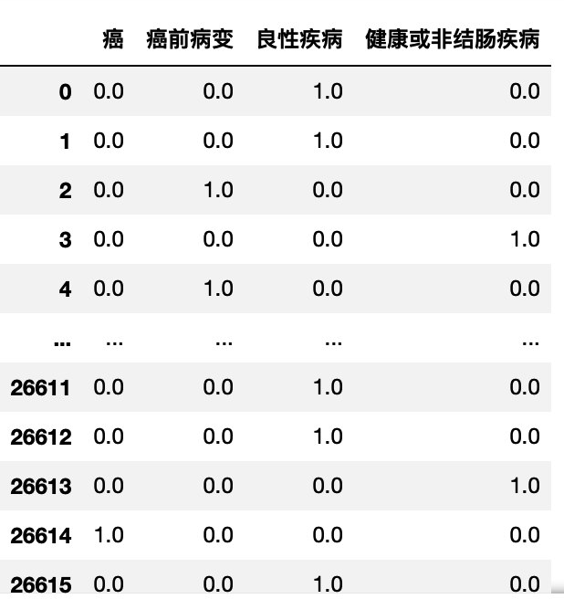
2.1 Variable Structures
Response
variable

Slide 7
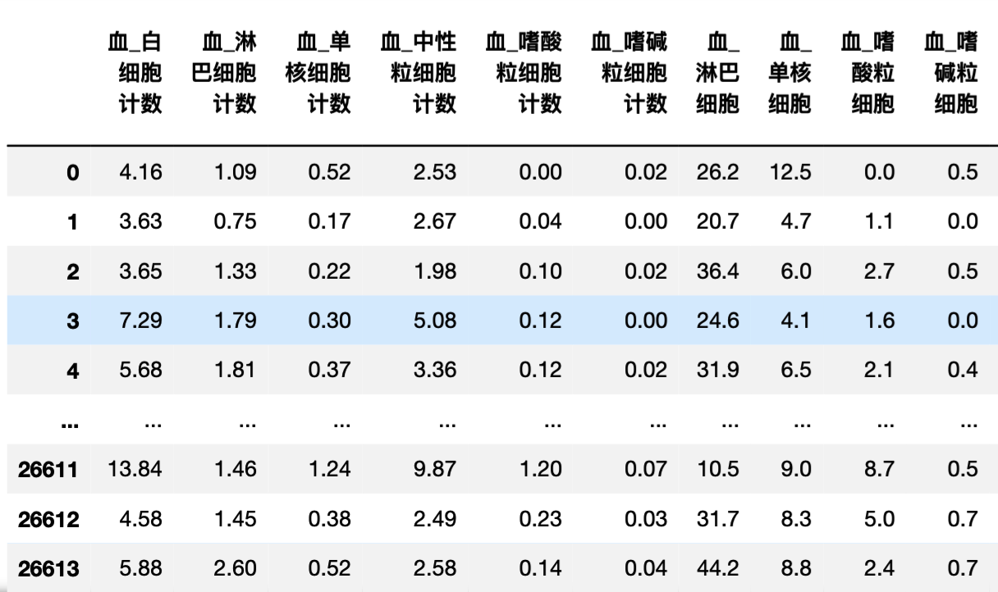

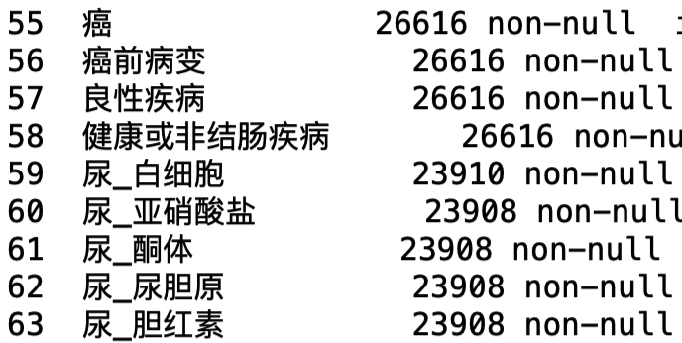
2.1 Variable Structures
Predictor variable
variae
26616 rows × 71 columns

Slide 8
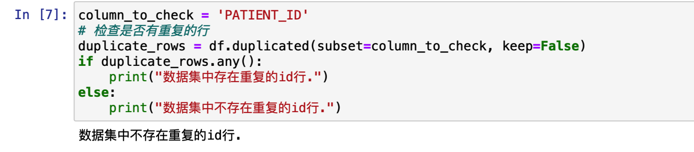
2.2 Independence
Check if there are multiple examinations conducted on the same patient in this dataset. There aren't any, so this study doesn't account for longitudinal data. We can assume each row of data is independent.

Slide 9
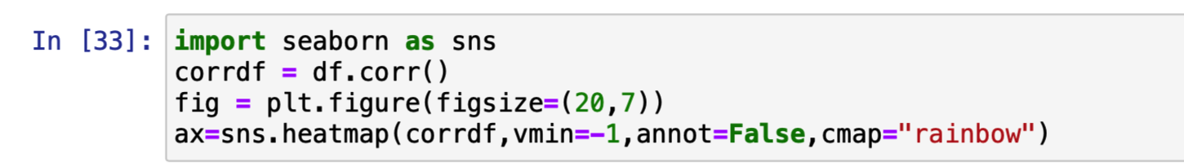
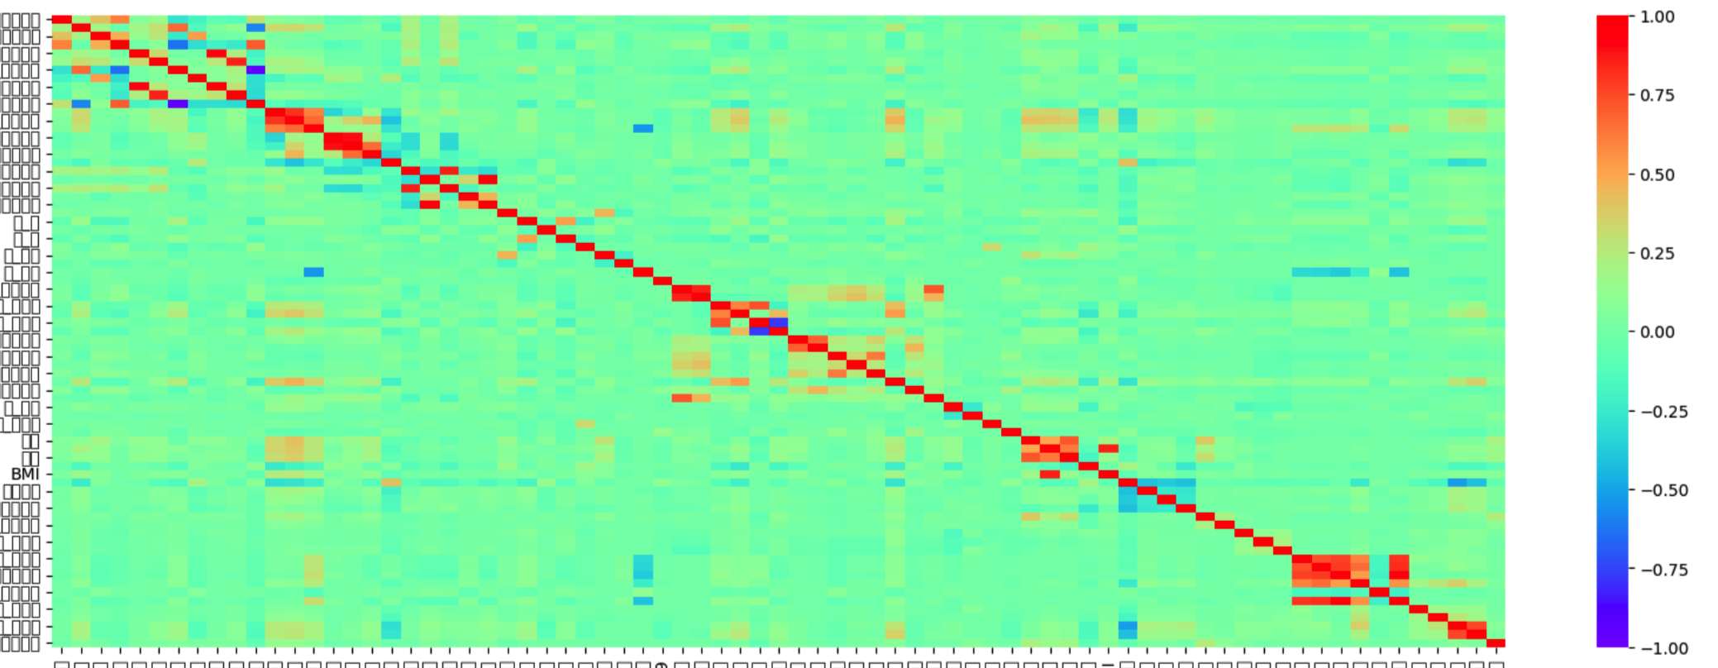
2.2 Independence

Slide 10
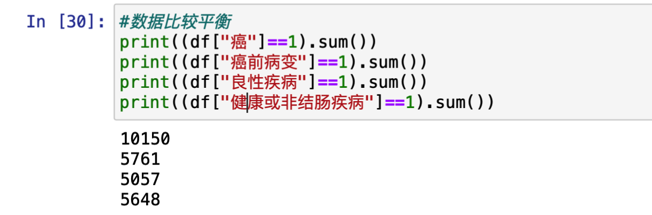
2.3 ？Balance

Slide 11
Data processing and Feature Engineering

Slide 12
3.1 Missing Values Management (important)
Method:
1. Naive
In numerical columns, fill the blank with median numbers; In categorious columns, fill the blank with the category that occurs the most frequently.
2. KNN
As all values from the dataset are numerical(0-1 type included), we can use the mean value of the neighbourhood to fill the blank.
3. Other Predicted model (Undone)
Use other model like Randomforest Classifier to fill the blank.

Slide 13
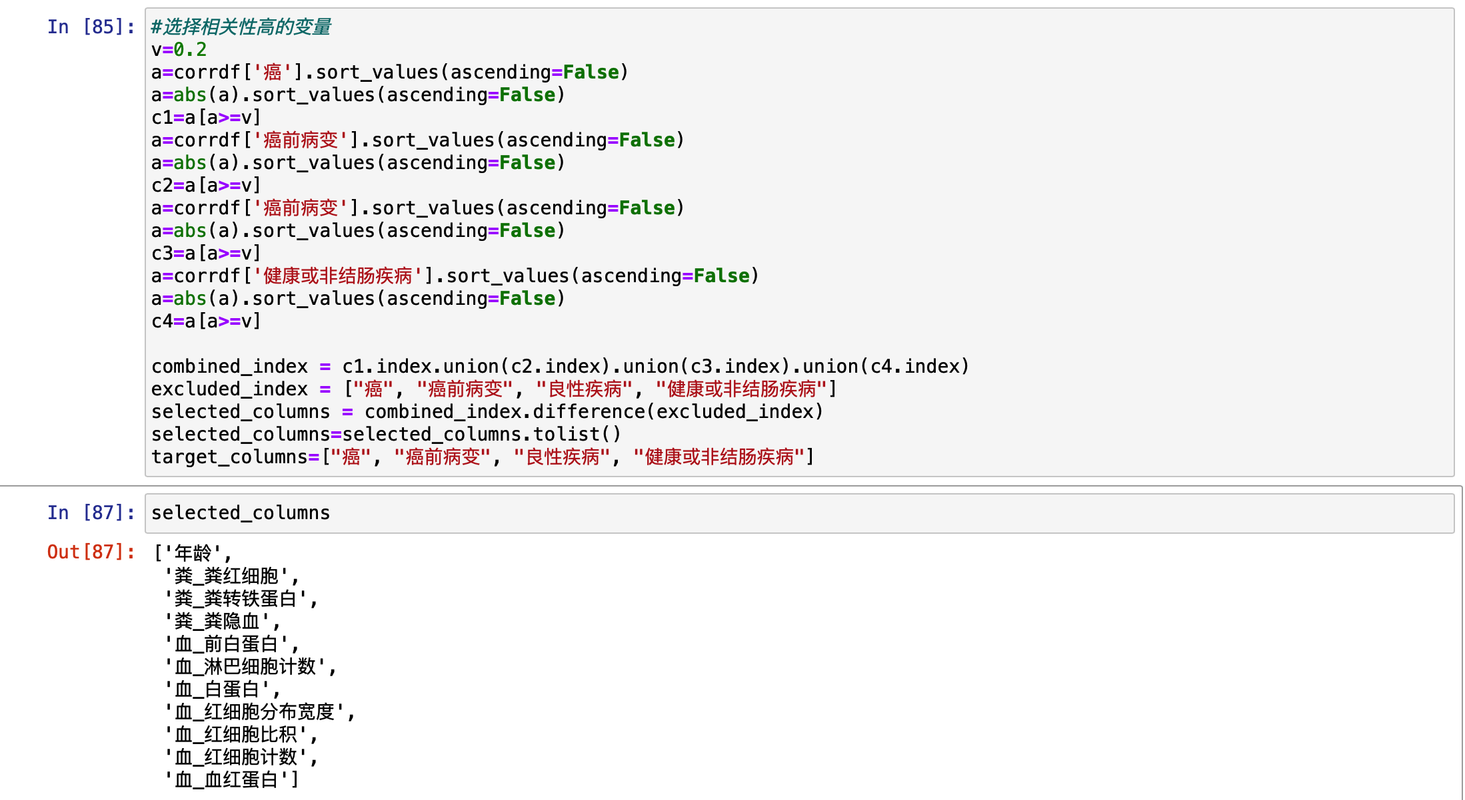
3.2 Feature Selecting

Slide 14
Model training

Slide 15
4.1 Evaluation metric （Under Cross-validation）
SSE = ||Y - g(XB)||^2
Accuracy = (TP+TN)/N
Precision = TP/(TP+FP)
Recall = TP/(TP+FN)
F1-score = 2 * (Precision*Recall)/(Precision+Recall)

Slide 16


4.2 Logistic Regression (Numerical data)
Goal:
1. Maximize the evaluation metric (Accuracy or Precision in the level of cv)
2. Enhance feasibility?
Scale: little improvement
No substantial differences in magnitudes
Regularization
Variable Selection
Gooood
(difference with correlation?)
Feature generation
Ensemble
......

Slide 17
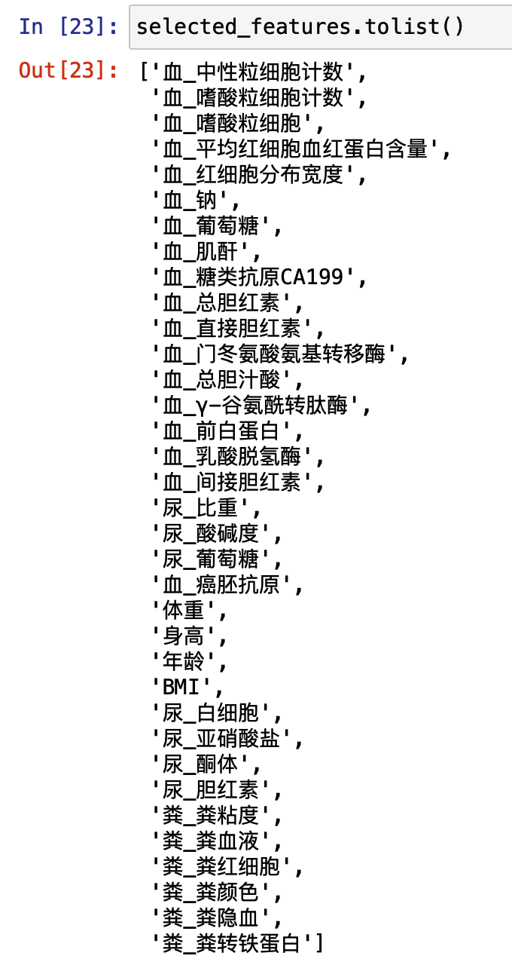

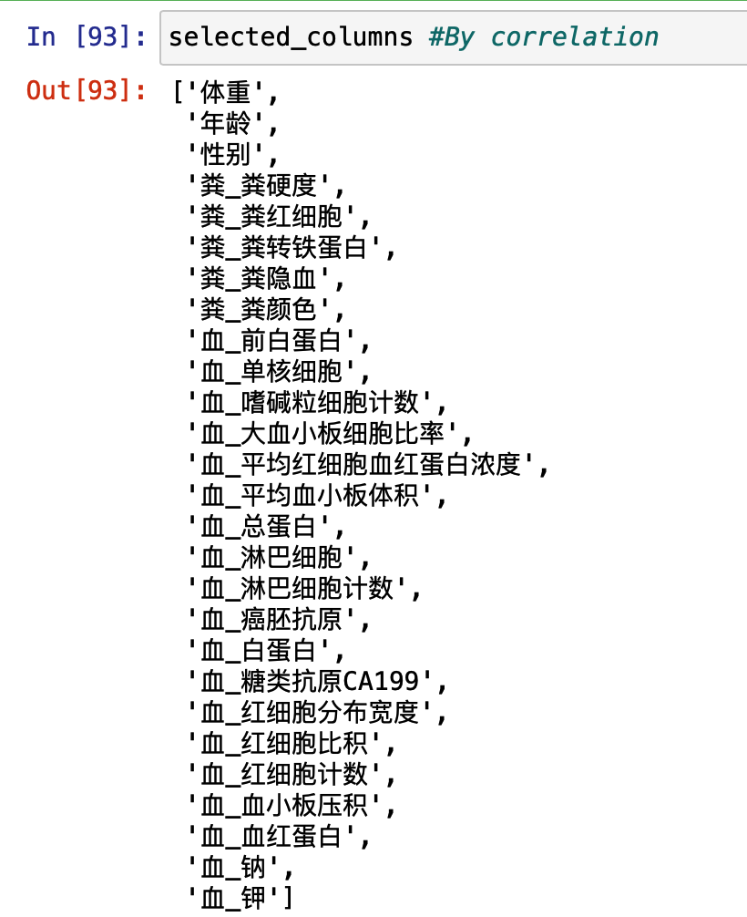
4.2* Variable Selection
Interpretability

Slide 18
4.3 Other models
Have been tried:
Linear Support Vector Classifier, the standard nonlinear Support Vector Classifier, Decision Tree (DecisionTree), Extra-Tree Decision Tree (ExtraTree), XGBoost, Randomforest....
No significant improvement..
Q: For a single y, accuracy is around 80%. If we predict k columns at the same time, it would decrease by P^k. Hence we need to find ways to make significant improvement to the single column prediction or seek ways to combine four data?
Under exploration
1. Adjust missing-value completement.
2. Discover better feature.
3. Predicit each column indepently first, do futher judgement.
4. ...

Slide 19
Tips for Improvement and Future Prospects

Slide 20
5.1 More Optimization
Model,feature,completement,etc.
Survey on single variable
Data-type expansions
Identifying factors through medical analysis

Slide 21
Prospects

Slide 22
Thanks for listening

