Slide 1
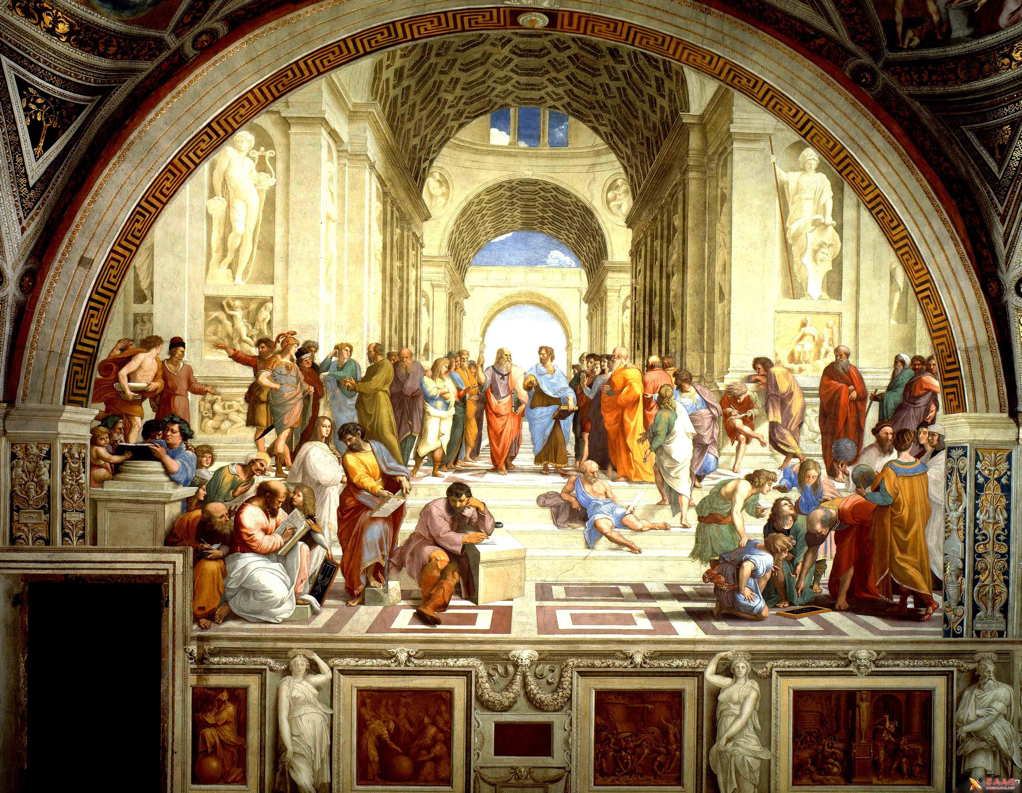

Slide 2
”Plato is dear to me,but dearer still is truth.“
“吾爱吾师，吾更爱真理“
亚里士多德
主讲人：魏浩、代秉欣

Slide 3
Content
01
02
03
04
生平简介
主要成就
主要思想
结语

Slide 4
1
幼年期
Aristotle was born into a medical family in northern Greece, and his exposure to medicine from an early age developed his perceptive（感知力的） observational, collecting and sharing abilities,
学习期
In the study life of Plato's Academy, he was called "the spirit of the school" by Plato because of his talent and diligence. In the pursuit of knowledge and truth, never blindly following authority, never hiding his differences of opinion from others, so Plato said to Aristotle, "I will put a bridle（缰绳） on you."
游历期
After Plato's death, Aristotle chose to leave Athens, travel, and was soon invited to teach 13-year-old Alexander, who took the throne（登上王位） a few years later, because alexander often worried about state affairs, which led to the interruption of his studies, his teacher-student relationship with aristotle only lasted for eight years
教学期
Aristotle returned to Athens and established his own school, the Lyceum, during which he taught and wrote philosophical works. It is said that Aristotle had a habit of "walking in the corridors（走廊） and gardens while he was lecturing", which is why, the philosophy of Lyceum is also known as "the philosophy of freedom"

Slide 5
2
Founded the disciplines of logic, ethics（伦理）, politics, and biology
Put forward the important concepts of syllogism（三段论）, inductive reasoning（归纳推理） and deductive reasoning（演绎推理）
Founded the first real library in the history of Western philosophy

Slide 6
3
灵魂学说
灵魂学说 亚里士多德认为,人的灵魂有三个组成部分,即植物灵魂、动物灵魂和理性灵魂。植物灵魂是灵魂中最低级的部分,它主要表现为营养、繁殖等生理方面;动物灵魂高于植物灵魂,它主要表现为本能、情感、欲望等方面;理性灵魂是灵魂中最高级的部分,它主要表现为认识、思维。
The Doctrine（学说） of the Soul
Aristotle believed that the human soul has three components, namely the plant soul, the animal soul, and the rational（理性） soul. The plant soul is the lowest part of the soul, which is mainly manifested in physiological（生理的） aspects such as nutrition and reproduction; The animal soul is higher than the plant soul, and it is mainly manifested in instinct, emotion, desire, etc.; The rational soul is the highest part of the soul, which is mainly manifested in cognition（认识） and thinking.

Slide 7
Harmonious Education
Based on his doctrine of the soul, Aristotle developed the idea of harmonious education. Education corresponding（类似于） to the three components of the soul are: physical education, moral education, intellectual education, and aesthetic（审美的） education. He pointed out that it is only through such multifaceted（多层面的） education that children's bodies and minds can develop in harmony. Aristotle combined this idea of harmonious education with his idea of age staging children, emphasizing that education should follow the natural sequence（顺序） of children's development.
和谐教育 以其灵魂说为基础,亚里士多德提出了关于和谐教育的思想。与灵魂三个组成部分相对应的教育分别是:体育、德育、智育和美育。他指出,只有通过这种多方面的教育,儿童的身心才能得到和谐的发展。 亚里士多德把这种和谐教育的思想与他提出的儿童年龄分期相结合,强调教育应当遵循儿童发展的自然顺序。

Slide 8
Metaphysics（形而上学）
According to Aristotle, metaphysics is an abstract philosophy that explores man's understanding of the universe. He believed that human beings could understand the universe by thinking and derive some universal truths from it. For example, he argues that human beings can understand the three concepts of "truth," "goodness," and "beauty" through thinking.
形而上学。
亚里士多德认为,形而上学是一种抽象的哲学,它探索人类对宇宙的理解。他认为,人类可以通过思考来理解宇宙,并从中得出一些普遍的真理。例如,他认为,人类可以通过思考来理解“真理”、“善”和“美”这三个概念。

Slide 9
4
Courage,for example, is a mean between foolhardiness（鲁莽） and cowardice（懦弱）; liberality, between extravagance（奢侈） and avarice（贪婪）;modesty,between bashfulness（羞怯） and shamelessness.
勇敢就是鲁莽和懦弱之间的中道；慷慨是奢侈和贪婪的中道；谦虚是羞怯和无耻的中道。

Slide 10
THANKS FOR
YOUR LISTENING

