Slide 1


Complementary Confucianism and Taoism
儒道互补
中国风
——李佳琪 李颖杰

Slide 2

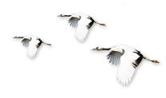

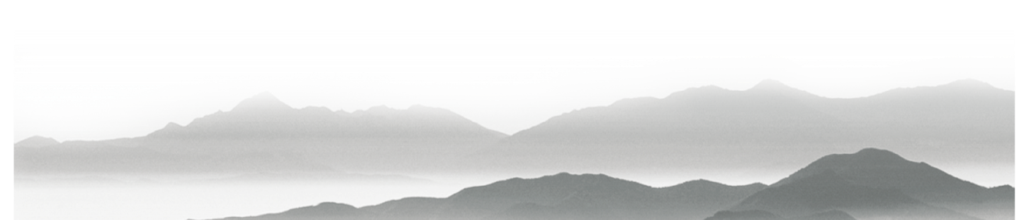
行业PPT模板http://www.1ppt.com/hangye/
part1
differences and similarities between Confucianism and Taoism
part2
confucianism and representative poet
content
part3
Taoism and representative poet
part4
complementary Confucianism and Taoism

Slide 3
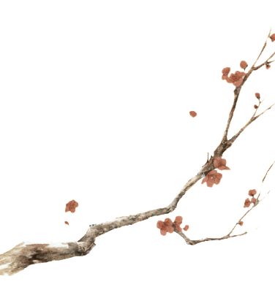

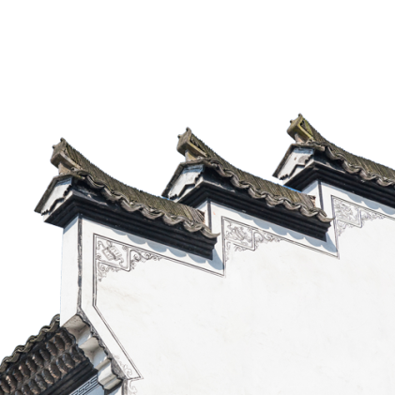
壹
Confucianism
Taoism
Benevolent governance
advocate for social harmony and order
emphasize the improvement of individual cultivation(培养) and spiritual realm（领域）
to conduct in-depth exploration and research on the universe and life
emphasize family ethics（伦理） and social responsibility
benevolent（仁慈的） governance
human is kind by nature
（人性本善）
actively improving society
govern by doing nothing that goes against nature
the essence（本质） of human nature（人性本真）
let nature take its course

Slide 4
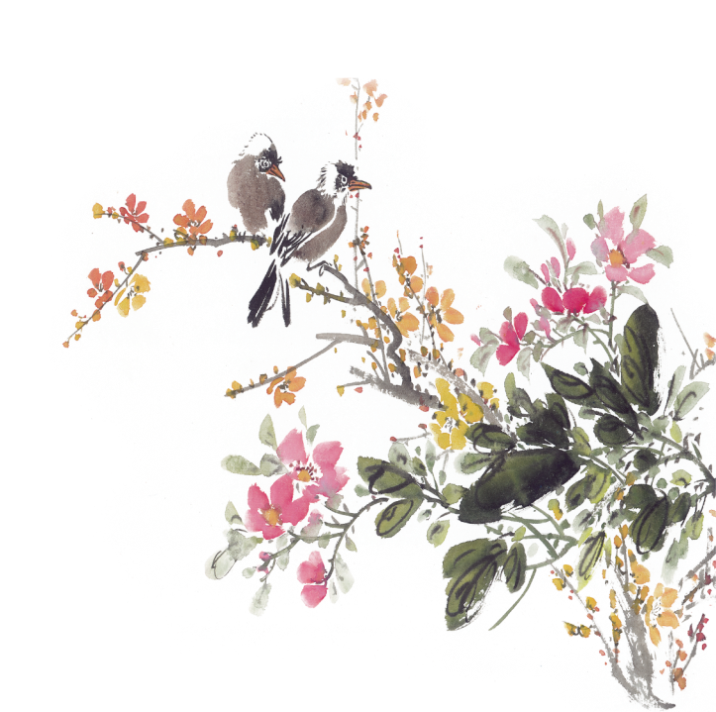
贰
Confucianism(儒家思想)
Representative poet：Du Fu
1.“ The cloth quilt has been covered for many years, cold and hard like an iron plate. The child’s sleeping posture is not good, and the quilt is broken. In case of rain, there is no dry place in the whole room, and raindrops keep leaking（漏） down like drooping twines(细绳).”[茅屋为秋风所破歌]
pay attention to social reality
care about the suffering of the people
a benevolent heart and a caring heart for the world
2.“Chang’an fell, the country was broken, only the mountains and rivers were still the same; Spring came, and the densely(密集的) populated（有人口居住的） Chang’an city was lush （茂盛的）with vegetation（植被）.”[春望]
loyalty and responsibility to the country and the people

Slide 5
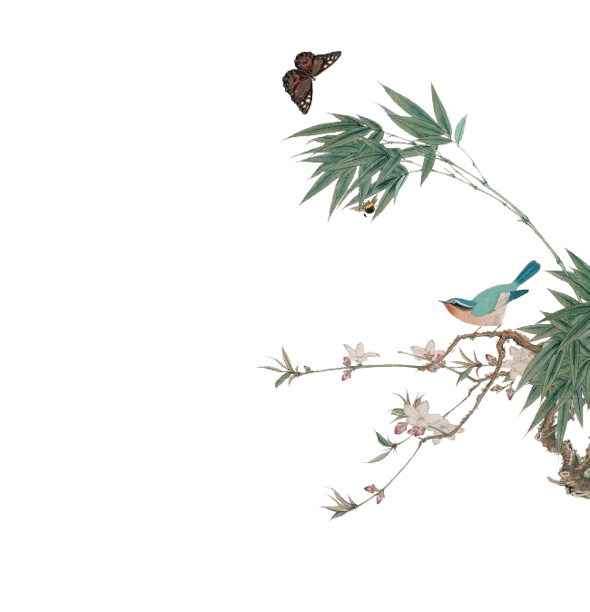
characteristic
kindheartedness（仁爱）
loyalty and filial piety(忠孝)
set of etiquette(礼制)
sense of social responsibility and mission
conservative（保守）
authoritarianism(权威主义)
dogmatism（教条主义）
unself-consistent(难以自洽)

Slide 6
叁
TAOISM(道家思想)
representative poet:Li Bai
1."Let the white deer roam（漫游） freely among the green cliffs. Whenever I want to, I'll ride it to visit the famous mountains.How can I bow down to the powerful and wealthy, making me unable to feel joy and contentment(满足)?"(梦游天姥吟留别）
pursue a state of transcendence(超越性) from the mundane（世俗的）world
filled with freedom and unfettered (自由的)spirit
2."The gale(大风) will break the waves in due time, and I'll set my sails to cross the vast ocean."
A life attitude of openness（豁达） and detachment（超然）

Slide 7
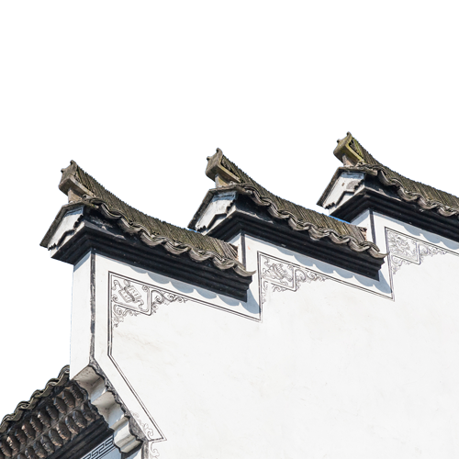

叁
TAOISM(道家思想)
characteristic
openness（豁达）
detachment（超然）
freedom
optimistic
let things slide(放任自流，摆烂)
“taking a passive and evasive attitude towards the world”（消极避世）

Slide 8
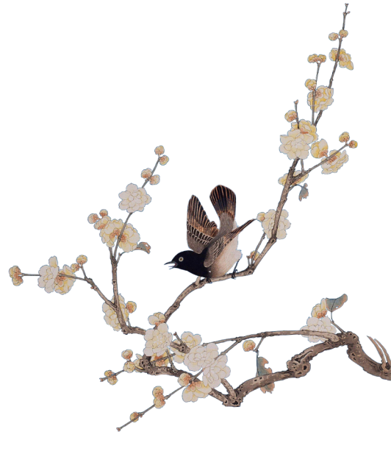
The golden mean(中庸)
complementary confucianism and taoism（儒道互补）

Slide 9
肆
complementary confucianism and taoism（儒道互补）
representative poet:Su Shi
“participating in society”积极入世（儒家）
“I will draw my bow like a full moon, looking northwest, shooting at the heavenly wolf.”
the political aspiration（志向） of safeguarding the country and its people.
“escaping from the world” 淡然出世（道家）
"A bamboo staff and grass shoes are lighter than a horse, who fears? Let the rain and mist of a lifetime come as they may, I'll face them unafraid."
openness（豁达） and detachment（超然）

Slide 10
肆
complementary confucianism and taoism（儒道互补）
experience
The ups and downs of Su Shi's political career saw him holding offices in various places./ Regardless of where he was, he always put the people first, actively promoted reforms, and sought to benefit the common people.
"Ask me about my lifelong achievements, and I'll mention Huangzhou, Huizhou, and Danzhou.‘

Slide 11
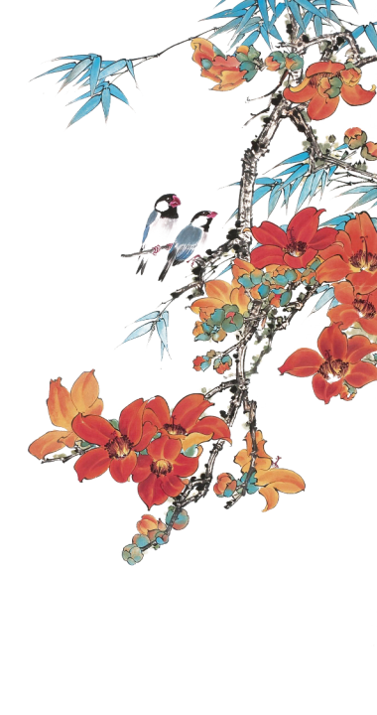
肆
complementary confucianism and taoism（儒道互补）
I hope we can use the thought of complementary confucianism and taoism When facing the challenges and difficulties of life, we could maintain a positive attitude and detached spirit, paying attention to the reality of life while pursuing inner peace and freedom.

Slide 12
Thank you

