Slide 1


English speaking in China
Environment Engineering--Liuguiyuan
日期：2023年12月21日

Slide 2
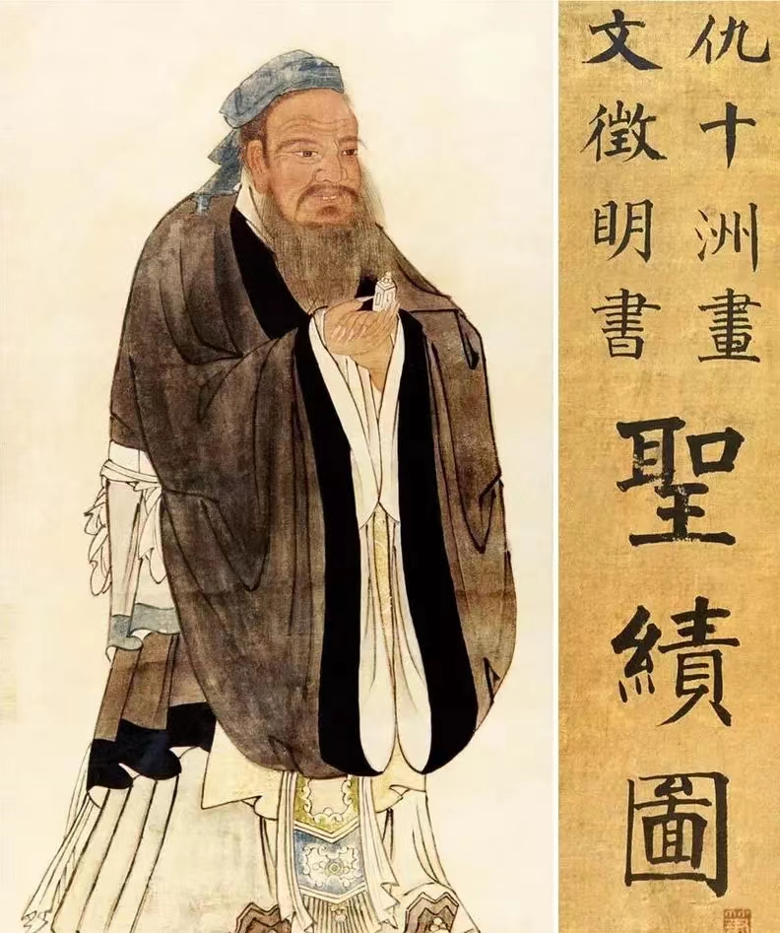

Slide 3

Confucius (551 BC - 479 BC), named Qiu, styled Zhongni, was born in the State of Lu. He was a great thinker, statesman and educator in ancient China and the founder of Confucian School
The world has a profound impact.
Confucius established a moral doctrine with benevolence as its core. When I am fifteen, I aim at learning; when I am thirty, I stand; when I am forty, I have no doubts; when I am fifty, I know the destiny of heaven; when I am sixty, I listen; when I am seventy, I follow my heart and do not exceed the rule." This is Confucius' summary of the various stages of his life. Confucius's highest political ideal is to establish a "world for the public" of the great harmony of the society, the people of the world, not only to their own family, not only to their own father shopping mother children for love, but to love each other, love all people in the world.

Slide 4
The doctrine of Confucius and Mencius
Confucius advocated "education without class", broke the monopoly of education, created private schools, and advocated benevolence, justice and propriety. Wisdom and faith. In terms of teaching methods, Confucius advocated "teaching students according to their aptitude", proposed "do not anger, do not unfold, do not unfold", and advocated heuristic teaching, which is taught by teachers when students have seriously thought and reached a certain level
Enlighten and enlighten profitably.
Confucius had as many as 3,000 disciples, among which the famous "seventy-two wise men". Many of the seventy-two became senior officials of various countries and continued the glory of the Confucian school. After the death of Confucius, his disciples and subsequent disciples recorded the sayings and thoughts of Confucius and his disciples and compiled them into the Analects of Confucius. The Analects of Confucius, the University, the Doctrine of the Mean and Mencius are known as the "Four Books". They are mainly in the form of quotations and dialogues. The language is concise and concise with profound meaning, which embodies Confucius' political views,
Ethical thoughts, moral concepts and educational principles are regarded as Confucian classics.
厚积薄发，开物成务

Slide 5
Both Confucius and Mencius are representatives of the Confucian school, but there are some differences in their ideas.
方法 | Gentleman | Monarch-subject relationship
孔子 | Confucius believed that a gentleman should have respect fear | Mencius believed that a gentleman should be a great man
孟子 | Confucius believed that the relationship between Kings and subjects It's a class | The people are more important than the king, and the government depends on the people
厚积薄发，开物成务

