Slide 1
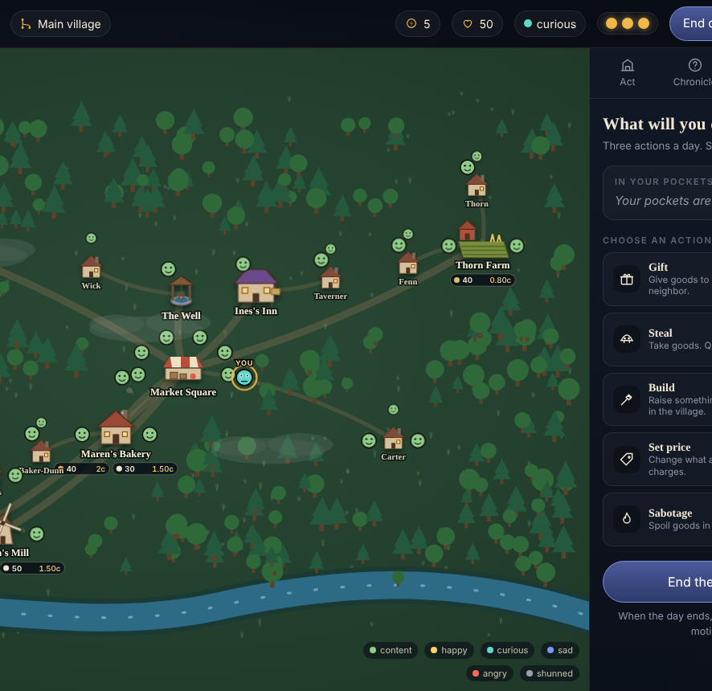
Butterfly
Effect
A village that never forgets. Every action leaves a trace, and the database can prove it.
DBMS course project · PostgreSQL · Node.js · SVG
Notes:
Open with the story: you buy bread, steal a loaf, and days later a festival is cancelled. Then say: the game is the skin; the database is the engine.

Slide 2
THE IDEA
Do something small. Ask the village why.
Ask Why
Parallel villages
Look Back
Point at anything that happened. A recursive query walks the causal graph back to the first action.
Rewind to any day and take a different path. The original village stays exactly as it was.
Slide through time and see prices, moods and homes exactly as they were.
Anything that must be correct is enforced by PostgreSQL itself, not by application code.

Slide 3
ARCHITECTURE
The database is the engine
Event store
append-only, hash-chained
16 tables, 46 functions, 6 triggers
3 views / materialized views, 5 RLS policies
13 SQL test suites on a fresh database
8 reproducible experiments with raw CSVs
Causal graph
DAG, recursive queries, closure table
Projections
triggers + procedures, rebuildable
Rules engine
rules are table rows, atomic cascades
Branching + time travel
snapshots, copy-on-write, as-of queries
Access layer
roles + row-level security
App + UI
Node API, WebSocket, SVG map

Slide 4
EVENT STORE AND HASH CHAIN
History is never edited, only extended
event is append-only: UPDATE and DELETE raise an exception and the privileges are revoked
hash = sha256(prev_hash || payload): change one old row and every later hash breaks
verify_event_chain() re-walks the chain and names the first bad row
Projections (stock, moods, coins) are disposable: rebuilt from events with the same digest
CREATE TRIGGER event_immutable
BEFORE UPDATE OR DELETE ON event
FOR EACH ROW
EXECUTE FUNCTION forbid_change();
-- UPDATE event SET ...
-- ERROR: events are immutable
Real life: bank ledgers, audit logs, Git, certificate transparency.

Slide 5
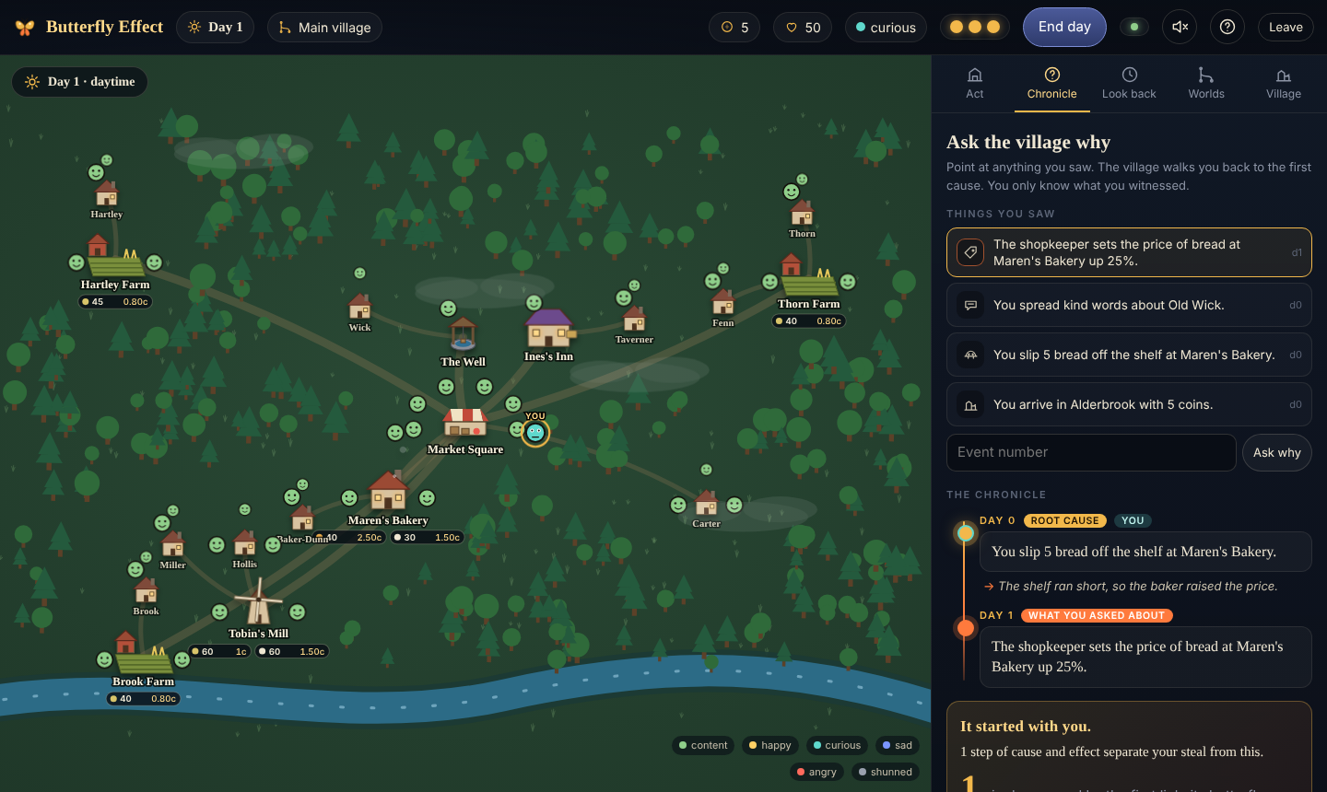
SUPERPOWER 1
Ask Why: a recursive query over a causal graph
WITH RECURSIVE walks event_cause back to the root
CHECK (cause_id < effect_id) makes cycles impossible
Compared with a closure table and a materialized path (experiment 3)
Fog of knowledge: you can only trace what you witnessed
Notes:
Demo: steal a loaf on day 0, end the day, click the price rise in the Chronicle. The village walks back to the theft.

Slide 6
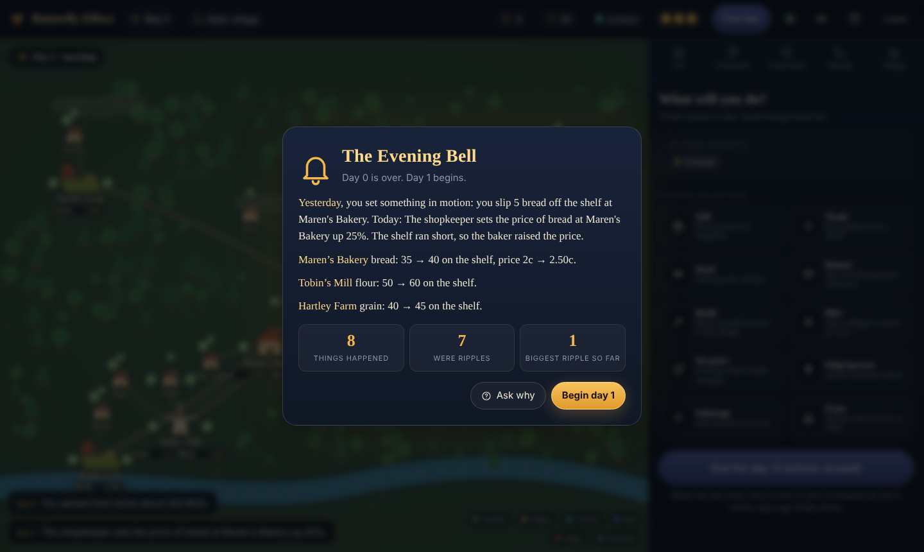
RULES ENGINE, TRIGGERS, PROCEDURES
Rules are data, not code
apply_action() inserts the action, finds firing rules, inserts effect events with causal links
Delayed consequences live in scheduled_effect and arrive when the day advances (FOR UPDATE SKIP LOCKED)
Add a rule with one INSERT: no application change
One action + its whole cascade = one transaction: failure leaves no trace

Slide 7
EXPERIMENT 1 · ISOLATION AND LOCKING
The last loaf goes to exactly one player
READ COMMITTED + read-then-write: 900 phantom sales (lost update)
FOR UPDATE, atomic UPDATE, optimistic version, SERIALIZABLE: correct
Atomic conditional UPDATE: ~1,234 TPS. FOR UPDATE: ~64 TPS
Deadlock: opposite lock order aborts 64 of 100; ordered locks abort 0

Slide 8
EXPERIMENT 5 · INDEXING AT 10K, 100K, 1M EVENTS
Indexes: 146 seconds became 0.19 seconds
Seq scans became index-only or index scans
Q5 closure lookup: 1,508x faster at 1M events
Cost: 9 s build, 245 MB at 1M events
Read EXPLAIN ANALYZE, then index

Slide 9
EXPERIMENT 4 · BRANCHING
Parallel villages: three ways to fork the past
Replay: always works, cost grows with history
Snapshot + delta: replay only events after the newest snapshot
Copy-on-write: cheapest, but only from today
A state digest proves each child equals the parent at the fork

Slide 10
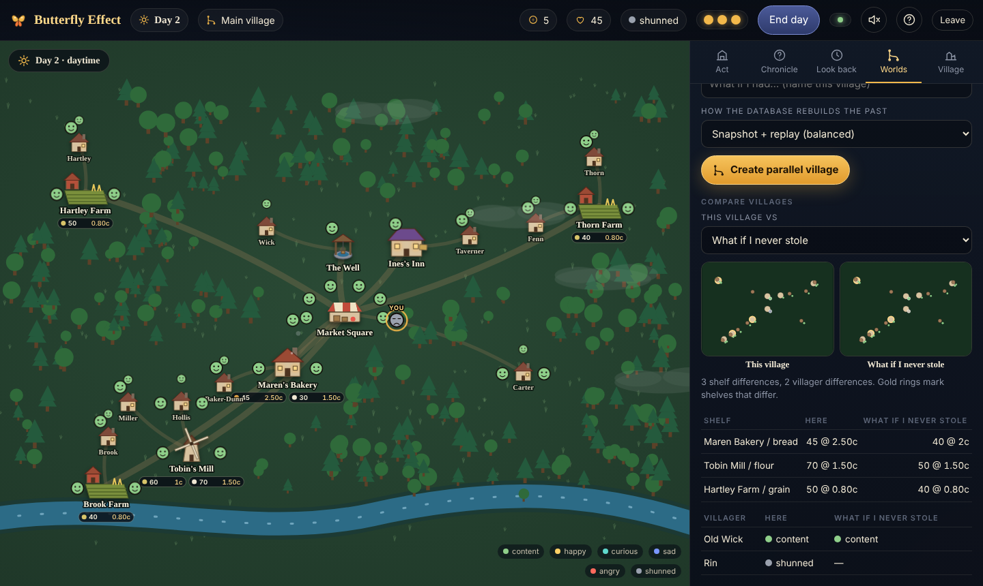
ROLES AND ROW-LEVEL SECURITY
Only know what you saw
Players see only events they witnessed (RLS policy on event_witness)
A causal link is visible only if both its events are: some trails go cold on purpose
look_back and branch_diff are privileged, so the API redacts other villagers to public mood
Parameterized queries everywhere; app.actor_id set per transaction

Slide 11
EXPERIMENT 7 · DURABILITY AND RECOVERY
Crash it, restore it, rebuild it
Crash mid-write
Point-in-time recovery
Rebuild from events
Server killed with a transaction in flight. After WAL redo: 0 partial rows, 0 chain problems, same digest, 1.13 s.
Base backup + archived WAL restored to a chosen moment: 1,304 of 1,304 events, same digest.
Drop every projection and replay. 10,404 events: projections in 1.9 s, whole world in 2.5 s, same digest.

Slide 12
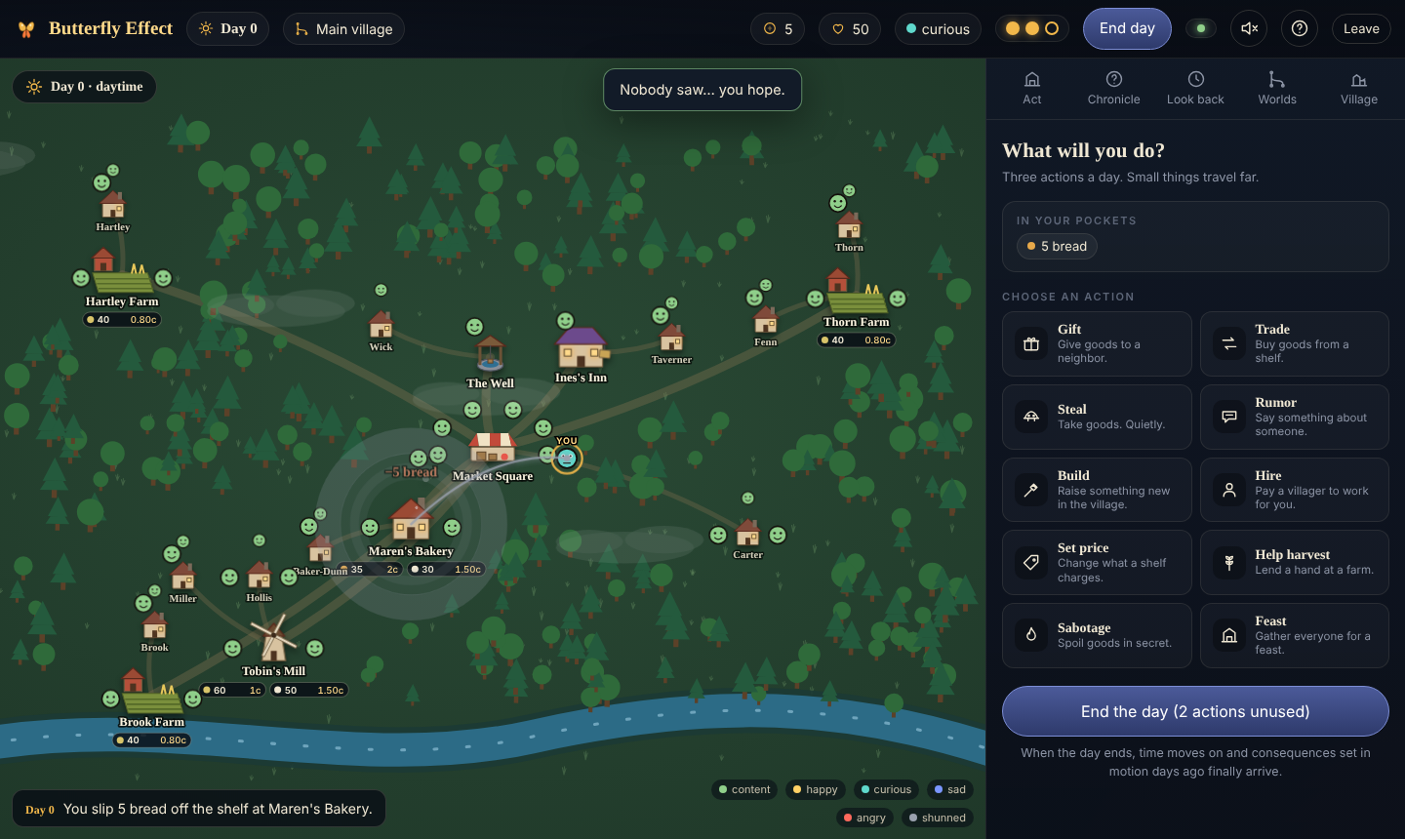
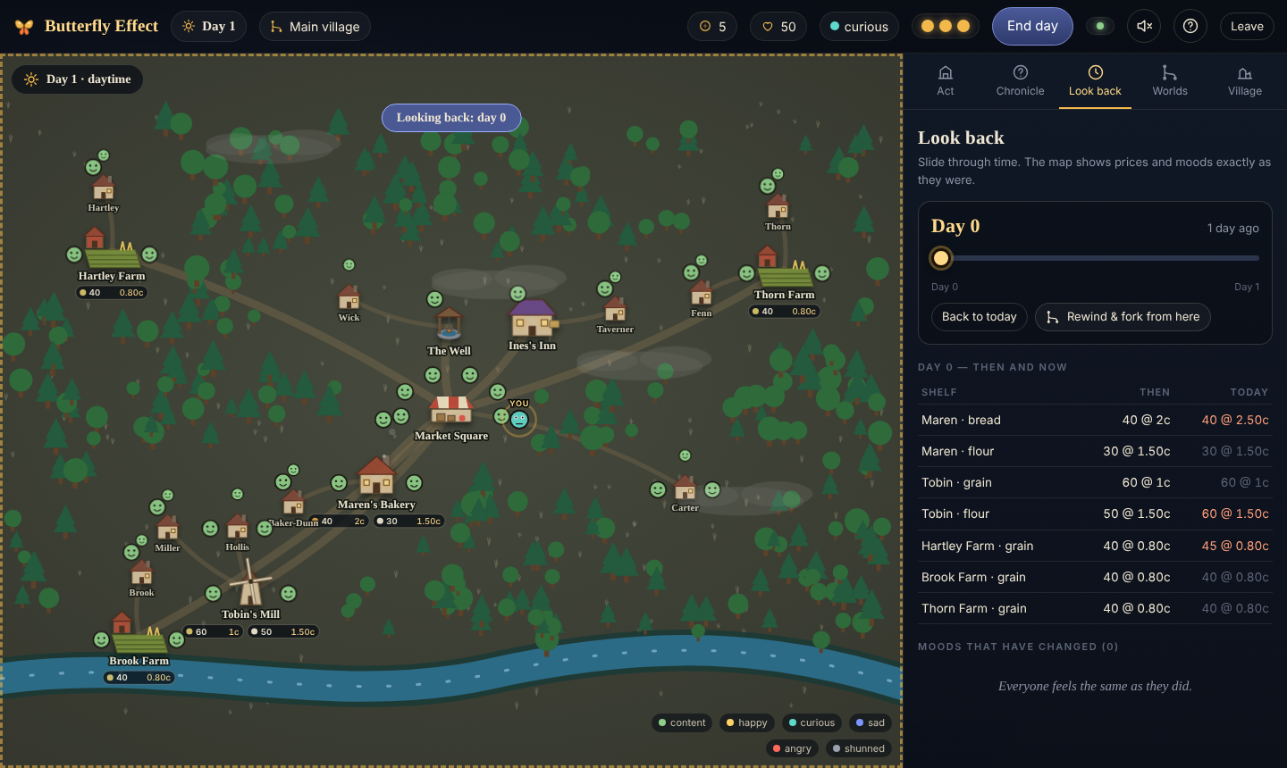
DEMO
Live demo path (4 minutes)
1 Steal a loaf → 2 End the day, Evening Bell → 3 Ask why on the price rise → 4 Look back → 5 Fork day 0 and compare

Slide 13
WRAP-UP
Every syllabus concept, with proof
Modeling, BCNF normalization, constraints (CHECK, exclusion)
Event sourcing, hash chain, immutability
Recursive queries, closure table, materialized path
Triggers, procedures, rules as data
Transactions, isolation levels, locking, deadlock
Indexing and EXPLAIN ANALYZE at 1M rows
Views, materialized views, window functions
Temporal data, branching, RLS, WAL, PITR, partitioning
If a system must explain what happened and prove it, this is the pattern.

