Slide 1
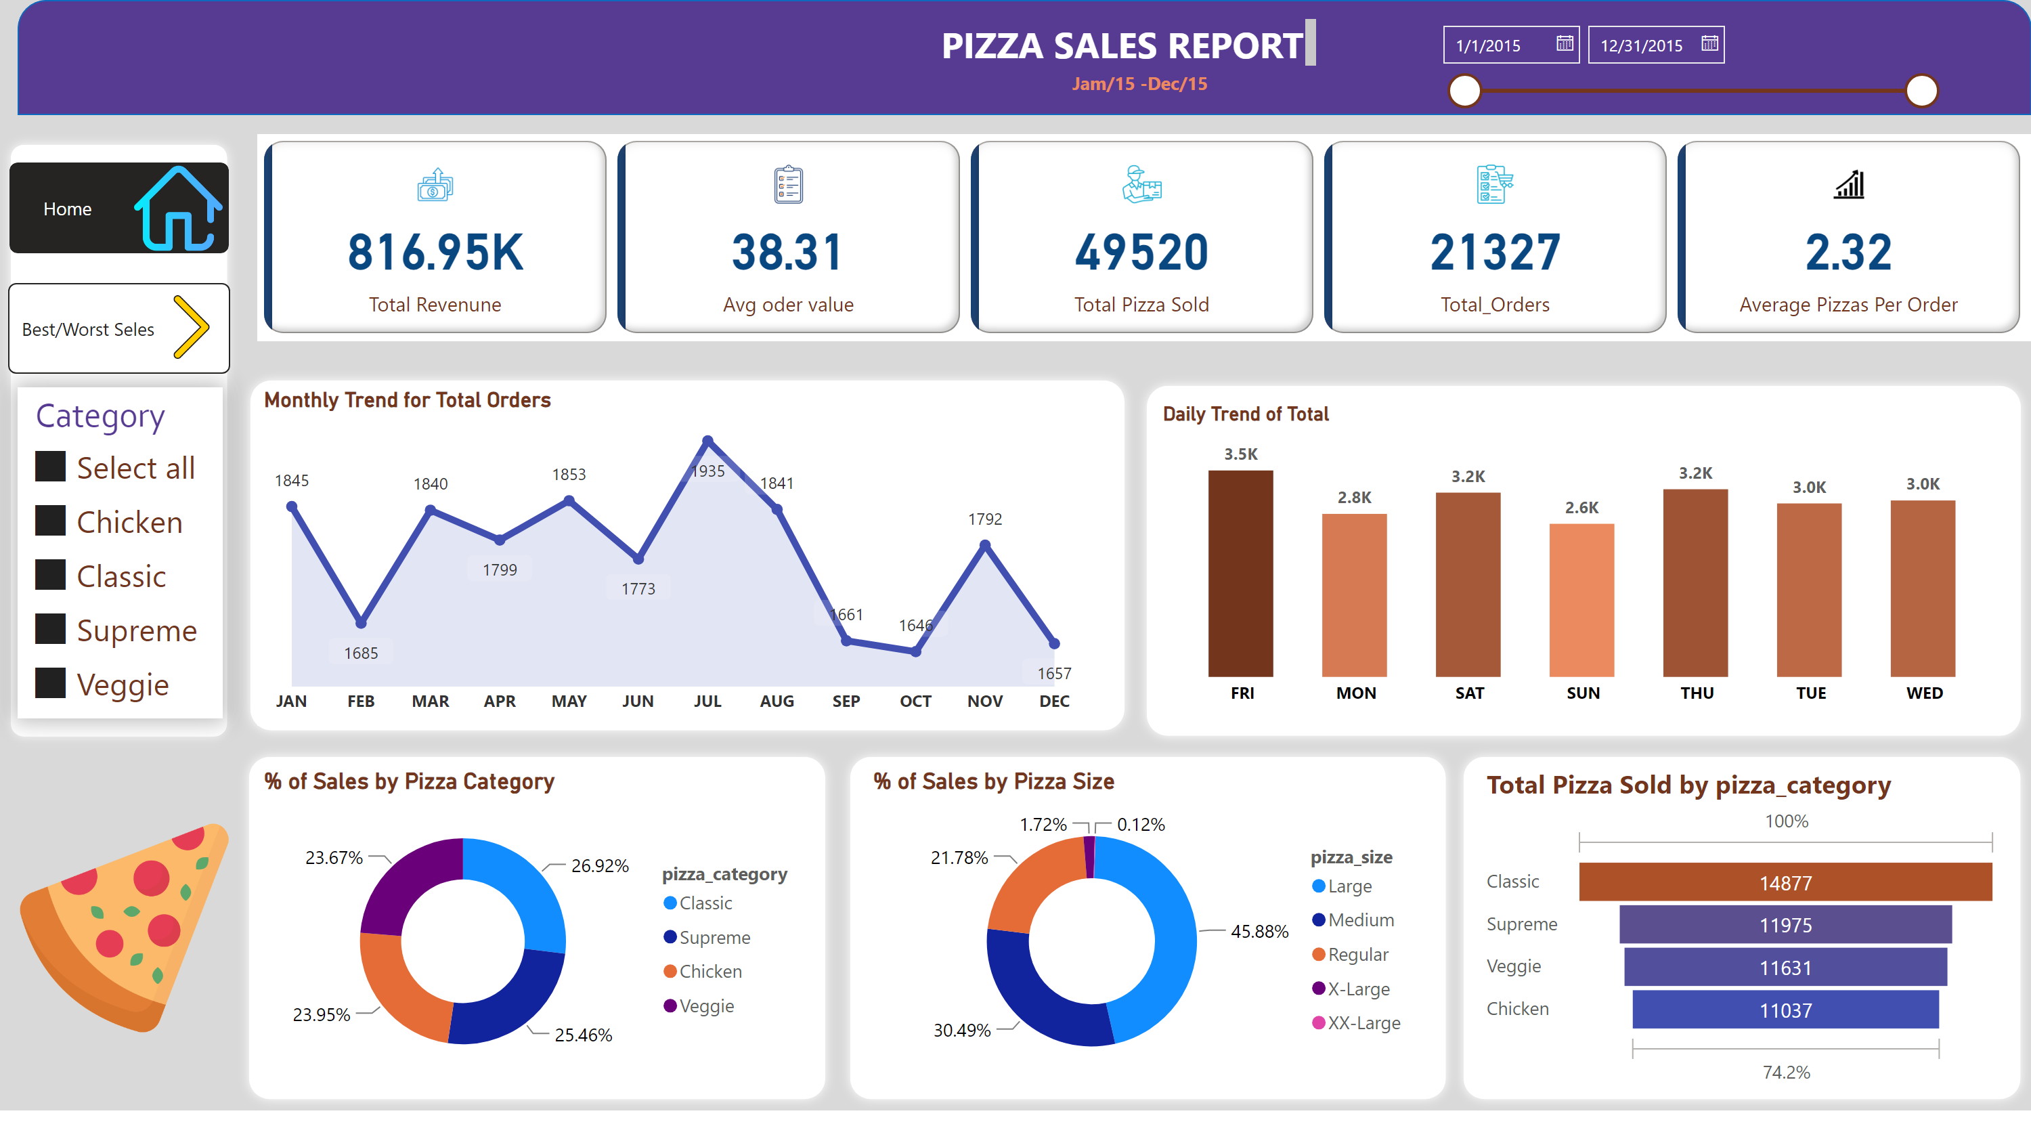
Home
Notes:
cardVisual
No alt text provided
shape
No alt text provided
textbox
No alt text provided
textbox
No alt text provided
image
No alt text provided
shape
No alt text provided
Daily Trend of Total
No alt text provided
Monthly Trend for Total Orders
No alt text provided
shape
No alt text provided
shape
No alt text provided
shape
No alt text provided
% of Sales by Pizza Category
No alt text provided
% of Sales by Pizza Size
No alt text provided
funnel
No alt text provided
shape
No alt text provided
shape
No alt text provided
slicer
No alt text provided
slicer
No alt text provided
pageNavigator
No alt text provided
pageNavigator
No alt text provided
image
No alt text provided
image
No alt text provided

Slide 2
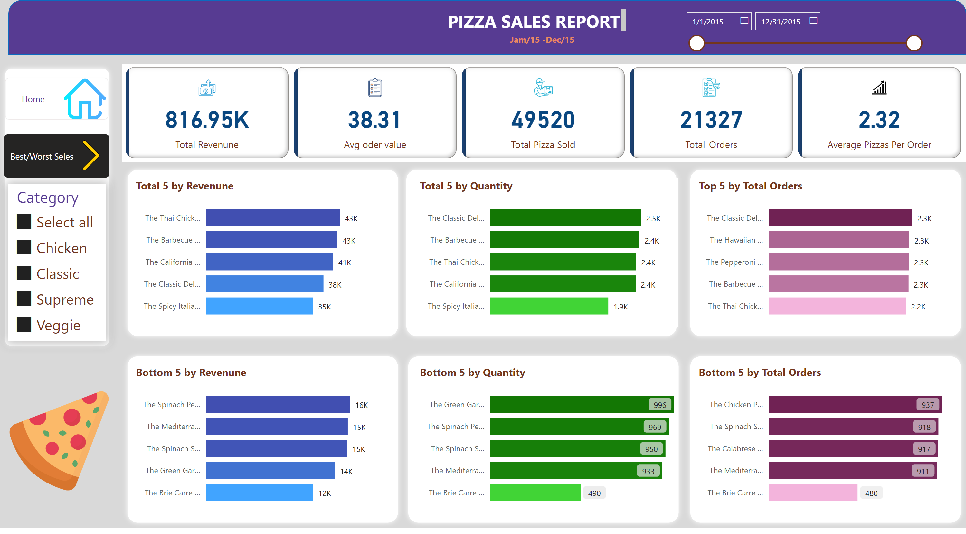
Best/Worst Seles
Notes:
cardVisual
No alt text provided
shape
No alt text provided
textbox
No alt text provided
textbox
No alt text provided
shape
No alt text provided
shape
No alt text provided
slicer
No alt text provided
slicer
No alt text provided
shape
No alt text provided
shape
No alt text provided
shape
No alt text provided
shape
No alt text provided
shape
No alt text provided
Total 5 by Revenune
No alt text provided
Bottom 5 by Revenune
No alt text provided
Total 5 by Quantity
No alt text provided
Bottom 5 by Quantity
No alt text provided
Top 5 by Total Orders
No alt text provided
Bottom 5 by Total Orders
No alt text provided
image
No alt text provided
pageNavigator
No alt text provided
pageNavigator
No alt text provided
image
No alt text provided
image
No alt text provided

