Slide 1
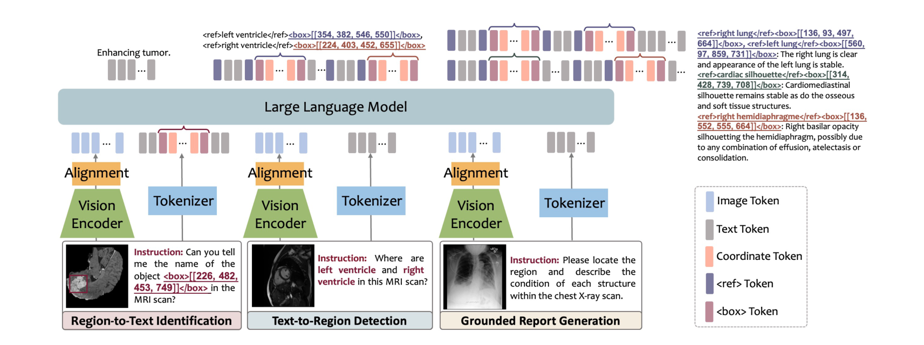
Region-Centric Task Formulation
Regions written as bounding-box tokens — the basis of the three region-centric tasks
Figure 4 — the three region-centric tasks (paper)
Box-as-text
Box coordinates written straight into the sentence: <ref>object</ref> <box>[x1,y1,x2,y2]</box>, normalized to integers in [0, 1000) (i.e. 0–999) → no separate box output; all three tasks reduce to text generation.
MedRegA · Wang et al., ICLR 2025
1

Slide 2
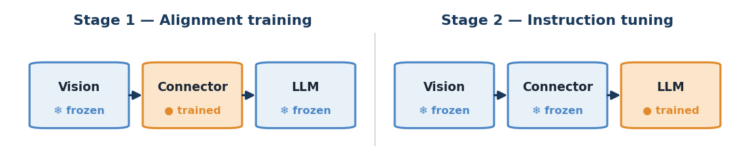
Model Training — two steps
Base InternVL 1.2 (InternViT-6B + Yi-34B) — alignment training, then instruction tuning
Stage 1 — Alignment training
Goal: teach the connector to map medical images → language
Data: medical images + captions (captioning)
Train: connector only; vision & LLM frozen
Stage 2 — Instruction tuning
Goal: perform many tasks from instructions
Data: public (VQA, report, classification) + MedRegInstruct (3 region tasks)
Train: LLM; loss = next-token prediction
MedRegInstruct — bilingual region data (used in Stage 2)
790K semi-automatically built samples: 550K Region-Text (SA-Med2D-20M) + 240K Region-Grounded (MIMIC-CXR + a Chinese hospital). Chinese hospital reports → the English–Chinese ability other baselines lack.
MedRegA · Wang et al., ICLR 2025
2

Slide 3
Stage-2 instructions — the three region-centric tasks
Each task is an instruction type: what goes in → what the model returns
Task | Input | Model returns
Region-to-Text Identification | image + box [coords] | region name — e.g. “liver”, “tumor”
Text-to-Region Detection | image + name — e.g. “where is the liver?” | box [coords] of the region
Grounded Report Generation | the whole image | a report, each line tied to a box
How instructions are written
Coordinates are written inline: <box>[x1,y1,x2,y2]</box>, normalized to 0–999 → every answer (including location) is text generation. These (instruction → answer) pairs come from MedRegInstruct (previous slide).
MedRegA · Wang et al., ICLR 2025
3

Slide 4
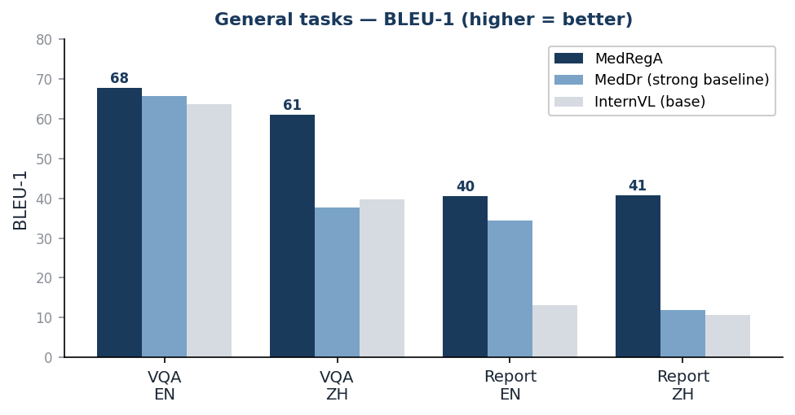
Performance on General Medical Tasks
On par in English, clearly ahead in Chinese
▪ English: slight edge — VQA 67.7 vs MedDr 65.7.
▪ Chinese: big jump — Report +28.8, VQA +23 BLEU-1.
▪ Classification: F1 47.97 vs 32.65 (+15).
▪ Regional CoT (detect regions first → then reason): +31.6 F1 (VinDr-SpineXR) → localizing helps even general tasks.
Takeaway
On general tasks MedRegA is slightly ahead; it pulls away on bilingual data and with region-guided reasoning.
MedRegA · Wang et al., ICLR 2025
4

Slide 5
Region-Aligned Evaluation on Region-Centric Tasks
Baselines score near 0 — this is MedRegA's unique ability
Region → Text (naming)
Text → Region (detection)
Metric | Baseline | MedRegA
BLEU-1 | ≤0.75 | 69.72
F1 | ≤1.27 | 70.43
BertScore | 50.28 | 87.13
Metric | InternVL | MedRegA
Object F1 | 56.60 | 77.93
Region F1 | 6.70 | 38.24
Alignment F1 | 5.45 | 36.53
IoU | 12.28 | 23.43
Metric ladder (harder →)
Object = right name → Region = right place → Alignment = both → IoU = how tight.
IoU note
IoU 23.43 is computed with Hungarian matching over matched pairs only. Grounded-report IoU 52.07 is higher because targets are large organs (easier), while detection aims at small tumors (harder).
MedRegA · Wang et al., ICLR 2025
5

Slide 6
Conclusion — and the bridge to our work
What the paper contributes, and its limits (our observations)
Paper's contributions
Three region-centric tasks + the MedRegInstruct dataset (semi-automatic labeling) + the MedRegA region-aware bilingual model. Core value: linking region ↔ text → more interpretable & clinically interactive.
▪ Only Chinese–English — no Vietnamese.
▪ Mostly 2D — no 3D / multi-phase CT.
▪ No external validation / calibration — deployment reliability still open.
→ Bridge
MedRegA is strong on region-language & interpretability, but limited on Vietnamese, 3D data, and external validation → that's where our work steps in.
* The paper has no explicit Limitations/Future-Work section — these are our own observations.
MedRegA · Wang et al., ICLR 2025
6

