Slide 1
Our Improvements on MedRegA
Fine-tuning Gemma 4 E4B for liver-tumor detection on CT (LiTS)
A small model — honest about evaluation & reliability
Deep Learning Seminar · 2026

Slide 2
Our architecture & method
Each choice fixes ONE MedRegA limitation
MedRegA limitation | Our choice (why)
Load on the 40B LLM; “eyes” & “bridge” frozen → localization not sharp | Gemma 4 E4B (~8B) + unlock vision (pIoU 0.015→0.27)
Only 1 central slice, no negatives → can't measure invented boxes | Multi-slice + negatives (measures false-positives); tight per-lesion boxes, split by patient
Cost 16×H800 — out of reach for a student | LoRA + full fine-tune vision, runs on 1 GPU
Per-image (pseudoreplication); no abstain / CI | Per-patient + CI, detect/localize split, selective prediction
MedRegA Improvements · Gemma 4 E4B (liver tumor, LiTS)
2

Slide 3
Our results
What our model achieves — reported directly
0.89
80%
0.27
Detection F1 (patient)
Sensitivity — catch tumors
Localization pIoU
▪ recall@IoU.25 = 54% · False-positive = 1.5% (rarely invents boxes) · pIoU CI95 [0.19, 0.36].
▪ No forgetting: still chats / JSON / poem / math (LoRA keeps base weights).
▪ Localization on the same (matched) basis: ~0.32 vs MedRegA ~0.23; our penalized pIoU (0.27) is stricter still — their targets are larger with looser boxes, different dataset.
⚠ Note
The test set is small — about 25 tumor patients and 2 without — so the numbers still vary; this is a proof-of-concept, not a clinical system.
MedRegA Improvements · Gemma 4 E4B (liver tumor, LiTS)
3
Notes:
METRIC EXPLANATION (Presenter View):
• Detection F1 0.89 = balance of recall (catching tumors) & precision (not over-flagging); computed PER-PATIENT to avoid inflation.
• Sensitivity 80% = caught 20/25 tumor patients (missed 5) — the most clinically important number (missing a tumor is dangerous).
• Localization pIoU 0.27 = box overlap (intersection/union), PENALIZED for extra/missing lesions → moderate, the weaker point (finds the region but not tightly).
• recall@IoU.25 54% = 54% of tumors roughly localized (overlap ≥ 0.25).
• False-positive 1.5% = on tumor-free slices, rarely invents a box (good).
• CI95 [0.19, 0.36] = 95% confidence interval; the number varies because n is small (not a hard value).
• No forgetting = thanks to LoRA keeping base weights → still chats / JSON / poem / math.
• vs MedRegA (Q&A): their IoU 0.23 is MATCHED-ONLY (no miss penalty — Algorithm 1 Hungarian) on mostly LARGE structures + LOOSE boxes ("need not be tight", paper). Same matched basis: ours ~0.32 > 0.23. Our pIoU 0.27 is PENALIZED, stricter. Don't claim "we win" (different dataset). Don't say "they merge one box" — they are multi-box too (Figure 8).
• Caveat: small n (25 pos / 2 neg), wide CI, a PoC — no clinical claim.
SCRIPT (~40s): "Our model reaches F1 0.89 on detection, 80% sensitivity (20/25 patients). Localization pIoU is 0.27 — only moderate, we don't hide it. Pluses: rarely invents tumors (FP 1.5%) and no forgetting thanks to LoRA. Localization is on par with MedRegA despite being 5× smaller, but different data so reference only. This is a PoC, small sample, so statistical limits remain."

Slide 4
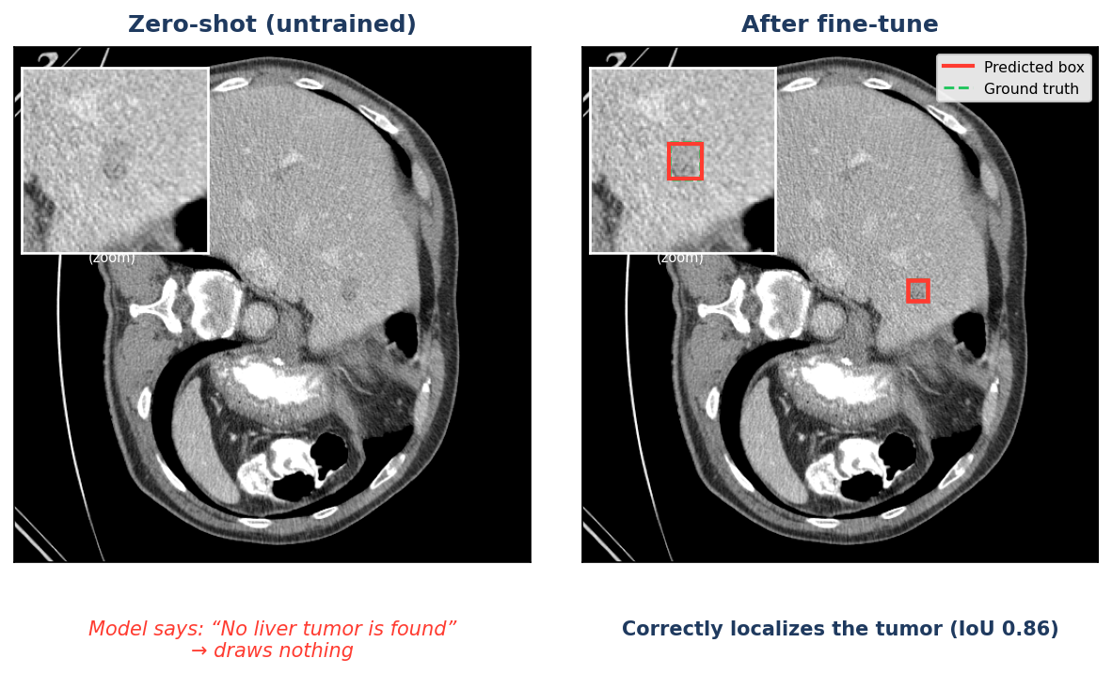
Where do the gains come from? — fine-tuning
Not just a model swap: zero-shot (new model, untrained) → fine-tuned
▪ Swapping models alone is NOT enough: zero-shot Gemma (untrained) scores only F1 0.33, almost always says “No tumor”.
▪ Fine-tuning creates the capability: F1 0.33→0.89, recall 0→54%, pIoU 0.002→0.27.
▪ Extra evidence: frozen vision → pIoU 0.015; unlock + train → 0.27 — the training choice is the key.
Takeaway
The gains come from FINE-TUNING (data + unlocked vision + eval), not from a newer model.
Same case: before → after fine-tune
MedRegA Improvements · Gemma 4 E4B (liver tumor, LiTS)
4

Slide 5
Future work
Each direction targets a limitation we observed
▪ Broaden scope: train on other medical tasks (multiple organs, more diseases); toward grounded reporting.
▪ Restore 3D context: 3D→2D loses context, hard to separate tumor from vessels (unlike radiologists) → stack consecutive slices (2.5D); further: multi-phase CT via contrast dynamics.
▪ Add Vietnamese medical knowledge: train on more Vietnamese data (many niche domain terms) for correct Vietnamese-context answers.
▪ More training data: current data is limited so evaluation n is too small to trust → more data + external validation + calibration.
Summary
This work demonstrates the feasibility of a region-centric approach at small scale (proof-of-concept); the directions above aim to address current limitations and move toward practical application.
MedRegA Improvements · Gemma 4 E4B (liver tumor, LiTS)
5

