Slide 1


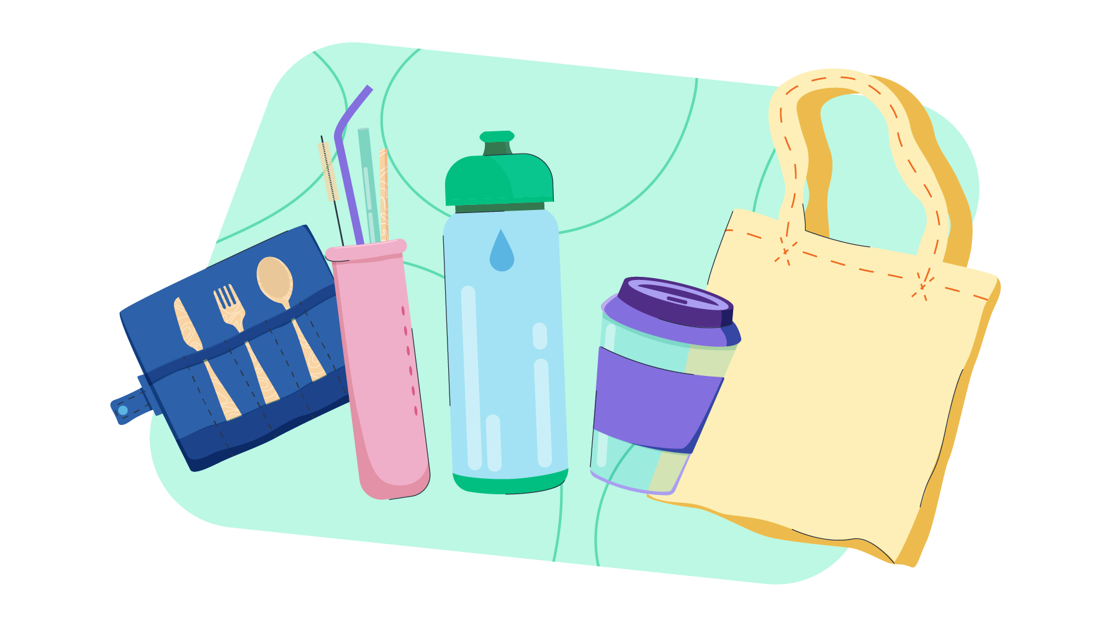
GROUP 1

Slide 2






OUR TEAM
Quang
Đức
Duy
Sơn

Slide 3


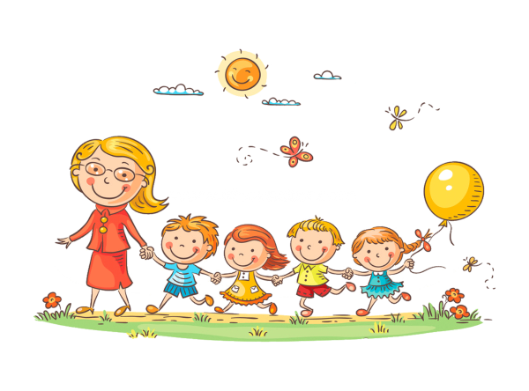

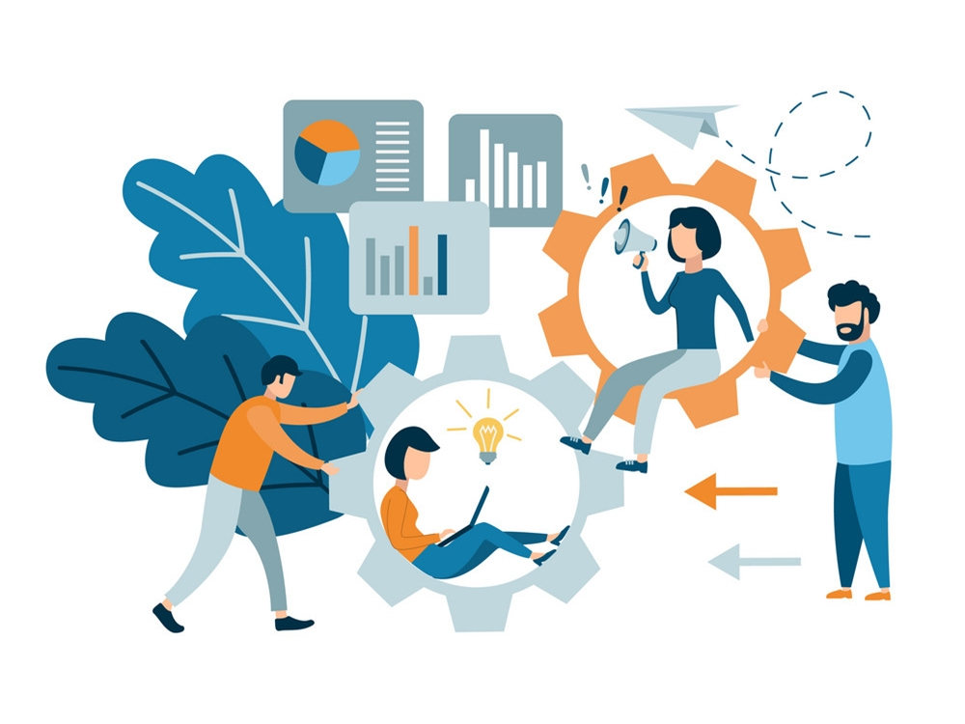
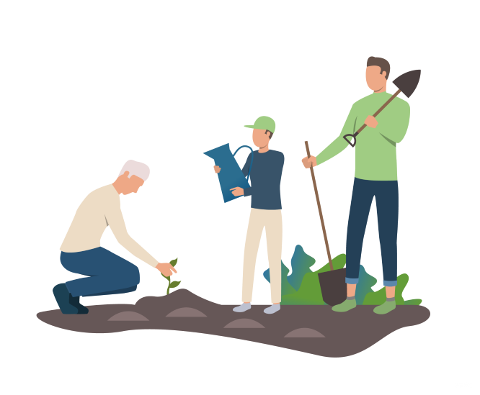

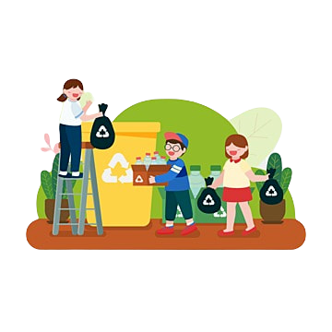






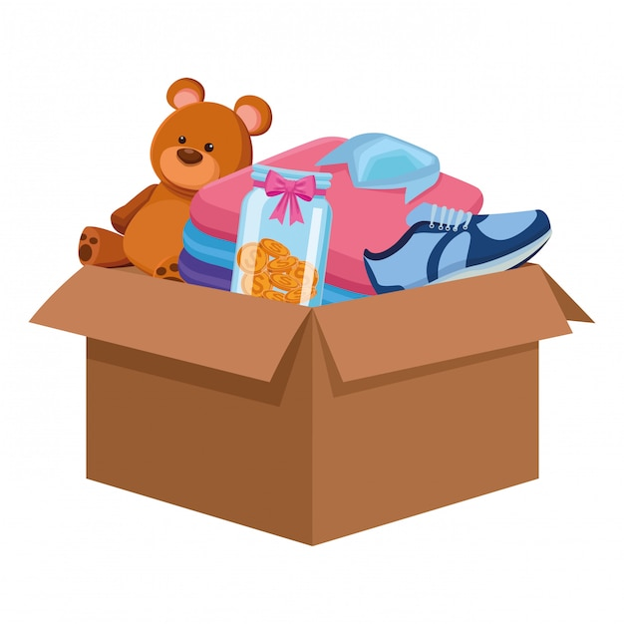
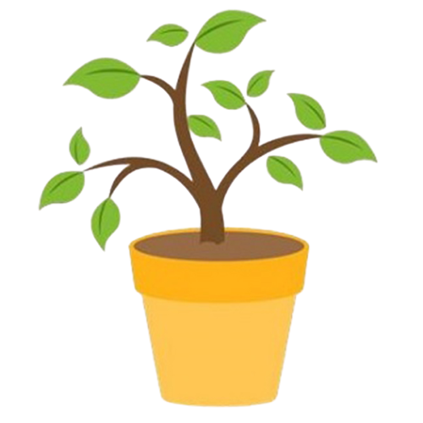

Holding a meeting with the local people to plan the details of what we will do.
Holding a meeting with the local people to plan the details of what we will do.
Holding a meeting with the local people to plan the details of what we will do.
Holding a meeting with the local people to plan the details of what we will do.
Holding a meeting with the local people to plan the details of what we will do.
In the morning, my friends and I will pick up trash that is littered on the street and put it in the trash
We will issue a report on the effectiveness of the event
We will also be giving away bags made from eco-friendly materials to help reduce the use of plastic bags
We will participate in planting new trees along the roadside
Holding a meeting with the local people to plan the details of what we will do
report
donate
plant
invite
pick up

Slide 4


