Slide 1
Chapter 10.B: File-System Implementation

Slide 2
Chapter 10.B: Outline
File-System Structure
File-System Operations
Directory Implementation
Allocation Methods
Free-Space Management
Efficiency and Performance

Slide 3
Objectives
Describe the details of implementing local file systems and directory structures
Discuss block allocation and free-block algorithms and trade-offs
Explore file system efficiency and performance issues
Look at recovery from file system failures
Describe the WAFL file system as a concrete example

Slide 4
File-System Structure
File structure
Logical storage unit
Collection of related information
File system resides on secondary storage (e.g., disks)
Provided user interface to storage, mapping logical to physical
Provides efficient and convenient access to disk by allowing data to be stored, located, and retrieved easily
Disk provides in-place rewrite and random access
I/O transfers performed in blocks of sectors (usually 512 bytes)
File control block (FCB) – storage structure consisting of information about a file
Device driver controls the physical device
File system is organized into layers

Slide 5
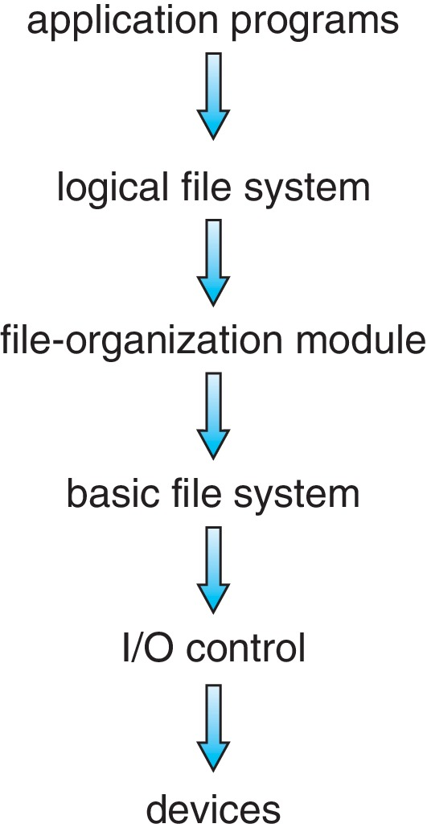
Layered File System
Layering useful for reducing complexity and redundancy, but adds overhead and can decrease performance
Device drivers manage I/O devices at the I/O control layer
E.g., Given commands like “read drive1, cylinder 72, track 2, sector 10, into memory location 1060” outputs low-level hardware specific commands to hardware controller
Basic file system given command like “retrieve block 123” translates to device driver
Also manages memory buffers and caches (allocation, freeing, replacement)
Buffers hold data in transit
Caches hold frequently used data

Slide 6
Layered File System
File organization module understands files, logical address, and physical blocks
Translates logical block # to physical block #
Manages free space, disk allocation
Logical file system manages metadata information
Translates file name into file number, file handle, location by maintaining file control blocks (i.e., inodes in UNIX)
Directory management
Protection
Logical layers can be implemented by any coding method according to OS designer

Slide 7
File System Layers (Cont.)
Many file systems exist within an operating system
Each with its own format (CD-ROM is ISO 9660; Unix has UFS, FFS; Windows has FAT, FAT32, NTFS as well as floppy, CD, DVD Blu-ray, Linux has more than 130 types, with extended file system ext3 and ext4 leading; plus distributed file systems NFS, etc.)

Slide 8
File-System Implementation
We have system calls at the API level, but how do we implement their functions?
On-disk and in-memory structures
Boot control block contains info needed by system to boot OS from that volume
Needed if volume contains OS, usually first block of volume
Volume control block (e.g., superblock, master file table) contains volume details
Total # of blocks, # of free blocks, block size, free block pointers or array
Directory structure organizes the files
Names and inode numbers, master file table

Slide 9
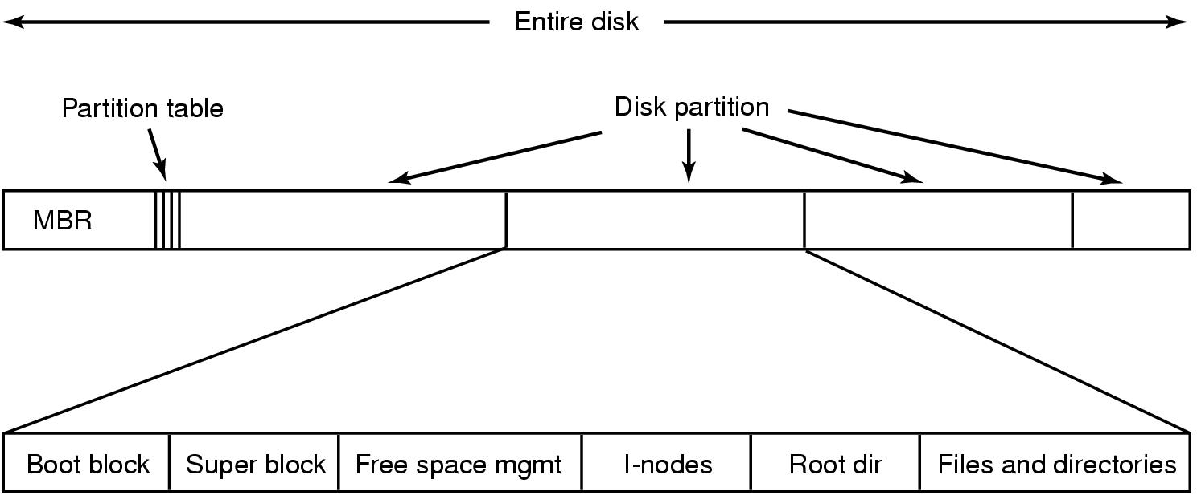
File-System Implementation (Cont.)
MBR
Partition control block
FCB’s
Boot sector
i-nodes

Slide 10
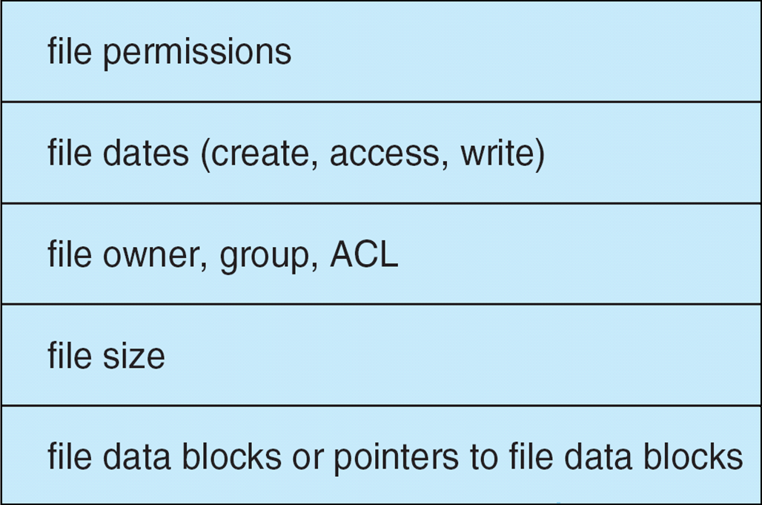
File-System Implementation (Cont.)
Per-file File Control Block (FCB) contains many details about the file
typically inode number, permissions, size, dates
NTFS stores into in master file table using relational DB structures

Slide 11
In-Memory File System Structures
Mount table storing file system mounts, mount points, file system types
System-wide open-file table contains a copy of the FCB of each file and other info
Per-process open-file table contains pointers to appropriate entries in system-wide open-file table as well as other info
The following figure illustrates the necessary file system structures provided by the operating systems
Figure (a) refers to opening a file
Figure (b) refers to reading a file
Plus buffers hold data blocks from secondary storage
Open returns a file handle for subsequent use
Data from read copied to specified user process memory address

Slide 12
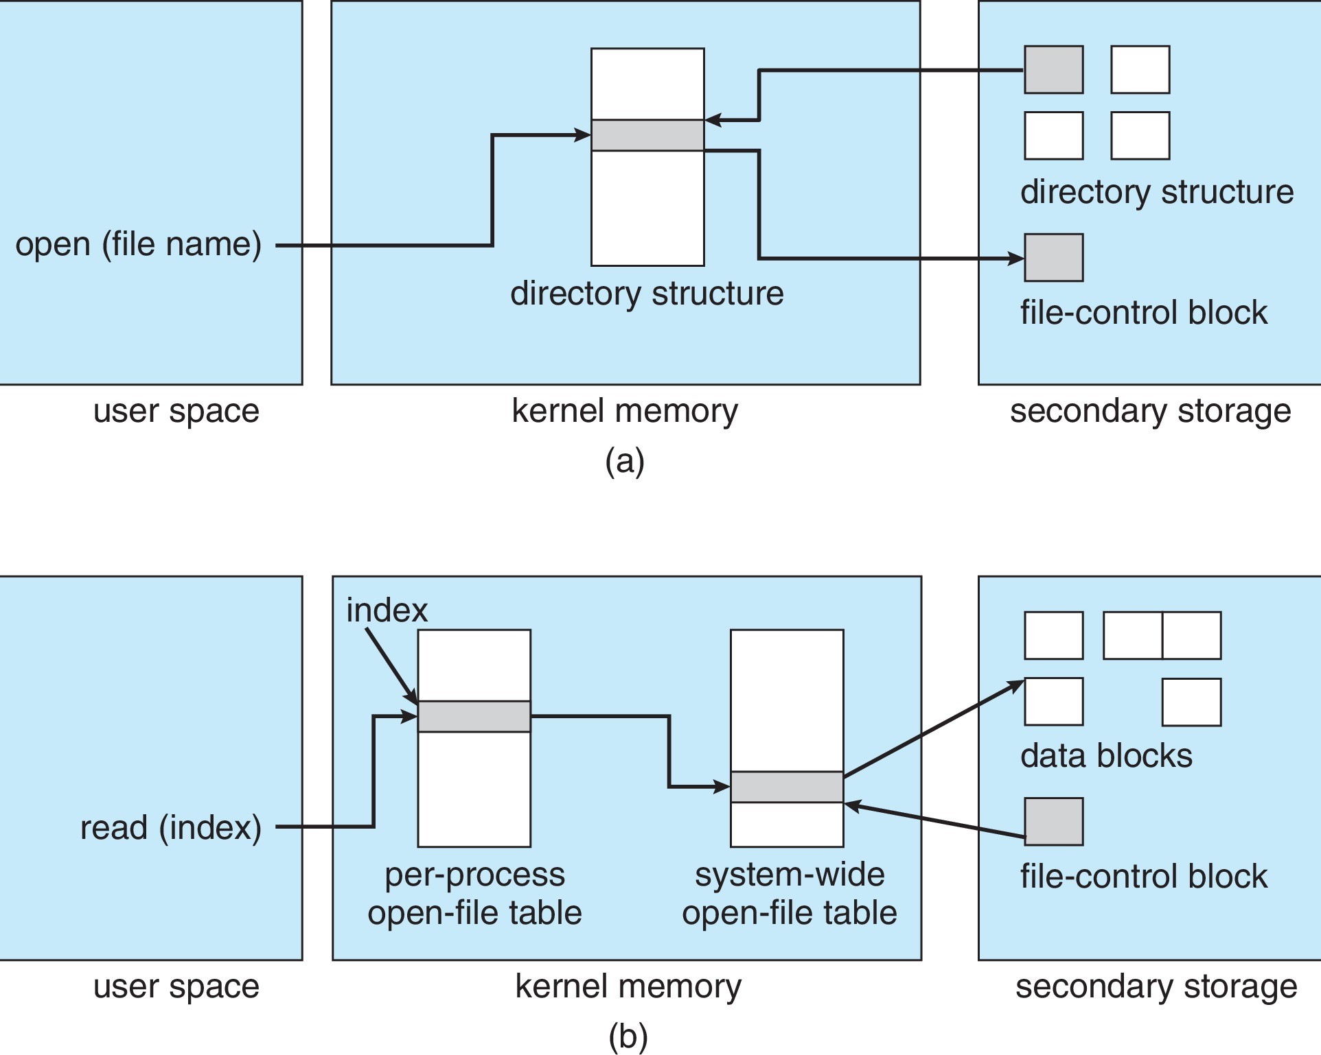
In-Memory File System Structures

Slide 13
Directory Implementation
Linear list of file names with pointer to the data blocks
Simple to program
Time-consuming to execute
Linear search time
Could keep ordered alphabetically via linked list or use B+ tree
Hash Table – linear list with hash data structure
Decreases directory search time
Collisions – situations where two file names hash to the same location
Only good if entries are fixed size, or use chained-overflow method

Slide 14
Allocation Methods – Contiguous
An allocation method refers to how disk blocks are allocated for files
Contiguous allocation – each file occupies set of contiguous blocks
Best performance in most cases
Simple – only starting location (block #) and length (number of blocks) are required
Problems include finding space for file, knowing file size, external fragmentation, need for compaction off-line (downtime) or on-line

Slide 15
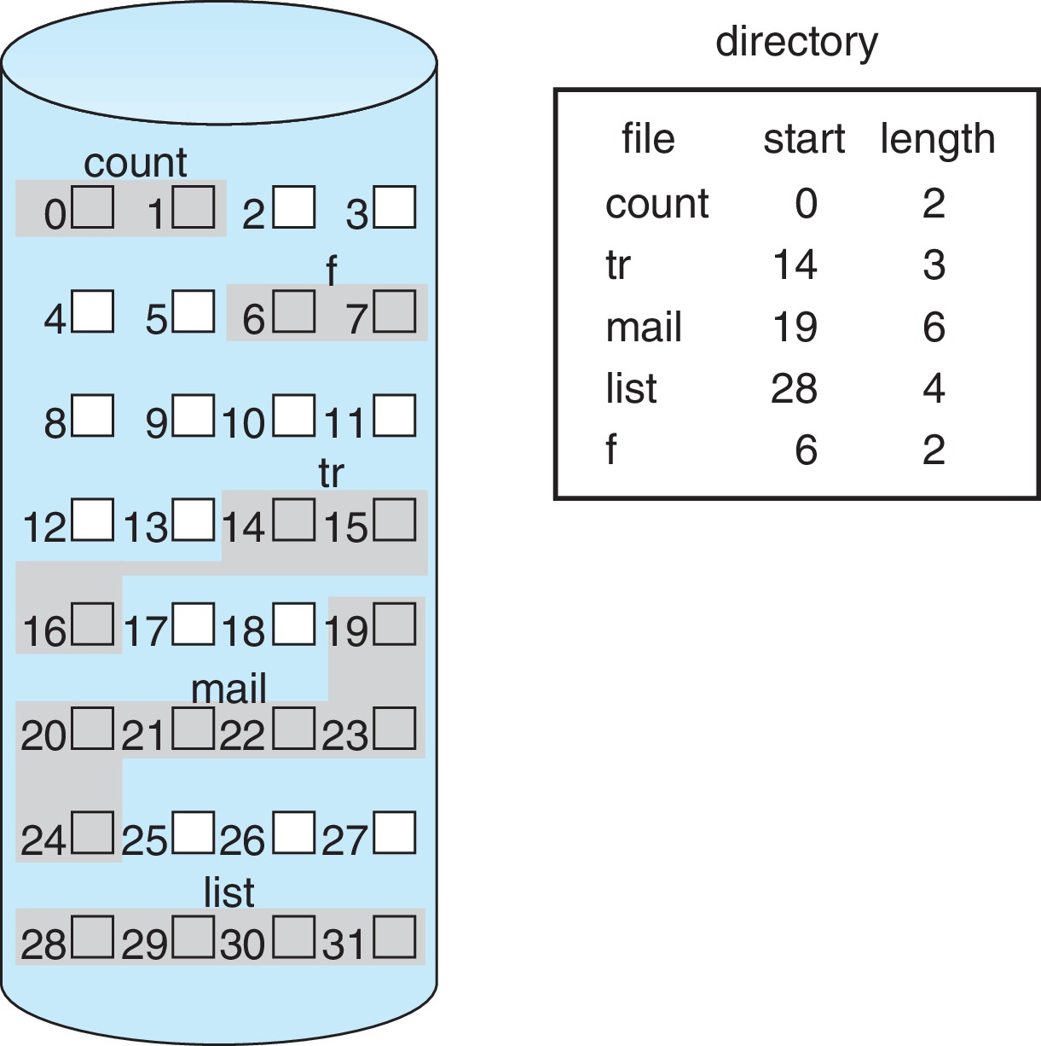
Contiguous Allocation
Mapping from logical to physical
Block to be accessed = Q + starting address
Displacement into block = R
Q
LA/512
R

Slide 16
Extent-Based Systems
Many newer file systems (e.g., Veritas File System) use a modified contiguous allocation scheme
Extent-based file systems allocate disk blocks in extents
An extent is a contiguous block of disks
Extents are allocated for file allocation
A file consists of one or more extents

Slide 17
Allocation Methods - Linked
Linked allocation – each file is a linked list of blocks
File ends at nil pointer
No external fragmentation
Each block contains pointer to next block
No compaction, external fragmentation
Free space management system called when new block needed
Improve efficiency by clustering blocks into groups but increases internal fragmentation
Reliability can be a problem
Locating a block can take many I/Os and disk seeks
File Allocation Table (FAT) variation
Beginning of volume has table, indexed by block number
Much like a linked list, but faster on disk and cacheable
New block allocation simple

Slide 18
Linked Allocation
Each file is a linked list of disk blocks: blocks may be scattered anywhere on the disk
Mapping
Block to be accessed is the Q^{th} block in the linked chain of blocks representing the file
Displacement into block = R + 1
block =
pointer
Q
LA/511
R

Slide 19
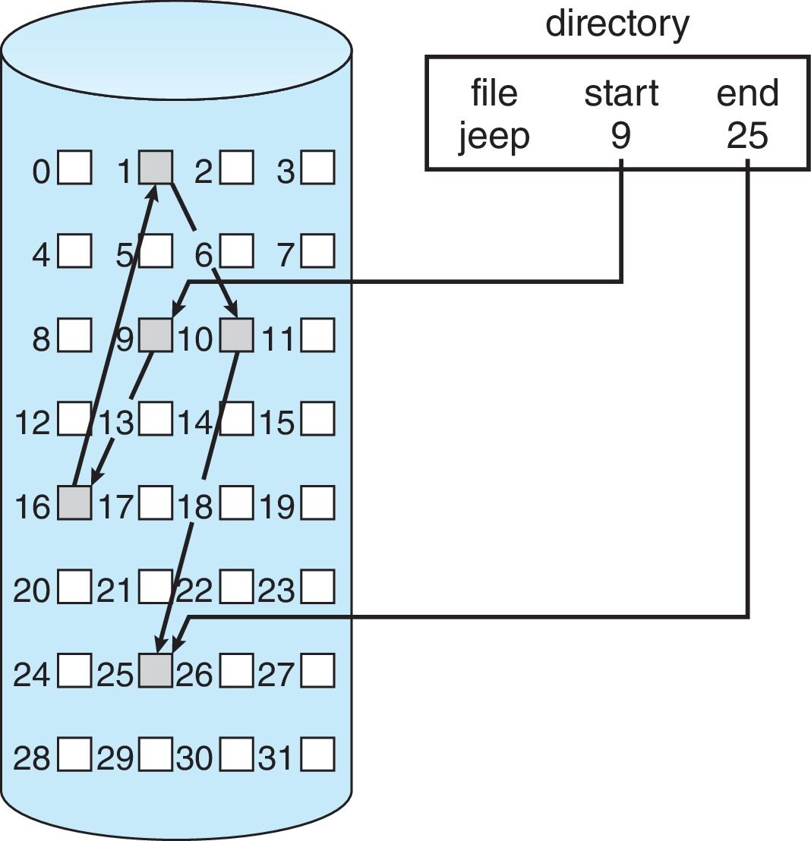
Linked Allocation

Slide 20
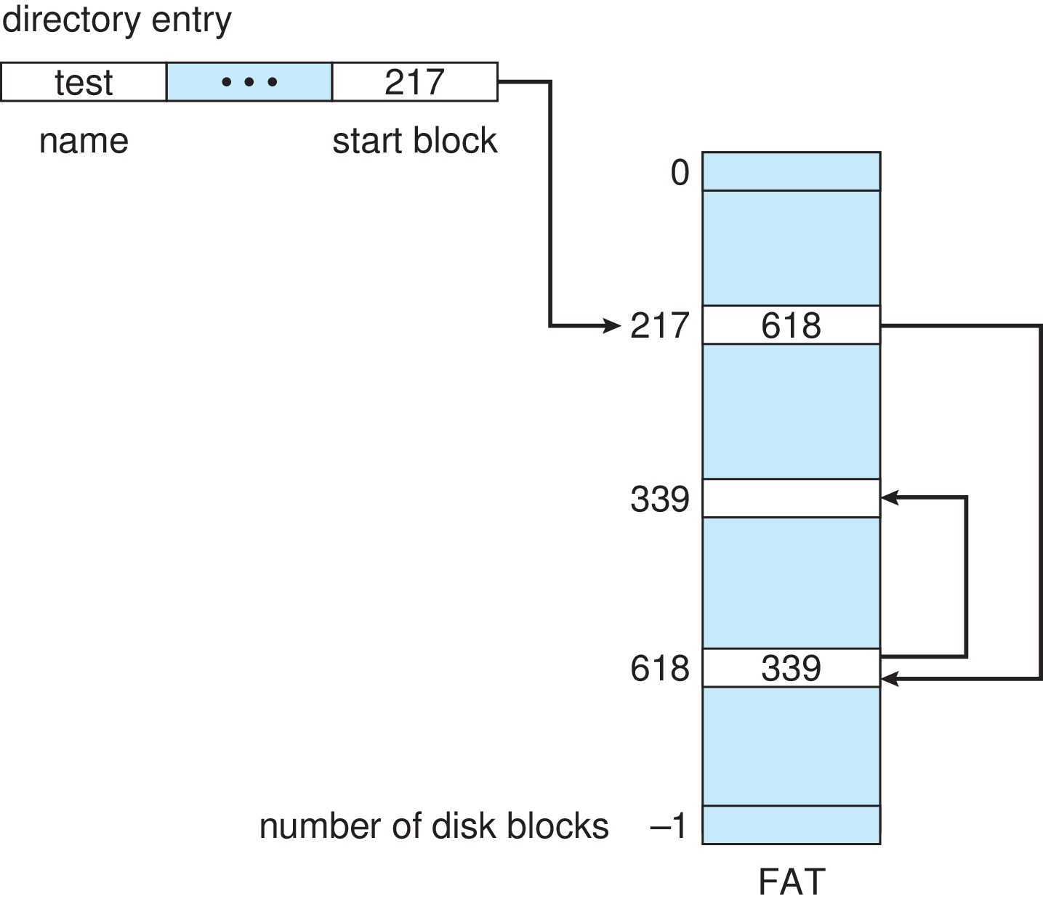
File-Allocation Table (FAT)

Slide 21
Allocation Methods – Indexed
Indexed allocation
Each file has its own index block(s) of pointers to its data blocks
Logical view

Slide 22
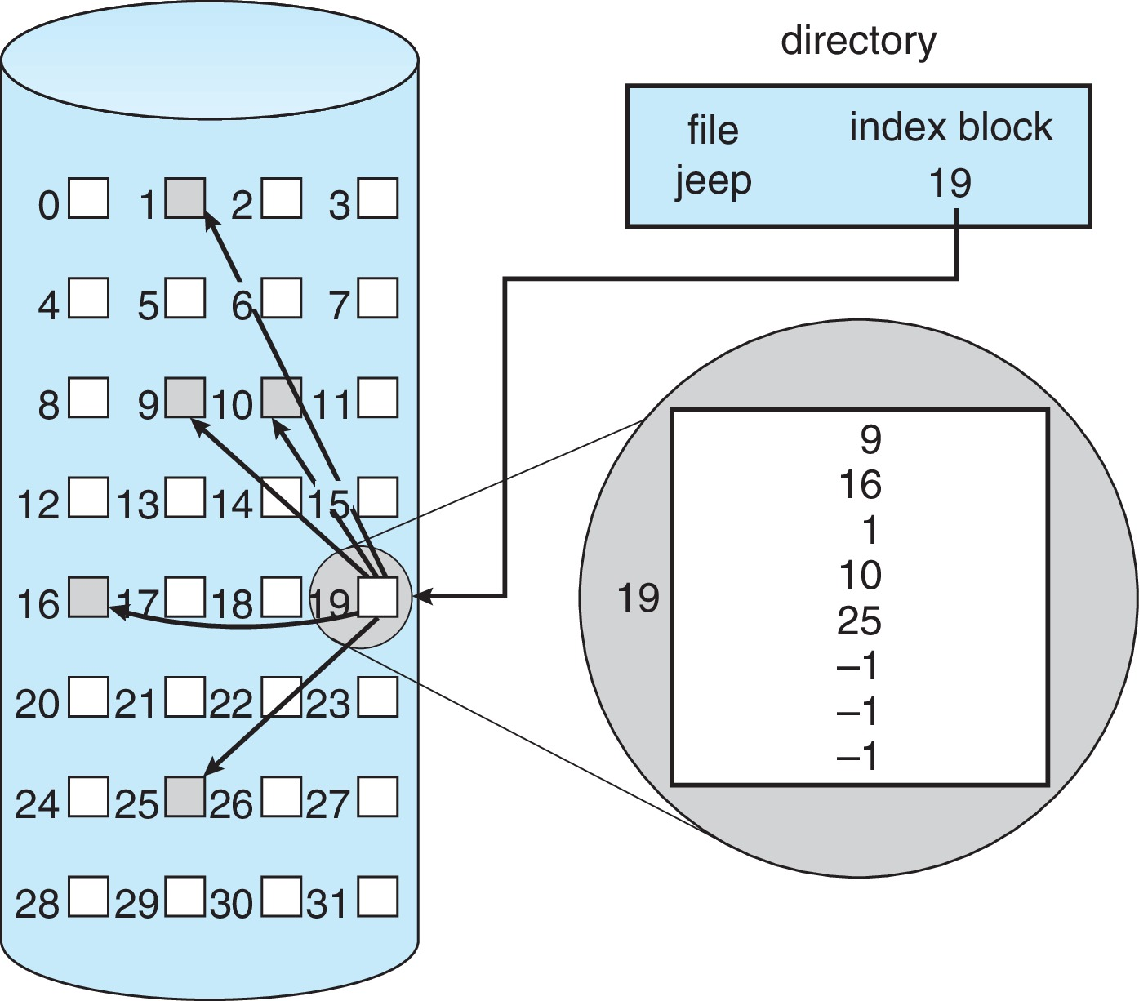
Example of Indexed Allocation

Slide 23
Indexed Allocation (Cont.)
Need index table
Random access
Dynamic access without external fragmentation, but have overhead of index block
E.g., Mapping from logical to physical in a file of maximum size of 256K bytes and block size of 512 bytes. We need only 1 block for index table
Q = displacement into index table
R = displacement into block
Q
LA/512
R

Slide 24
Indexed Allocation – Mapping (Cont.)
Mapping from logical to physical in a file of unbounded length (block size of 512 words)
Linked scheme – Link blocks of index table (no limit on size)
Q₁ = block of index table
R₁ is used as follows:
Q₂ = displacement into block of index table
R₂ = displacement into block of file:
Q₁
LA / (512 x 511)
Q₂
R₁
R₁ / 512
R₂

Slide 25
Indexed Allocation – Mapping (Cont.)
E.g., Two-level index (4K blocks could store 1,024 four-byte pointers in outer index -> 1,048,567 data blocks and file size of up to 4GB)
Q₁ = displacement into outer-index
R₁ is used as follows:
Q₂ = displacement into block of index table
R₂ displacement into block of file:
Q₁
LA / (512 x 512)
Q₂
R₁
R₁ / 512
R₂

Slide 26
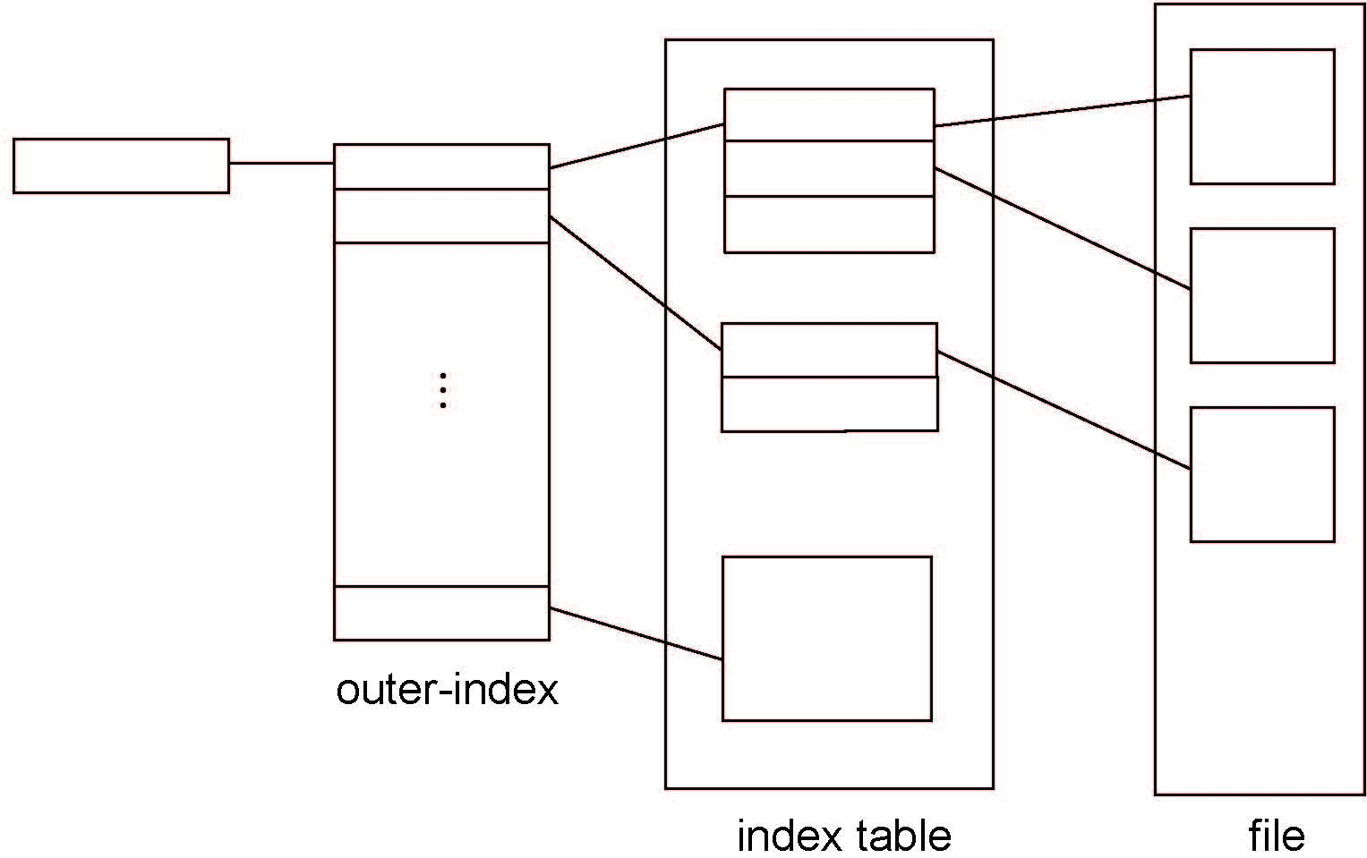
Indexed Allocation – Mapping (Cont.)

Slide 27
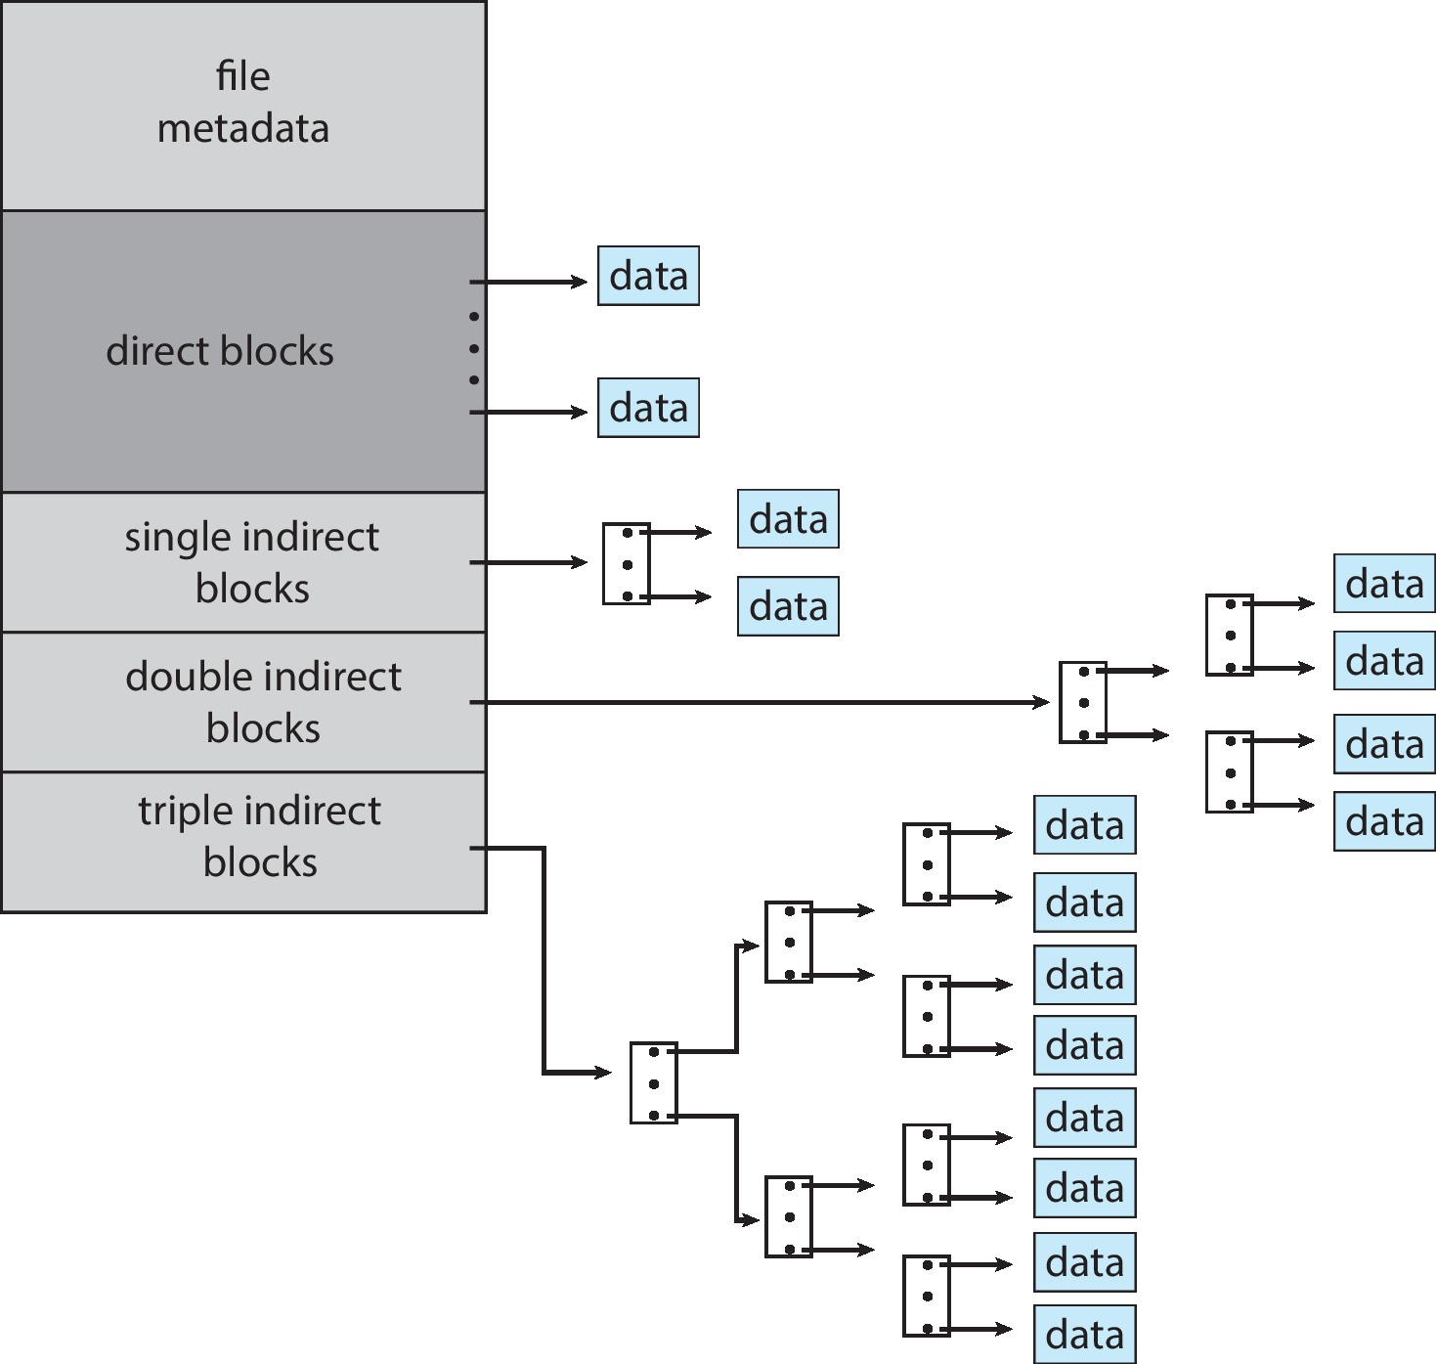
Combined Scheme: UNIX UFS
Suppose that on a computer, the OS uses i-nodes and each disk block is 4KB.
Assume that an i-node contains 12 direct block
numbers (disk addresses)
and the block numbers for one indirect block,
one double indirect block,
and one triple indirect block. Assume also that a block
number is 4 bytes.
What is the largest possible file on that computer
(assuming the disk is large enough).
4K bytes per block, 32-bit addresses
More index blocks than can be addressed with 32-bit file pointer

Slide 28
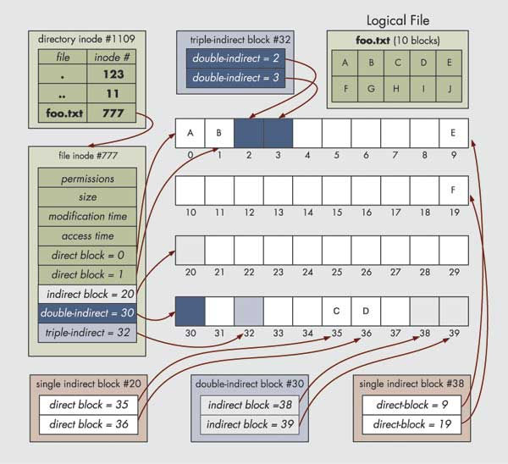
File (user view)

Slide 29
Performance
Best method depends on file access type
Contiguous great for sequential and random
Linked good for sequential, not random
Declare access type at creation –> select either contiguous or linked
Indexed more complex
Single block access could require 2 index block reads, then data block read
Clustering can help improve throughput, reduce CPU overhead
For NVM, no disk head so different algorithms and optimizations needed
An old algorithm uses many CPU cycles for trying to avoid non-existent head movement
With NVM goal is to reduce CPU cycles and overall path needed for I/O

Slide 30
Performance (Cont.)
Adding instructions to the execution path to save one disk I/O is reasonable
Intel Core i7 Extreme Edition 990x (2011) at 3.46Ghz = 159,000 MIPS
http://en.wikipedia.org/wiki/Instructions_per_second
Typical disk drive at 250 I/Os per second
159,000 MIPS / 250 = 630 million instructions during one disk I/O
Fast SSD drives provide 60,000 IOPS
159,000 MIPS / 60,000 = 2.65 millions instructions during one disk I/O

Slide 31
Free-Space Management
File system maintains free-space list to track available blocks/clusters
(Using term “block” for simplicity)
Bit vector or bit map (n blocks)
Block number calculation
(number of bits per word)* (number of 0-value words) + offset of first 1 bit
CPUs have instructions to return offset within word of first “1” bit
0
1
2
n-1
…
1 ⇒ block[i] free
0 ⇒ block[i] occupied
bit[i] =


Slide 32
Free-Space Management (Cont.)
Bit map requires extra space
Example:
block size = 4KB = 212 bytes
disk size = 240 bytes (1 terabyte)
n = 240/212 = 228 bits (or 32MB)
if clusters of 4 blocks -> 8MB of memory
Easy to get contiguous files

Slide 33
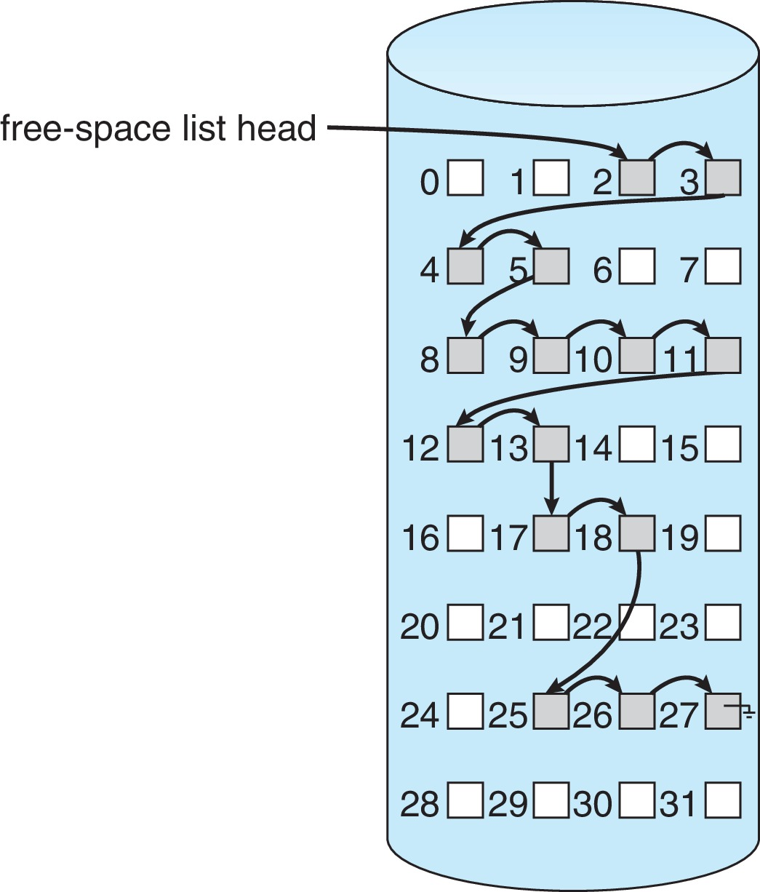
Linked Free Space List on Disk
Linked list (free list)
Cannot get contiguous space easily
No waste of space
No need to traverse the entire list (if # free blocks recorded)

Slide 34
Free-Space Management (Cont.)
Grouping
Modify linked list to store address of next (n-1) free blocks in first free block, plus a pointer to next block that contains free-block-pointers (like this one)
Counting
Because space is frequently contiguously used and freed, with contiguous-allocation allocation, extents, or clustering
Keep address of first free block and count of following free blocks
Free space list then has entries containing addresses and counts

Slide 35
Free-Space Management (Cont.)
Grouping
Modify linked list to store address of next (n) free blocks in first free block, plus a pointer to next block that contains free-block-pointers (like this one)
0
1
2
3
4
5
6
7
8
9
10
11
12
13
14
15
16
17
18
19
Grouping, n = 3 Block 2 stores 3, 4, 5 Block 5 stores 8, 9, 10 Block 10 stores 11, 12, 13 Block 13 stores 17, 28, 25 Block 25 stores 26, 27
20
21
22
23
24
25
26
27
28
29
30
31

Slide 36
Free-Space Management (Cont.)
Counting
Because space is frequently contiguously used and freed, with contiguous-allocation allocation, extents, or clustering
Keep address of first free block and count of following free blocks
Free space list then has entries containing addresses and counts
0
1
2
3
4
5
6
7
8
9
10
11
12
13
14
15
16
17
18
19
20
21
22
23
24
25
26
27
28
29
30
31
start count
2 4 8 6 17 2 25 3

Slide 37
Free-Space Management (Cont.)
Space Maps
Used in ZFS
Consider meta-data I/O on very large file systems
Full data structures like bit maps couldn’t fit in memory –> thousands of I/Os
Divides device space into metaslab units and manages metaslabs
Given volume can contain hundreds of metaslabs
Each metaslab has associated space map
Uses counting algorithm
But records to log file rather than file system
Log of all block activity, in time order, in counting format
Metaslab activity –> load space map into memory in balanced-tree structure, indexed by offset
Replay log into that structure
Combine contiguous free blocks into single entry

Slide 38
TRIMing Unused Blocks
HDDs overwrite in place so need only free list
Blocks not treated specially when freed
Keeps its data but without any file pointers to it, until overwritten
Storage devices not allowing overwrite (e.g., NVM) suffer badly with same algorithm
Must be erased before written, erases made in large chunks (blocks, composed of pages) and are slow
TRIM is a newer mechanism for the file system to inform the NVM storage device that a page is free
Can be garbage collected or if block is free, now block can be erased

Slide 39
Efficiency and Performance
Efficiency dependent on:
Disk allocation and directory algorithms
Types of data kept in file’s directory entry
Pre-allocation or as-needed allocation of metadata structures
Fixed-size or varying-size data structures
Performance
Keeping data and metadata close together
Buffer cache – separate section of main memory for frequently used blocks
Synchronous writes sometimes requested by apps or needed by OS
No buffering / caching – writes must hit disk before acknowledgement
Asynchronous writes more common, buffer-able, faster
Free-behind and read-ahead – techniques to optimize sequential access
Reads frequently slower than writes

Slide 40
Page Cache
A page cache caches pages rather than disk blocks using virtual memory techniques and addresses
Memory-mapped I/O uses a page cache
Routine I/O through the file system uses the buffer (disk) cache
This leads to the following figure

Slide 41
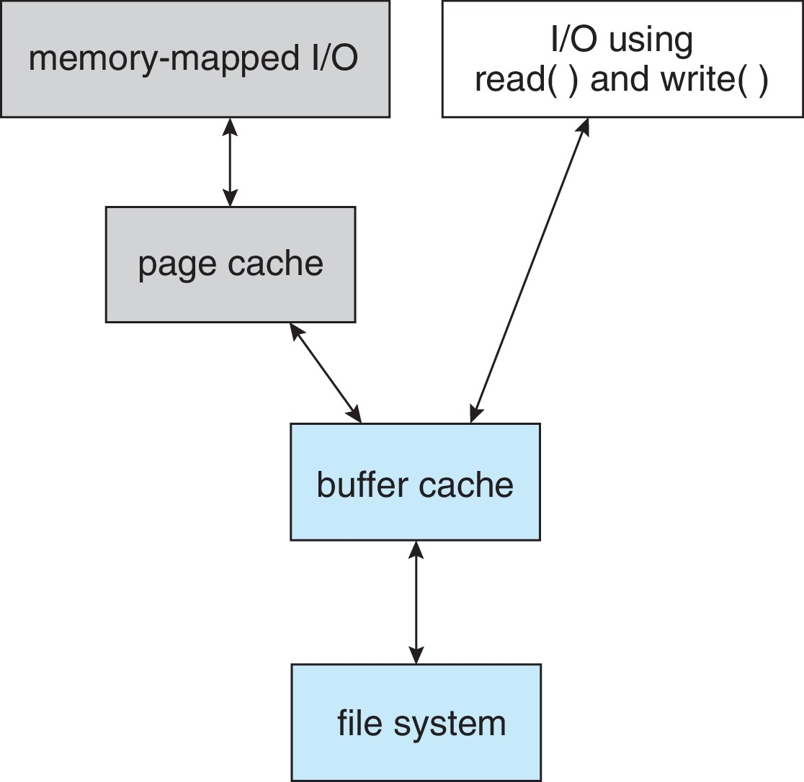
I/O Without a Unified Buffer Cache

Slide 42
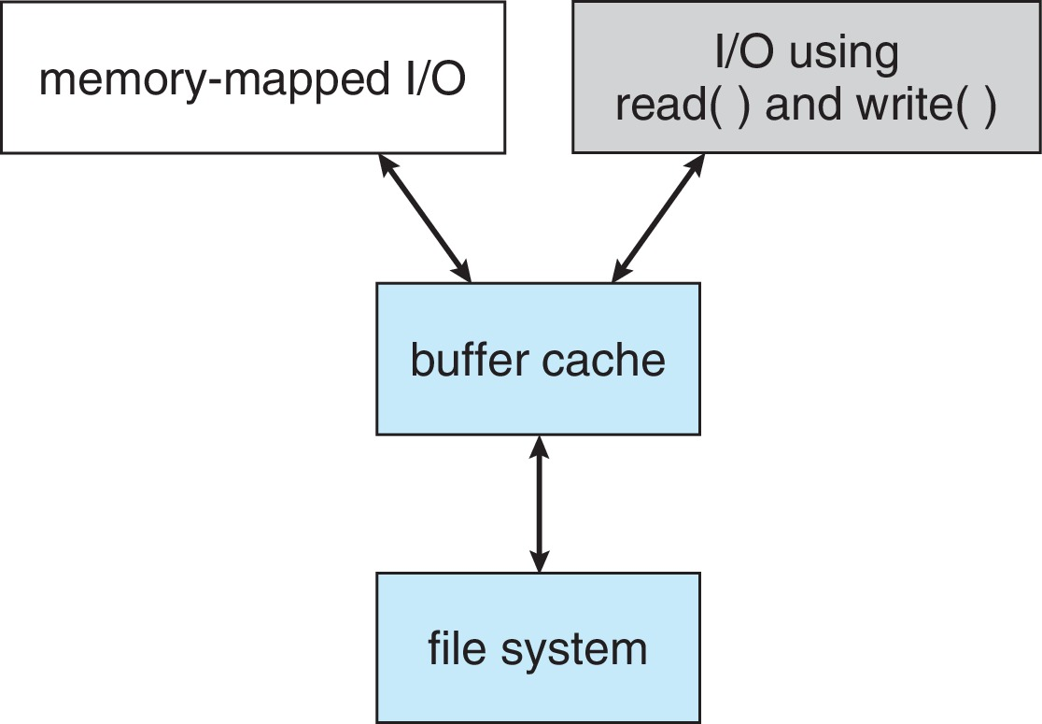
I/O Using a Unified Buffer Cache
A unified buffer cache uses the same page cache to cache both memory-mapped pages and ordinary file system I/O to avoid double caching
But which caches get priority, and what replacement algorithms to use?

Slide 43
Recovery
Consistency checking – compares data in directory structure with data blocks on disk, and tries to fix inconsistencies
Can be slow and sometimes fails
Use system programs to back up data from disk to another storage device (magnetic tape, other magnetic disk, optical)
Recover lost file or disk by restoring data from backup

Slide 44
Log Structured File Systems
Log structured (or journaling) file systems record each metadata update to the file system as a transaction
All transactions are written to a log
A transaction is considered committed once it is written to the log (sequentially)
Sometimes to a separate device or section of disk
However, the file system may not yet be updated
The transactions in the log are asynchronously written to the file system structures
When the file system structures are modified, the transaction is removed from the log
If the file system crashes, all remaining transactions in the log must still be performed
Faster recovery from crash, removes chance of inconsistency of metadata

Slide 45
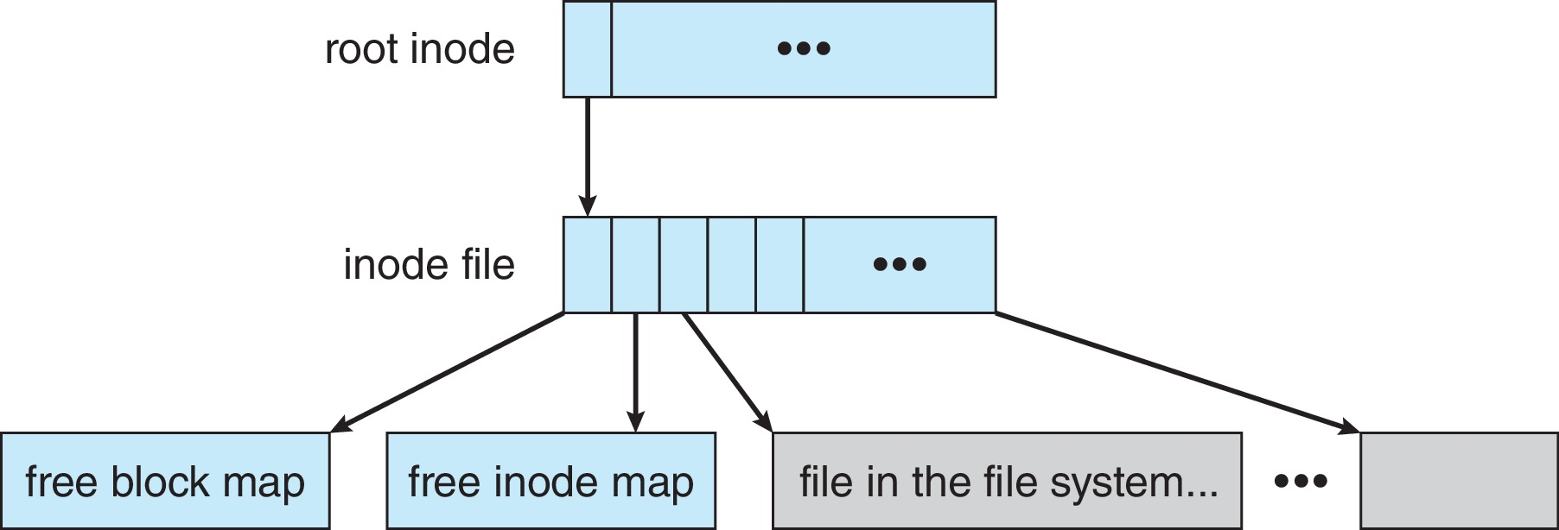
Example: WAFL File System
Write-Anywhere File Layout (WAFL)
Used on Network Appliance “Filers” – distributed file system appliances
Serves up NFS, CIFS, http, ftp
Random I/O optimized, write optimized
NVRAM for write caching
Similar to Berkeley Fast File System, with extensive modifications

Slide 46
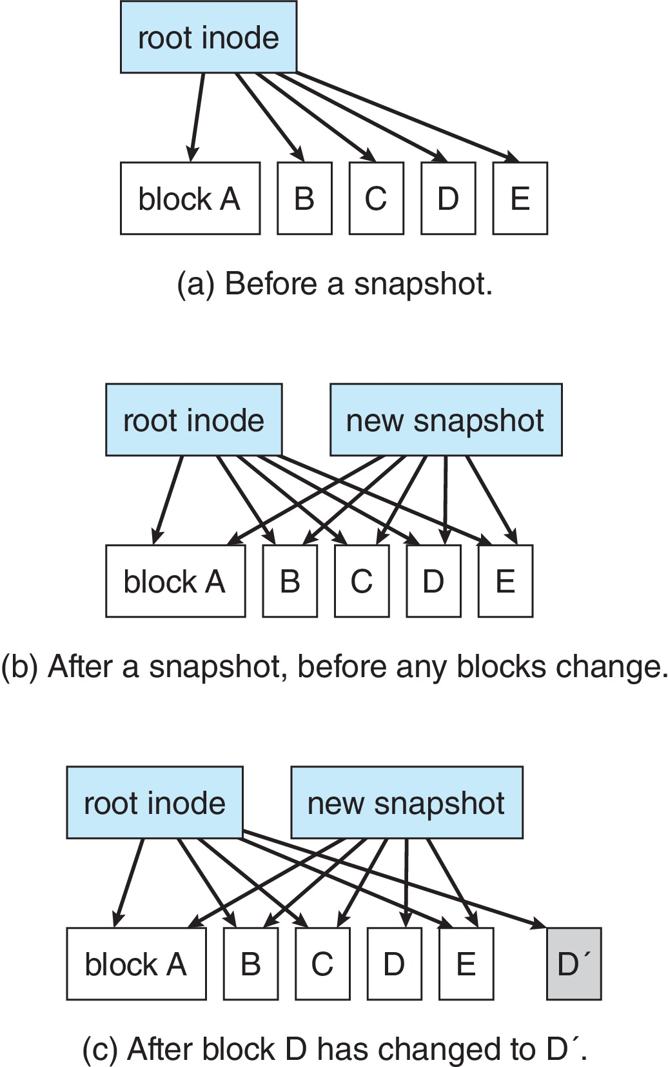
Snapshots in WAFL

Slide 47
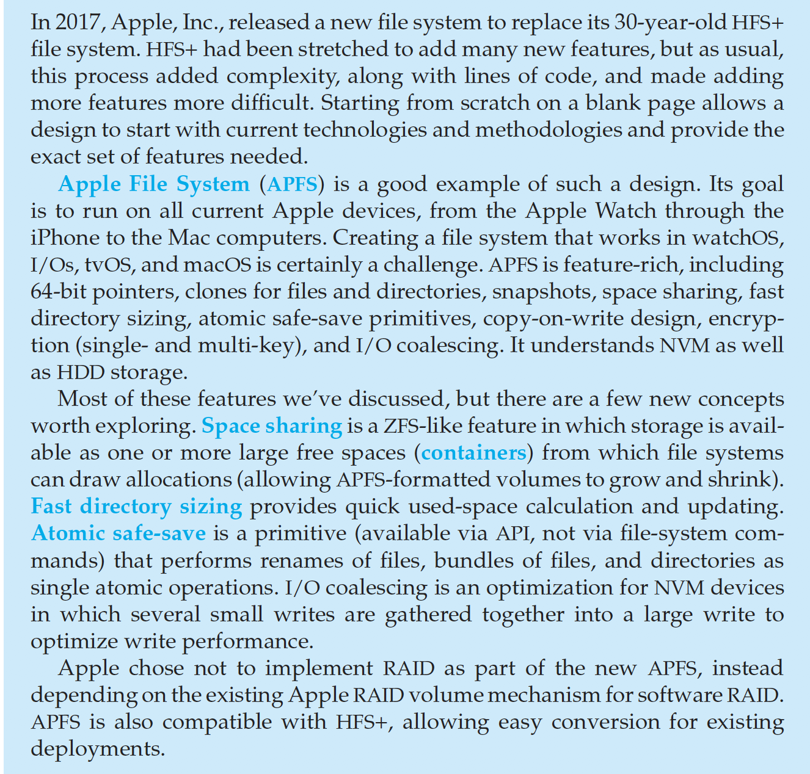
The Apple File System

Slide 48
Summary
Most file systems reside on secondary storage, which is designed to hold a large amount of data permanently. The most common secondary-storage medium is the disk, but the use of NVM devices is increasing.
Storage devices are segmented into partitions to control media use and to allow multiple, possibly varying, file systems on a single device. These file systems are mounted onto a logical file system architecture to make them available for use.
File systems are often implemented in a layered or modular structure. The lower levels deal with the physical properties of storage devices and communicating with them. Upper levels deal with symbolic file names and logical properties of files.

Slide 49
Summary (Cont.)
The various files within a file system can be allocated space on the storage device in three ways: through contiguous, linked, or indexed allocation. Contiguous allocation can suffer from external fragmentation. Direct access is very inefficient with linked allocation. Indexed allocation may require substantial overhead for its index block.
These algorithms can be optimized in many ways. Contiguous space can be enlarged through extents to increase flexibility and to decrease external fragmentation. Indexed allocation can be done in clusters of multiple blocks to increase throughput and to reduce the number of index entries needed. Indexing in large clusters is similar to contiguous allocation with extents.

Slide 50
Summary (Cont.)
Free-space allocation methods also influence the efficiency of disk-space use, the performance of the file system, and the reliability of secondary storage. The methods used include bit vectors and linked lists. Optimizations include grouping, counting, and the FAT, which places the linked list in one contiguous area.
Directory-management routines must consider efficiency, performance, and reliability. A hash table is a commonly used method, as it is fast and efficient. Unfortunately, damage to the table or a system crash can result in inconsistency between the directory information and the disk’s contents.
A consistency checker can be used to repair damaged file-system structures. Operating-system backup tools allow data to be copied to magnetic tape or other storage devices, enabling the user to recover from data loss or even entire device loss due to hardware failure, operating system bug, or user error.

Slide 51
Summary (Cont.)
Due to the fundamental role that file systems play in system operation, their performance and reliability are crucial. Techniques such as log structures and caching help improve performance, while log structures and RAID improve reliability. The WAFL file system is an example of optimization of performance to match a specific I/O load.

Slide 52
End of Chapter 10.B.

