Slide 1
Advanced Programming
CO2039
Chapter 1: Object Oriented Programming Revision - Encapsulation
TP.HCM, 03/01/2025

Slide 2
CONTENT
01
02
03
04
05
06
INTRODUCTION TO OOP
ENCAPSULATION
HOW ENCAPSULATION WORKS?
BEST PRACTICES
CONCLUSION
EXTENSION: CLASS DIAGRAM

Slide 3
01
INTRODUCTION TO OBJECT ORIENTED PROGRAMMING

Slide 4
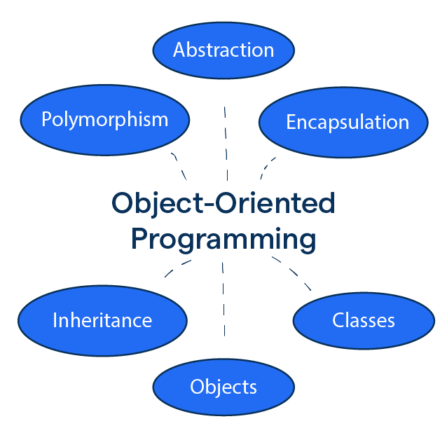
What is OOP?
Object-oriented programming (OOP) is a programming paradigm that organizes software design around objects, which can represent real-world entities or abstract concepts. Each object contains data (attributes or properties) and behavior (methods or functions).

Slide 5
Key principles of OOP
Encapsulation: Bundles data (attributes) and methods (behavior) into a single unit (class) and restricts access to protect data integrity. Example: A Car object has private attribute speed and a public method getSpeed() to access it. => Protects data integrity by restricting direct access.

Slide 6
Key principles of OOP
Inheritance: Allows one class to inherit attributes and methods from another, promoting code reuse and hierarchical relationships. Example: A Truck class can inherit from a Vehicle class. => Promotes code reuse.

Slide 7
Key principles of OOP
Polymorphism: Allows objects to take on many forms, e.g., a single method or class to represent different underlying data types or behaviors. Example: A draw() method behaves differently for Circle and Rectangle objects. =>Simplifies code and makes it flexible.

Slide 8
Key principles of OOP
Abstraction: Hides implementation details and exposes only essential features, simplifying complex systems for the user. Example: A user presses a car's "start" button without needing to understand the engine mechanics. =>Reduce complexity

Slide 9
Why OOP?
Create systems that are modular, scalable, reusable, and easier to understand. Think of a car in the real world. It has: Attributes: color, brand, speed, fuel capacity. Behaviors: start, stop, accelerate. Modular -> divides programs into independent, self-contained classes Scalable -> allows new functionality to be added or extended Reusable -> creating generic classes or extending existing classes Easier to understand -> models real-world entities with objects

Slide 10
02
ENCAPSULATION

Slide 11
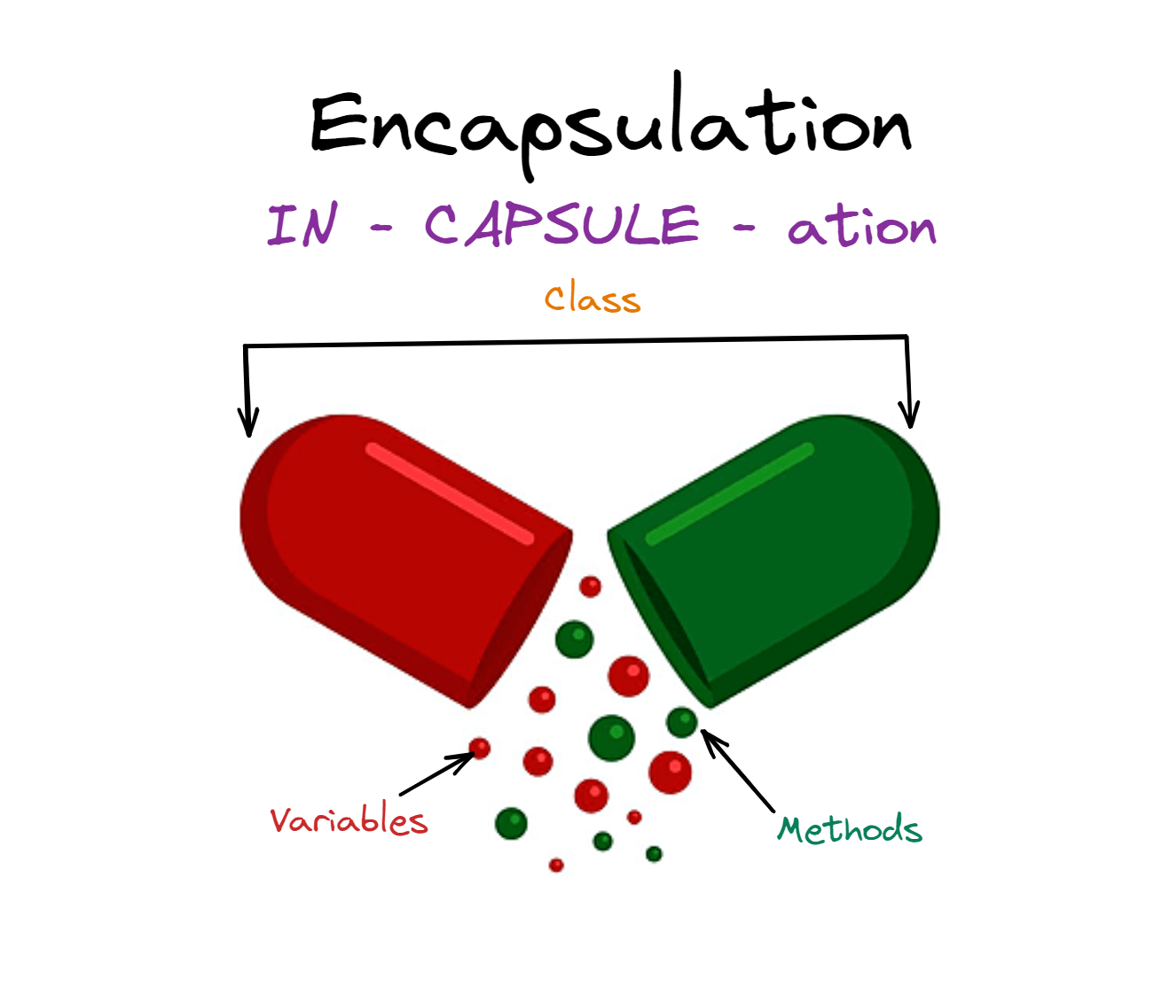
What is Encapsulation?
When creating new data types (classes) the details of the actual data and the way operations work is hidden from the other programmers who will use those new data types.

Slide 12

Why is Encapsulation important?
By controlling how data and methods are accessed or modified, encapsulation ensures:
Data Integrity: Prevents unauthorized or accidental changes to data.
Security: Sensitive data is hidden from unauthorized access.
Ease of Use: Users of the class do not need to understand its internal complexities.
Code Maintenance: Internal implementation can change without impacting external usage.

Slide 13
Core principles of Encapsulation
Data Hiding: The internal state of an object is kept private and can only be accessed through public methods (getters and setters).
Access Control: Access specifiers are used to control the visibility of class members:
private: Accessible only within the defining class. default: Accessible only within the same package.
protected: Accessible within the same package and by subclasses (even in different packages). public: Accessible from anywhere (any class, any package, and any subclass).

Slide 14
Example
public class Person { // Public: Accessible anywhere public String name; // Protected: Accessible within the same package or by subclasses protected int age; // Default (Package-private): Accessible only within the same package String address; // Private: Accessible only within this class private String password; // Constructor to initialize the object public Person(String name, int age, String address, String password) { this.name = name; this.age = age; this.address = address; this.password = password; } // Getter for password to demonstrate controlled access public String getPassword() { return password; }

Slide 15
03
HOW ENCAPSULATION WORKS?

Slide 16
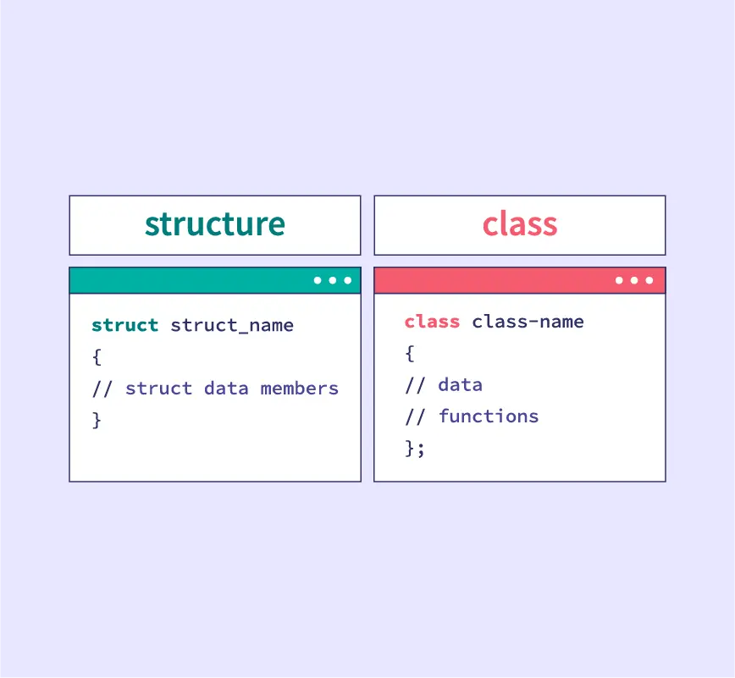
Class vs struct
Defining Classes and Objects
⇒ Can I use Struct instead of Class? Java: no struct C++: class and struct
 | Struct | Class
Default Access | Public | Private
Encapsulation | Less support | Full support
Use case | Light weight objects | All

Slide 17
Constructor in Encapsulation
A constructor is a special function in a class:
Same name as the class.
Not have a return value.
It is automatically called when an object is created (the programmer does not call it directly).
If no constructor is declared, the program automatically provides a default empty constructor.
⇒ What is the access modifier for the default constructor? ⇒ Can we create a private constructor? (Singleton Pattern)

Slide 18
Getters and Setters
Getters and Setters are methods used to access and modify the private fields of a class, adhering to the principles of encapsulation
Example:
public class Getset {
private int age;
// Getter for 'age'
public int getAge() {
return age;
}
// Setter for 'age' with validation
public void setAge(int age) {
if (age >= 0) {
this.age = age;
} else {
System.out.println("Age cannot be negative.");
}
}
public static void main(String[] args) {
}
}

Slide 19
Getters and Setters
Encapsulation: Protects the internal state of an object.
Control: Allows you to validate or modify data before it's set.
Consistency: Helps maintain consistent object state.
Flexibility: Makes it easier to change the internal implementation without affecting other code.
Readability: Improves the readability and maintainability of the code.
Access Control: Allows creation of read-only or write-only properties.
Debugging: Enables easy tracking and debugging of changes to the data.

Slide 20
04
BEST PRACTICES

Slide 21
Exercise 1 - Multiple constructor
Create a Car class with the following private attributes:
brand (string)
model (string)
year (int)
Add the following:
A default constructor that sets default values.
A parameterized constructor to initialize all attributes.
Setters and getters for all attributes.
Write a main function to:
Create an object using the default constructor and display its details.
Create another object using the parameterized constructor and display its details.

Slide 22
Exercise 2 - Constructor chaining
Create a Laptop class with attributes:
brand (string)
model (string)
price (double)
Add the following:
A default constructor.
A parameterized constructor to initialize all attributes.
Use constructor chaining to call one constructor from another.
Write a main function to test the class.

Slide 23
Exercise 3 (Bonus)
Create a Library system using encapsulation and constructors.
Create a Book class with attributes: title, author, ISBN, price, and stock.
Create a Library class with:
An array of Book objects.
Methods to:
Add new books.
Search for books by title or author.
Borrow books (reduce stock).
Write a main function to simulate library operations.

Slide 24
05
CONCLUSION

Slide 25
Conclusion
Encapsulation is the foundation of OOP, focusing on bundling data and functions within a class.
The main difference between a class and a struct lies in the level of data security (private/public).
A constructor is a special mechanism in OOP that automatically executes when an object is created and can cause errors if not properly designed.

Slide 26
06
EXTENSION:
CLASS DIAGRAM

Slide 27
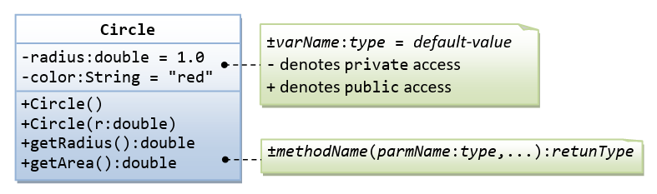
Class diagram
Can you write a program based on the above class diagram?
Notes:
A class called Circle is designed as shown in the following class diagram. It contains:
Two private instance variables: radius (of the type double) and color (of the type String), with default value of 1.0 and "red", respectively.
Two overloaded constructors - a default constructor with no argument, and a constructor which takes a double argument for radius.
Two public methods: getRadius() and getArea(), which return the radius and area of this instance, respectively.

Slide 28
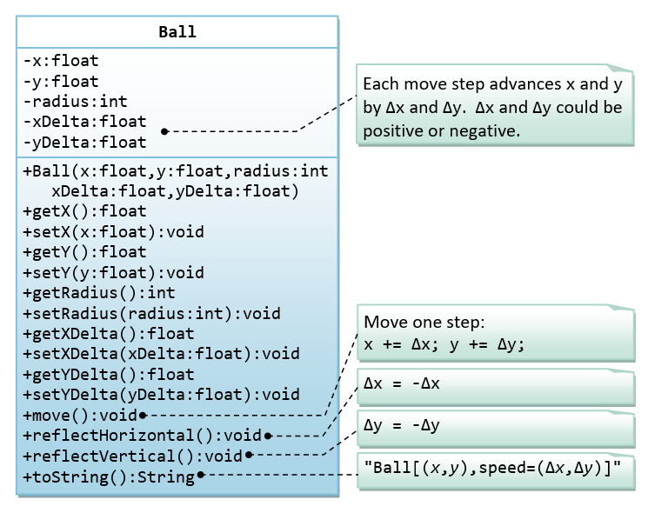
Hands-on exercise
A class called Ball, which models a bouncing ball, is designed as shown in the following class diagram.
It contains its radius, x and y position. Each move-step advances the x and y by delta-x and delta-y, respectively. delta-x and delta-y could be positive or negative.
The reflectHorizontal() and reflectVertical() methods could be used to bounce the ball off the walls. Write the Ball class. Study the main() on how the ball bounces.
https://www.programiz.com/online-compiler/5VrKcTuK0GRr6
Notes:
A class called Circle is designed as shown in the following class diagram. It contains:
Two private instance variables: radius (of the type double) and color (of the type String), with default value of 1.0 and "red", respectively.
Two overloaded constructors - a default constructor with no argument, and a constructor which takes a double argument for radius.
Two public methods: getRadius() and getArea(), which return the radius and area of this instance, respectively.

Slide 29
Thank you for your attention!
https://www.cse.hcmut.edu.vn

