Slide 1
Advanced Programming
CO2039
Chapter 5: Functions as First-Class Citizens - Lambda, Higher-Order, Currying Part of the Functional Programming paradigm
TP.HCM, 03/01/2025

Slide 2
CONTENT
01
02
03
04
LAMBDA FUNCTION
HIGHER-ORDER FUNCTION
CURRYING
CONCLUSION

Slide 3
01
LAMBDA FUNCTION

Slide 4
Lambda Function
Also called anonymous function - function defined without a name.
No need to use def keyword ⇒ use lambda to define the functions.
Have its own local namespace & cannot access variables other than those in its parameter list and those in the global namespace.
Syntax:
lambda [arg₁ [, arg₂, …, arg_{n}]]: expression

Slide 5
Example
Lambda calculus: λx.λy.+ x y
Python:
sum = lambda arg1, arg2: arg1 + arg2
print("Value of total : ", sum(10, 20))
print("Value of total : ", sum(20, 20))
Q: Given a lambda expression as follows:
(λf.f(5)) (λx.+ x 2)
Write the corresponding Python code.
Notes:
Python code:
f = lambda x: x + 2
f(5)

Slide 6
02
HIGHER-ORDER FUNCTION

Slide 7
Higher-order Function (1)
Given function f, return function f ∘ f
λf.λx.f (f x)
How does this work?
(λf.λx.f (f x)) (λy.+ y 1)
= λx.(λy.+ y 1) ((λy.+ y 1) x)
= λx.(λy.+ y 1) (+ x 1)
= λx.+ (+ x 1) 1

Slide 8
Higher-order Function (2)
Function that takes another function as a parameter.
“Higher-order” because it is a function of a function.
Examples:
map
reduce
filter
Lambda works great as a parameter to higher-order functions if you can deal with its limitations ⇒ What are those limitations?
Notes:
Main limitations of Python lambdas: - Only single expressions allowed - No statements - Can't use annotations

Slide 9
Map
map(function, iterable, …)
Map applies function to each element of iterable and creates a list of the results.
You can optionally provide more iterables as parameters to map and it will place tuples in the result list.
Map returns an iterator which can be cast to list.
Example:
nums = [0, 4, 7, 2, 1, 0 , 9 , 3, 5, 6, 8, 0, 3]
nums = list(map(lambda x : x % 5, nums))
print(nums) #[0, 4, 2, 2, 1, 0, 4, 3, 0, 1, 3, 0, 3]

Slide 10
Filter
filter(function, iterable)
The filter runs through each element of iterable (any iterable object such as a List or another collection).
It applies function to each element of iterable.
If function returns True for that element then the element is put into a List.
Example:
nums = [0, 4, 7, 2, 1, 0 , 9 , 3, 5, 6, 8, 0, 3]
nums = list(filter(lambda x : x != 0, nums))
print(nums) #[4, 7, 2, 1, 9, 3, 5, 6, 8, 3]
Notes:
This list is returned from filter in versions of Python under 3.
In Python 3, filter returns an iterator which must be cast to type list with list().

Slide 11
Reduce
reduce(function, iterable[, initializer])
Reduce will apply function to each element in iterable along with the sum so far and create a cumulative sum of the results.
function must take two parameters.
If initializer is provided, initializer will stand as the first argument in the sum.
Example:
nums = [1, 2, 3, 4, 5, 6, 7, 8]
nums = list(reduce(lambda x, y : (x, y), nums))
print(nums) #(((((((1, 2), 3), 4), 5), 6), 7), 8)
Notes:
Unfortunately in Python 3 reduce() requires an import statement: from functools import reduce

Slide 12
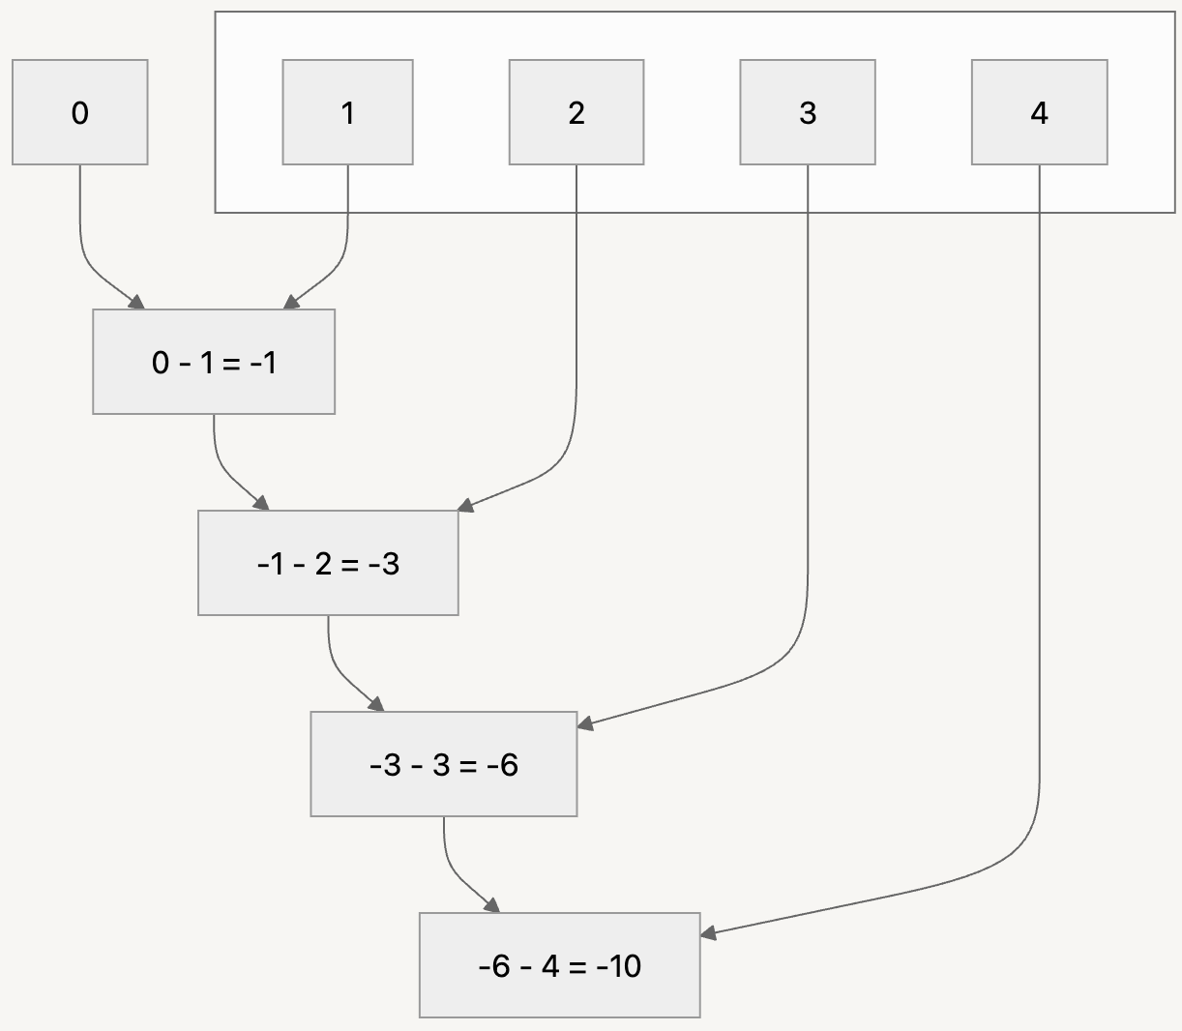
Another example
reduce(lambda acc, e: acc - e,
[1, 2, 3, 4],
0
)
# Output: -10

Slide 13
Zip
zip(iterable1, iterable2, ...) Combine multiple iterables (like lists or tuples) into a single iterable of tuples. Each tuple contains elements from the input iterables that are at the same position (index). Example: names = ["Alice", "Bob", "Charlie"] ages = [25, 30, 35] combined = zip(names, ages) print(list(combined)) Results: [('Alice', 25), ('Bob', 30), ('Charlie', 35)]

Slide 14
03
CURRYING

Slide 15
Currying Function
Currying is the technique of breaking down the evaluation of a function that takes multiple arguments into evaluating a sequence of single-argument functions.
In mathematical notation it looks like this: If we have a function f which takes n arguments, we can “replace” it by a composition of n functions f₁, f₂, … f_{n} where each takes only one argument:
let x = f(a₁, a₂, a₃)
we will get the same value x as if we call:
f₂ = f₁(a₁)
f₃ = f₂(a₂)
and
x = f₃(a₃)

Slide 16
Example
def f(a1, a2, a3):
return a1 * a2 * a3
def f1(a1):
def f2(a2):
def f3(a3):
return f(a1, a2, a3)
return f3
return f2
for i in range(1, 10):
print(f(i, i+1, i+2), f1(i)(i+1)(i+2)) # What is the output?
Notes:
OUTPUT:
6 6
24 24
60 60
120 120
210 210
336 336
504 504
720 720
990 990

Slide 17
Partially Applied Function
A partially applied function is a new function that is derived from an existing function by fixing a certain number of arguments in advance.
The result is a function that can be called with the remaining arguments. We can use it for the composition of functions.
Example:
def f(a1, a2):
return a1 * a2
partial(f, 3)(4) # Output: 12
Notes:
To run above example, remember to import necessary package: from functools import partial

Slide 18
Decorator for Currying
def curry(func):
def curried(*args):
if len(args) == func.__code__.co_argcount:
return func(*args)
else:
return lambda x: curried(*(args + (x,)))
return curried
@curry
def prod3(x, y, z):
return x + y + z
print(prod3(1)(2)(3)) # Output: 6
Notes:
The following Python function curry is a higher-order function that transforms a regular function into a curried function. The curried function returns a new function for each argument provided, and you can apply these functions one at a time, which can be useful in various scenarios. Inside the curry function, a nested function curried is defined. It accepts a variable number of arguments using *args. This allows the curried function to accept any number of arguments.
print(f'{args}'): simply prints the current arguments to the console. It's not necessary for the functionality of course, it's included for debugging and illustration purposes.
if len(args) == func.__code__.co_argcount: This condition checks whether the number of arguments provided (len(args)) matches the number of arguments that the original function func expects. The co_argcount attribute is used to retrieve the number of arguments of the func function.
return func(*args): If the number of arguments matches, the original function func is called with the provided arguments, and the result is returned.
else: return lambda x: curried(*(args + (x,))) If the number of arguments doesn't match, a new lambda function is returned. This lambda function takes a single argument x, and it calls the curried function with the existing args and the new argument x appended. This effectively allows you to build up (accumulate) the arguments one by one and create a chain of unary functions.

Slide 19
04
CONCLUSION

Slide 20
Conclusion
Lambda Function: Anonymous, inline functions using lambda keyword
Higher-Order Function:
Accept other functions as arguments or return them
Examples: map(), filter(), reduce()
Currying:
Convert multi-arg functions into chained single-arg functions
Enables partial application

Slide 21
Thank you for your attention!
https://www.cse.hcmut.edu.vn

