Slide 1
Advanced Programming
CO2039
Chapter 2: Object Oriented Programming Revision - Inheritance
TP.HCM, 03/01/2025

Slide 2
Additional Notes
Call constructor of the superclass
Default baseclass
Class Object
Overloading method
Subclass inherits ALL members of the superclass

Slide 3
CONTENT
01
02
03
04
05
06
INTRODUCTION TO INHERITANCE
KEY CONCEPTS OF INHERITANCE
HOW INHERITANCE WORKS?
BEST PRACTICES
CONCLUSION
EXTENSION: COMPOSITION

Slide 4
01
INTRODUCTION TO INHERITANCE

Slide 5
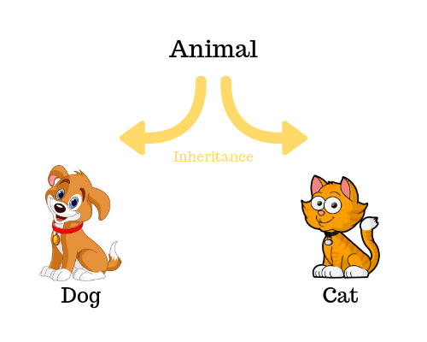
What is Inheritance?
A mechanism for creating a new class (called a derived class or child class) from an existing class (called a base class or parent class) to reuse and extend its functionality.

Slide 6

Why is Inheritance important?
Code Reusability: Reuse of common logic from base classes ⇒ codebase more efficient and maintainable.
Extensibility: New features can be added by extending the base class ⇒ easy updates without affecting existing code.
Polymorphism: Introduced in Chap 3 later.
Hierarchical Organization: Classes can be organized in a logical structure, representing real-world relationships.

Slide 7
02
KEY CONCEPTS OF INHERITANCE

Slide 8
Base class & Derived class
Base class (Parent/Superclass): The class whose properties (attributes) and methods (functions) are inherited by another class.
Example: Animal is a base class.
Derived class (Child/Subclass): The class inheriting from the base class. It can use or override the members of the base class and add its own ⇒ “is-a” relationship
Example: Dog inherits from Animal ⇒ Dog “is-a” Animal.

Slide 9
Method overriding
A derived class can redefine (override) a method from the base class to provide specific functionality.
The method in the base class must have the same name, return type, and parameters as the overridden method.
Constructors: When an object of a derived class is created, the base class constructor is called first, followed by the derived class constructor.
Destructors: When an object is destroyed, the derived class destructor is called first, followed by the base class destructor.
Introduced more detailed in Chap 3 - Polymorphism

Slide 10
Types of Inheritance
Single Inheritance: A derived class inherits from one base class.
Multiple Inheritance: A class inherits from more than one base class. (Supported in C++ but not in Java)
Multilevel Inheritance: A class inherits from a derived class, forming a chain.
Hierarchical Inheritance: Multiple derived classes inherit from one base class.
Hybrid Inheritance: A combination of two or more types of inheritance.

Slide 11
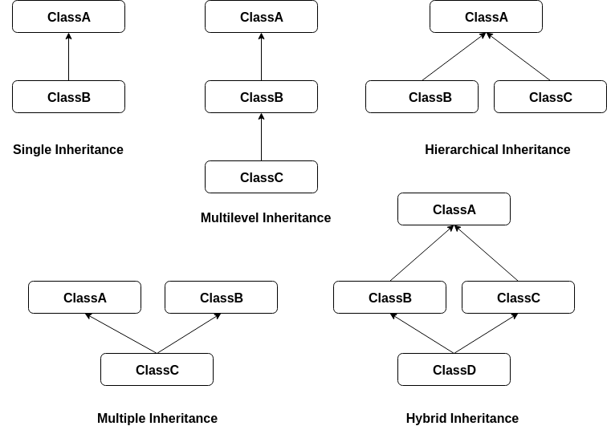
Types of Inheritance
Diamond Problem?

Slide 12
03
HOW INHERITANCE WORKS?

Slide 13
Subclass inherits all members from Superclass
When a subclass inherits from a superclass:
All members of the superclass, whether public or private, are technically inherited.
However, accessibility depends on the access specifier:
Public and protected members can be directly accessed in the subclass.
Private members are inherited but not accessible directly; they are accessible through public or protected getters and setters in the superclass.

Slide 14
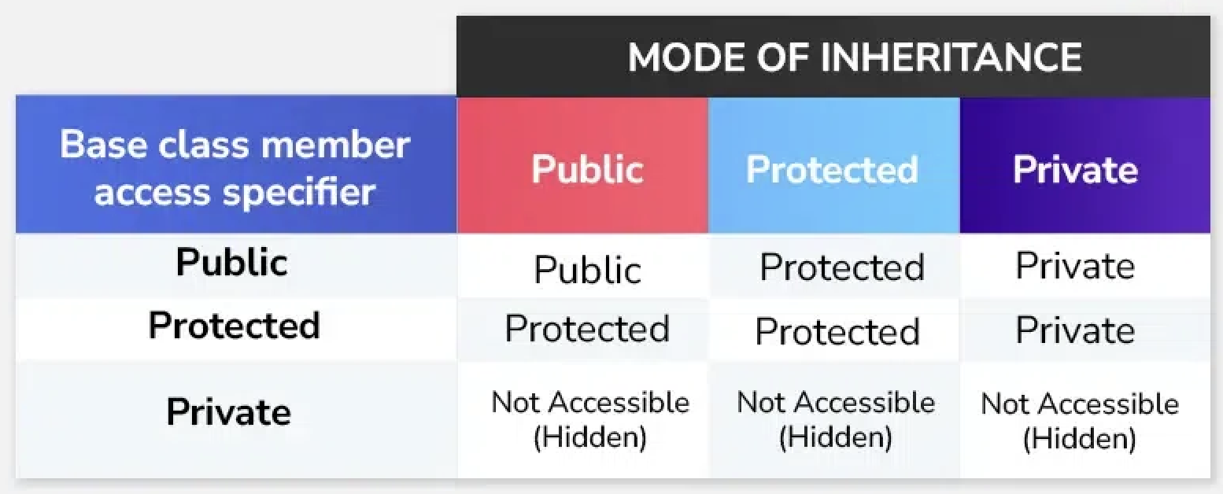
Subclass inherits all members from Superclass

Slide 15
Pointers for Polymorphism (1)
class Superclass {
public:
virtual void display() { cout << "Superclass\n"; }
};
class Subclass : public Superclass {
public:
void display() override { cout << "Subclass\n"; }
};
int main() {
Subclass sub;
Superclass sup = sub;
sup.display(); // Output: ???
}
Superclass
Subclass
sup
sub

Slide 16
Pointers for Polymorphism (2)
class Superclass {
public:
virtual void display() { cout << "Superclass\n"; }
};
class Subclass : public Superclass {
public:
void display() override { cout << "Subclass\n"; }
};
int main() {
Subclass sub;
Superclass* sup = &sub;
sup–>display(); // Output: ???
}
Superclass
Subclass
sup
sub

Slide 17
Implicit use of pointers
class Superclass {
public void display() {
System.out.println("Superclass");
}
}
class Subclass extends Superclass {
@Override
public void display() {
System.out.println("Subclass");
}
}
public class Main {
public static void main(String[] args) {
Superclass obj = new Subclass();
obj.display(); // Output: ???
}
}
In Java (and many other OOP languages): All objects are accessed via references (similar to pointers in C++).

Slide 18
04
BEST PRACTICES

Slide 19
Exercise 1 - Inheritance in Vehicle classes (1)
Create a base class Vehicle with the following private attributes:
brand (string)
year (int)
Add the following to Vehicle:
A default constructor that sets default values ("Unknown" for brand, 0 for year).
A parameterized constructor to initialize brand and year.
Setters and getters for brand and year.
A method displayInfo() to print details of the vehicle.

Slide 20
Exercise 1 - Inheritance in Vehicle classes (2)
Create a derived class Car that inherits from Vehicle:
Add a private attribute: model (string).
Provide a default constructor and a parameterized constructor for Car using constructor chaining.
Override the displayInfo() method to include model.
Create another derived class Bike that inherits from Vehicle:
Add a private attribute: engineCapacity (int).
Provide constructors and override displayInfo() to include engineCapacity.
In the main function:
Create a Car object using both default and parameterized constructors and display its details.
Create a Bike object using both default and parameterized constructors and display its details.

Slide 21
Exercise 2 - Enhanced Library System with Inheritance (1)
Book Class (Base Class):
Attributes: title, author, ISBN, price, and stock.
Methods:
Constructor to initialize attributes.
Getter and setter methods.
A virtual displayDetails() method to display book information.
Derived Classes:
EBook (inherits Book):
Additional attribute: fileSize (in MB).
Override displayDetails() to include file size.
PrintedBook (inherits Book):
Additional attribute: pageCount.
Override displayDetails() to include page count.

Slide 22
Exercise 2 - Enhanced Library System with Inheritance (2)
Library Class:
Attributes:
A dynamic array or vector of pointers to Book objects (supporting both EBook and PrintedBook).
Methods:
addBook(Book*): Add a new book (of any type).
searchByTitle(string) and searchByAuthor(string): Search books by title/author.
borrowBook(string ISBN): Reduce stock of the specified book by 1.
displayAllBooks(): Display all books in the library.
Main Function:
Add a mix of EBook and PrintedBook objects to the library.
Simulate user operations: Search for books by title/author, Borrow books, Display all books.

Slide 23
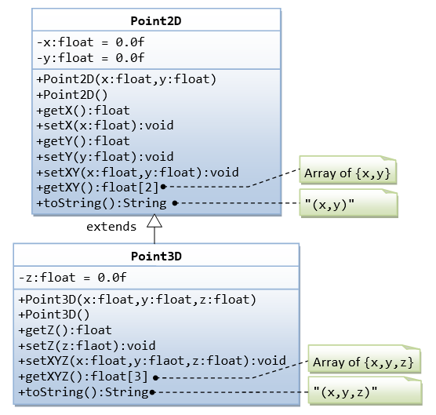
Exercise 3 - Point2D and Point3D
Can you write a program based on this class diagram?

Slide 24
05
CONCLUSION

Slide 25
Conclusion
Inheritance is a fundamental concept of OOP, enabling the creation of new classes by reusing and extending existing ones.
The primary benefit of inheritance lies in code reuse and the establishment of hierarchical relationships between classes.
Method overriding and dynamic binding¹ are key mechanisms in inheritance, supporting polymorphism and enhancing flexibility in design.
¹Introduced in Chap 3 - Polymorphism

Slide 26
06
EXTENSION: COMPOSITION

Slide 27
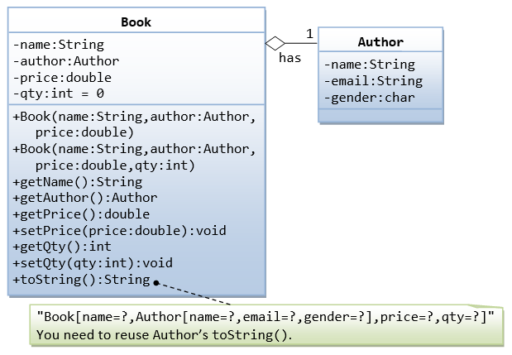
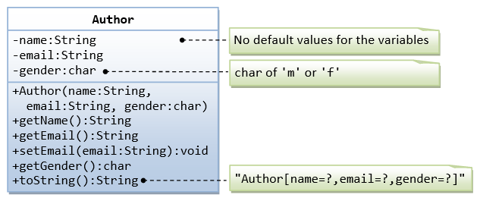
OOP Composition
Complete this code: https://www.programiz.com/online-compiler/03auquyMRJCj0
Notes:
A class called Author (as shown in the class diagram) is designed to model a book's author. It contains:
Three private instance variables: name (String), email (String), and gender (char of either 'm' or 'f');
One constructor to initialize the name, email and gender with the given values;
(There is no default constructor for Author, as there are no defaults for name, email and gender.)
public getters/setters: getName(), getEmail(), setEmail(), and getGender();
(There are no setters for name and gender, as these attributes cannot be changed.)
A toString() method that returns "Author[name=?,email=?,gender=?]", e.g., "Author[name=Tan Ah Teck,email=ahTeck@somewhere.com,gender=m]".
A class called Book is designed (as shown in the class diagram) to model a book written by one author. It contains:
Four private instance variables: name (String), author (of the class Author you have just created, assume that a book has one and only one author), price (double), and qty (int);
public methods getName(), getAuthor(), getPrice(), setPrice(), getQty(), setQty().
A toString() that returns "Book[name=?,Author[name=?,email=?,gender=?],price=?,qty=?". You should reuse Author’s toString().
Write the Book class (which uses the Author class written earlier).

Slide 28
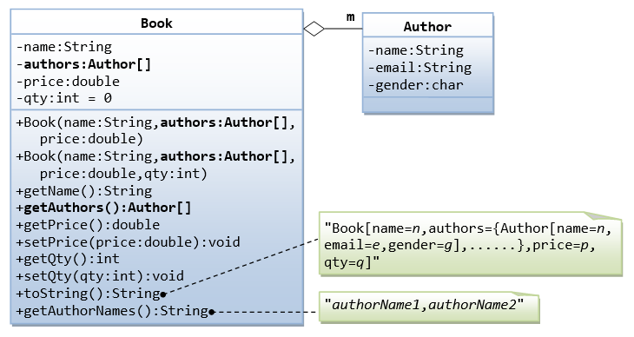
Hands-on exercise
Complete this code: https://www.programiz.com/online-compiler/74XUfgm8cwc0G
Notes:
In the earlier exercise, a book is written by one and only one author. In reality, a book can be written by one or more author. Modify the Book class to support one or more authors by changing the instance variable authors to an Author array.
Notes:
The constructors take an array of Author (i.e., Author[]), instead of an Author instance. In this design, once a Book instance is constructor, you cannot add or remove author.
The toString() method shall return "Book[name=?,authors={Author[name=?,email=?,gender=?],......},price=?,qty=?]".
You are required to:
Write the code for the Book class. You shall re-use the Author class written earlier.

Slide 29
Thank you for your attention!
https://www.cse.hcmut.edu.vn

