Slide 1
Advanced Programming
CO2039
Chapter 3: Object Oriented Programming Revision - Polymorphism
TP.HCM, 03/01/2025

Slide 2
CONTENT
01
02
03
INTRODUCTION TO POLYMORPHISM
KEY CONCEPTS OF POLYMORPHISM
CONCLUSION

Slide 3
01
INTRODUCTION TO POLYMORPHISM

Slide 4
What is Polymorphism?
In Java, polymorphism refers to the fact that you can have multiple methods with the same name in the same class.
Two kinds of polymorphism:
Overloading: two or more methods with different signatures.
Overriding: replacing an inherited method with another having the same signature.

Slide 5
Polymorphism overview
Two methods have to differ in their names or in the number or types of their parameters.
Example:
foo(int i) and foo(int i, int j) are different
foo(int i) and foo(int k) are the same
foo(int i, double d) and foo(double d, int i) are different

Slide 6
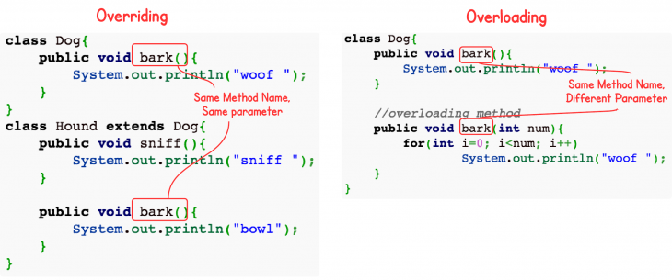
Overloading vs. Overriding

Slide 7
int main()
{
A a; B b;
a.n = 1; b.n = 2;
a.f2(); b.f2();
std::cout<<a.n <<" " << b.n;
return 0;
}
#include <iostream>
class A
{
public:
int n;
int f() {n++; return n;}
int f2() {f(); return n;}
};
class B: public A
{
public:
int f(){n--; return n;}
};

Slide 8
class A
{
public int n;
public int f() {n++; return n;}
public int f2() {f(); return n;}
};
class B extends A
{
public int f(){n--; return n;}
};
public class Main
{
public static void main(String[] args) {
A a = new A(); B b = new B();
a.n = 1; b.n = 2; a.f2(); b.f2();
System.out.println(a.n);
System.out.println(b.n);
}
}

Slide 9
#include <iostream>
class A
{
public:
int n;
virtual int f() {n++; return n;}
int f2() {f(); return n;}
};
class B: public A
{
public:
virtual int f(){n--; return n;}
};
int main()
{
A a; B b;
a=b;
a.n=1;
a.f2();
std::cout<<a.n;
return 0;
}

Slide 10
public class Main
{
public static void main(String[] args) {
A a = new A(); B b = new B(); a = b;
a.n = 1; a.f2();
System.out.println(a.n);
//System.out.println(b.n);
}
}
class A
{
public int n;
public int f() {n++; return n;}
public int f2() {f(); return n;}
};
class B extends A
{
public int f(){n--; return n;}
};

Slide 11
02
KEY CONCEPTS OF POLYMORPHISM

Slide 12
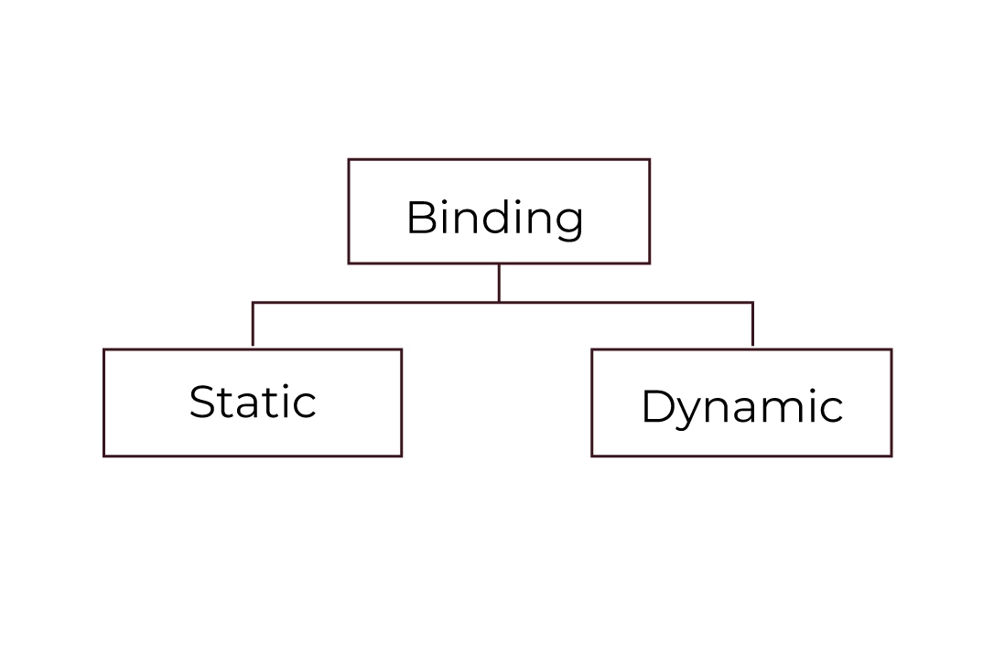
Binding
Dynamic Binding vs. Static Binding:
Static Binding: Determined at compile-time.
Dynamic Binding: Determined at runtime.
Polymorphism requires dynamic binding.

Slide 13
Binding in OOP languages
In C++:
Static binding (default): the function to be called is determined during compilation.
Dynamic binding (using virtual): enables polymorphism by resolving function calls at runtime.
In Java:
Java uses dynamic binding by default for method overriding.
The method invoked is determined at runtime based on the actual object, not the reference type.

Slide 14
Hands-on exercise
class A {
void f() { cout << "A::f"; }
void f2() { f(); }
};
class B: public A {
void f() { cout << "B::f"; }
};
int main() {
A* a = new B();
a->f2(); // Output: ???
return 0;
}
1. What is the output?
2. Is polymorphism used in this code? If it isn't, how can we implement it?
3. Can you rewrite the code in Python and Java?

Slide 15
Key differences: C++ vs. Java
Features | C++ | Java
Default binding | Static binding | Dynamic binding
Enabling dynamic binding | Use virtual keyword | Always enabled for overrides
Polymorphism | Requires explicit virtual | Default behaviour
Behind the scenes | Requires explicit pointers | Abstracted as object references

Slide 16
Why use pointers for dynamic binding in C++?
Reason:
In C++, the vtable (virtual table) is used to enable dynamic method resolution.
When using pointers or references, the program accesses the vtable of the actual object to determine the appropriate method.
Static Objects (No Pointer):
Vtable lookup is skipped, leading to static binding.
Dynamic Objects (Pointer/Reference):
Vtable is consulted, allowing polymorphism to work.

Slide 17
03
CONCLUSION

Slide 18
Conclusion
Polymorphism:
A key OOP feature that enables objects to behave differently based on their actual type.
Dynamic Binding:
Required for polymorphism.
Default in pure OOP languages like Java.
C++ vs. Java:
C++: Static binding by default; use virtual for dynamic binding.
Java: Always dynamic binding.

Slide 19
Thank you for your attention!
https://www.cse.hcmut.edu.vn

