Slide 1
Advanced Programming
CO2039
Chapter 4: Abstract class & Interface
TP.HCM, 03/01/2025

Slide 2
CONTENT
01
02
03
04
INTRODUCTION TO ABSTRACT CLASS & INTERFACE
INTERFACE IN DEPTH
CONCLUSION
ADVANCED SECTION

Slide 3
01
INTRODUCTION TO ABSTRACT CLASS & INTERFACE

Slide 4
What is Abstract class?
An abstract class is a class that cannot be instantiated. It serves as a blueprint for other classes.
Key characteristics:
Can include abstract methods (methods without implementation).
May also include concrete methods (methods with implementation).
Used when classes share common behavior but also require customization in subclasses.
Supports inheritance.

Slide 5
Example in Java
abstract class Shape {
abstract void draw(); // Abstract method
void info() { // Concrete method
System.out.println("This is a shape");
}
}
class Circle extends Shape {
void draw() {
System.out.println("Drawing Circle");
}
}
Notes:
Subclasses must implement all abstract methods unless the subclass is also abstract.

Slide 6
What is Interface?
An interface is a classlike construct that contains only constants and abstract methods.
Key characteristics:
Cannot be instantiated (only classes that implements interfaces can be instantiated).
Why not just use Abstract class? ⇒ Java does not permit multiple inheritance but allow a class can implement multiple interfaces. Can an interface be implemented by multiple classes?
No instance variables; only constants allowed.

Slide 7
Creating an Interface
File InterfaceName.java:
modifier interface InterfaceName {
constants declarations;
methods signatures;
}
File ClassName.java:
modifier Class ClassName implements InterfaceName {
methods implementation;
}
⇒ modifier is public or not used.
Notes:
If a class implements an interface, it should override all the abstract methods declared in the interface.

Slide 8
Hands-on exercise
interface Drawable {
void draw(); // Abstract method
}
class Rectangle implements Drawable {
public void draw() {
System.out.println("Drawing Rectangle");
}
}
Add new interface Area to calculate the area of a shape and implement it in Rectangle. Write main function to test.
Notes:
Interfaces promote multiple inheritance in a structured way.
Find the hands-on exercise easy? Implement above code in C++.

Slide 9
02
INTERFACE IN DEPTH

Slide 10
More in Interfaces (1)
Compile-Time Dependency Problem:
Normally, methods from one class to another need compile-time presence for signature checks.
This creates rigid inheritance hierarchies, pushing shared functionality higher in the class tree.
Interfaces to the Rescue:
Allow dynamic method resolution at runtime.
Decouple method definitions from the class inheritance hierarchy.
Enable unrelated classes to implement the same interface.
Key Benefit: Promote composition over inheritance and avoid the rigidity of deep class hierarchies.

Slide 11
More in Interfaces (2)
Dynamic Method Resolution:
The actual method is determined at runtime, not compile time.
Calling code interacts with an interface or abstract class reference, not specific implementations.
Benefit:
Decouples calling code from concrete classes.
Allows flexibility to add/change implementations without modifying the calling code.
Notes:
Dynamic method resolution means that the actual method to be executed is determined at runtime, not at compile time. Because of this:
Calling code doesn't need to know the specific implementation:
The calling code only interacts with an interface reference (or a base class reference, in the case of abstract classes).
It doesn't matter which specific class implements the interface or inherits from the base class; the JVM will dynamically resolve and call the correct method implementation at runtime.
Why is this useful?
It decouples the calling code from the concrete implementations.
You can add new classes or change implementations without altering the code that uses them, making the design more flexible and extensible.

Slide 12
More in Interfaces - Example
interface Shape { void draw(); }
class Circle implements Shape {
public void draw() { System.out.println("Drawing a Circle"); }
}
class Square implements Shape {
public void draw() { System.out.println("Drawing a Square"); }
}
public class Main {
public static void main(String[] args) {
Shape shape = new Circle(); // Interface reference, dynamic resolution
shape.draw(); // Calls Circle's draw() method
shape = new Square(); // Switch to a different implementation
shape.draw(); // Calls Square's draw() method
}
}

Slide 13
Does interface solve diamond problem?
Interfaces help address the diamond problem in multiple inheritance, but indirectly:
The diamond problem arises when a class inherits from two parent classes that define methods with the same name and signature, leading to ambiguity.
In Java:
Classes do not support multiple inheritance, which avoids this issue.
Interfaces support multiple inheritance, but there’s no ambiguity because a class implementing multiple interfaces must explicitly define the methods it inherits.
If a default method in two interfaces clashes, the implementing class must override it to resolve the conflict explicitly.

Slide 14
Example: Interface in diamond problem
interface A {
default void show() { System.out.println("A"); }
}
interface B {
default void show() { System.out.println("B"); }
}
class C implements A, B {
// Resolving the diamond problem
@Override
public void show() {
A.super.show(); // Explicitly choose which interface method to call
}
}
Notes:
Interfaces promote multiple inheritance in a structured way.

Slide 15
03
CONCLUSION

Slide 16
Abstract class vs. Interface
Feature | Abstract class | Interface
Instantiation | Cannot be instantiated | Cannot be instantiated
Methods | Can have abstract and concrete | Only abstract methods
Variables | Can have instance variables | Only constants allowed
Inheritance | Supports single inheritance | Supports multiple inheritance
Accessibility Modifiers | Methods can have any modifier | Methods are implicitly public
Notes:
Interfaces promote multiple inheritance in a structured way.

Slide 17
04
ADVANCED SECTION

Slide 18
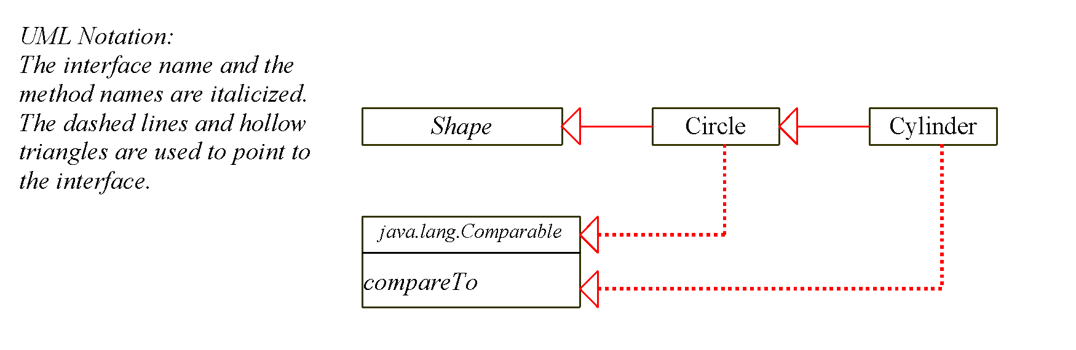
Class diagram: Interface

Slide 19
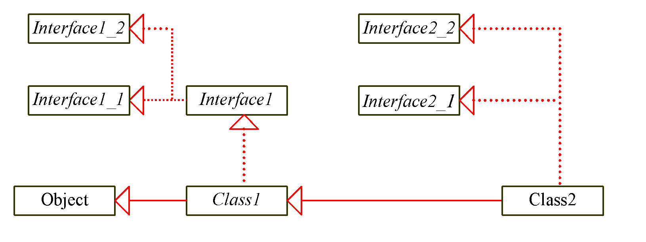
Classes & Interfaces
Can you write a Java pseudocode for the above diagram?
Notes:
One interface can inherit another by use of the keyword extends. The syntax is the same as for inheriting classes.
When a class implements an interface that inherits another interface, it must provide implementations for all methods defined within the interface inheritance chain.

Slide 20
The Cloneable interface
public class Circle extends Shape implements Cloneable {
private int x, y, radius;
// Constructor
...
// Clone method
@Override
public Object clone() {
try { return super.clone(); } // Shallow copy
catch (CloneNotSupportedException ex) { return null; }
}
}
Main function:
Circle c1 = new Circle(1, 2, 3); // Create an instance of Circle
Circle c2 = (Circle) c1.clone(); // Clone c1 into c2
System.out.println("Cloned Circle: " + c2); // Verify cloning
Notes:
Marker Interface: An empty interface.
A marker interface does not contain constants or methods, but it has a special meaning to the Java system. The Java system requires a class to implement the Cloneable interface to become cloneable.

Slide 21
Thank you for your attention!
https://www.cse.hcmut.edu.vn

