Slide 1
Advanced Programming
CO2039
Chapter 1: Stateless Programming
TP.HCM, 03/01/2025

Slide 2
CONTENT
01
02
03
IMPERATIVE VS DECLARATIVE
CORE PRINCIPLES OF FUNCTIONAL PROGRAMMING
CONCLUSION

Slide 3
01
IMPERATIVE VS DECLARATIVE

Slide 4
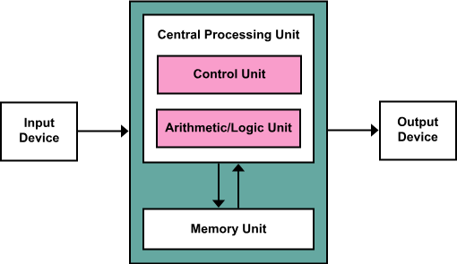
Imperative languages
Based on von Neumann architecture
Relies on modifying variables (state changes)
Use assignment to modify program state
Figure 1: von Neumann architecture

Slide 5
What is a state?
Programs in imperative languages rely heavily on modifying the values of a collection of variables, called the state.
Before execution, the state has some initial value σ.
During execution, each command changes the state:
σ = σ₀ → σ₁ → σ₂ → … → σ_{n} = σ’

Slide 6
Declarative languages
No state → State-oriented computations are accomplished by carrying the state around explicitly rather than implicitly.
Uses expressions instead of commands
Loops are replaced by recursion
Functional Languages: The underlying model of computation is function.
Logic Programming Languages: The underlying model of computation is predicates.

Slide 7
Example: Factorial (1)
def factorial(x):
if x == 1:
return 1
else:
return x * factorial(x-1)
n := x;
a := 1;
while n > 0 do
begin
a := a * n;
n := n – 1;
end;
Factorial in Imperative Style
Factorial in Functional Style
The value of the program is the desired factorial rather than storing it in a store.
Declarative programming is often described as expressing what is being computed rather than how.

Slide 8
02
CORE PRINCIPLES OF FUNCTIONAL PROGRAMMING

Slide 9
Functional Programming
Functions are first class values.
A data type is first class if it can be used anywhere, passed to and returned from functions, assigned to variables
May also have imperative constructs.
Examples: Lisp, Scheme, ML, Erlang
Pure functional languages have no implicit side-effects or other imperative features.
Examples: Miranda, Haskell

Slide 10
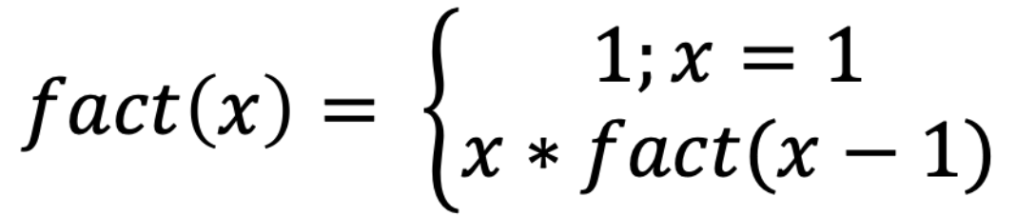
Example: Factorial (2)
factorial :: Integer -> Integer
factorial 0 = 1
factorial n = n * factorial (n - 1)
Factorial in Haskell

Slide 11
Why functional programming?
John Backus (Fortran Creator) argued FP is better than imperative programming.
Functional programming removes state and assignments.
Enables parallel execution (Concurrency without race conditions).
Algebraic laws
Reason about programs
Optimizing compilers

Slide 12
Von Neumann bottleneck
Von Neumann bottleneck: pumping single words back and forth between CPU and store ⇒ Task of a program: change store in some major way.
It has kept us tied to word-at-a-time thinking
Instead of encouraging us to think in terms of the larger conceptual units of the task at hand.
The assignment statement is the von Neumann bottleneck of programming languages ⇒ Pure functional programming languages remove state and assignments.
Concurrency possible: order of evaluation doesn’t matter.

Slide 13
Referential transparency
A referentially transparent function is a function that, given the same parameter(s), always returns the same result.
⇒ Do we have such property in imperative languages?
If the function has side-effects (updating a global variable, doing input or output), then f(3) + f(3) may not be the same as 2 * f(3).
The second f(3) has a different meaning than the first.
Purely declarative languages guarantee referential transparency.
The importance of referential transparency is that it allows a programmer (or compiler) to reason about program behavior.

Slide 14
03
CONCLUSION

Slide 15
Conclusion
Imperative vs Declarative Programming
Imperative: State-based, step-by-step execution
Declarative: Focus on "what" rather than "how"
Core Principles of Functional Programming
Pure Functions → No side effects
Immutability → Data doesn’t change after creation
Higher-Order Functions → Functions as first-class values
Recursion replaces loops
Von Neumann Bottleneck
Traditional imperative programming relies on modifying shared memory
Functional Programming removes mutable state → better parallelism

Slide 16
Thank you for your attention!
https://www.cse.hcmut.edu.vn

