Slide 1
Chapter 4: Online Marketing
Electronic Commerce
Notes:
Mô hình định giá và doanh thu

Slide 2
Outline
Advertising on the web
Search engine positioning and domain name
Marketing basics
Notes:
Auctions: đấu giá

Slide 3
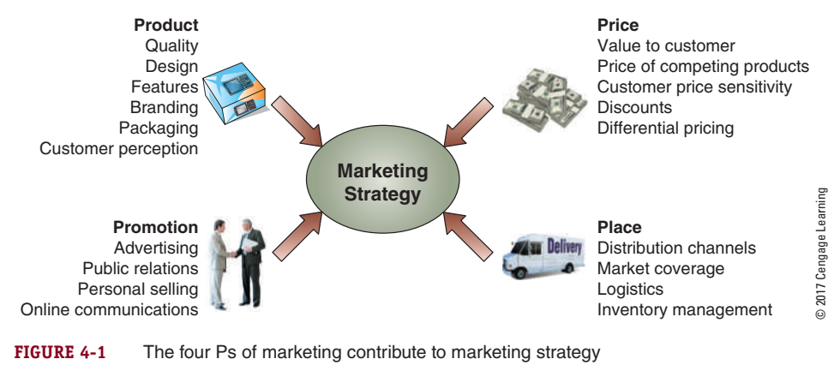
Marketing basics
Marketing mix: Element combination to achieve goals
Selling and promoting products and services
Four Ps of marketing
Notes:
Marketing mix: tiếp thị hỗn hợp: kết hợp nhiều yếu tố để đạt được mục tiêu: bán được hang và thu lợi nhuận
Product: Elements such as quality, design, features, characteristics, and even the packaging make up the product. These intrinsic characteristics of the product are important, but customers’ perceptions of the product, called the product’s brand, can be as important as the actual characteristics of the product Promotion: On the Internet, possibilities abound for communicating with existing and potential customers. In this chapter, you will learn how organizations use their Web sites, e-mail strategies, and social media as communication tools for promoting their products and services

Slide 4
Marketing basics
Marketing strategies
Product-based
Customer-based
Communicating with Different Market Segments
Physical world
Use building construction and floor space design
Online firm
No physical presence
Customer contact through media and Web site
Communications media selection is critical
Online firm challenge
Customer trust with no physical presence
Notes:
Examples of product-based strategy: phân loại sản phẩm theo danh mục sản phẩm: web catalog: ví dụ: cửa hàng thể thao Decathlon: chia danh mục sản phẩm theo môn thể thao, Siêu thị: tươi sống, đồ hộp, đồ lạnh …
Web office supply stores, Previous print catalog sales
Examples of customer-based strategy: phân loại khách hàng: tùy vào giới tính, độ tuổi …
university Web sites for student, investor, staff; job site for employer, job seeker
Chọn nơi/ hình thức tiếp thị:
-Thế giới thật: sử dụng thiết kế nội – ngoại thất để giao tiếp với khách hàng (café, ngân hàng, cơ sở giáo dục… có thiết kế khác nhau, theo mục đích mà chúng muốn khách hàng cảm nhận được)
-Web: sử dụng thiết kế website => khó khăn hơn nhiều

Slide 5
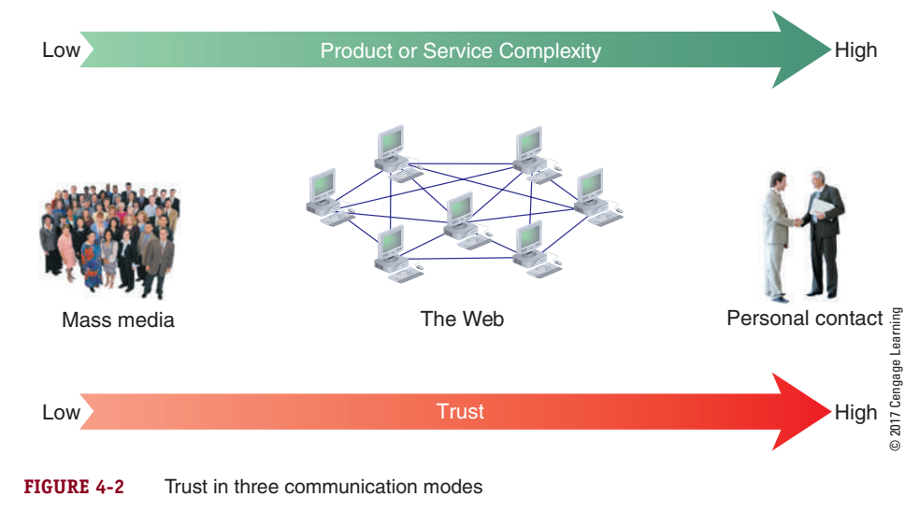
Marketing basics
Trust and communication media
Notes:
Mass media: quảng cáo trên TV, các trang web nổi tiếng: chi phí cho quảng cáo cao nhưng nếu tính số tiền/viewer: rẻ → Trust ko cao
Personal contact: giới thiệu từng người, được giới thiệu → trust cao hơn

Slide 6

Market segmentation
Market segmentation: divides the pool of potential customers into groups or segments
Identify specific portions of their markets and target them with specific advertising messages
Geographic segmentation
Demographic segmentation
Behavioral segmentation
Psychographic segmentation
Notes:
Market Segment – phân khúc thị trường là những đối tượng có các đặc điểm chung như giới tính, tuổi tác, sở thích, lối sống,… được tập hợp thành một nhóm để hỗ trợ cho mục đích tiếp thị.
Phân khúc thị trường theo yếu tố địa lý
Đây là phương pháp chia nhóm khách hàng dựa theo vị trí địa lý của họ, được xác định theo tỉnh, thành phố, mã bưu điện, quốc gia,... Vị trí địa lý sẽ giúp bạn nắm được những yếu tố ảnh hưởng đến hành vi mua sắm như mức thu nhập, khả năng chi tiêu, điều kiện thời tiết,... để cân nhắc lựa chọn sản phẩm, triển khai những loại hình quảng cáo hiệu quả.
Phân khúc thị trường theo yếu tố nhân khẩu học
Theo yếu tố nhân khẩu học, doanh nghiệp sẽ dựa trên các yếu tố như giới tính, tuổi tác, nghề nghiệp, tôn giáo, tình trạng hôn nhân... để phân chia khách hàng thành các nhóm riêng. Đây được coi là phương pháp dễ thực hiện, có độ tin cậy cao nên được áp dụng rất phổ biến.
Phân khúc thị trường theo yếu tố hành vi
Phương pháp này sẽ mang lại hiệu quả cao nhất với những doanh nghiệp hoạt động trong lĩnh vực thương mại điện tử. Những dữ liệu về hành vi khách hàng có thể dễ dàng được thu thập từ chính website của công ty. Yếu tố này bao gồm: thói quen chi tiêu, mua sắm, thời gian truy cập web, mức độ tương tác với doanh nghiệp, những phản hồi về sản phẩm đã mua,... Từ những dữ liệu này, doanh nghiệp sẽ điều chỉnh thông điệp, mục tiêu chiến dịch marketing sao cho phù hợp nhất.
Phân khúc thị trường theo yếu tố tâm lý
So với phân khúc thị trường theo nhân khẩu học, phân khúc tâm lý sẽ khó xác định hơn bởi những yếu tố như sở thích, tính cách, giá trị, niềm tin, mục tiêu, phong cách sống,... rất trừu tượng và dễ thay đổi. Các nhóm tâm lý cũng có thể là sự kết hợp của những phân loại khác như tuổi tác, nghề nghiệp (nhân khẩu học) hay vị trí của họ (địa lý), nhưng tựu chung lại chúng đều thể hiện thái độ, lối sống của một nhóm. Phân khúc tâm lý sẽ giúp hoạt động tiếp thị của doanh nghiệp có hiệu quả cao bởi qua đó khách hàng sẽ cảm thấy doanh nghiệp hiểu được họ đang cần và muốn gì.
-micromarketing: chia thành nhóm càng ngày càng nhỏ để đưa đến các thông điệp quảng cáo: chi phí cao khi quảng cáo trên mass media
-demographic: tuổi tác, giới tính, thu nhập, tôn giáo, v.v…
-psychographic: giai cấp, cá tính, v.v… (xe hơi: người mê tốc độ vs người quan tâm an toàn vs người quan tâm kinh tế)
.

Slide 7
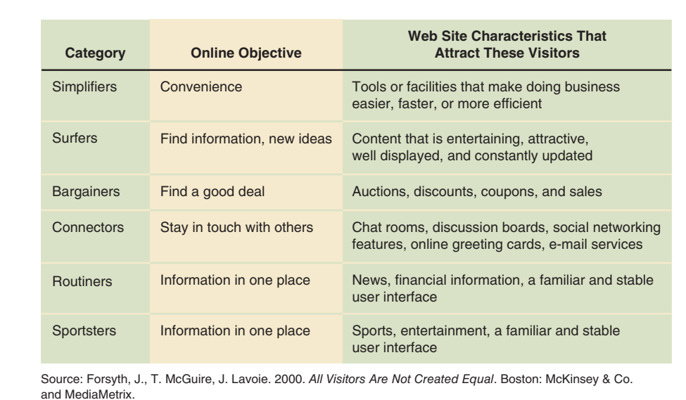
Internet users segmentation
Notes:
-Simplifiers are users who like convenience. They are attracted by sites that make doing business easier, faster, or otherwise more efficient than is possible in the physical world.
-Surfers use the Web to find information, explore new ideas, and shop. They like to be entertained, and they spend far more time on the Web than other people. To attract surfers, sites must offer a wide variety of content that is attractive, well displayed, and constantly updated.
-Bargainers are in search of a good deal. Although they make up less than 10 percent of the online population, they make up more than half of all visitors to the eBay auction site. They enjoy searching for the best price or shipping terms and are willing to visit many sites to do that.
-Connectors use the Web to stay in touch with other people. They are intensive users of chat rooms, instant messaging services, social networking sites, electronic greeting card sites, and Web-based e-mail. Connectors tend to be new to the Web, less likely than other people to purchase on the Web, and actively trying to learn what the Web has to offer them.
-Routiners return to the same sites over and over again. They use the Web to obtain news, stock quotes, and other financial information. Routiners like the comfort of working with a user interface that they know well.
-Sportsters are similar to routiners, but they tend to spend time on sports and entertainment sites rather than news and financial information sites. Since they view the Web as an entertainment vehicle, sportsters are attracted by sites that are interactive and attractive

Slide 8
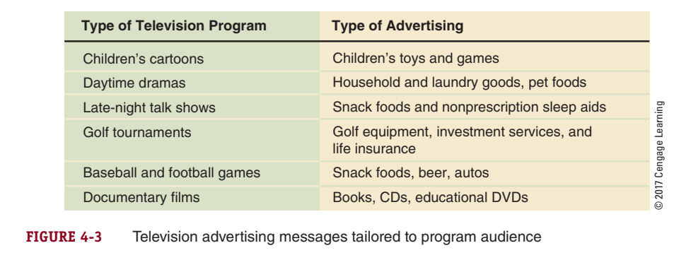
Market segmentation
Notes:
-Simplifiers are users who like convenience. They are attracted by sites that make doing business easier, faster, or otherwise more efficient than is possible in the physical world.
-Surfers use the Web to find information, explore new ideas, and shop. They like to be entertained, and they spend far more time on the Web than other people. To attract surfers, sites must offer a wide variety of content that is attractive, well displayed, and constantly updated.
-Bargainers are in search of a good deal. Although they make up less than 10 percent of the online population, they make up more than half of all visitors to the eBay auction site. They enjoy searching for the best price or shipping terms and are willing to visit many sites to do that.
-Connectors use the Web to stay in touch with other people. They are intensive users of chat rooms, instant messaging services, social networking sites, electronic greeting card sites, and Web-based e-mail. Connectors tend to be new to the Web, less likely than other people to purchase on the Web, and actively trying to learn what the Web has to offer them.
-Routiners return to the same sites over and over again. They use the Web to obtain news, stock quotes, and other financial information. Routiners like the comfort of working with a user interface that they know well.
-Sportsters are similar to routiners, but they tend to spend time on sports and entertainment sites rather than news and financial information sites. Since they view the Web as an entertainment vehicle, sportsters are attracted by sites that are interactive and attractive

Slide 9
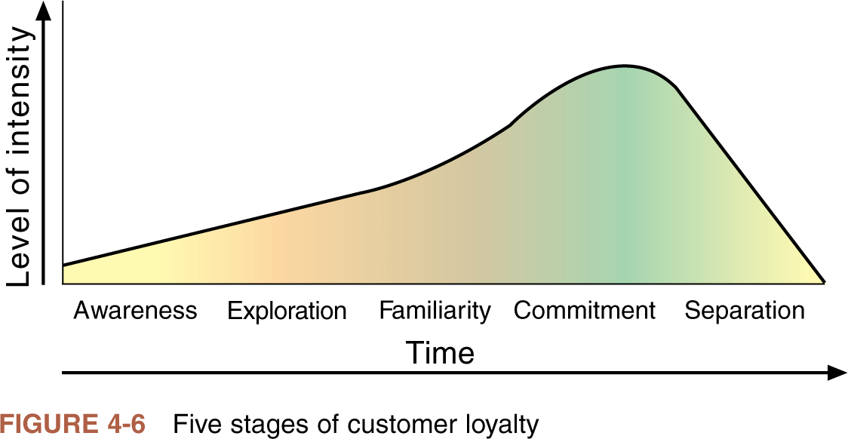
Advertising on the web
Five-stage customer loyalty model
Notes:
One goal of marketing is to create strong relationships between a company and its customers.
Good customer experiences can help create an intense feeling of loyalty toward the company and its products or services

Slide 10
Advertising on the web
Advertising: communication
Five-stage customer loyalty model
Awareness stage
Advertising message should inform
Exploration stage
Message should explain how product, service works
Encourage switching brands
Familiarity stage
Message should be persuasive
Commitment stage
Reminder messages
Separation stage
Not targeted

Slide 11
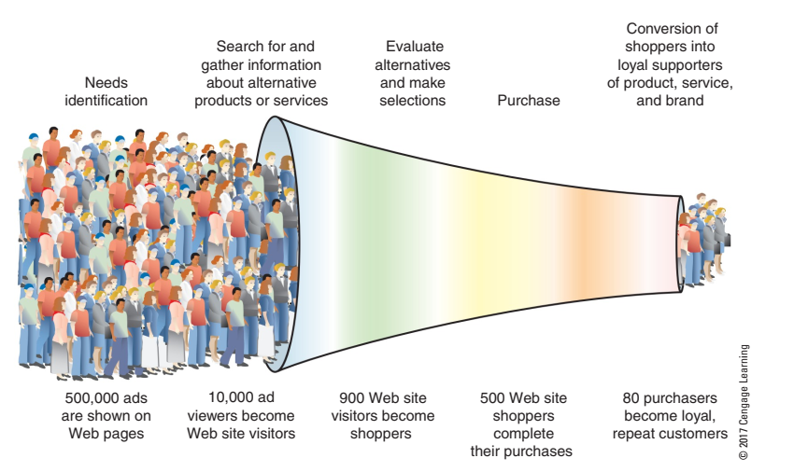
Customer Acquisition: The Funnel Model

Slide 12
Advertising on the web: Display Ads
Banner ad
Small rectangular object on Web page
Displays stationary or moving graphic
Includes hyperlink to advertiser’s Web site
Versatile
Leaderboard ad: designed to span Web page top or bottom
Skyscraper ad: designed to be placed on Web page side => Remains visible as user scrolls through page
Banner ad placement
Use a banner exchange network
Pay sites to carry ad
Use a banner advertising network
Notes:
-Banner exchange network: coordinates ad sharing
-Banner advertising network: acts as broker between advertisers and Web sites that carry ads

Slide 13
Advertising on the web
Text ads
Short promotional message
Usually placed along Web page top or right side
Simple but very effective
Pop-up ad
Appears in its own window
Extremely annoying
Ad-blocking software: Prevents banner ads and pop-up ads from loading
Rich media ads (active ads)
Generate graphical activity that “floats” over the Web page itself

Slide 14
Advertising on the web
Online advertising cost
Cost per thousand (CPM): amount paid for every thousand people in the estimated audience
“M” from Roman numeral for “thousand”
Cost per click (CPC), in which the site monitors the number of visitors who click an ad and charges for each click.
Measuring Web audiences (complicated)
Web’s interactivity
Value of visitor to an advertiser
Notes:
-Value of each visitor is not equal depends on how much information she give to the site (email, name, phone, etc.)

Slide 15
Advertising on the web
Some popular metrics
Visit: occurs when visitor requests a page from Web site
Trial visit: first time a particular visitor loads Web site page
Repeat visits: subsequent page loads
Ad view: occurs if page contains an ad
Impression: each time banner ad loads
Click (click-through): action whereby visitor clicks banner ad to open advertiser’s page

Slide 16
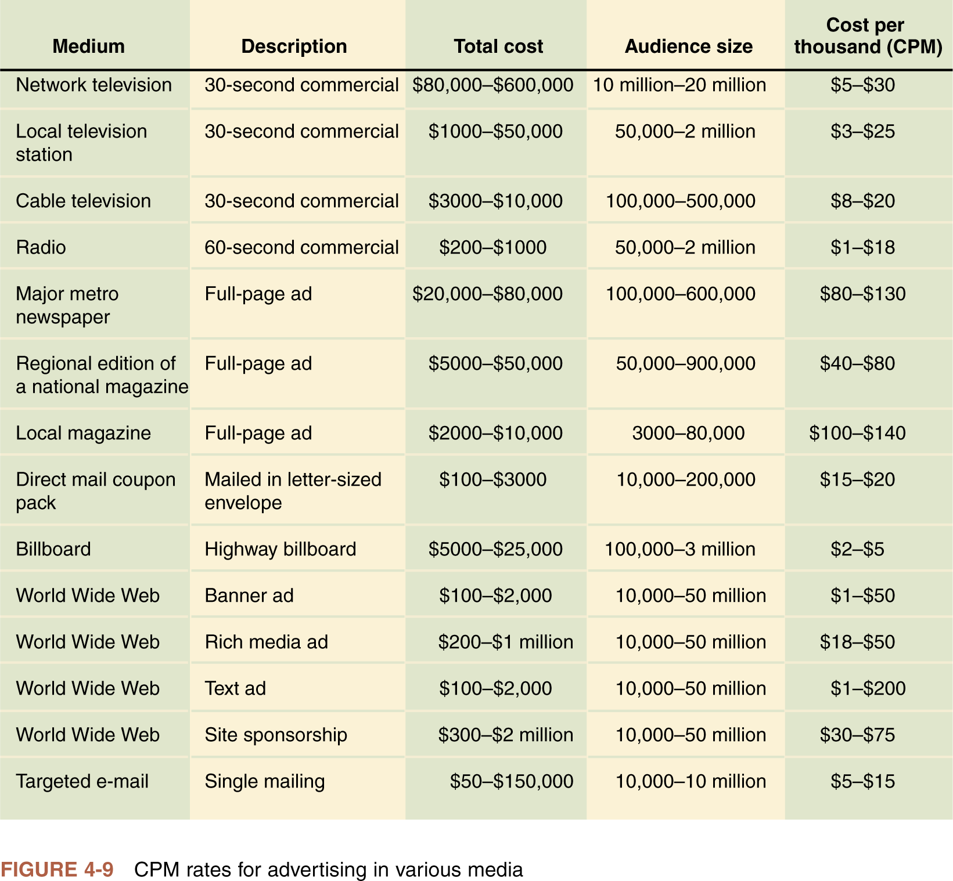
Advertising on the web

Slide 17
Search engine positioning and domain name
Ways that potential customers find Web sites
Referred by friend
Referred by affiliate marketing partner
See site’s URL in print advertisement, television
Arrive unintentionally after mistyping similar URL
Use a search engine or directory Web site

Slide 18
Search engine positioning and domain name
Search engine
Web site that helps people find things on the Web
Contains three major parts
Spider (crawler, robot, bot): program automatically searches the Web to find potentially interesting Web pages for people
Index (database): storage element of search engine
Search utility: takes terms, finds matching Web page entries in index
Notes:
Search Engine Optimization (tối ưu hóa công cụ tìm kiếm), là một quy trình nâng cao thứ hạng của website trên các công cụ

Slide 19
Search engine positioning and domain name
Search engine ranking
Weighting of factors: factors to decide URLs that appear first on searches for a particular search term
Search engine positioning (search engine optimization, search engine placement)
Results from the combined art and science of having a particular URL listed near the top of search engine
Paid placement (sponsorship, search term sponsorship)
Option of purchasing top listing on results pages for a particular set of search terms

Slide 20
Search engine positioning and domain name
Website naming issues
Companies would like URLs for their Web sites to reflect name or reputation
Troublesome domain names
Purchase more suitable domain names
Companies often buy more than one domain name
In case user misspells URL: redirected to intended site
Have different names or forms of names

Slide 21
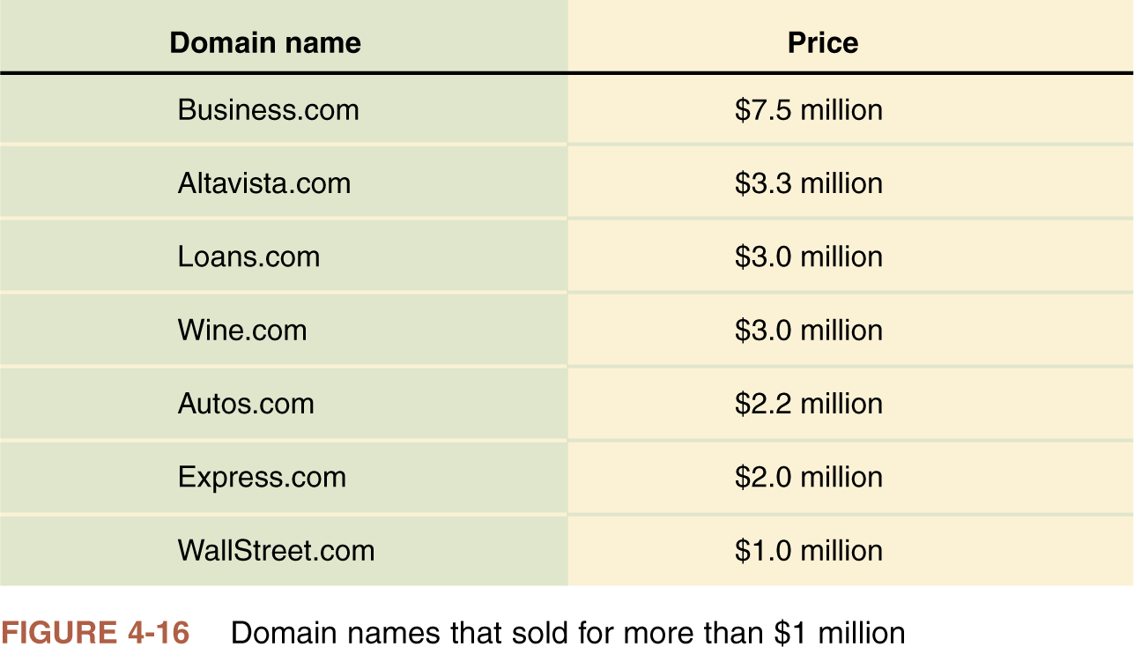
Search engine positioning and domain name
Buying, selling, and leasing domain names
Recently, higher prices have prevailed in the market for domain names

