Slide 1
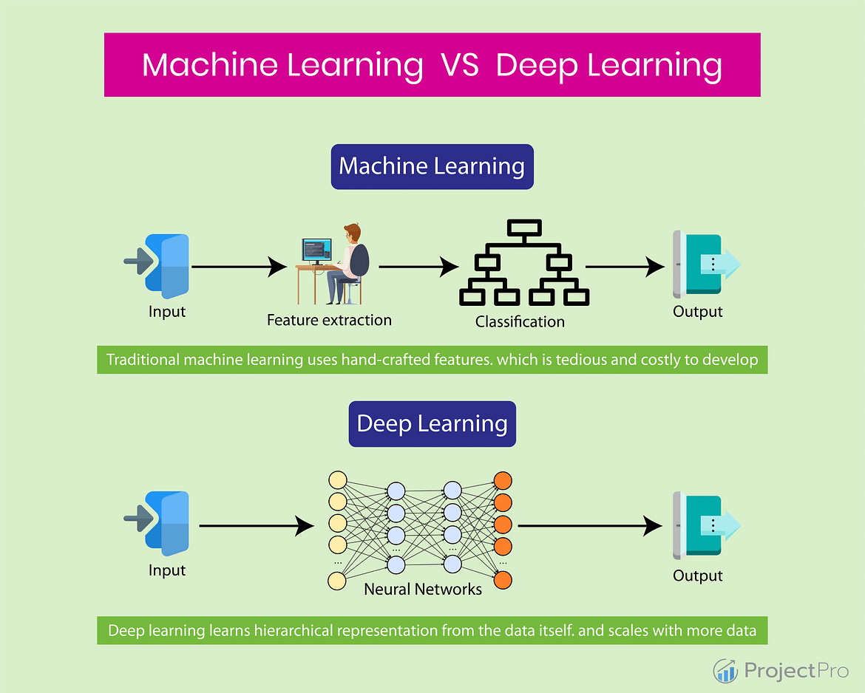
Introduction to Artificial Intelligence, Machine Learning and Deep Learning

Slide 2
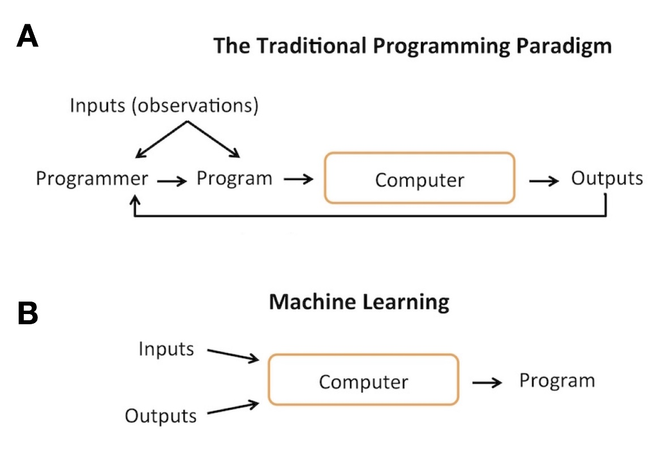
Computer Program and Machine Learning
Machine Learning comes up with the decision making “program” (machine learning model) that optimizes the decision making according to a user-defined objective.

Slide 3
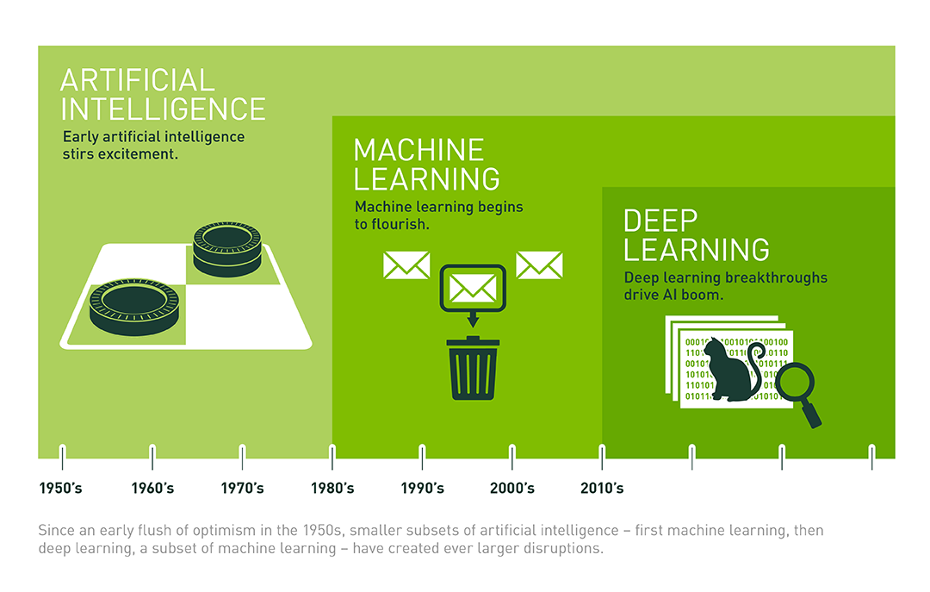
Artificial Intelligence Overview

Slide 4
Machine Learning vs Deep Learning
Deep learning models are gaining popularity for the fact that they can achieve state-of-the-art accuracy which at times can outperform human

Slide 5
What is Machine Learning (ML)?
ML allows machines(computers) to learn from data or experience and make a prediction based on the experience
ML enables the computers or the machines to make data-driven decisions rather than being explicitly programmed for carrying out a certain task
These programs or algorithms are designed in a way that they learn and improve over time when are exposed to new data

Slide 6
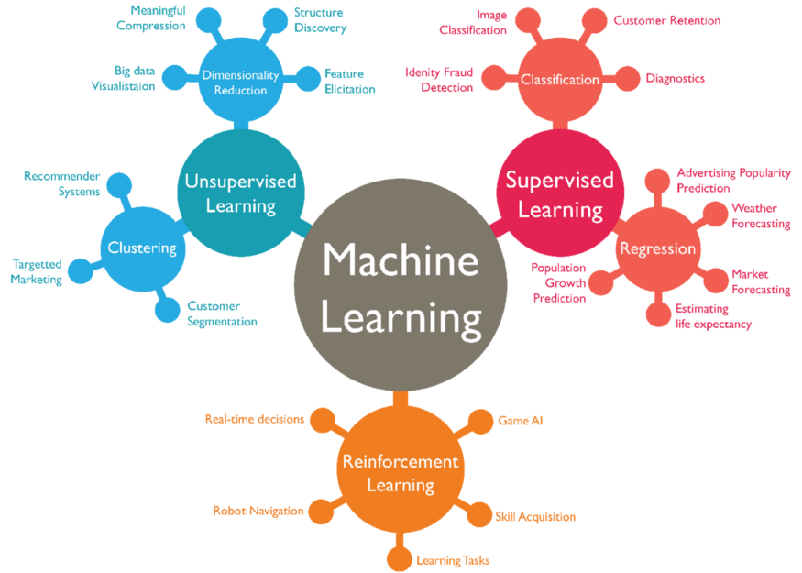
Types of Machine Learning
Supervised
Unsupervised
Reinforcement

Slide 7
Supervised Learning
Find the mapping between the input variable(X) and output variable(Y) (input X and label Y)
Supervised learning is divided into two types:
Regression — The output variable is continuous and real value. For example price, weight, etc
Classification — The output variable is a category, such as “red” or “blue” or “disease” or “no disease”.

Slide 8
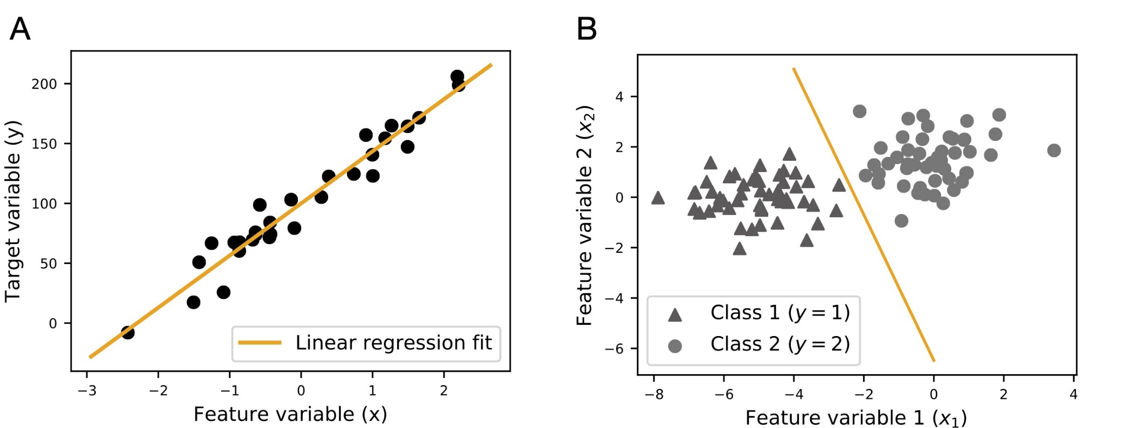
Regression and Classification
llustrations of the two main categories of supervised learning, regression (A) and classification (B)

Slide 9
Unsupervised Learning
Unsupervised learning is where you only have input data (X) and no corresponding output variables. The goal of unsupervised learning is to model the underlying structure or distribution in the data in order to learn more about the data.
Unsupervised learning is divided into two types:
Clustering: discover the inherent groupings in the data, such as grouping customers by purchasing behavior.
Association: discover rules that describe large portions of your data, such as people that buy X also tend to buy Y.

Slide 10
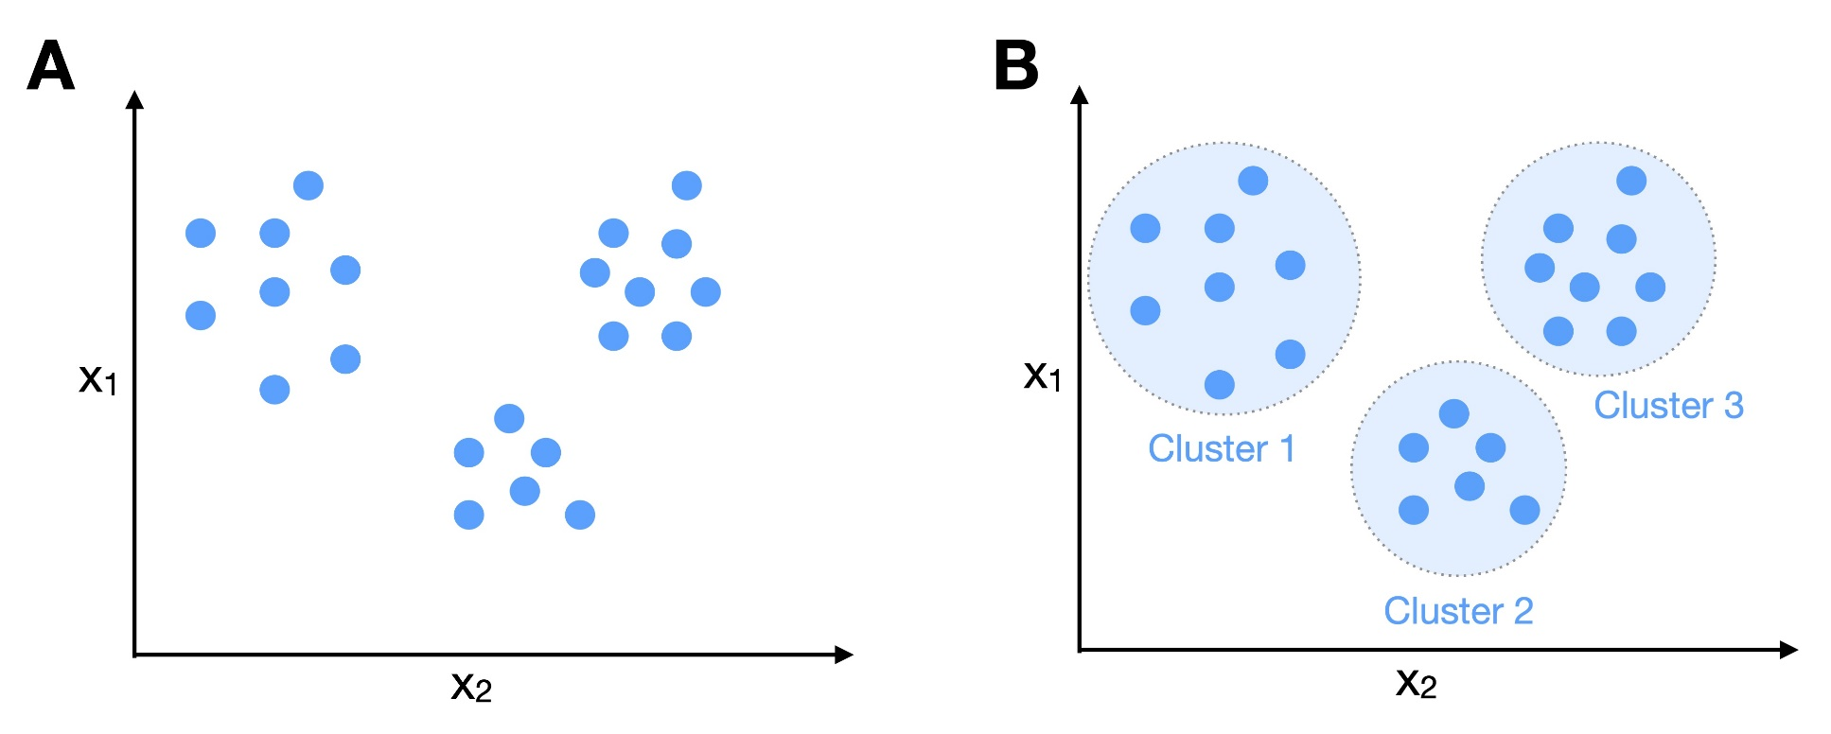
Example of Clustering
It seems that there are 3 clusters for the example dataset

Slide 11
Reinforcement Learning
Reinforcement learning, in the context of artificial intelligence, is a type of dynamic programming that trains algorithms using a system of reward and punishment
The agent receives rewards by performing correctly and penalties for performing incorrectly. The agent learns without intervention from a human by maximizing its reward and minimizing its penalty

Slide 12
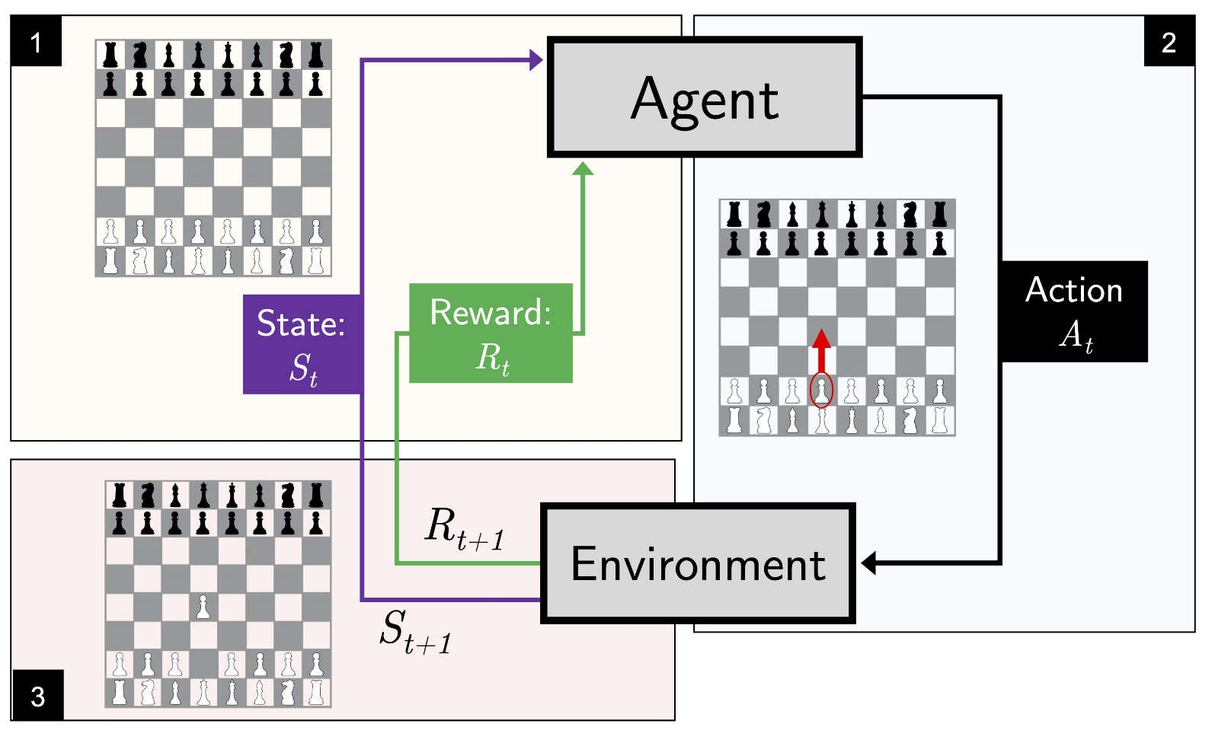
Example of Reinforcement
AI Games (Bot)
Optimize the power consumption in a house

Slide 13
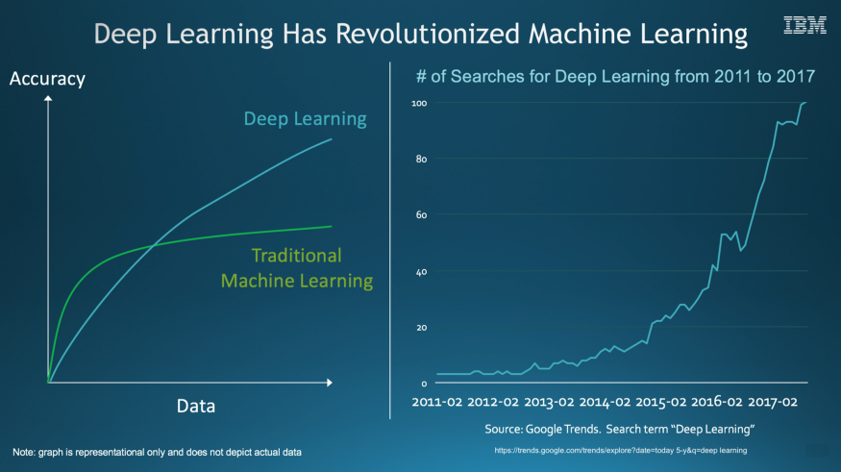
What is Deep Learning?
Deep Learning is a subfield of machine learning concerned with algorithms inspired by the structure and function of the brain called artificial neural networks.

Slide 14
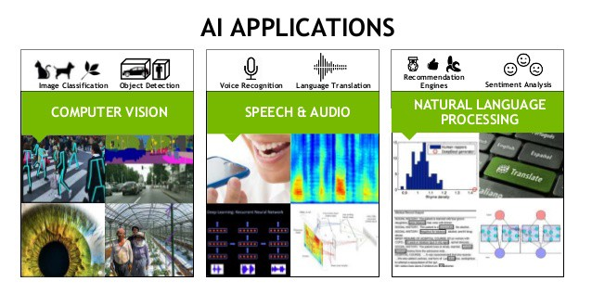
Applications of Deep Learning
Self-driving cars
Voice search and virtual assistants
Machine translation
Image caption generation
Real-time object recognition in the image (Google lens).

Slide 15
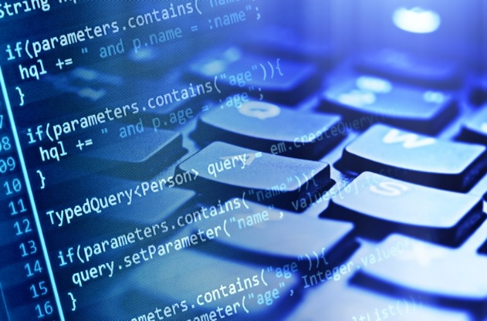
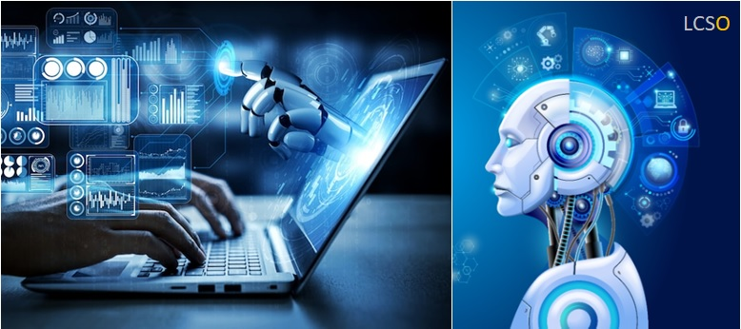
Introduction to TensorFlow

Slide 16
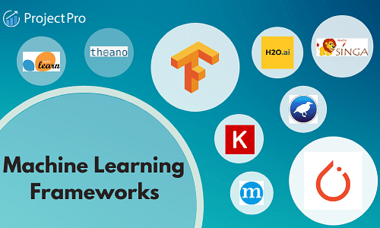
What is TensorFlow?
TensorFlow is one of the most popular machine learning frameworks that help engineers, deep neural scientists to create AI models (Machine Learning and Deep Learning)

Slide 17
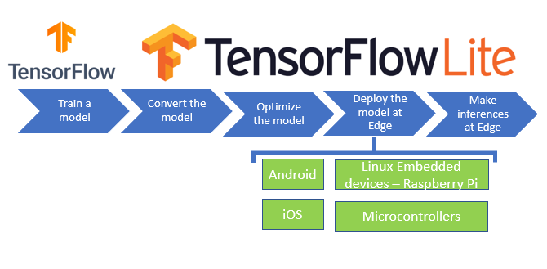
TensorFlow Lite
TensorFlow Lite is an open-source, product ready, cross-platform deep learning framework that converts a pre-trained model in TensorFlow to a special format that can be optimized for speed or storage.

Slide 18
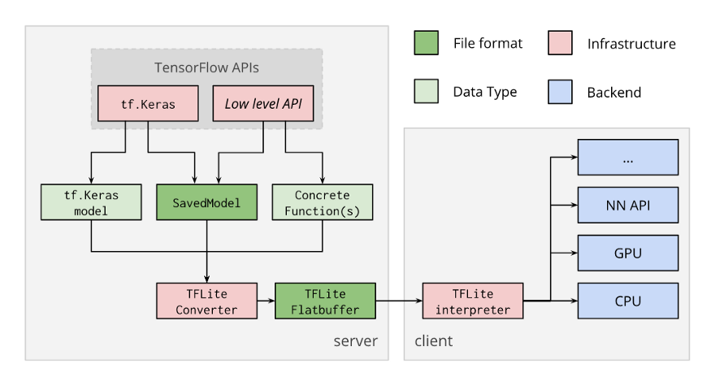
Convert TensorFlow and TensorFlow Lite
Edge Computing and AI

Slide 19
Build A Simple AI using Google Teachable Machine and Python
LÊ TRỌNG NHÂN
trongnhanle@hcmut.edu.vn
trongnhanle85@gmail.com

Slide 20
Content
Build a simple AI model in Google Teachable Machine
Implement AI inference using Python
Extra work: Publish AI result to Adafruit IO server

Slide 21
Part 1: Build A Simple AI

Slide 22
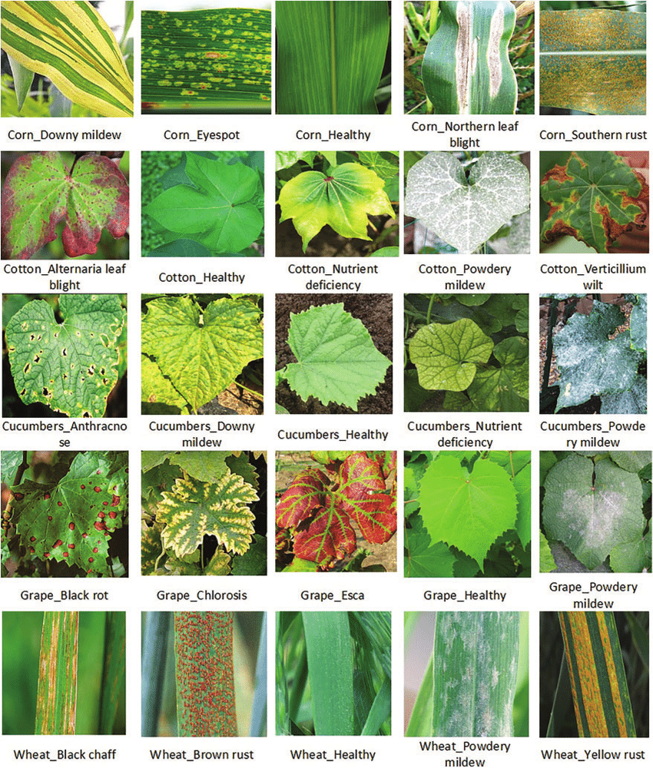
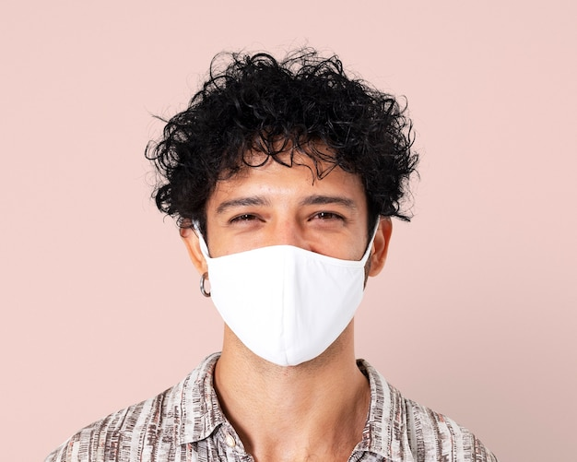
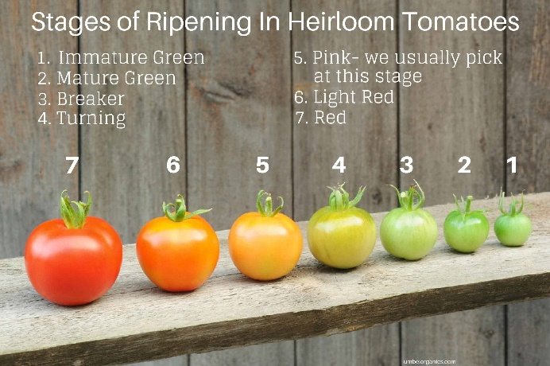
Build a simple AI model
Use PC webcam to recognize simple objects, for instance:
People is wearing masks or not wearing masks
Ripe tomatoes (normally in red) or raw tomatoes (normally in green)
Leaves are wilted or diseased

Slide 23
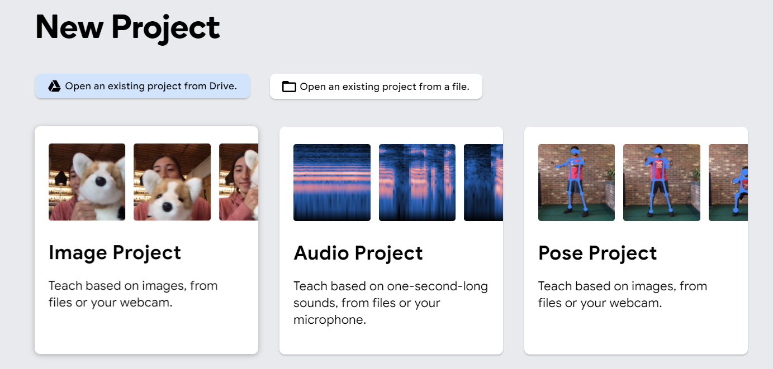

Step 1
Go to the Google Teachable Machine website:
https://teachablemachine.withgoogle.com/train
Select on the Image Project
1

Slide 24
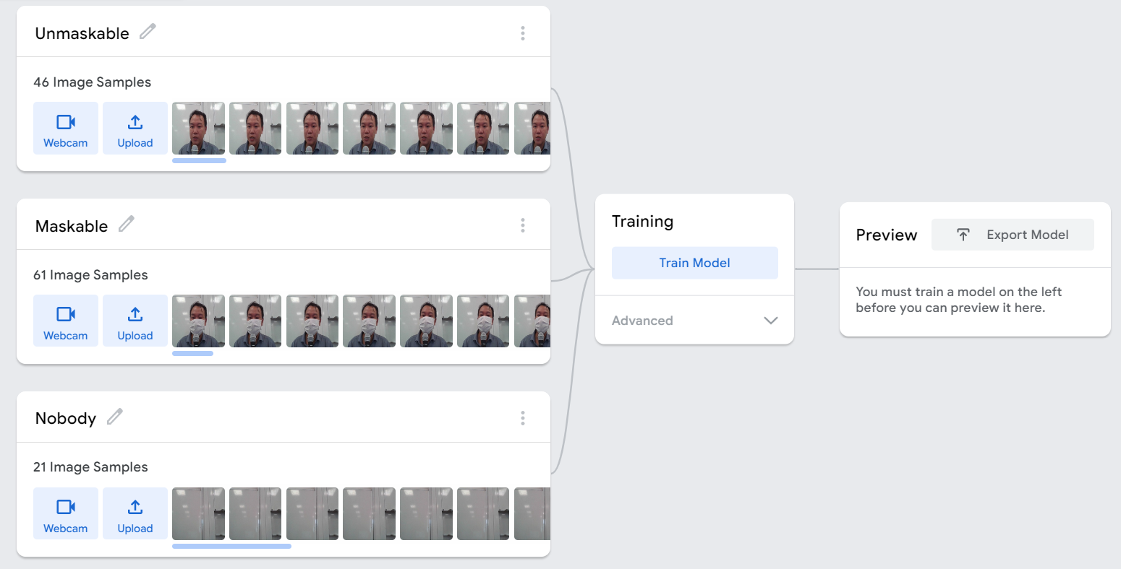
Step 2
Provide images for each class. Note that each class should have a name.
Provide a class name “background”, when there is no object need to be recognized

Slide 25
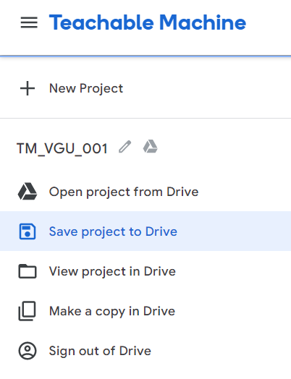
Step 3
Save your project to Google Drive
1
2

Slide 26
Step 4
Click on the Train Model button to train your AI
Test your model in the Preview option. If the performance is not so good, provide more images and train the AI again
1

Slide 27
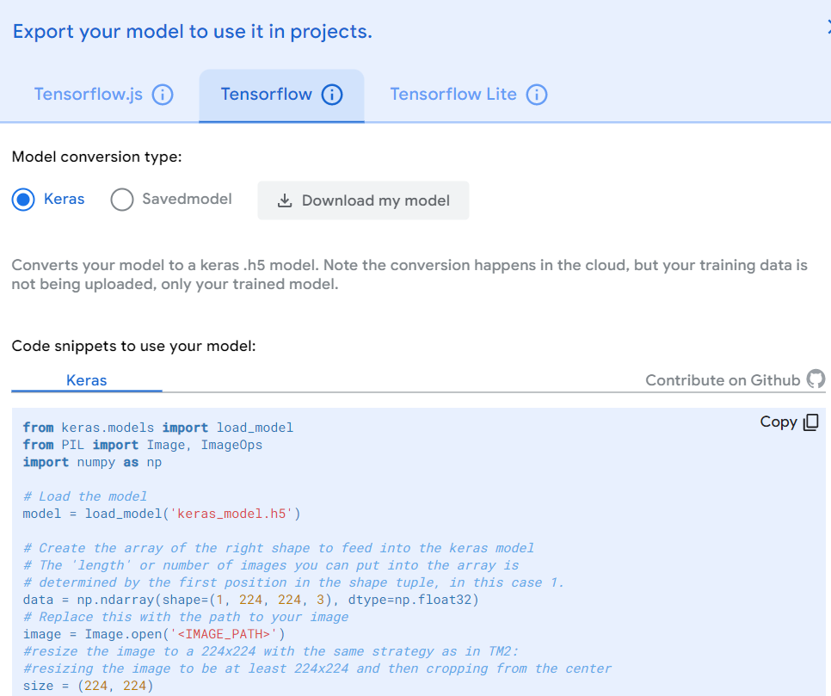
Step 4
Export the AI model:
Click on Export
Select Tensorflow, Keras and Download the Model
1
2
3

Slide 28
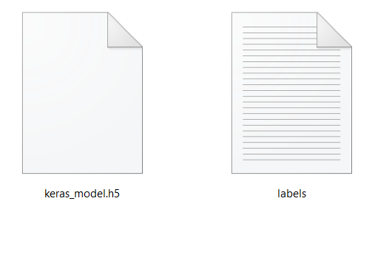
Step 5
Prepare materials for Python programming:
Unzip the files
Copy the source code from Google Teachable to Notepad
Python Source Code
AI Files (keras_model.h5 and lables.txt)
from keras.models import load_model
from PIL import Image, ImageOps
import numpy as np
# Load the model
model = load_model('keras_model.h5')
# Create the array of the right shape to feed into the keras model
# The 'length' or number of images you can put into the array is
# determined by the first position in the shape tuple, in this case 1.
data = np.ndarray(shape=(1, 224, 224, 3), dtype=np.float32)
# Replace this with the path to your image
image = Image.open('<IMAGE_PATH>')
#resize the image to a 224x224 with the same strategy as in TM2:
#resizing the image to be at least 224x224 and then cropping from the center
size = (224, 224)
image = ImageOps.fit(image, size, Image.ANTIALIAS)
#turn the image into a numpy array
image_array = np.asarray(image)
# Normalize the image
normalized_image_array = (image_array.astype(np.float32) / 127.0) - 1
# Load the image into the array
data[0] = normalized_image_array
# run the inference
prediction = model.predict(data)
print(prediction)

Slide 29
Part 2: Python Programming

Slide 30
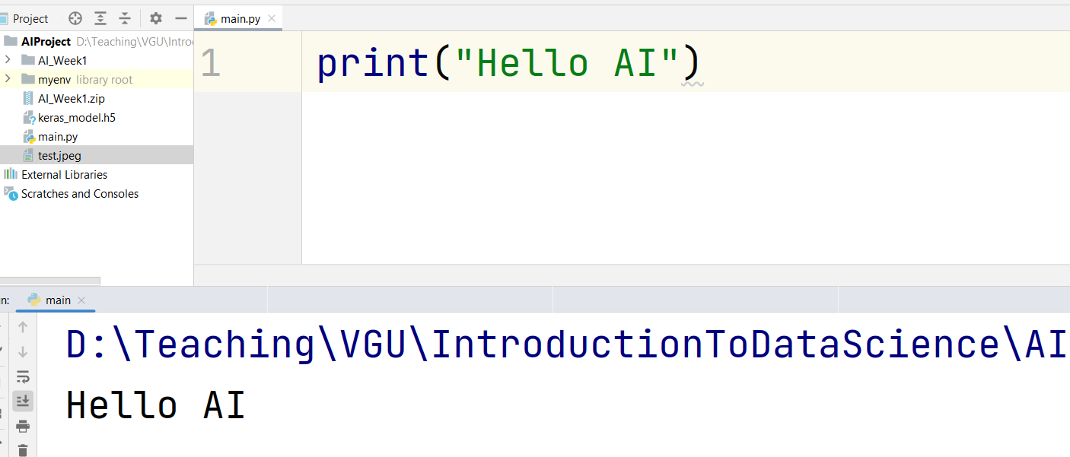
Step 1
Create a new Python project:
Save the project in an empty folder (e.g. AI_Python)
Python version 3.8.5 (or older) is recommended
Student should print to the console a simple string in order to test the Python Editor and Python Interpreter

Slide 31
Step 2
Install following libraries (required for AI processing):
tensorflow
keras
numpy
pillow
opencv-python
In Pycharm Editor, these libraries can be installed through GUI:
From menu File, select Setting
Navigate to the Project
Select Python Interpreter
Click on Add icon, filter the library and click on Install

Slide 32
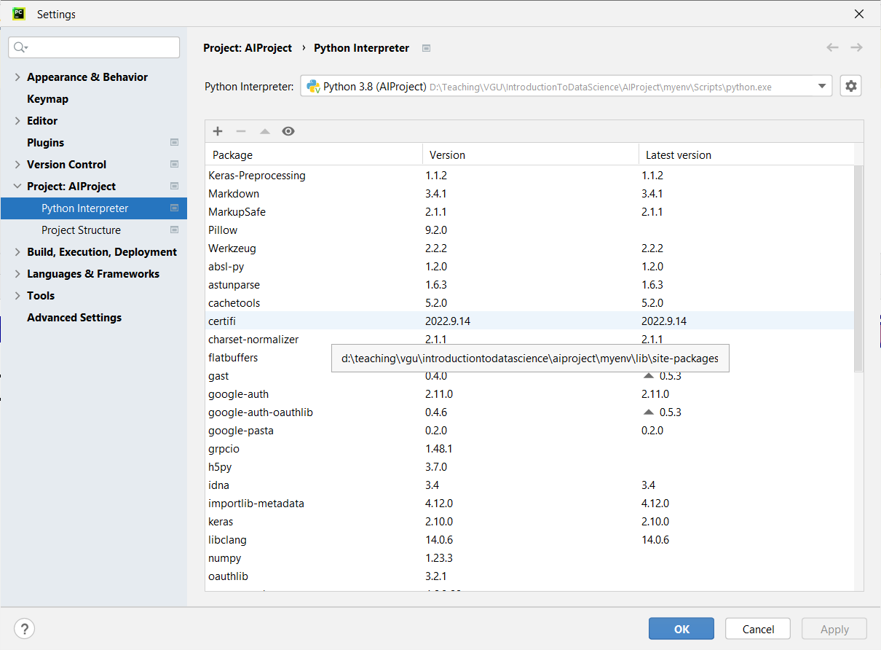
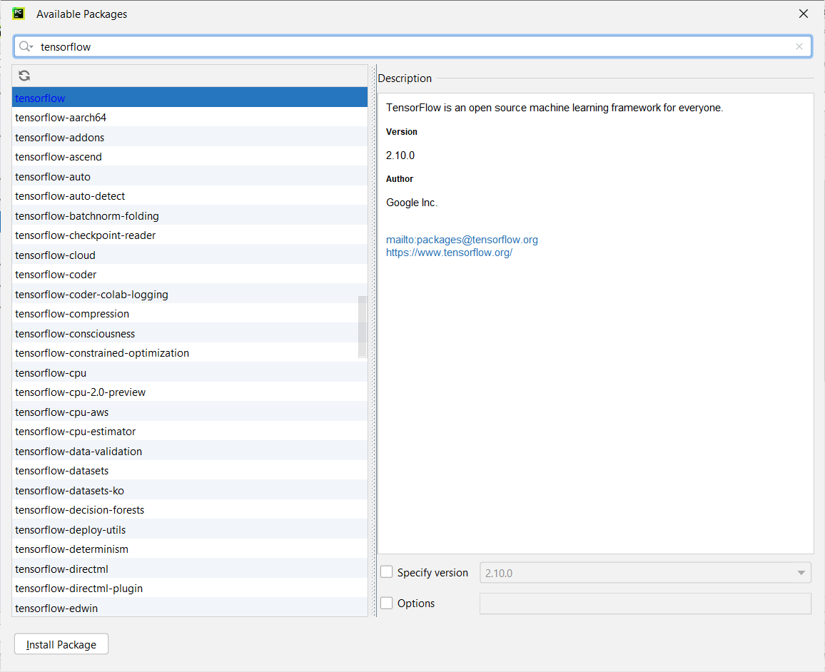
Install library by GUI in PyCharm
3
2
1
4
This option is only available in Pycharm IDE. Other IDEs normally use the pip command to install a package

Slide 33
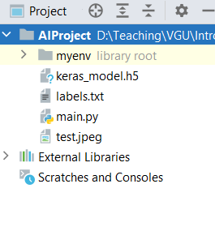
Step 4
Copy the AI Files (keras_model.h5 and lables.txt) to the same folder of main.py
Copy an simple image to the same folder of main.py (the resolution should be higher than 224x224 pixel)
1

Slide 34
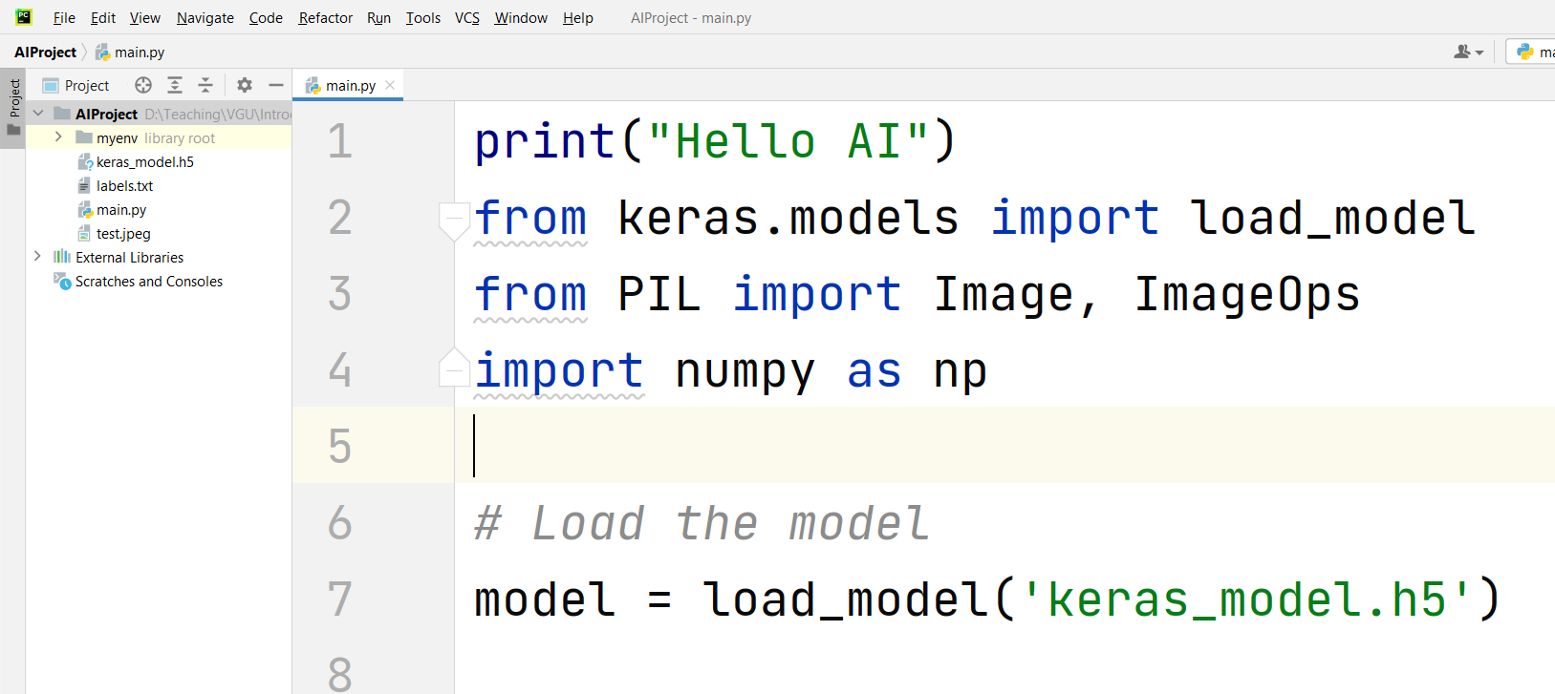
Step 5
Copy the whole source code and place in main.py:

Slide 35
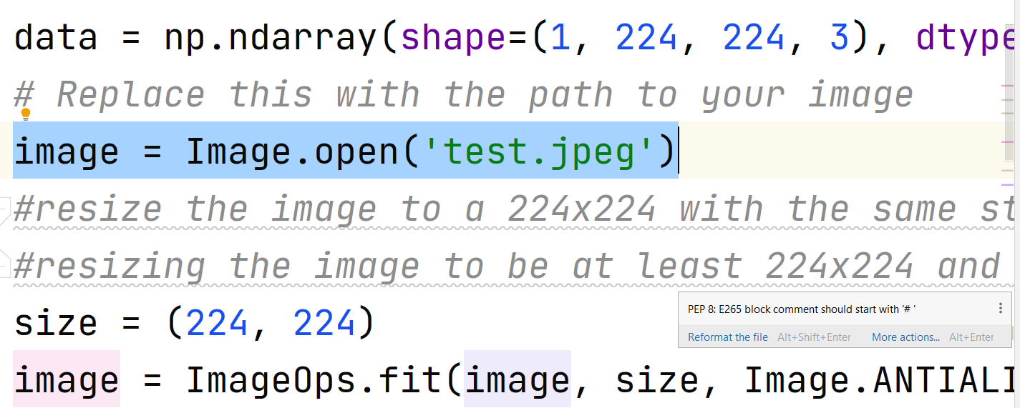
Step 6
Modify the line 13 or 14, change the name of the image to your image, which is placed in the same folder with main.py

Slide 36
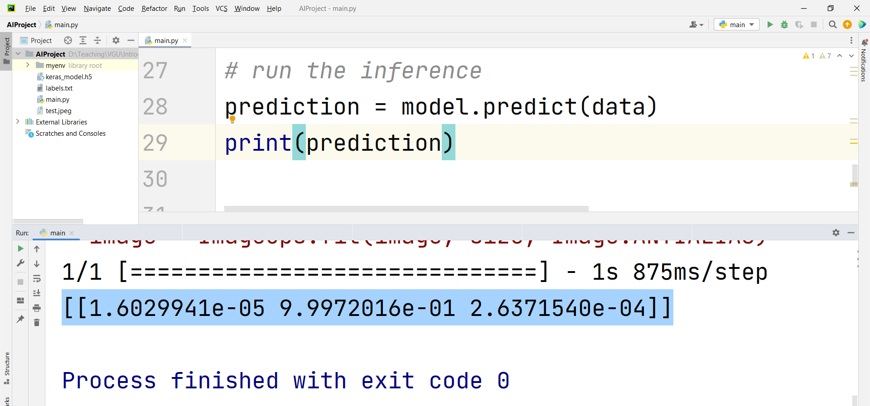
Step 7
Run the python program. The output should be an 2D array, presenting the confidence (in percent) of all the labels trained in Google Teachable Machine

Slide 37
Step 8
Find the maximum confidence and its index from 2D array
#get the 1D array
output = prediction[0]
#assign default value for max confidence
max_index = 0
max_confidence = output[0]
#find the maximum confidence and its index
for i in range(1, len(output)):
if max_confidence < output[i]:
max_confidence = output[i]
max_index = i
print(max_index, max_confidence)

Slide 38
Step 9
Map the labels to the maximum index
file = open("labels.txt",encoding="utf8") data = file.read().split("\n") print("AI Result: ", data[max_index])

Slide 39
Step 10
Add live image from the camera
import cv2 cam = cv2.VideoCapture(0)
def image_capture(): ret,frame = cam.read() cv2.imwrite ("test.png",frame)

Slide 40
Step 11
print("Hello AI") from keras.models import load_model from PIL import Image, ImageOps import numpy as np import cv2 cam = cv2.VideoCapture(0) # Load the model model = load_model('keras_model.h5') def image_capture(): ret,frame = cam.read() cv2.imwrite ("test.png",frame) def image_detector(): data = np.ndarray(shape=(1, 224, 224, 3), dtype=np.float32) # Replace this with the path to your image image = Image.open('test.png') #resize the image to a 224x224 with the same strategy as in TM2: #resizing the image to be at least 224x224 and then cropping from the center size = (224, 224) image = ImageOps.fit(image, size, Image.ANTIALIAS) #turn the image into a numpy array image_array = np.asarray(image) # Normalize the image normalized_image_array = (image_array.astype(np.float32) / 127.0) - 1 # Load the image into the array data[0] = normalized_image_array # run the inference prediction = model.predict(data) #get the 1D array output = prediction[0] #assign default value for max confidence max_index = 0 max_confidence = output[0] #find the maximum confidence and its index for i in range(1, len(output)): if max_confidence < output[i]: max_confidence = output[i] max_index = i print(max_index, max_confidence) file = open("labels.txt",encoding="utf8") data = file.read().split("\n") print("AI Result: ", data[max_index])
Refactor the python source code, having image_capture() and image_detector()

Slide 41
Step 12
print("Hello AI") from keras.models import load_model from PIL import Image, ImageOps import numpy as np import cv2 import time cam = cv2.VideoCapture(0) # Load the model model = load_model('keras_model.h5') def image_capture(): ret,frame = cam.read() cv2.imwrite ("test.png",frame) def image_detector(): data = np.ndarray(shape=(1, 224, 224, 3), dtype=np.float32) # Replace this with the path to your image image = Image.open('test.png') #resize the image to a 224x224 with the same strategy as in TM2: #resizing the image to be at least 224x224 and then cropping from the center size = (224, 224) image = ImageOps.fit(image, size, Image.ANTIALIAS) #turn the image into a numpy array image_array = np.asarray(image) # Normalize the image normalized_image_array = (image_array.astype(np.float32) / 127.0) - 1 # Load the image into the array data[0] = normalized_image_array # run the inference prediction = model.predict(data) #get the 1D array output = prediction[0] #assign default value for max confidence max_index = 0 max_confidence = output[0] #find the maximum confidence and its index for i in range(1, len(output)): if max_confidence < output[i]: max_confidence = output[i] max_index = i print(max_index, max_confidence) file = open("labels.txt",encoding="utf8") data = file.read().split("\n") print("AI Result: ", data[max_index]) while True: time.sleep(5) image_capture() image_detector()
Add an infinite loop to the python source code.
Import time library
Every 5 seconds, call image_capture() then call image_detector()

Slide 42
Part 3: Upload to Adafruit IO

Slide 43
Introduction
The AI result can be published to the Adafruit IO for remote monitoring
When AI is combined with IoT, we form a kind of AIoT application!!!

Slide 44
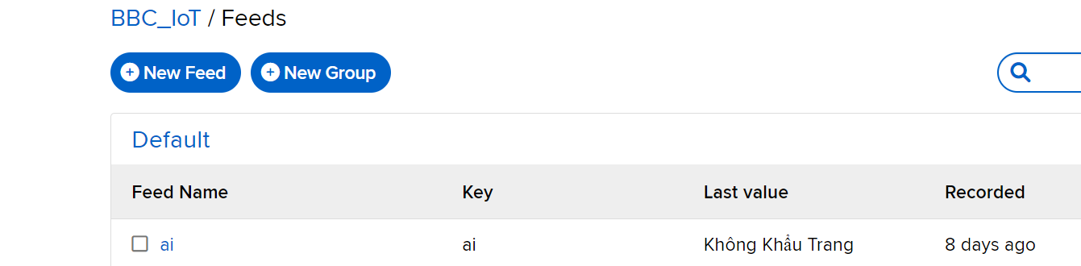
Step 1
Create an account in Adafruit IO
Create a feed on Adafruit IO:
Feed/ New Feed
Provide the name for the Feed, e.g. “ai”

Slide 45
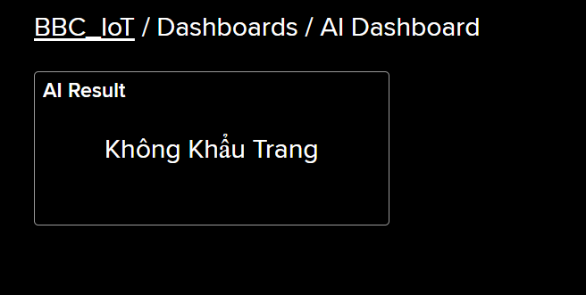
Step 2
Create a simple Dashboard, have a textview to display the last data from feed ai

Slide 46
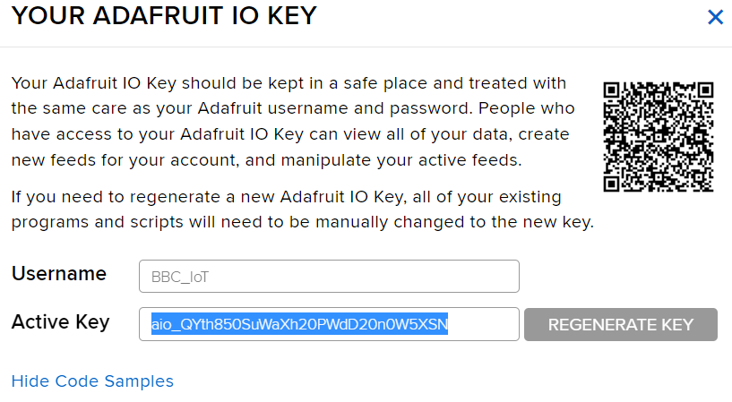
Step 3
Copy your account and your key, which are used for the Python programming

Slide 47
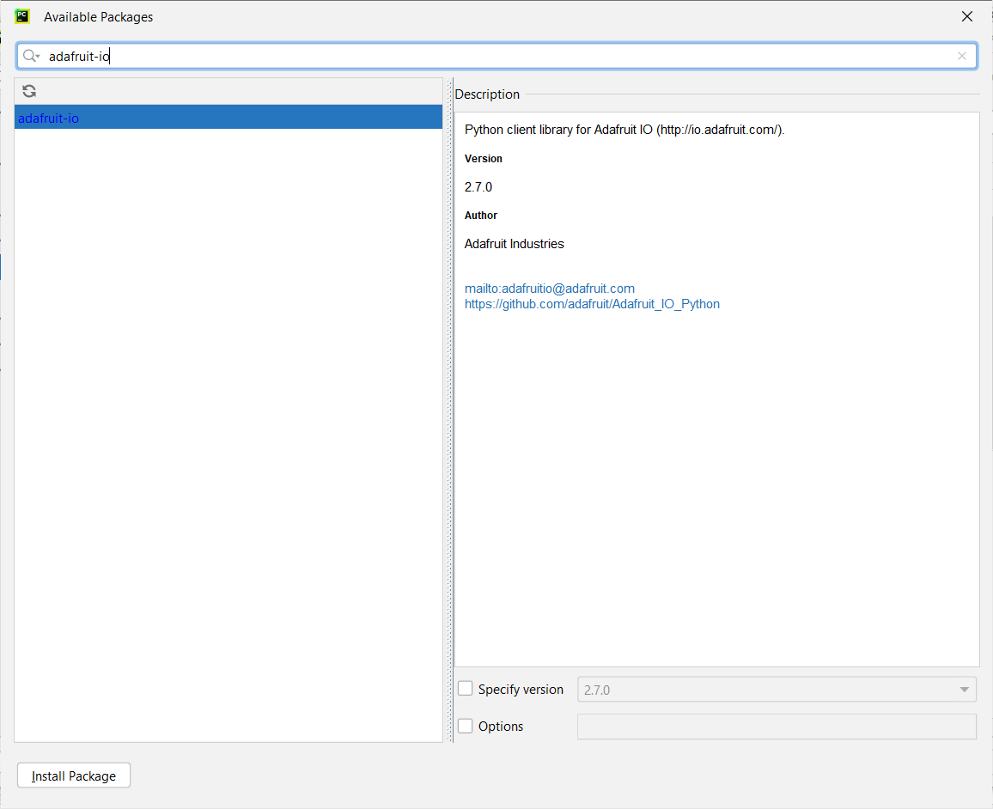
Step 4
Install the adafruit-io library
Import libs:
import sys
from Adafruit_IO import MQTTClient

Slide 48
Step 5
Create an instance of the MQTT Client
Then, use client.publish(“ai”, “your_ai_result”) to the service
client = MQTTClient("your_usr","your_key")
client.connect()
client.loop_background()

Slide 49
Step 6
print("Hello AI") from keras.models import load_model from PIL import Image, ImageOps import numpy as np import cv2 import time from Adafruit_IO import MQTTClient cam = cv2.VideoCapture(0) # Load the model model = load_model('keras_model.h5') def image_capture(): ret,frame = cam.read() cv2.imwrite ("test.png",frame) def image_detector(): # Create the array of the right shape to feed into the keras model # The 'length' or number of images you can put into the array is # determined by the first position in the shape tuple, in this case 1. data = np.ndarray(shape=(1, 224, 224, 3), dtype=np.float32) # Replace this with the path to your image image = Image.open('test.png') #resize the image to a 224x224 with the same strategy as in TM2: #resizing the image to be at least 224x224 and then cropping from the center size = (224, 224) image = ImageOps.fit(image, size, Image.ANTIALIAS) #turn the image into a numpy array image_array = np.asarray(image) # Normalize the image normalized_image_array = (image_array.astype(np.float32) / 127.0) - 1 # Load the image into the array data[0] = normalized_image_array # run the inference prediction = model.predict(data) #get the 1D array output = prediction[0] #assign default value for max confidence max_index = 0 max_confidence = output[0] #find the maximum confidence and its index for i in range(1, len(output)): if max_confidence < output[i]: max_confidence = output[i] max_index = i print(max_index, max_confidence) file = open("labels.txt",encoding="utf8") data = file.read().split("\n") print("AI Result: ", data[max_index]) client.publish("ai", data[max_index]) client = MQTTClient("BBC_IoT","aio_QYth850SuWaXh20PWdD20n0W5XSN") client.connect() client.loop_background() while True: time.sleep(5) image_capture() image_detector()
Finalize the whole program

