Slide 1
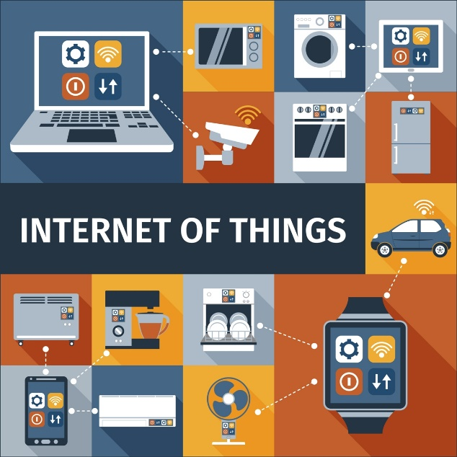
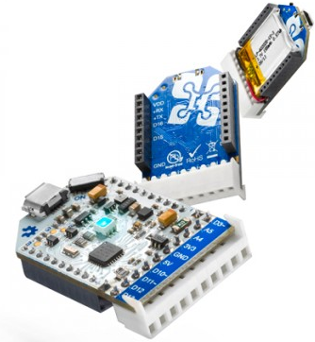
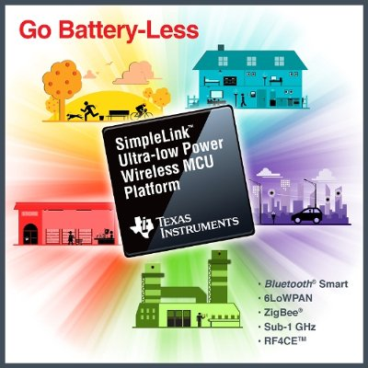
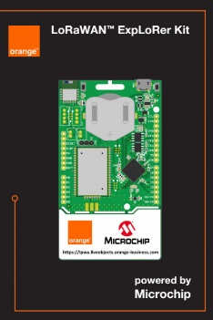

Programming Platform for Internet of Things (IoTs) Applications

Slide 2
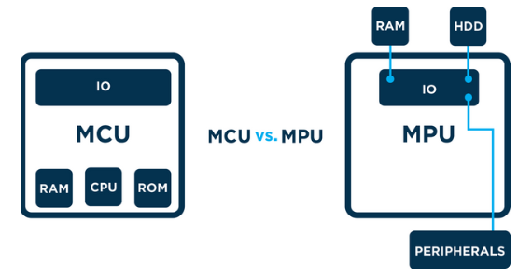

Micro-Controller Platform
Micro-Controller Unit (MCU) contains RAM, ROM and IO
Micro-Processor Unit (MPU) only contains the CPU
System on Chip (SoC) refers to MCUs with a greater number of onboard peripherals and functionality
http://theairboard.cc
http://www.ti.com
http://www.microchip.com

Slide 3

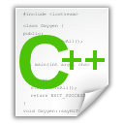
C Language: Header and C++ Files
#include “led.h”
int T_on;
int T_off;
int counter;
void setOn(long duration){
//TODO: set LED on here
}
void setoff(long duration){
//TODO: set LED off here
}
void delay(long duration){
//TODO: set delay here
}
#ifndef __LED_H_
#define __LED_H_
#include <system_lib.h>
#include “user_lib.h”
#include “UserFolder/lib.h”
extern int T_on;
extern int T_off;
void setOn(long duration);
void setoff(long duration);
#endif

Slide 4
C Language: Main File
#include “led.h”
#include “timer.h”
#include “gpio.h”
#include “button.h”
void main(){
initGPIO();
initTimer();
initButton();
initLED();
….
….
while(1){};
}
void timer_isr(){
}
void ext_isr(){
}
Modules/ Libraries are included
LED
Modules/ Libraries are initiated
TIMER
GPIO
System operations are implemented in interrupt functions
BUTTON

Slide 5
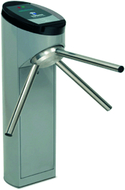
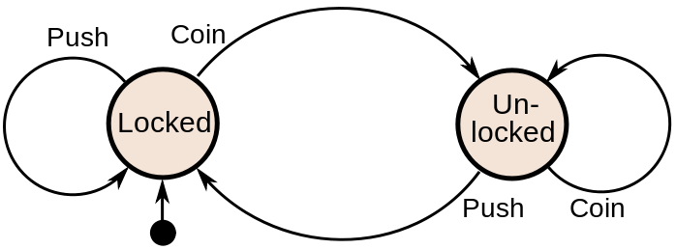
Finite State Machine (FSM)
Finite-State Machine (FSM) or Deterministic Finite Automata (DFA), finite automaton, or simply a state machine, is a mathematical model of computation
Current State | Input | Next State
Locked | Coin | Unlocked
 | Push | Locked
Unlocked | Coin | Unlocked
 | Push | Locked
A turnstile

Slide 6
Finite State Machine Programming
while(1){
switch(status){
case LOCKED: lock_turnstile(); //operation in a state
if(Coin == true) //transition condition
status = UNLOCKED; //next state
break;
case UNLOCKED:
unlock_turnstile(); //operation in a state
if(Push == true) //transition condition
status = LOCKED; //next state
break;
default:
break;
}
}

Slide 7
Bài toán mở cửa
Cửa mở thì loa sẽ kêu
Cửa đóng thì loa sẽ không kêu
Tuy nhiên, nếu cửa mở quá 3 giây, thì loa cũng không kêu

Slide 8
Example 1
Given an LED turns on for T_on and then turns off for T_off.
Design an DFA for this LED
Implement the DFA in Arduino
digitalWrite(13, HIGH): turn on the LED
digitalWrite(13, LOW): turn off the LED
setTime(duration): set a clock (timer_flag = 0), when the clock is expired, timer_flag = 1; duration is in mili-seconds.

Slide 9
Answer
timer_flag == 1
INIT
LED_ON
LED_OFF
timer_flag == 1
INIT: Set pin 13 to OUTPUT mode, set timer
LED_ON: Turn on the LED
LED_OFF: Turn off the LED

Slide 10
Answer (Arduino Code)
void loop(){
switch(status){
case INIT: pinMode(13, OUTPUT);
setTimer(T_on);
status = LED_ON;
digitalWrite(13, HIGH);
break;
case LED_ON:
if(timer_flag == 1){
status = LED_OFF;
setTimer(T_off);
digitalWrite(13, LOW);
}
break;
case LED_OFF:
if(timer_flag == 1){
status = LED_ON;
setTimer(T_on);
digitalWrite(13, HIGH);
}
break;
default:
break;
}
delay(10);
}
void timer_run(){
if(timer_counter > 0)
timer_counter--;
if(counter_timer == 0)
timer_flag =1;
}
void setTimer(long duration){
timer_counter = duration;
timer_flag = 0;
}

Slide 11
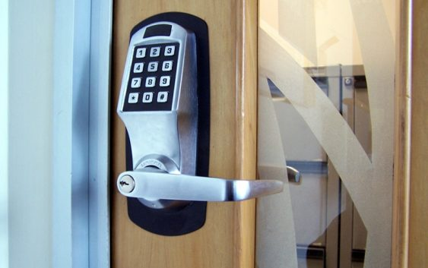
Example 2
Design a smart lock which accepts 4 digits as a secrete code. However, there is a time-out for each digit (e.g. T_out = 5s). After this period, the system is reset

Slide 12
Embedded Platform based on Operating System
Embedded means something that is attached to another thing.
“Any sort of device which includes a programmable computer but itself is not intended to be a general-purpose computer” [Marilyn Wolf]
Embedded system has three components:
Hardware
Real Time Operating System (RTOS)
Software

Slide 13
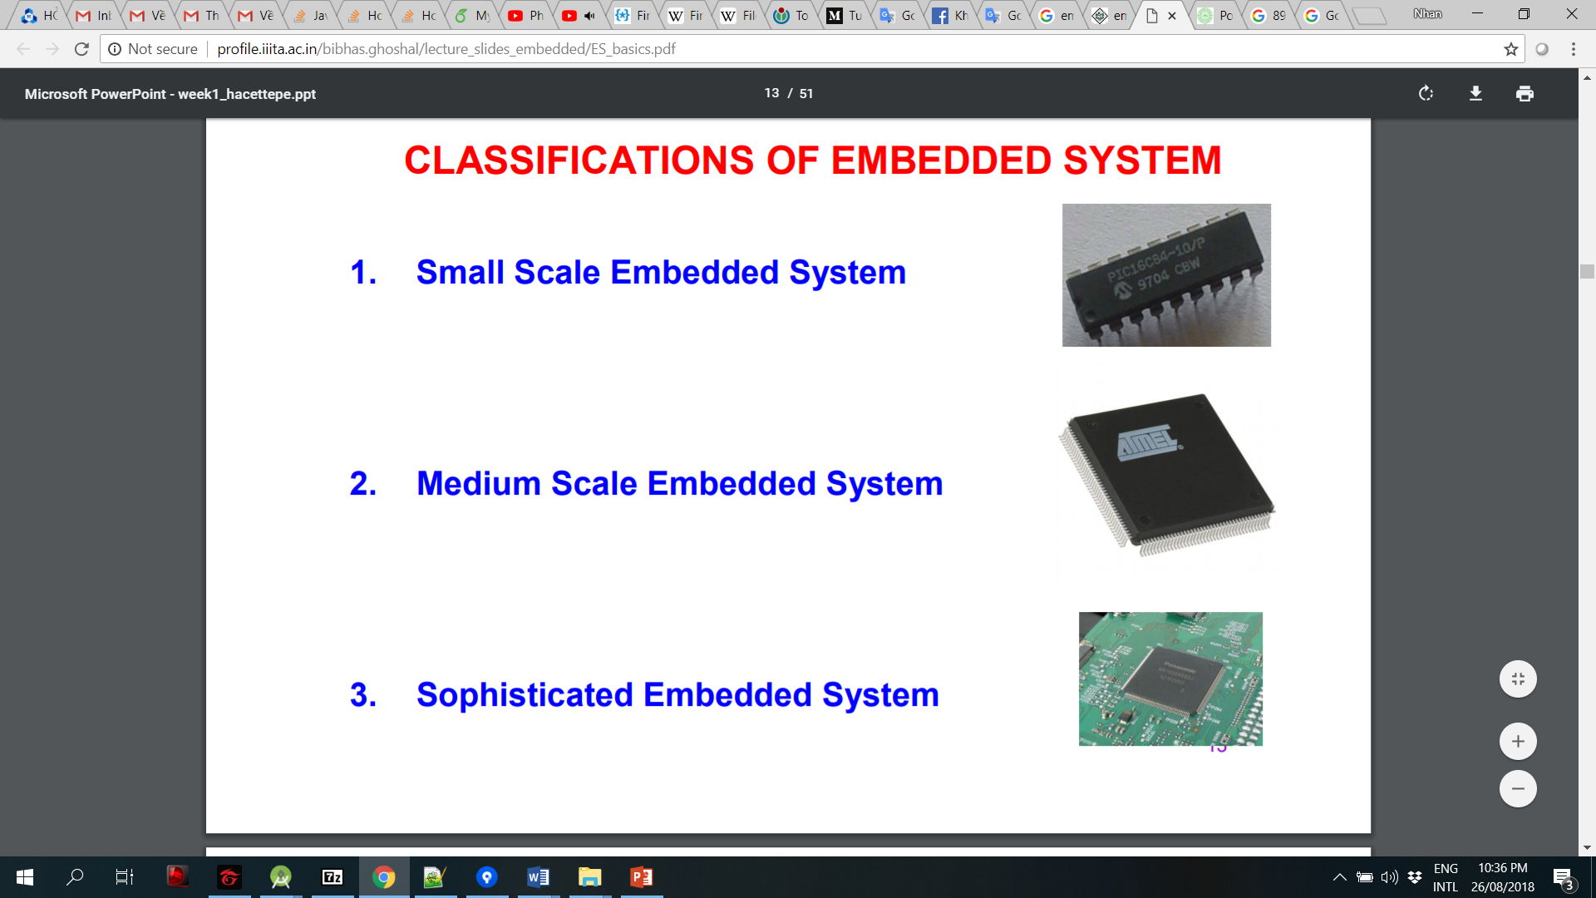
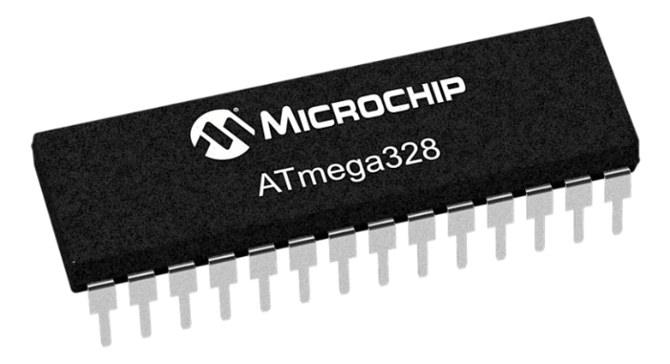
Classification of Embedded System
Small Scale
Medium Scale
Sophisticated Scale

Slide 14
Processor
Processor is the heart of the Embedded Syste
General Purpose processor (GPP)
Microprocessor
Microcontroller
Embedded Processor
Digital Signal Processor
Application Specific System Processor (ASSP)
Multi Processor System using GPPs

Slide 15
Operating System: Linux and Android
Connectivity and UI
Two powerful operating systems used in most of the embedded systems
Wireless connectivity and graphics interface: Android OS
Linux comes with a complex flow and it might be difficult for a beginner to understand it
Power management
Android and Linux supports effective power management compared to real time operating systems
Responsiveness
Cost

Slide 16
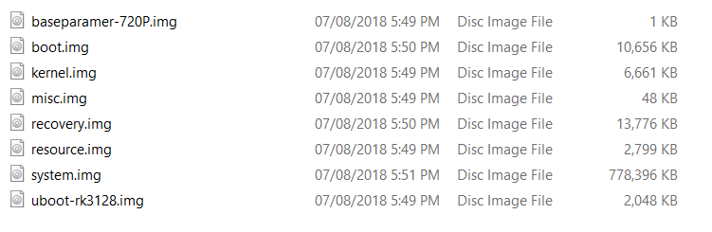
Android Operating System Component

Slide 17
Android Boot File
mkdir /system
mkdir /data 0771 system system
mkdir /cache 0770 system cache
mkdir /config 0500 root root
mkdir /metadata 0770 root root
service yunos_preinstall /system/bin/yunos_preinstall.sh
user root
group root
class main
disabled
oneshot

Slide 18
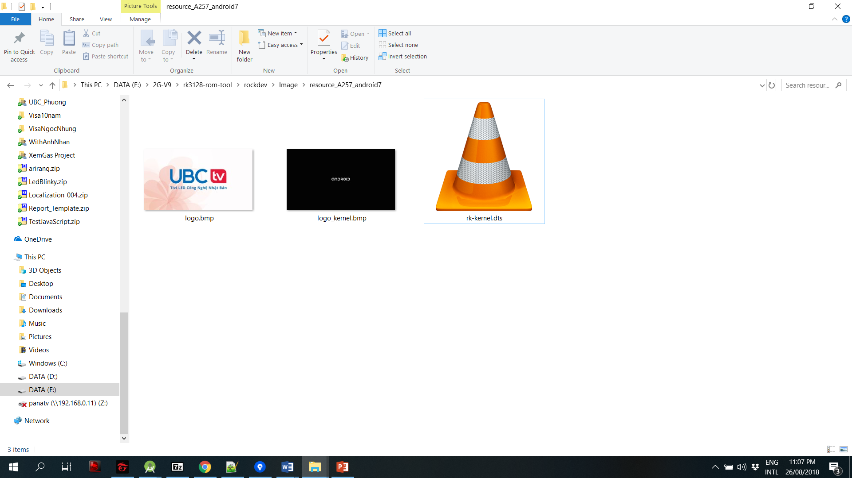
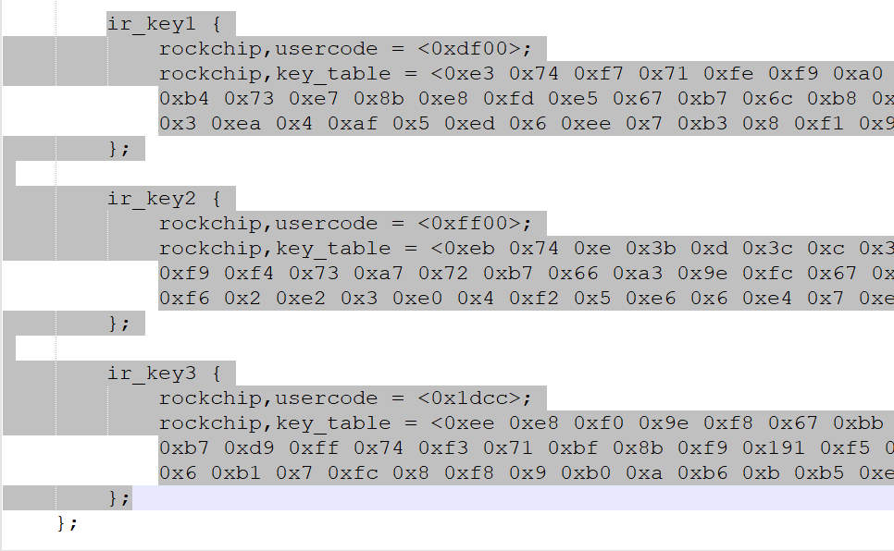
Android Resource File
IR Remote Data

Slide 19
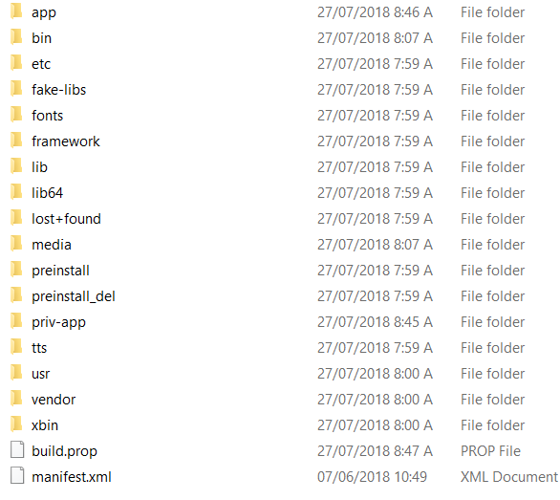
Android System File
System apps
User apps
Launcher apps
Preinstall apps
Libs
KeyLayout
…

Slide 20
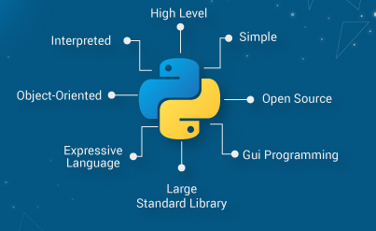
Python Programing Language
AI, Data science and Deep Learning
Interpreter programing language

Slide 21
Class in Python
class Student: def __init__(self, _name, _age): self.name = _name self.age = _age def setName(self, _name): self.name = _name
Flexible and high level approach

Slide 22
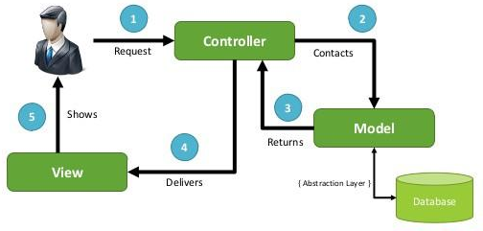
Model View Controller
A pattern for OOP program

Slide 23
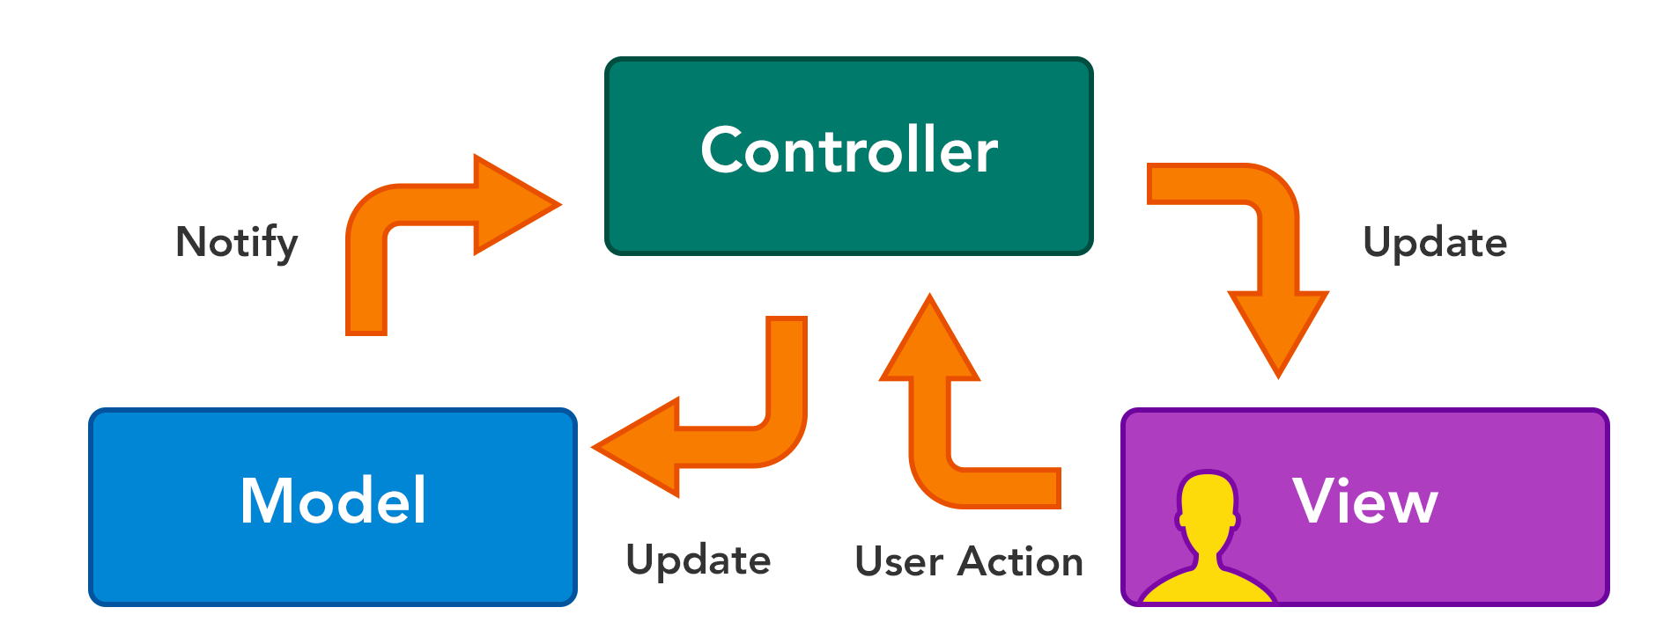
MVC using Python

Slide 24
Step 1: Create a new project in Python
Create Model folder:
Student.py
Create Controller folder:
StudentController.py
The main.py is the View of the project

Slide 25
Step 2: Implement the Student Class
class Student: def __init__(self, _name, _age): self.name = _name self.age = _age def setName(self, _name): self.name = _name def getName(self): return self.name def setAge(self, _age): self.age = _age def getAge(self): return self.age
The fields are highly related to the database properties

Slide 26
Step 3: Implement the Controller
class StudentController: def insertStudent(self, student): print(student.name, student.age)
Data manipulation: insert, update or delete
Data storage: database or file management system

Slide 27
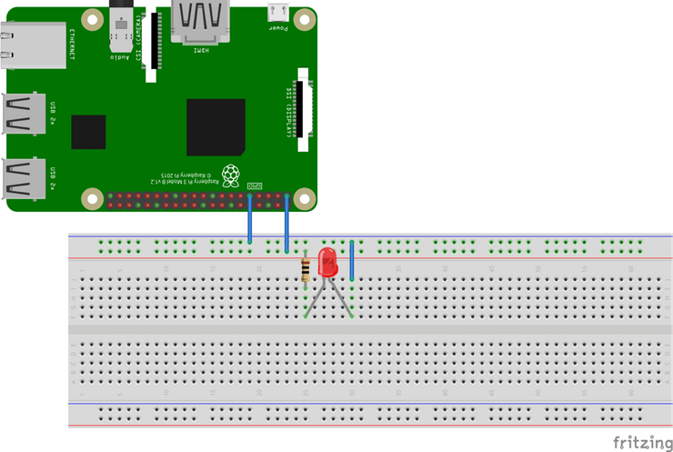
Lab 2: LED Blinky on Android Things
Hardware connection

Slide 28
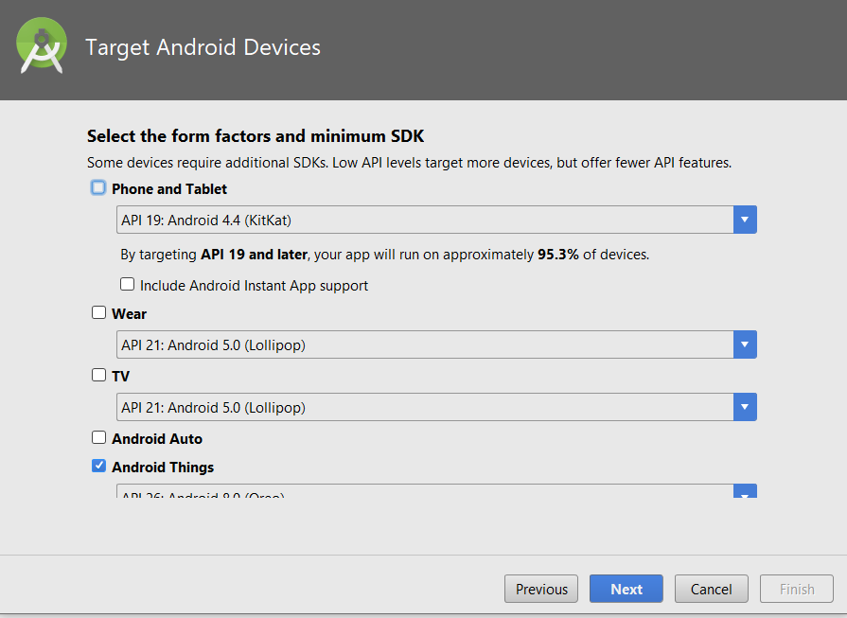
Create an Android Things Project
dependencies { ... compileOnly 'com.google.android.things:androidthings:+' }

Slide 29
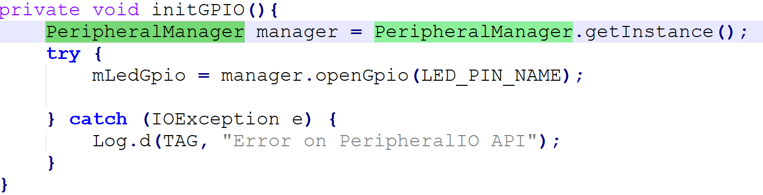
MainActivity.java
Step 1: Declare a pin name wired to LED
private static final String LED_PIN_NAME = "BCM26";
Step 2: Implement initGPIO function
Step 3: Call initGPIO() on OnCreate()

Slide 30
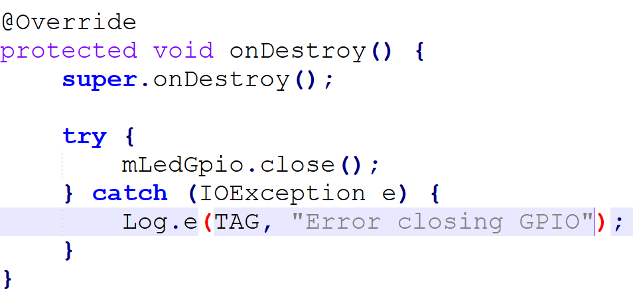
MainActivity.java
Step 4: Release the pin when the app is closed

Slide 31
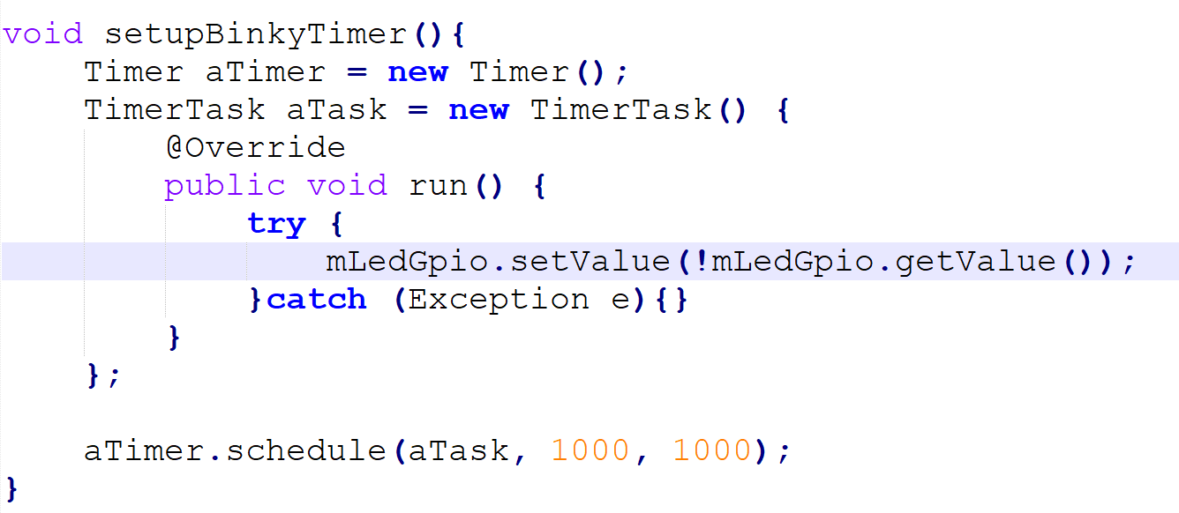
MainActivity.java
Step 5: Create a Timer
Step 6: Call this function on OnCreate()

Slide 32
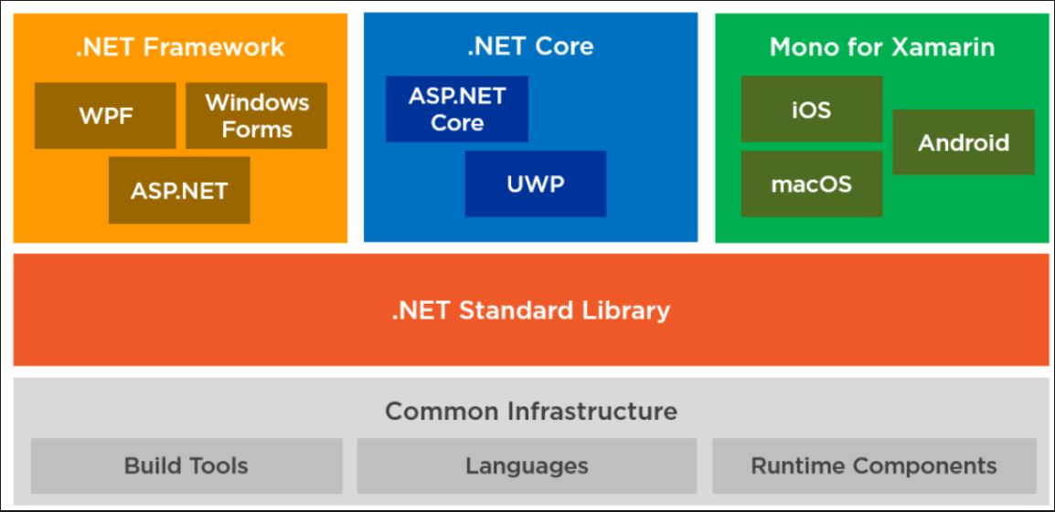
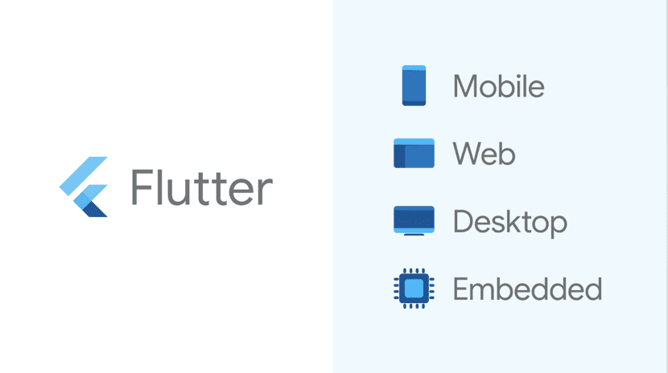
Software Development Framework

Slide 33
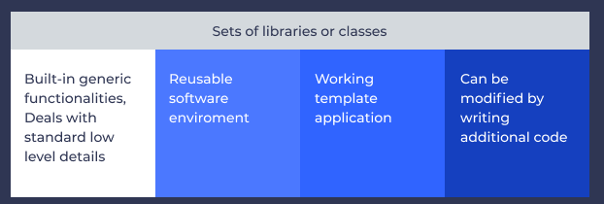
What is Software Development Framework?
Supported libraries, SDK, programming languages for software development and deployment

Slide 34
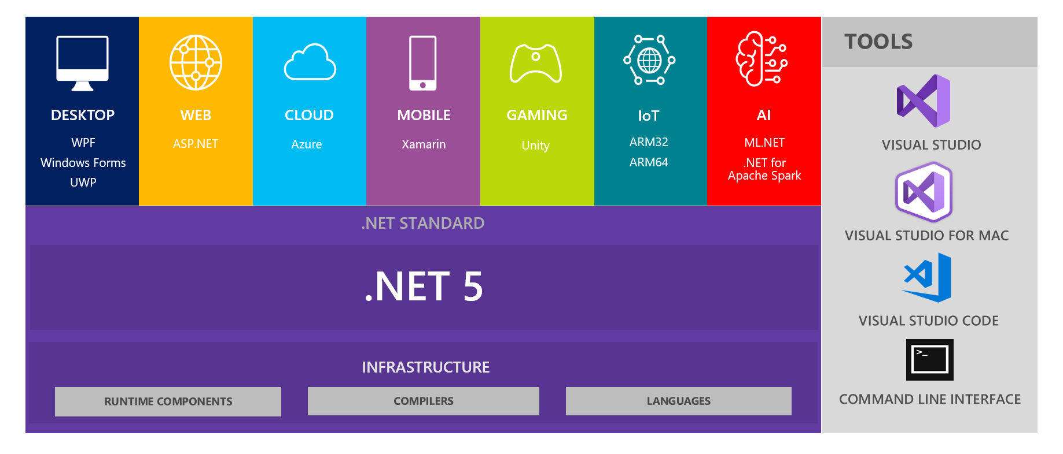
Dot Net Framework
Unify framework for Desktop Applications
C, C++ and C# are the most popular languages
Visual studio IDE: Drag and Drop!!!

Slide 35
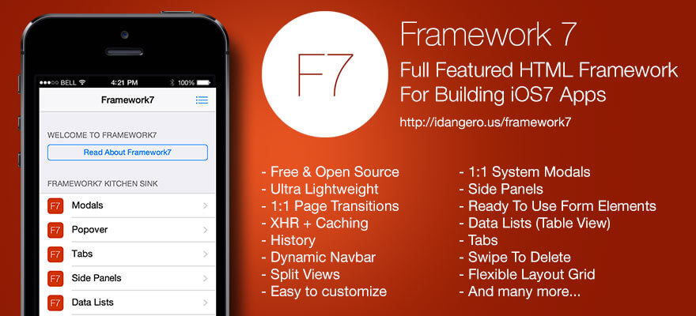
Framework 7 – React JS
https://framework7.io/react/

Slide 36
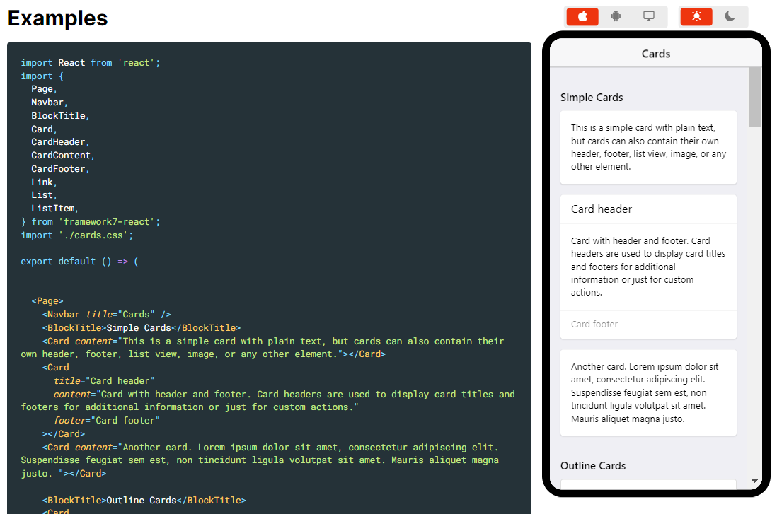
Example of Framework 7
Framework 7 Web-App development environment

Slide 37
Android Studio and Flutter
Flutter is an Android Studio plug-in:
Access to the hardware of the mobile device (Bluetooth, NFC, Wifi, …)

Slide 38
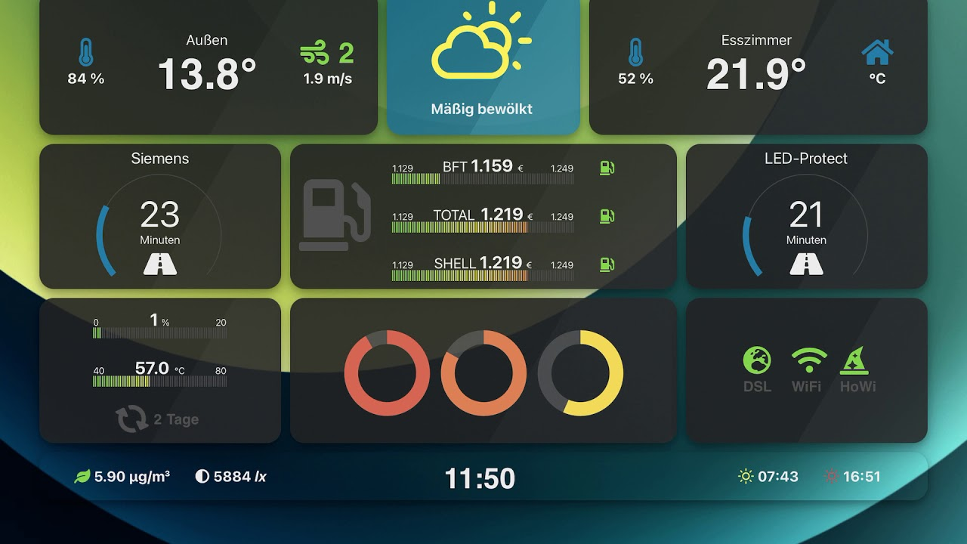
Unity 3D
A product from Microsoft
Not only for game developers, but also a cross-framework for software developemt
C# programing language

Slide 39

Unity Asset Store
https://assetstore.unity.com/templates
https://www.youtube.com/watch?v=uZaFHx1daLU

