Slide 1
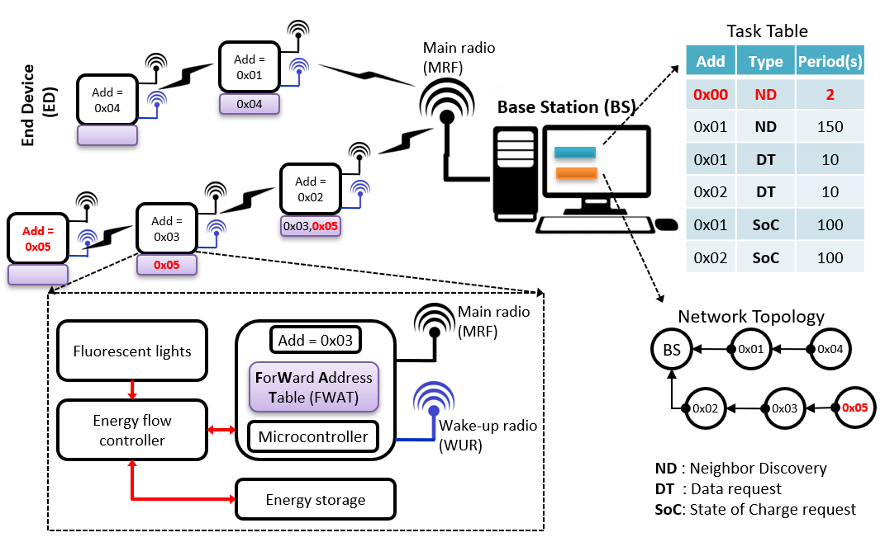
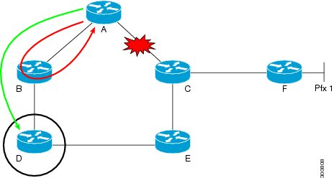

Wireless Communication in Internet of Things (IoT)

Slide 2
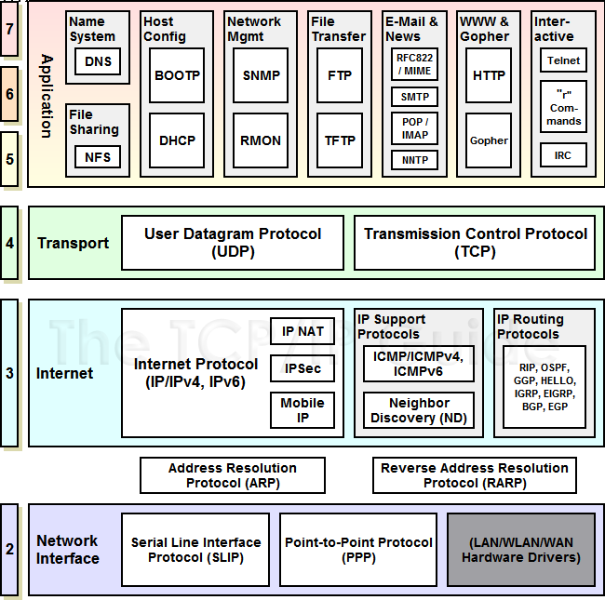
IoTs based TCP/IP Architecture
Application layer
Transport layer
Internet layer
Network access layer
Physical layer

Slide 3
Medium Access Control (MAC) Protocol
Protocol is the combination of framing, flow control, and error control to achieve the delivery of data from one node to another
The protocols are normally implemented in software by using one of the common programming languages
Flow control: Refers to a set of procedures used to restrict the amount of data that the sender can send before waiting for acknowledgment
Error control: is both error detection and error correction

Slide 4
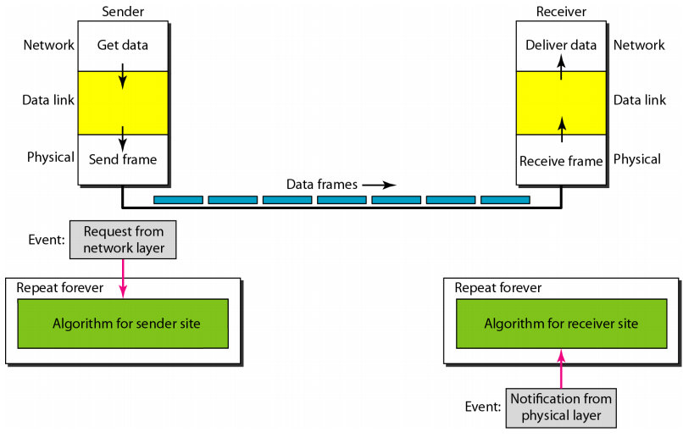
Simplest Protocol Design
message

Slide 5
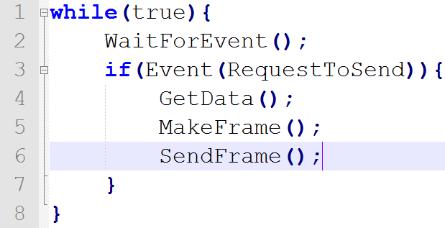
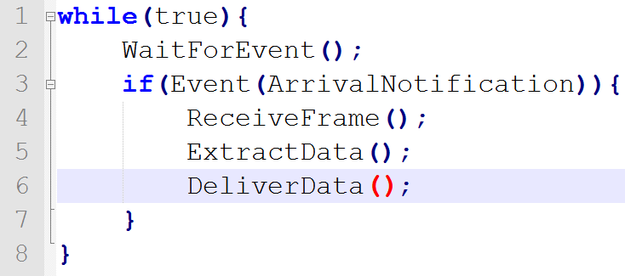
Implementation

Slide 6
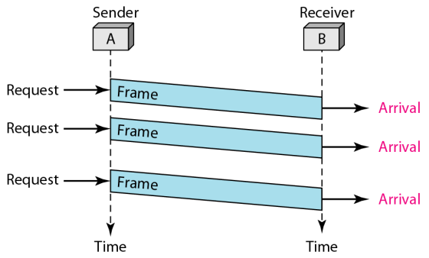
Example
Propagation delay
The sender sends a sequence of frames without even thinking about the receiver
There is no error handler
There is no synchronization (the receiver processing time is slower than the transmission speed)

Slide 7
MAC Protocol in IoTs
Synchronous protocols
The stream of data to be transferred is encoded as fluctuating voltage levels in one wire (the 'DATA'), and a periodic pulse of voltage on a separate wire (called the "CLOCK") which tells the receiver that the current DATA bit is available at this moment in time
Asynchronous protocols
Data is transmitted at a random time. Normally, a start and stop conditions are used to begin a “rendez-vous” to initiate a comunication

Slide 8
Advantage and Disadvantage
 | Advantage | Disadvantage
Asynchronous transmission | Simple, doesn't require synchronization of both communication sides Cheap, asynchronous requires less hardware Suitable for low data rate applications | Large relative overhead, a high proportion of the transmitted bits are uniquely for control purposes and thus carry no useful information
Synchronous transmission | Lower overhead and thus, greater throughput | Slightly more complex Hardware is more expensive

Slide 9
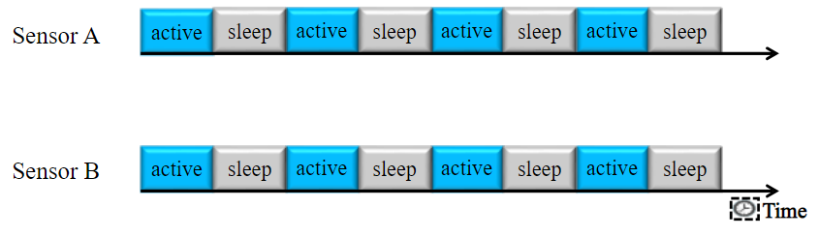
Synchronous Protocols: S-MAC
Communication are synchronized in time with two state:
Active: Carrier sensing, Request To Send, Clear To Send and Sync Packet
Sleep: Low power mode for energy reservation
Drawback: Energy wasted for active period:
When there is no packet to send?????

Slide 10
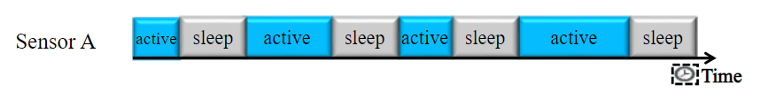
Synchronous Protocols: T-MAC
An extended version from S-MAC:
Active period is adapted: if there is no RTS or CTS after a period, the node go to sleep mode
Drawback: Energy wasted due to SYNC packet
High impact on low data rate networks

Slide 11
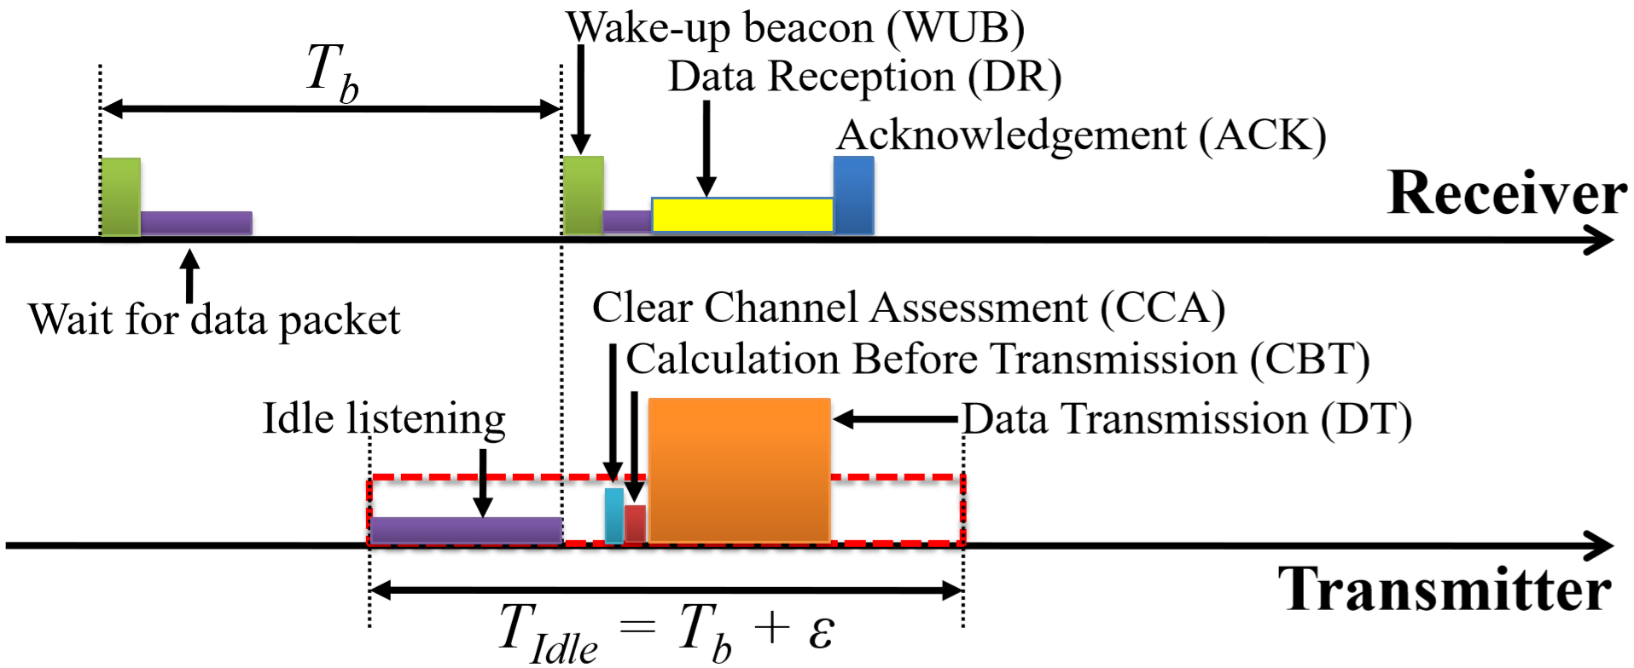
Asynchronous Protocols
RICER (Receiver Initiated Cycled Receiver):
Receiver sends a BEACON
Transmitter waits for a BEACON, before sending its DATA
ACK is used to confirm a communication

Slide 12
Asynchronous Protocols
Extended version of RICER:
RICER3, RICER3b, RICE5
ODMAC: ACK plays the role of a new BEACON
SymMAC: RICER + TICER
DATA
Tx
DATA
Preambles
DATA
Tx
CCA
CCA
R-Mote
T-Mote
Wait for a DATA
BEA
BEA
ACK
Rx
BEA
ACK
CCA
ACK
Rx

Slide 13

Routing Protocol in IoTs
Node(17)
Node(19)
Node(15)
Node(8)
Node(9)
Node(18)
Node(7)
Node(16)
Node(14)
Node(0)
Node(1)
Node(2)
Node(20)
Base Station
Node(6)
Node(12)
Node(11)
Node(10)
Node(5)
Node(4)
Node(3)
Node(13)
Energy efficient routing for sending a packet???

Slide 14
Neighbor Discovery Process
Node(17)
Node(19)
Node(15)
Node(8)
Node(9)
Node(18)
Node(7)
Node(16)
Node(14)
Node(0)
Node(1)
Node(2)
Node(20)
Base Station
Node(6)
Node(12)
Node(11)
Node(10)
Node(5)
Node(4)
Node(3)
Base station nodes send neighbor discovery packet:
Node (1) (6) (7) are discovered

Slide 15
Neighbor Discovery Process
Forward Table
Node (8)
Node (9)
Node(17)
Node(19)
Node(15)
Node(8)
Node(9)
Node(18)
Node(7)
Node(16)
Node(14)
Node(0)
Node(1)
Node(2)
Node(20)
Base Station
Node(6)
Node(12)
Node(11)
Node(10)
Node(5)
Node(4)
Node(3)
Node (7) sends neighbor discovery packet:
Node (8) and (9) response
(8) and (9) are added to the forward table of node (7)

Slide 16
Data Request Process
Forward Table
Node (8)
Node (9)
Node(17)
Node(19)
Node(15)
Node(8)
Node(9)
Node(18)
Node(7)
Node(16)
Node(14)
Node(0)
Node(1)
Node(2)
Node(20)
Base Station
Node(6)
Node(12)
Node(11)
Node(10)
Node(5)
Node(4)
Node(3)
Node (0) send data request packet to Node 8.
Node (7) forwards this packet
Node (8) response to Node (7) and then, forward to Node (0)

