Slide 1

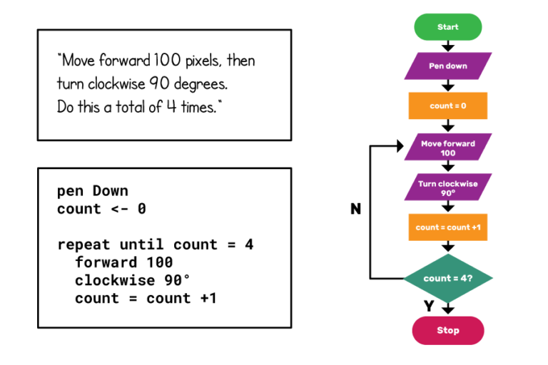
Introduction to Algorithm

Slide 2
What is an algorithm?
An algorithm is “a finite set of precise instructions for performing a computation or for solving a problem”
A program is one type of algorithm
All programs are algorithms
Not all algorithms are programs!
Design a scheduler for RTOS is an algorithm

Slide 3
Some algorithms are harder than others
Some algorithms are easy
Finding the largest (or smallest) value in a list
Finding a specific value in a list
Some algorithms are a bit harder
Sorting a list
Some algorithms are very hard
Finding the shortest path between Miami and Seattle
Some algorithms are essentially impossible
Factoring large composite numbers
→ Algorithm complexity needs to be considered

Slide 4
Algorithm 1: Maximum Element
Given a list, how do we find the maximum element in the list?
To express the algorithm, Pseudocode can be used
procedure max(a1, a2, …, an: integers)
max := a₁
for i := 2 to n
if max < a_{i} then max := a_{i}

Slide 5
Maximum element running time
How long does this take?
If the list has n elements, worst case scenario is that it takes n “steps”
Here, a step is considered a single step through the list

Slide 6
Properties of Algorithms
Algorithms generally share a set of properties:
Input: what the algorithm takes in as input
Output: what the algorithm produces as output
Definiteness: the steps are defined precisely
Correctness: should produce the correct output
Finiteness: the steps required should be finite
Effectiveness: each step must be able to be performed in a finite amount of time
Generality: the algorithm should be applicable to all problems of a similar form

Slide 7
Searching Algorithms
Given a list, find a specific element in the list
We will see two types
Linear search
a.k.a. sequential search
Binary search

Slide 8
Algorithm 2: Linear Search
Given a list, find a specific element in the list
List does NOT have to be sorted!
procedure linear_search (x: integer; a₁, a₂, …, a_{n}: integers)
i := 1
while ( i ≤ n and x ≠ a_{i} )
i := i + 1
if i ≤ n then location := i
else location := 0
{location is the subscript of the term that equals x, or it is 0 if x is not found}

Slide 9
Linear Search Running Time
How long does this take?
If the list has n elements, worst case scenario is that it takes n “steps”
Here, a step is considered a single step through the list
Complexity is O(N)

Slide 10
Algorithm 3: Binary Search
Given a list, find a specific element in the list
List MUST be sorted!
Each time it iterates through, it cuts the list in half
procedure binary_search (x: integer; a₁, a₂, …, a_{n}: increasing integers)
i := 1 { i is left endpoint of search interval }
j := n { j is right endpoint of search interval }
while i < j
begin
m := ⎣(i+j)/2⎦ { m is the point in the middle }
if x > a_{m} then i := m+1
else j := m
end
if x = a_{i} then location := i
else location := 0

Slide 11
Binary Search Running Time
How long does this take (worst case)?
If the list has 8 elements
It takes 3 steps
If the list has 16 elements
It takes 4 steps
If the list has n elements
It takes log₂ n steps

Slide 12
Sorting Algorithms
Given a list, put it into some order
Numerical, lexicographic, etc.
We will see two types
Bubble sort
Insertion sort

Slide 13
Algorithm 4: Bubble Sort
One of the most simple sorting algorithms
Also one of the least efficient
It takes successive elements and “bubbles” them up the list
procedure bubble_sort (a₁, a₂, …, a_{n})
for i := 1 to n-1
for j := 1 to n-i
if a_{j} > a_{j}+1
then interchange a_{j} and a_{j}+1
{ a₁, …, a_{n} are in increasing order }

Slide 14
Bubble Sort Running Time
Outer for loop does n-1 iterations
Inner for loop does
n-1 iterations the first time
n-2 iterations the second time
…
1 iteration the last time
Total: (n-1) + (n-2) + (n-3) + … + 2 + 1 = (n²-n)/2
We can say that’s “about” n² time

Slide 15
Algorithm 5: Insertion Sort
Another simple (and inefficient) algorithm
It starts with a list with one element, and inserts new elements into their proper place in the sorted part of the list
procedure insertion_sort (a₁, a₂, …, a_{n})
for j := 2 to n
begin
i := 1
while a_{j} > a_{i}
i := i +1
m := a_{j}
for k := 0 to j-i-1
a_{j-k} := a_{j-k-1}
a_{i} := m
end { a₁, a₂, …, a_{n} are sorted }

Slide 16
Insertion Sort Running Time
Outer for loop runs n-1 times
In the inner for loop:
Worst case is when the while keeps i at 1, and the for loop runs lots of times
If i is 1, the inner for loop runs 1 time (k goes from 0 to 0) on the first iteration, 1 time on the second, up to n-2 times on the last iteration
Total is 1 + 2 + … + n-2 = (n-1)(n-2)/2
We can say that’s “about” n² time

Slide 17
Comparison of Running Times
Searches
Linear: n steps
Binary: log₂ n steps
Binary search is about as fast as you can get
Sorts
Bubble: n² steps
Insertion: n² steps
There are other, more efficient, sorting techniques
In principle, the fastest are heap sort, quick sort, and merge sort
These each take take n * log₂ n steps
In practice, quick sort is the fastest, followed by merge sort

Slide 18
RTOS ‘update’ function
void SCH_Update(void) {
tByte Index;
// NOTE: calculations are in *TICKS* (not milliseconds)
for (Index = 0; Index < SCH_MAX_TASKS; Index++) {
// Check if there is a task at this location
if (SCH_tasks_G[Index].pTask) {
if (SCH_tasks_G[Index].Delay == 0) {
// The task is due to run
SCH_tasks_G[Index].RunMe += 1; // Inc. the 'RunMe' flag
if (SCH_tasks_G[Index].Period) {
// Schedule periodic tasks to run again
SCH_tasks_G[Index].Delay = SCH_tasks_G[Index].Period;
}
} else {
// Not yet ready to run: just decrement the delay
SCH_tasks_G[Index].Delay -= 1;
}
}
}
}

Slide 19
MCQ
The word ____________comes from the name of a Persian mathematician
a) Flowchart b) Flow c) Algorithm d) Syntax
Notes:
C

Slide 20
MCQ
The time that depends on the input: an already sorted sequence that is easier to sort.
a) Process b) Evaluation c) Running d) Input
Notes:
C

Slide 21
MCQ
Algorithms can be represented (select incorrect): a) as pseudo codes b) as syntax c) as programs d) as flowcharts
Notes:
B

Slide 22
MCQ
When an algorithm is written in the form of a programming language, it becomes a _________
a) Flowchart b) Program c) Pseudo code d) Syntax
Notes:
B

Slide 23
MCQ
Any algorithm is a program.
a) True b) False
Any program is an algorithm
a) True b) False

Slide 24
MCQ
A system wherein items are added from one and removed from the other end
a) Stack b) Queue c) Linked List d) Array
Notes:
B

Slide 25
MCQ
Another name for 1-D arrays.
a) Linear arrays b) Lists c) Horizontal array d) Vertical array
Notes:
A

Slide 26
https://www.youtube.com/watch?v=01sAkU_NvOY
import cv2 import mediapipe as mp import time cap = cv2.VideoCapture(1) mpHands = mp.solutions.hands hands = mpHands.Hands() mpDraw = mp.solutions.drawing_utils while True: success, img = cap.read() imgRGB = cv2.cvtColor(img, cv2.COLOR_BGR2RGB) results = hands.process(imgRGB) if results.multi_hand_landmarks: for handlms in results.multi_hand_landmarks: #21 points in handlms mpDraw.draw_landmarks(img, handlms, mpHands.HAND_CONNECTIONS) cv2.imshow("Image", img) cv2.waitKey(1)

Slide 27

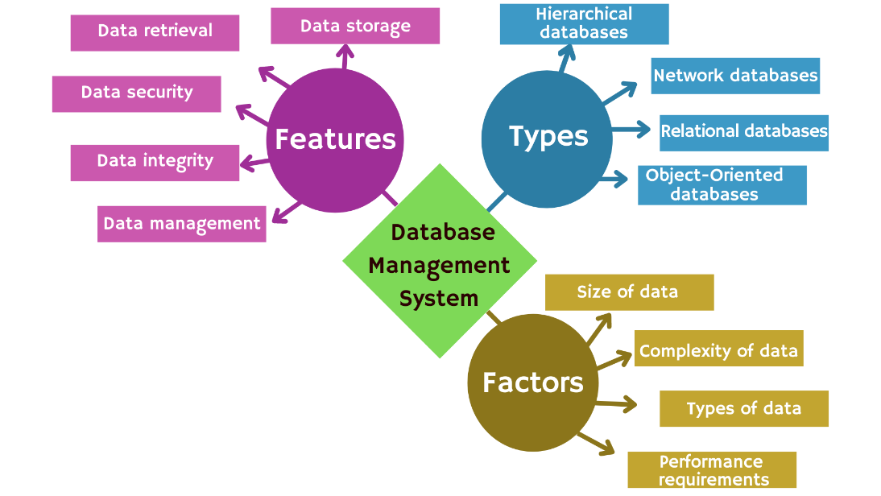
Assignment Project (20% and +2 maximum)

Slide 28
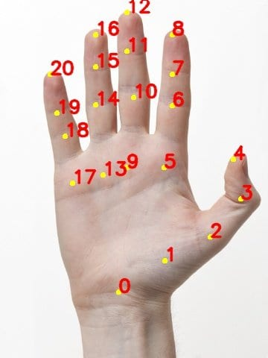

General Information
Pick one of the following topics:
AI, DA, Blockchain or Software Engineering
DA (World Cloud)
AI (MediaPipe)

Slide 29
Example 1: Gesture Detection

Slide 30
Example 2: World Cloud Generation Software

Slide 31
Project Presentation
Introduction to the project
Use-Case diagram
Sequence Diagram, Flowchart or Algorithm of one or two typical use-cases
Implementation
Results and Demo

