Slide 1

COMPUTER GRAPHICS
Hochiminh city University of Technology
Faculty of Computer Science and Engineering
CHAPTER 01:
Graphics System

Slide 2
Outline
Computer Graphics: Why & What?
Application
Computer Graphics Systems
Image Formation
Models and Architectures
API Contents

Slide 3

Computer Graphics: Why & What?
Why
“A Picture is Worth a Thousand Words”

Slide 4
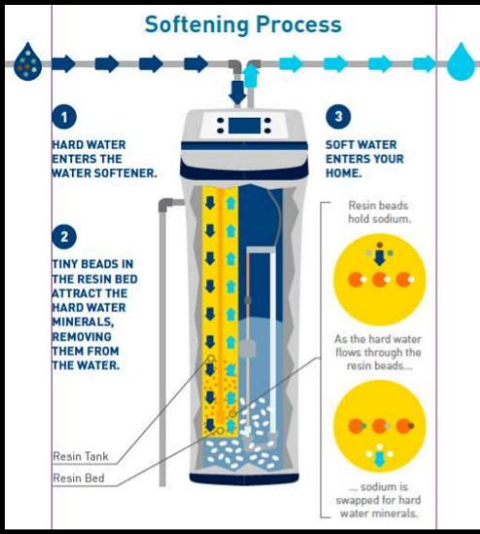
Computer Graphics: Why & What?

Slide 5
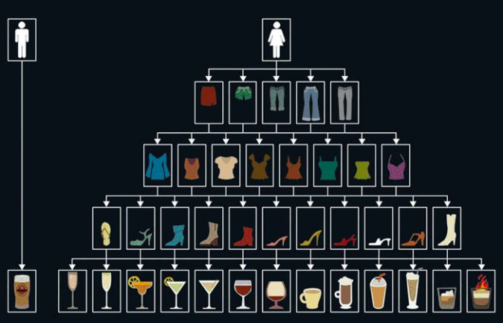
Computer Graphics: Why & What?

Slide 6
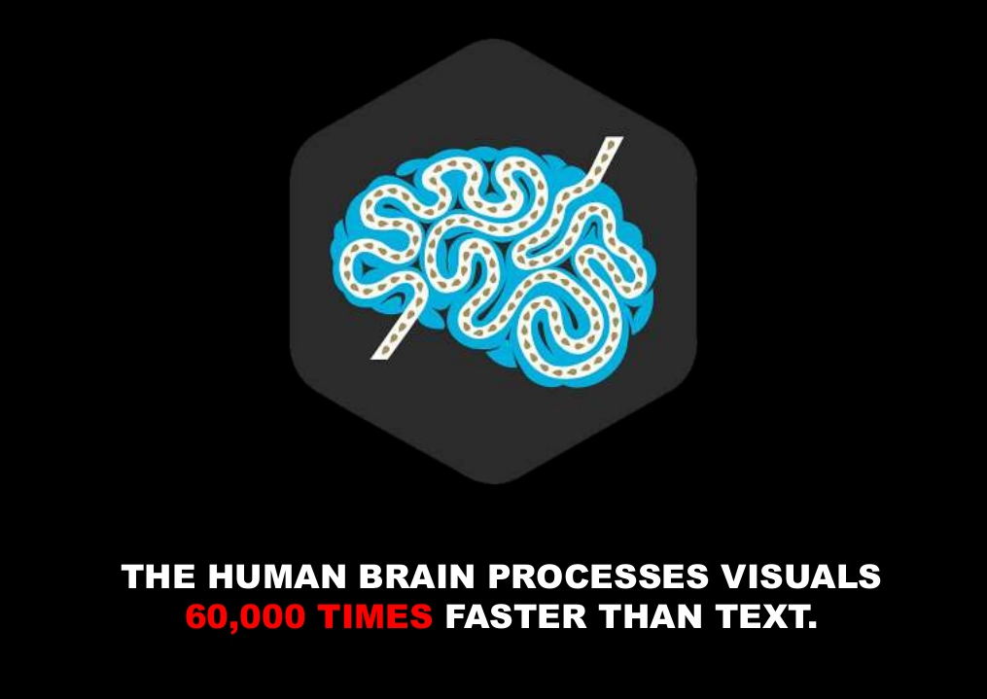
Computer Graphics: Why & What?

Slide 7
Computer Graphics: Why & What?
What
Computer graphics deals with all aspects of
creating images with a computer
Hardware
Software
High-Level: Maya, Lightwave, 3DS Studio
Low-level: OpenGL, Direct3D – Libraries for
programming graphics applications
Applications

Slide 8
Application
Display of Information
Computer-Aided Design
Simulation and Animation
User Interface

Slide 9
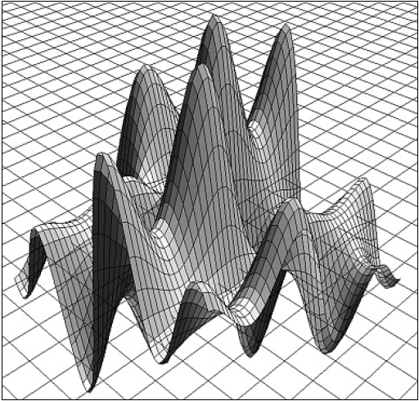
Application
Display of Information
Complex scientific data

Slide 10
Application
Display of Information
Medical Imaging

Slide 11
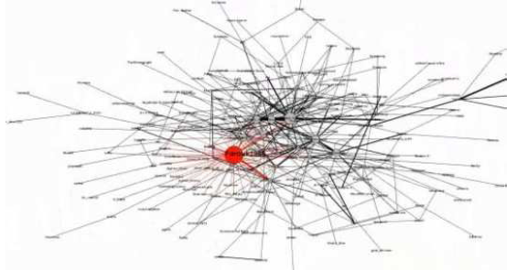
Application
Display of Information
Network and threat visualization

Slide 12
Application
Computer-Aided Design
Architecture

Slide 13
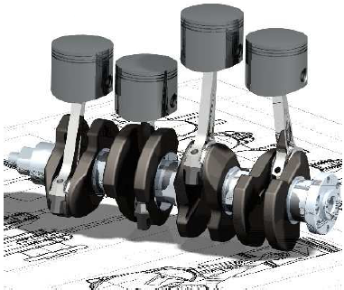
Application
Computer-Aided Design
Mechanical Engineering

Slide 14
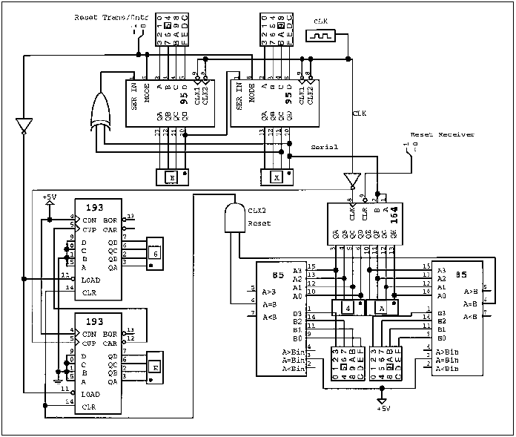
Application
Computer-Aided Design
Digital Logic Design

Slide 15
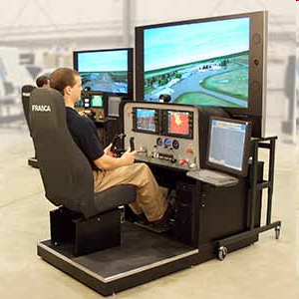
Application
Simulation and Animation
Flight simulators

Slide 16
Application
Simulation and Animation
Surgical training

Slide 17
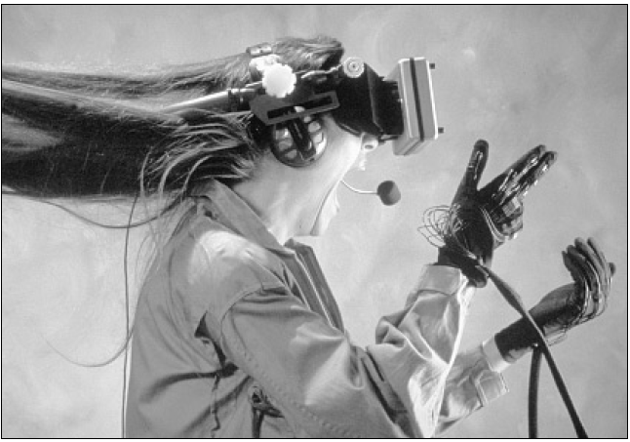
Application
Simulation and Animation
Virtual Reality

Slide 18
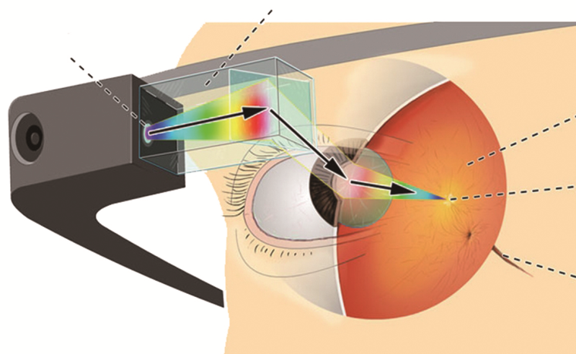
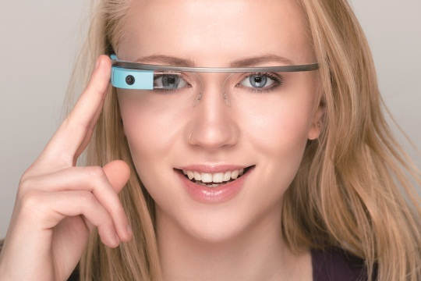
Application
Simulation and Animation
Augmented Reality
Lăng kính
Máy chiếu
Võng mạc
Hố trung tâm
Dây thần kinh

Slide 19
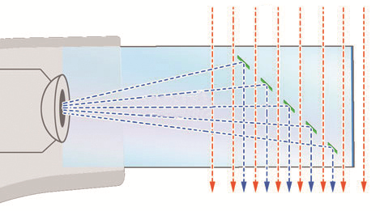
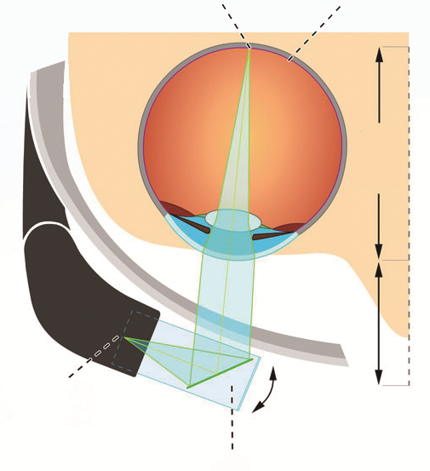
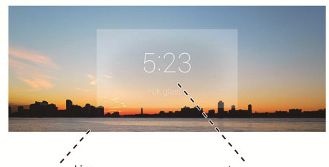
Application
Simulation and Animation
Augmented Reality
Cảnh vật thực tế
Ảnh ảo

Slide 20
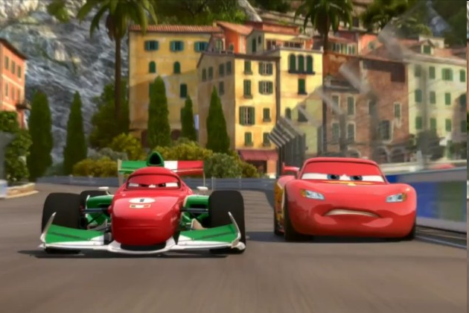
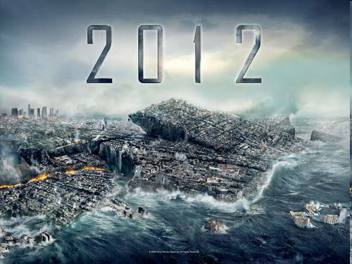
Application
Simulation and Animation
Entertainment

Slide 21
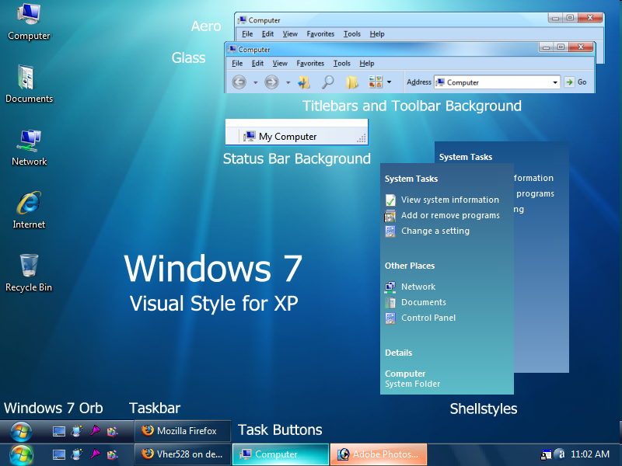
Application
User Interface

Slide 22
Computer Graphics Systems
System’s Overview
Input devices
Processor
Memory
Frame buffer
Output devices

Slide 23
Computer Graphics Systems
System’s Overview

Slide 24
Computer Graphics Systems
Input devices
Keyboard, Button boxes, dials
Mouse Devices: 2D and 3D
Trackballs and Spaceballs
Joysticks
Data Gloves, CyberGloves
Data tablet
Image Scanner
Touch Panels
Light Pens
3D Scanner

Slide 25
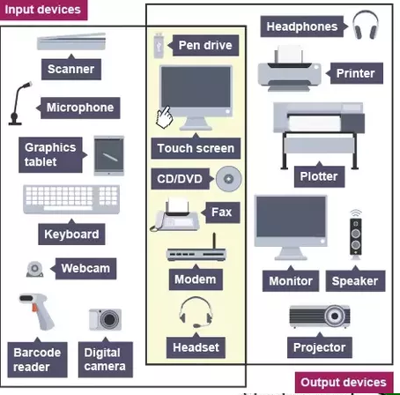
Computer Graphics Systems

Slide 26
Computer Graphics Systems
Frame buffer
Location
Inside the system memory
Inside GPU, graphic card
Store pixels of image to be shown on video
display

Slide 27
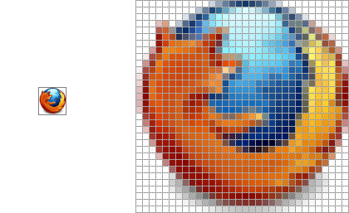
Computer Graphics Systems
Frame buffer
Pixel
Is the smallest element of images
Image = 2D Array of pixels
Specification:
Location: (X,Y)
Value: (Color)
– Gray value
– Color: [R,G,B]
– Index to color

Slide 28
Computer Graphics Systems
Frame buffer
Specification:
Resolution: the number of pixels in the frame
buffer
Depth or Precision: the number of bits that are
used for each pixel
– 1 bit: back and white color
– 8 bits: 28 (= 256) colors
– 24 bits: full-color system or true-color system.

Slide 29
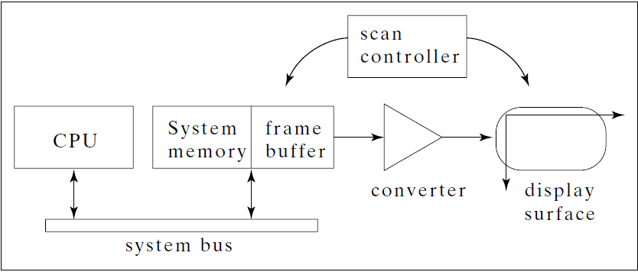
Computer Graphics Systems
Frame buffer

Slide 30
Computer Graphics Systems
Output devices
Hard-copy devices
Printer
Film recorder
Video display/projector
Cathode-Ray Tube (CRT)
Flat-panel display.

Slide 31
Computer Graphics Systems

Slide 32
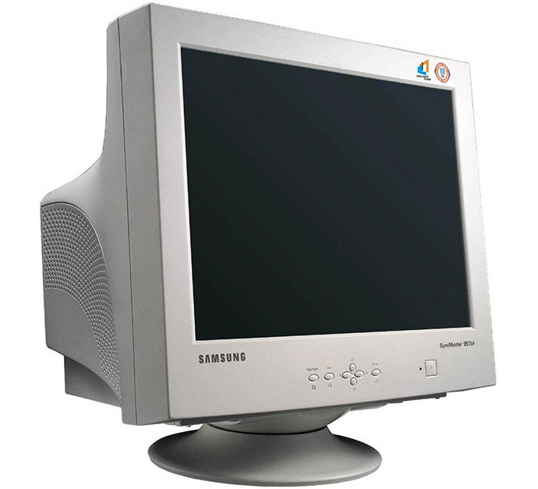
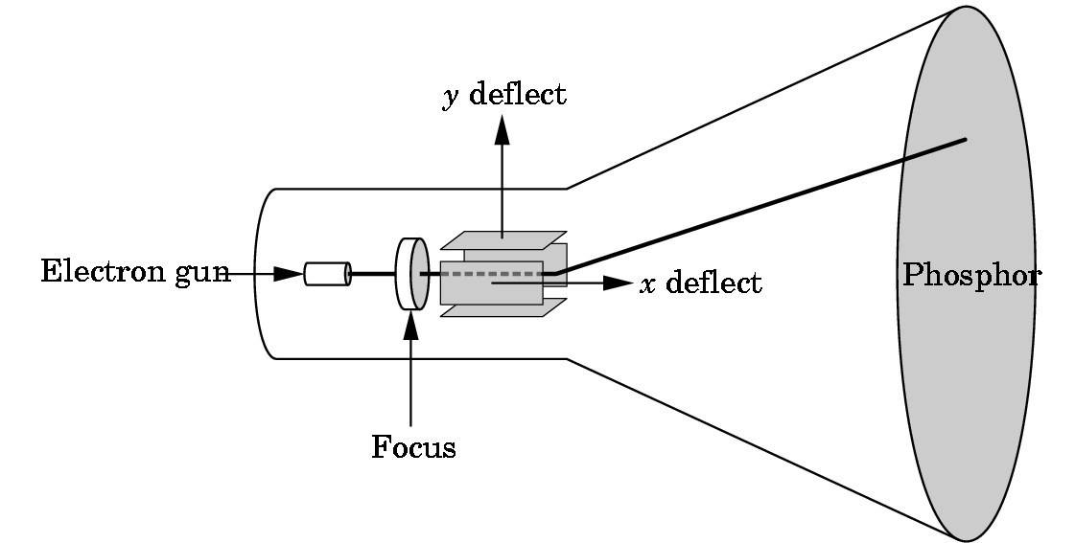
Computer Graphics Systems
Output devices
CRT (cathode ray tube)

Slide 33
Computer Graphics Systems
Output Devices
-
+
-
+
++
-

Slide 34
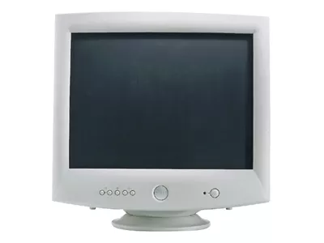
Computer Graphics Systems
Output Devices

Slide 35
Computer Graphics Systems
Output Devices

Slide 36
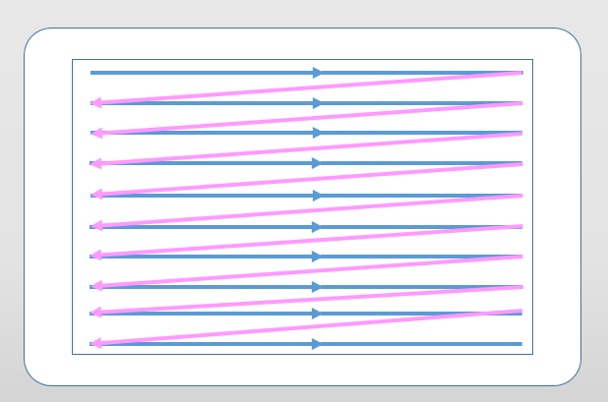
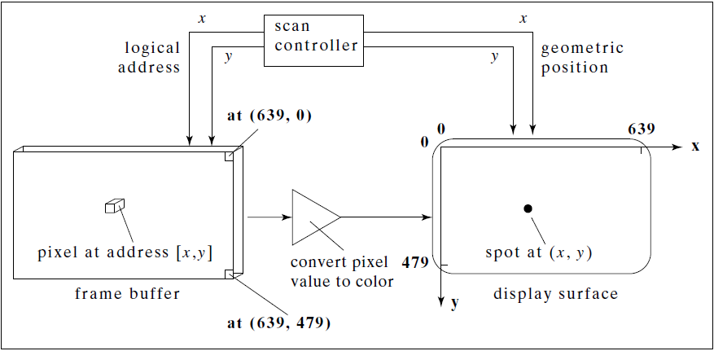
Computer Graphics Systems
Output devices

Slide 37
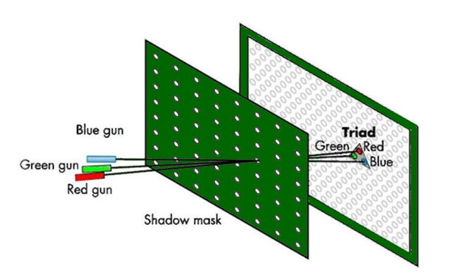
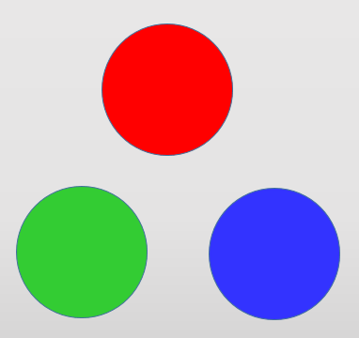
Computer Graphics Systems
Output Devices – Color Monitor

Slide 38






Computer Graphics Systems
Output Devices – Color Monitor
RGB =(0, 0, 0)
RGB =(255, 255, 0)
RGB =(255, 0, 0)
RGB =(0, 255, 0)
RGB =(150, 125, 0)
RGB =(0, 0, 255)

Slide 39
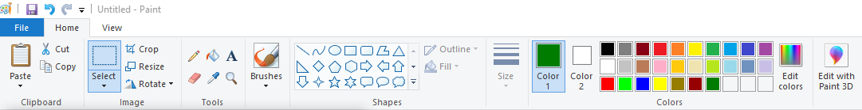
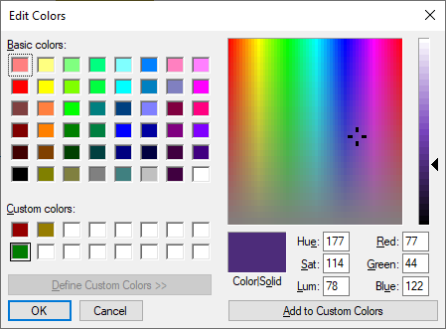
Computer Graphics Systems
Output Devices

Slide 40
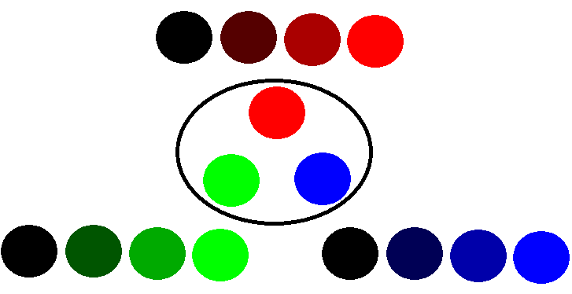
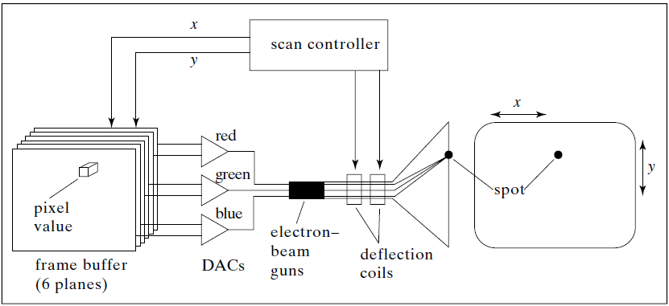
Computer Graphics Systems
Output devices
Color CRT

Slide 41

Computer Graphics Systems
00, 01, 10, 11
00, 01, 10, 11
00, 01, 10, 11
110110

Slide 42
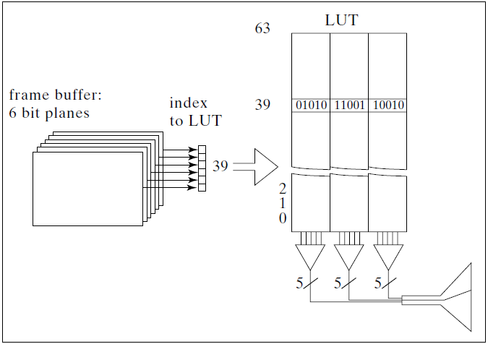
Computer Graphics Systems
Output devices
Indexed Color & Look up table
640*480*6/8 = 230 K
640*480*15/8 = 230K*2.5
LUT : 64*15/8 = 120 bytes

Slide 43
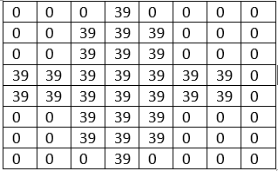
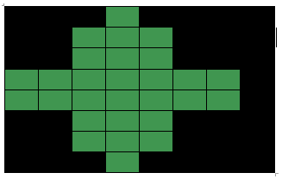
Computer Graphics Systems
Output devices
10010 11001 01010
00000 00000 00000
10010 = 18
11001 = 25
01010 = 10
R = 18*8 = 64
G = 25*8 = 150
B = 10*8 = 80

Slide 44
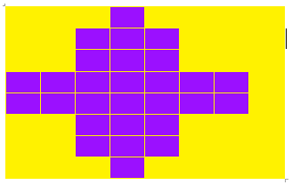
Computer Graphics Systems
Output Devices
11111 00001 11111
11111 11111 00000
R, G, B
11111, 00010, 11111
255 , 16, 255

Slide 45
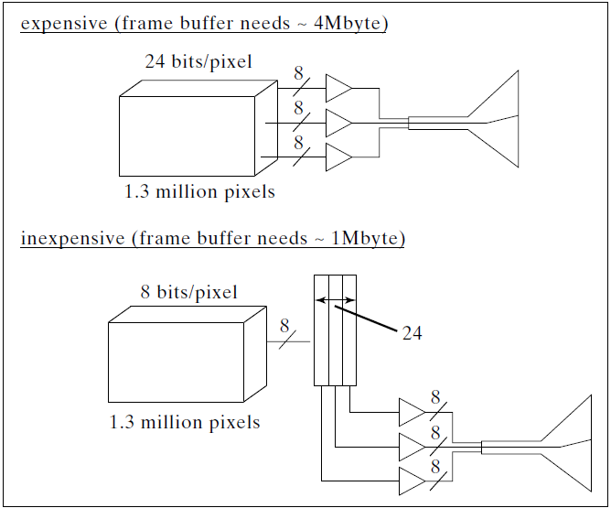
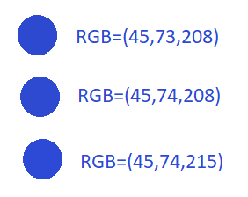
Computer Graphics Systems
Output devices

Slide 46
Computer Graphics Systems
Output Devices

Slide 47
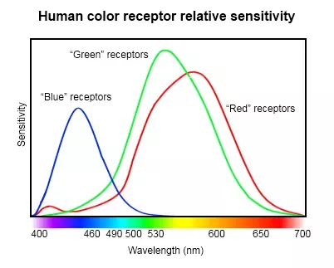
Computer Graphics Systems
Output Devices

Slide 48
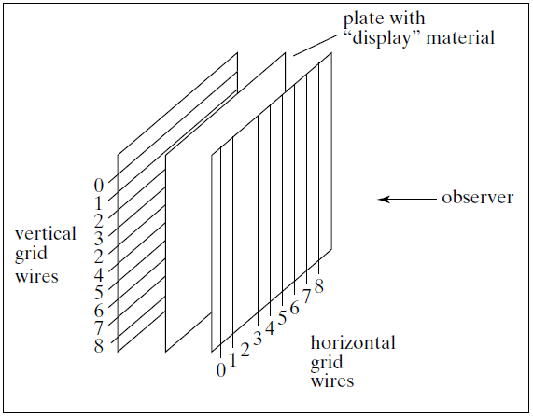
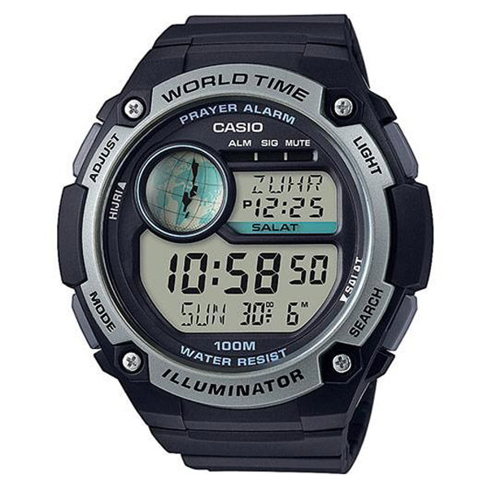

Computer Graphics Systems
Output devices

Slide 49
Image Formation
Elements of Image Formation
Objects
Viewers
Lights (Materials)
Advantages
Separation of objects, viewer, light sources
Two-dimensional graphics is a special case of three-dimensional graphics
Leads to simple software API
Leads to fast hardware implementation

Slide 50
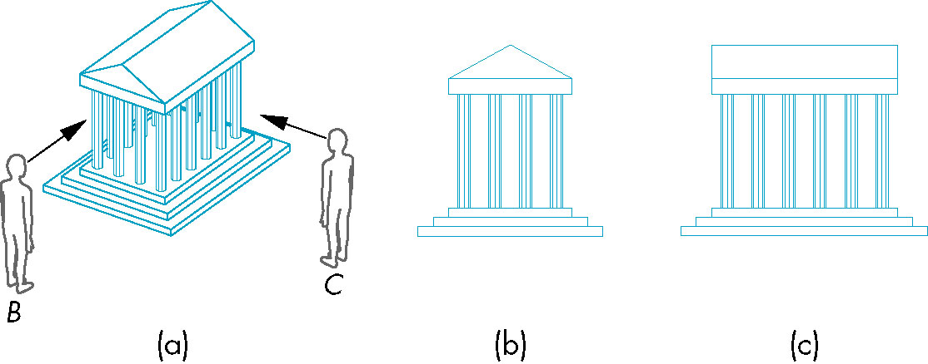
Image & Image Formation
Elements of Image Formation
Objects & viewers

Slide 51
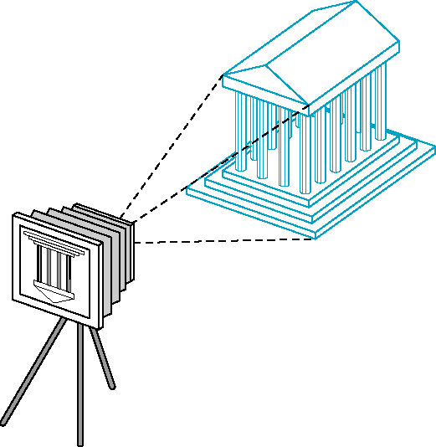
Image & Image Formation
Elements of Image Formation
Objects & viewers

Slide 52
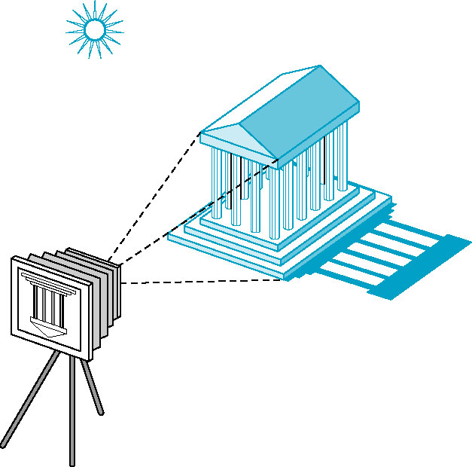
Image & Image Formation
Elements of Image Formation
Lights

Slide 53
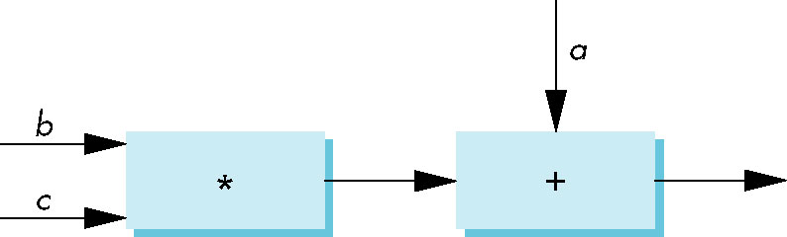
Models and Architectures
Practical Approach : Pipeline
Fast, simple
All steps can be implemented in hardware on the graphics card

Slide 54
API Contents
Functions that specify what we need to form an image
Objects
Viewer
Light Source(s)
Materials
Other information
Input from devices such as mouse and keyboard
Capabilities of system

Slide 55
API Contents
Object Specification
Most APIs support a limited set of primitives including
Points (0D object)
Line segments (1D objects)
Polygons (2D objects)
Some curves and surfaces
All are defined through locations in space or vertices

Slide 56
API Contents
Object Specification

Slide 57
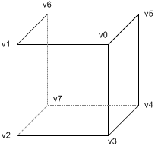
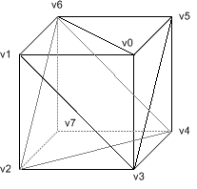
API Contents
Object Specification

Slide 58
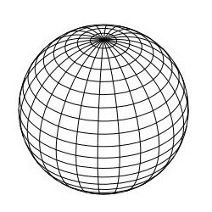
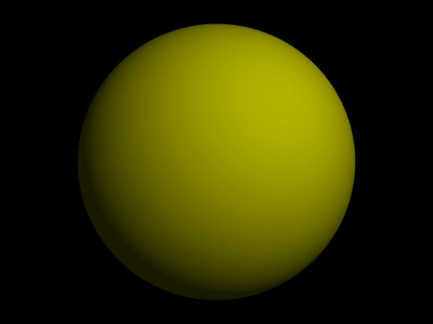

API Contents
Object Specification

Slide 59
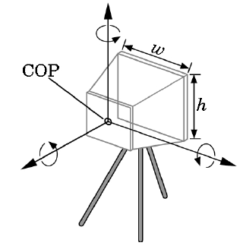
API Contents
Camera Specification
Six degrees of freedom
Position of center of lens
Orientation
Lens
Film size
Orientation of film plane

Slide 60
API Contents
Lights and Materials
Types of lights
Point sources vs distributed sources
Spot lights
Near and far sources
Color properties
Material properties
Absorption: color properties
Scattering
Diffuse
Specular

Slide 61
Further Reading
“Interactive Computer Graphics: A Topdown Approach Using OpenGL”, Edward Angel
Chapter 1: Graphics Systems And Models
“Đồ họa máy tính trong không gian hai chiều”, Trần Giang Sơn
Chương 1: Giới thiệu đồ họa máy tính

