Slide 1

COMPUTER GRAPHICS
Hochiminh city University of Technology
Faculty of Computer Science and Engineering
CHAPTER 07:
Rasterization

Slide 2
Overview
At end of the geometric pipeline, vertices have been assembled into primitives
Must clip out primitives that are outside the view frustum
  Algorithms based on representing primitives by lists of vertices
Must find which pixels can be affected by each primitive
  Fragment generation
  Rasterization or scan conversion

Slide 3
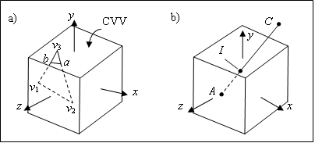
Overview

Slide 4
Required Tasks
Modeling
Geometric processing
  Projection
  Primitive assembly
  Clipping
  Shading
Rasterization
Fragment Processing
  Texture, Blending color

Slide 5
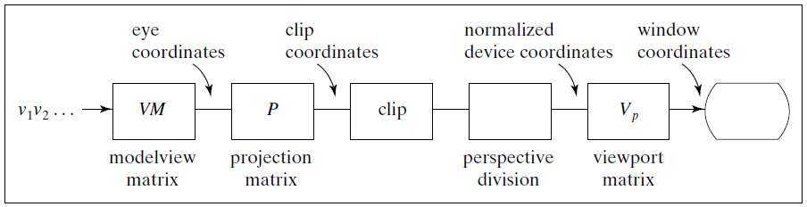
Required Tasks

Slide 6
Rasterization Meta Algorithms
Consider two approaches to rendering a scene with opaque objects
For every pixel, determine which object that projects on the pixel is closest to the viewer and compute the shade of this pixel
  Ray tracing paradigm
For every object, determine which pixels it covers and shade these pixels
  Pipeline approach
  Must keep track of depths

Slide 7
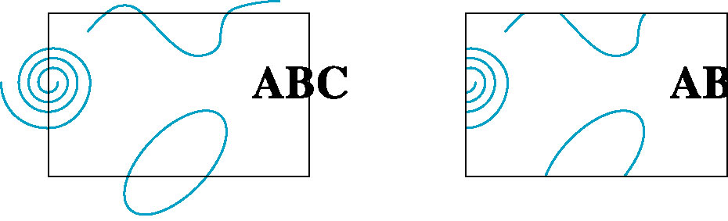
Clipping
2D against clipping window
3D against clipping volume
Easy for line segments polygons
Hard for curves and text
  Convert to lines and polygons first

Slide 8
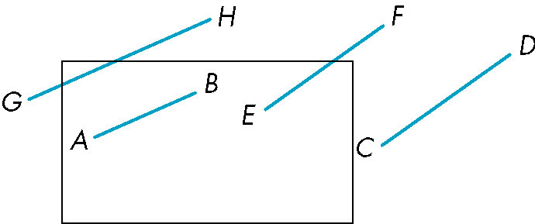
Clipping 2D Line Segments
Brute force approach: compute intersections with all sides of clipping window
  Inefficient: one division per intersection

Slide 9
Cohen-Sutherland Algorithm
Idea: eliminate as many cases as possible without computing intersections
Start with four lines that determine the sides of the clipping window
y = y_{max}
x = x_{min}
x = x_{max}
y = y_{min}

Slide 10
The Cases
Case 1: both endpoints of line segment inside all four lines
  Draw (accept) line segment as is
Case 2: both endpoints outside all lines and on same side of a line
  Discard (reject) the line segment
y = y_{max}
x = x_{min}
x = x_{max}
y = y_{min}

Slide 11
The Cases
Case 3: One endpoint inside, one outside
  Must do at least one intersection
Case 4: Both outside
  May have part inside
  Must do at least one intersection
y = y_{max}
x = x_{min}
x = x_{max}

Slide 12
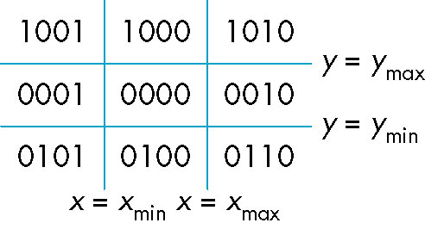
Defining Outcodes
For each endpoint, define an outcode
Outcodes divide space into 9 regions
Computation of outcode requires at most 4 subtractions
b₀b₁b₂b₃
b₀ = 1 if y > y_{max}, 0 otherwise
b₁ = 1 if y < y_{min}, 0 otherwise
b₂ = 1 if x > x_{max}, 0 otherwise
b₃ = 1 if x < x_{min}, 0 otherwise

Slide 13
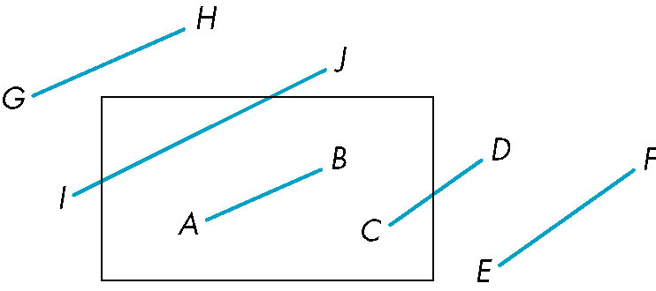
Using Outcodes
Consider the 5 cases below
AB: outcode(A) = outcode(B) = 0
  Accept line segment

Slide 14
Using Outcodes
CD: outcode (C) = 0 (0000), outcode(D) (0010) ≠ 0
  Compute intersection
  Location of 1 in outcode(D) determines which edge to intersect with
  Note if there were a segment from C to a point in a region with 2 ones in outcode, we might have to do two interesections

Slide 15
Using Outcodes
EF: outcode(E) (0010) logically ANDed with outcode(F) (0010) (bitwise) ≠ 0
  Both outcodes have a 1 bit in the same place
  Line segment is outside of corresponding side of clipping window
  reject

Slide 16
Using Outcodes
GH and IJ: same outcodes, neither zero but logical AND yields zero. G, I(0001), H, J(1000)
Shorten line segment by intersecting with one of sides of window
Compute outcode of intersection (new endpoint of shortened line segment)
Reexecute algorithm

Slide 17

Using Outcodes
int clipSegment(Point2& p1, Point2& p2, RealRect W)
{
do{
if (trivial accept) return 1;
if (trivial reject) return 0;
if (p1 nằm ngoài)
{
if (p1 nằm bên trên) cắt xén p1 với cạnh trên
else if (p1 nằm bên dưới) cắt xén p1 với cạnh dưới
else if (p1 nằm phải) cắt xén p1 với cạnh phải
else if (p1 nằm trái) cắt xén p1 với cạnh trái
}
else //p2 nằm ngoài
{
if (p2 nằm bên trên) cắt xén p2 với cạnh trên
else if (p2 nằm bên dưới) cắt xén p2 với cạnh dưới
else if (p2 nằm phải) cắt xén p2 với cạnh phải
else if (p2 nằm trái) cắt xén p2 với cạnh trái
}
}while(1);
}
p2
C
D
A
B
p1

Slide 18
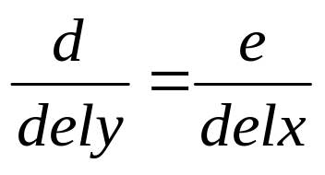
Using Outcodes
p1
cửa sổ
d
top
A
e
dely
p2
bottom
delx
e = p1.x - W.right;
delx = p2.x - p1.x;
dely = p2.y - p1.y;
p1.y = p1.y + (W.right - p1.x)*dely/delx
left
right

Slide 19
Efficiency
In many applications, the clipping window is small relative to the size of the entire data base
  Most line segments are outside one or more side of the window and can be eliminated based on their outcodes
Inefficiency when code has to be reexecuted for line segments that must be shortened in more than one step

Slide 20
Liang-Barsky Clipping
Consider the parametric form of a line segment
We can distinguish between the cases by looking at the ordering of the values of α where the line determined by the line segment crosses the lines that determine the window
p(α) = (1-α)p₁+ αp₂ 1 ≥ α ≥ 0
p₂
p₁

Slide 21
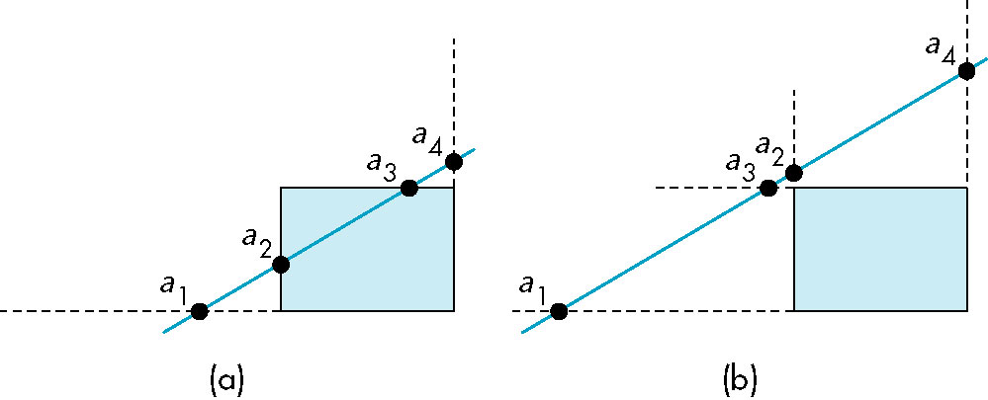
Liang-Barsky Clipping
In (a): 1>α₄ > α₃ > α₂ > α₁>0
  Intersect right, top, left, bottom: shorten
In (b): 1>α₄ > α₂ > α₃ > α₁ >0
  Intersect right, left, top, bottom: reject

Slide 22
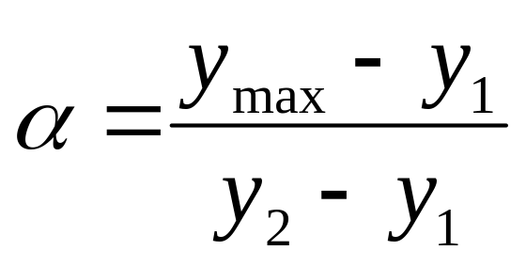
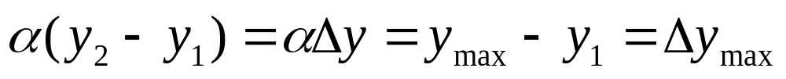
Liang-Barsky Clipping
p(α) = (1- α)p₁+ α p₂ 1 ≥ α ≥ 0
x(α) = (1- α)x₁+ α x₂
y(α) = (1- α)y₁+ α y₂

Slide 23
Advantages
Can accept/reject as easily as with Cohen-Sutherland
Using values of α, we do not have to use algorithm recursively as with C-S
Extends to 3D

Slide 24
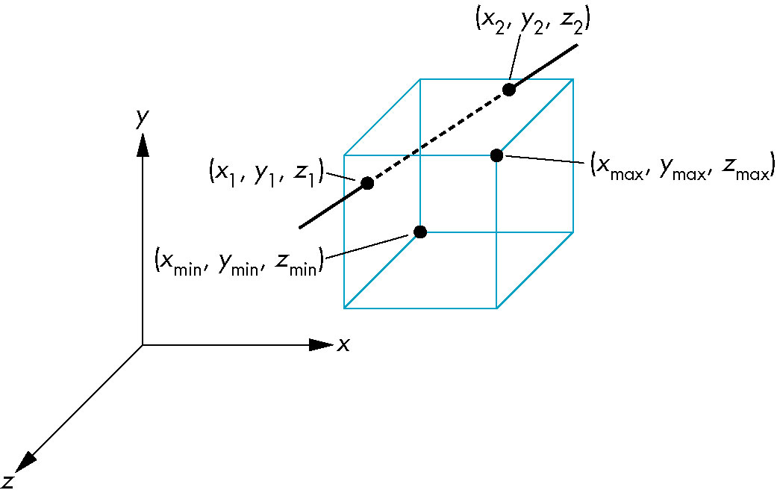
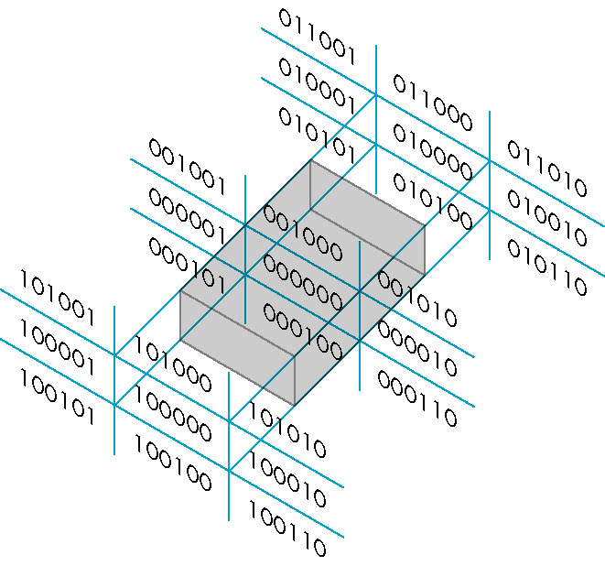
Cohen Sutherland in 3D
Use 6-bit outcodes
When needed, clip line segment against planes

Slide 25
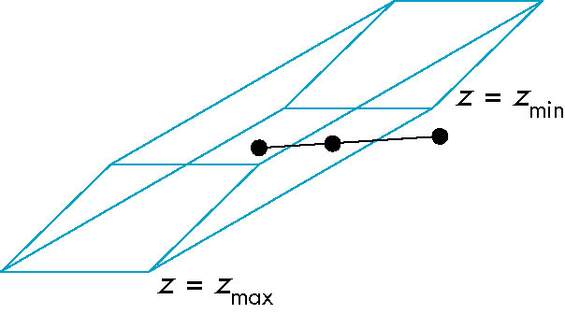
Clipping and Normalization
General clipping in 3D requires intersection of line segments against arbitrary plane
Example: oblique view

Slide 26
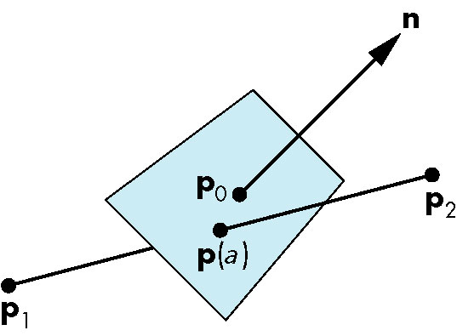
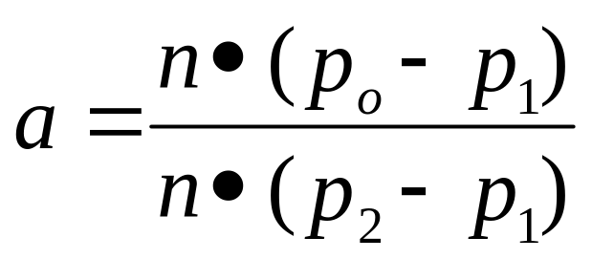
Plane-Line Intersections

Slide 27
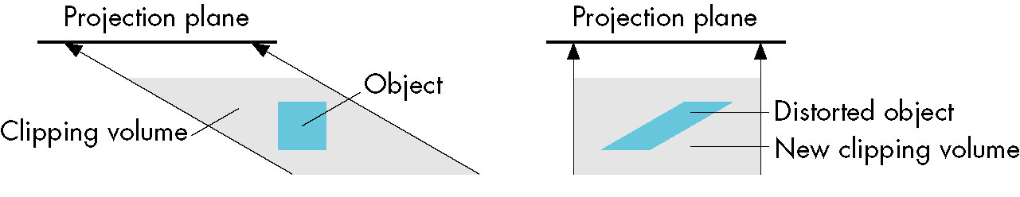
Normalized Form
top view
before normalization
after normalization
Normalization is part of viewing (pre clipping) but after normalization, we clip against sides of right parallelepiped
Typical intersection calculation now requires only a floating point subtraction, e.g. is x > xmax ?

Slide 28
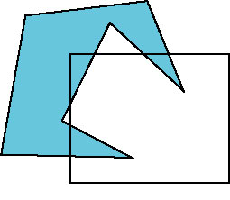
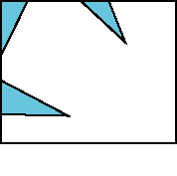
Polygon Clipping
Not as simple as line segment clipping
  Clipping a line segment yields at most one line segment
  Clipping a polygon can yield multiple polygons
However, clipping a convex polygon can yield at most one other polygon

Slide 29

Tessellation and Convexity
One strategy is to replace nonconvex (concave) polygons with a set of triangular polygons (a tessellation)
Also makes fill easier
Tessellation code in GLU library

Slide 30
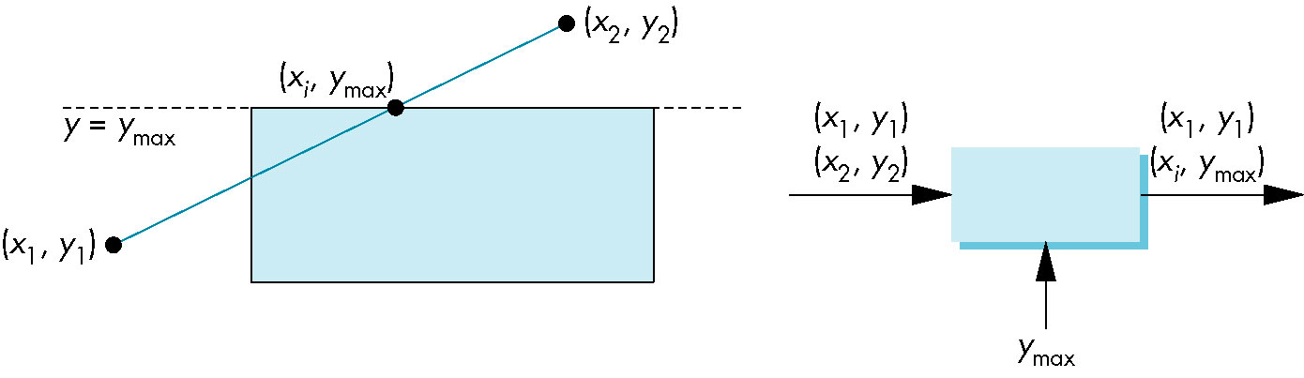
Clipping as a Black Box
Can consider line segment clipping as a process that takes in two vertices and produces either no vertices or the vertices of a clipped line segment

Slide 31
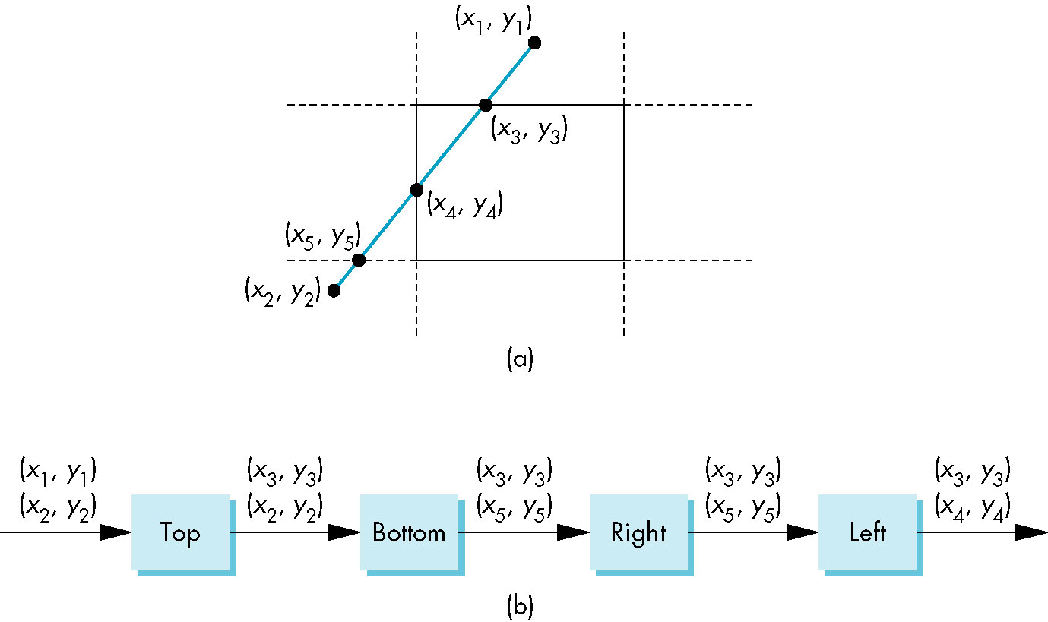
Pipeline Clipping of Line Segments
Clipping against each side of window is independent of other sides
  Can use four independent clippers in a pipeline

Slide 32
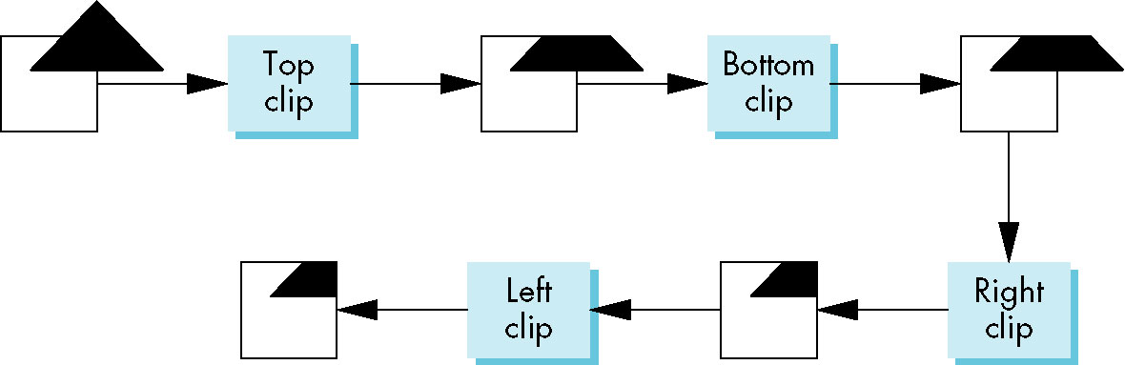
Pipeline Clipping of Polygons
Three dimensions: add front and back clippers
Strategy used in SGI Geometry Engine
Small increase in latency

Slide 33
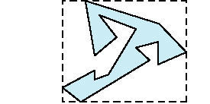
Bounding Boxes
Rather than doing clipping on a complex polygon, we can use an axis-aligned bounding box or extent
  Smallest rectangle aligned with axes that encloses the polygon
  Simple to compute: max and min of x and y

Slide 34
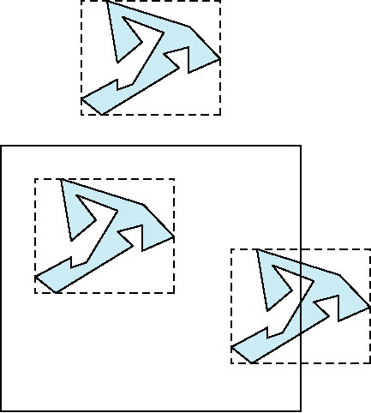
Bounding boxes
Can usually determine accept/reject based only on bounding box
reject
accept
requires detailed
clipping

Slide 35
Rasterization
Rasterization (scan conversion)
  Determine which pixels that are inside primitive specified by a set of vertices
  Produces a set of fragments
  Fragments have a location (pixel location) and other attributes such color and texture coordinates that are determined by interpolating values at vertices
Pixel colors determined later using color, texture, and other vertex properties

Slide 36
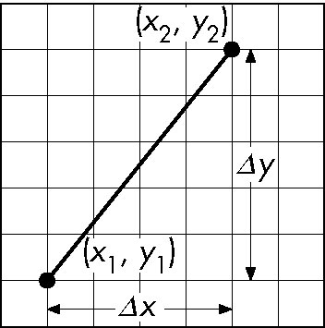
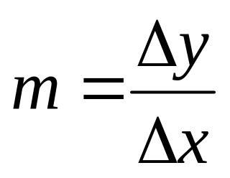
Scan Conversion of Line Segments
Start with line segment in window coordinates with integer values for endpoints
Assume implementation has a write_pixel function
y = mx + h

Slide 37
Scan Conversion of Line Segments
Requirements
  Pass 2 end points
  Independent of start point
  Smooth, equal thickness
  Independent of number of call

Slide 38
DDA Algorithm
Digital Differential Analyzer
  DDA was a mechanical device for numerical solution of differential equations
  Line y = mx + h satisfies differential equation
  dy/dx = m = Δy/Δx = y₂-y₁/x₂-x₁
Along scan line Δx = 1
for(x=x1; x<=x2,ix++) {
y+=m;
write_pixel(x, round(y), line_color)
}

Slide 39
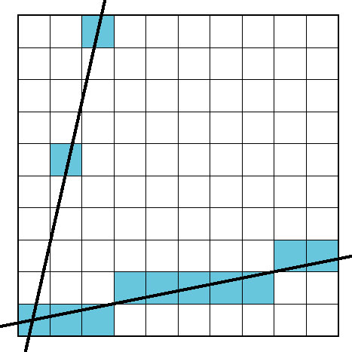
Problem
In some case, line segment does not pass both end point
Slow because using round().
Problems for steep lines

Slide 40
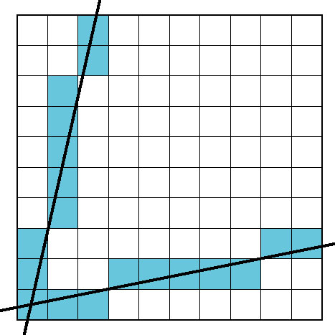
Problem
Use for 1 ≥ m ≥ 0
For m > 1, swap role of x and y
  For each y, plot closest x

Slide 41
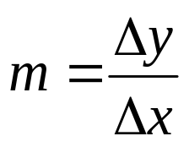
Bresenham’s Algorithm
DDA requires one floating point addition per step
We can eliminate all fp through Bresenham’s algorithm
Line segment with end point: (x_{a} , y_{a}) and (x_{b} , y_{b}),
Line equation:
(Without loss of generality), x_{a} < x_{b} and 0 < m < 1
  Other cases by symmetry
If we start at a pixel that has been written, there are only two candidates for the next pixel to be written into the frame buffer
y = m(x − x_{a}) + y_{a}
Δy = y_{b} − y_{a}
Δx = x_{b} − x_{a}

Slide 42
Bresenham’s Algorithm
Generate the pixel by incremental Algorithm
Error defined as follow:
e(T_{i}) = y* − y_{i − 1}
e(S_{i}) = (y_{i − 1} + 1) − y*
Ideal line
S_{i}
y*
y_{i − 1}
T_{i}
x_{i − 1}
x_{i}
Choose T_{i} iff e(T_{i}) - e(S_{i}) < 0

Slide 43
Bresenham’s Algorithm
- e(T_{i}) - e(S_{i}) = 2m(x_{i} - x_{a}) + 2(y_{a} – y_{i-1}) – 1
- Defined
e_{i} = Δx⋅(e(T_{i}) - e(S_{i}))
= 2(Δy)(x_{i} - x_{a}) + 2(Δx)(y_{a} – y_{i-1}) - Δx (*)
The rule:
If e_{i} < 0 choose y_{i} = y_{i - 1} ,
else choose y_{i} = y_{i - 1} + 1
Ideal line
S_{i}
y*
y_{i − 1}
T_{i}
x_{i − 1}
x_{i}

Slide 44
Bresenham’s Algorithm
Idea line segment pass the middle of S_{i} and T_{i}
Ideal line
S_{i}
y*
y_{i − 1}
T_{i}
x_{i − 1}
x_{i}
e(T_{i}) = y* - y_{i - 1}
e(S_{i}) = (y_{i - 1} + 1) - y*

Slide 45
Bresenham’s Algorithm
S_{i}
S_{i}
T_{i}
y_{i − 1}
y_{i − 1}
T_{i}
x_{i − 1}
x_{i}
x_{i − 1}
x_{i}
e(T_{i}) >= 0
e(S_{i}) <= 0
e(T_{i}) <= 0
e(S_{i}) >= 0
e(T_{i}) = y* - y_{i - 1}
e(S_{i}) = (y_{i - 1} + 1) - y*
e_{i} = Δx⋅(e(T_{i}) - e(S_{i}))
The rule:
If e_{i} < 0 choose y_{i} = y_{i - 1} ,
else choose y_{i} = y_{i - 1} + 1

Slide 46
Bresenham’s Algorithm
e_{i} = 2(Δy)(x_{i} - x_{a}) + 2(Δx)(y_{a} – y_{i-1}) - Δx
→ e_{i+1} = 2(Δy)(x_{i+1} - x_{a}) + 2(Δx)(y_{a} – y_{i}) - Δx
→ e_{i+1} = e_{i} + 2(Δy)(x_{i+1} - x_{i}) - 2(Δx)(y_{i} – y_{i-1})
According the rule
  if e_{i} < 0 choose y_{i} = y_{i-1}
    e_{i+1} = e_{i} + 2Δy
  else choose y_{i} = y_{i-1} + 1
    e_{i+1} = e_{i} + 2Δy - 2Δx
The rule:
If e_{i} < 0 choose y_{i} = y_{i - 1} ,
else choose y_{i} = y_{i - 1} + 1

Slide 47
Bresenham’s Algorithm
Start:
    x₀ = x_{a}, y₀ = y_{a}
    e₁ = 2(Δy) − Δx (x₁ − x_{a} = 1)
(Use e_{i} = 2(Δy)(x_{i} - x_{a}) + 2(Δx)(y_{a} – y_{i-1}) - Δx)

Slide 48
Bresenham’s Algorithm
procedure Bresenham(xa, xb : col; ya, yb : row; col_val : color);
begin
y := ya; dx := xb - xa; dy := yb - ya;
e_noinc := dy + dy; {2dy}
e := e_noinc - dx; {e1=2dy-dx}
e_inc := e - dx; {2dy-2dx}
for x := xa to xb do
begin
SetPixel(x, y, col_val);
if e < 0 then e := e + e_noinc;
else begin
y := y + 1;
e := e + e_inc
end;
end;
end; {Bresenham}

Slide 49
Bresenham’s Algorithm
x_{a} > x_{b} (change the points)
m > 1 (change the role of x and y)
−1 < m < 0 (replace dy by –dy)
m < -1 (replace dx by –dx, change the role of x and y)
Vertical and horizontal line

Slide 50
Circle Drawing Algorithms
y
(−x, y)
(x, y)
A
B
(−y, x)
(y, x)
x
(−y, −x)
(y, −x)
(−x, −y)
(x, −y)

Slide 51
Circle Drawing Algorithms
Suppose pixel at step i - 1 is P_{i-1} = (x_{i-1}, y_{i-1})
Define
  S_{i} = (x_{i-1} + 1, y_{i-1})
  T_{i} = (x_{i-1} + 1, y_{i-1} - 1)
Define the error
  e(P) = (x² + y²) – R²
Define the decision function
  d_{i} = e(S_{i}) + e(T_{i})
- if d_{i} < 0 choose S_{i}
else choose T_{i}
P_{i − 1}
S_{i}
y_{i − 1}
T_{i}
x_{i − 1}
x_{i}

Slide 52
Circle Drawing Algorithms
  d_{i} = e(S_{i}) + e(T_{i})
d_{i} < 0 choose S_{i}
S_{i}
S_{i}
S_{i}
T_{i}
T_{i}
T_{i}
e(S_{i}) < 0
e(T_{i}) < 0
e(S_{i}) > 0
e(T_{i}) < 0
e(S_{i}) > 0
e(T_{i}) > 0
OK!
OK
imposible

Slide 53
Circle Drawing Algorithms
  d_{i} = e(S_{i}) + e(T_{i})
d_{i} >= 0 choose T_{i}
S_{i}
S_{i}
S_{i}
T_{i}
T_{i}
T_{i}
e(S_{i}) < 0
e(T_{i}) < 0
e(S_{i}) > 0
e(T_{i}) < 0
e(S_{i}) > 0
e(T_{i}) > 0
Impossible
OK
OK

Slide 54
Circle Drawing Algorithms
  e(P) = (x² + y²) – R²
  d_{i} = e(S_{i}) + e(T_{i})
  d_{i + 1} = d_{i} + 4 x_{i − 1} + 6 + 2(y_{i}² − y_{i − 1}²) − 2(y_{i} − y_{i − 1})
  if d_{i} < 0 → y_{i} = y_{i − 1} , choose T_{i}
    d_{i + 1} = d_{i} + 4 x_{i − 1} + 6
  else y_{i} = y_{i − 1} − 1, choose S_{i}
    d_{i + 1} = d_{i} + 4(x_{i − 1} − y_{i − 1}) + 10
Start:
  x₀ = 0, y₀ = R
→ S₁ = (1, R) and T₁ = (1, R − 1),
→ d₁=e(S₁) + e(T₁) =(1²+R²-R²)+(1²⁺(R-1)² –R²)=3 − 2R

Slide 55
Circle Drawing Algorithms
procedure MichCirc(xc : col; yc : row; Rad : integer; value : color);
begin
x := 0; y := Rad; d := 3 - 2*Rad;
while x <= y do begin
SetPixel(xc + x, yc + y, value); {draw 8 points }
SetPixel(xc - x, yc + y, value); {based on (x, y)}
…………………………………
if d < 0 then d := d + 4*x + 6 {update error term}
else begin
d := d + 4*(x - y) + 10;
y := y - 1
end;
x := x + 1
end
end;

Slide 56
Flood Fill
Fill can be done recursively if we know a seed point located inside (WHITE)
Scan convert edges into buffer in edge/inside color (BLACK)
flood_fill(int x, int y) {
if(read_pixel(x,y)= = WHITE) {
write_pixel(x,y,BLACK);
flood_fill(x-1, y);
flood_fill(x+1, y);
flood_fill(x, y+1);
flood_fill(x, y-1);
}
}

Slide 57
Flood Fill
Repeat many times
overflow

Slide 58
Flood Fill
procedure FloodFill(x : col; y : row; int_color, new_color : color);
begin
if (GetPixel(x, y) >< bound_color) and (GetPixel(x, y) >< new_color) then begin
SetPixel(x, y, new_color);
FloodFill(x – 1, y, int_color, new_color);
FloodFill(x + 1, y, int_color, new_color);
FloodFill(x, y + 1, int_color, new_color);
FloodFill(x, y – 1, int_color, new_color);
end
end;

Slide 59
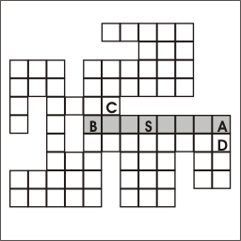
Run of Pixels

Slide 60
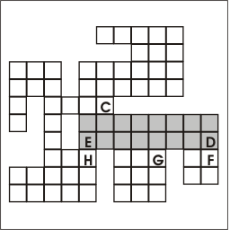
Run of Pixels
D
C

Slide 61
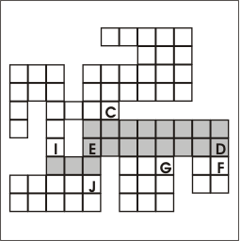
Run of Pixels
J
I
G
F
C

Slide 62
Run of Pixels
Push address of seed pixel on the stack;
while stack not empty do
Pop the stack to provide the next seed;
Fill in the run defined by the seed;
Examine the row above for runs reachable
from this run;
Push the address of the rightmost pixels
of each such run;
Do the same for the row below the current run;
end;

Slide 63
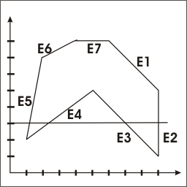
Fill Polygon-defined Region
With each scan line
  Find intersections with the edge of polygon
  Sort the intersections
  Fill each span

Slide 64
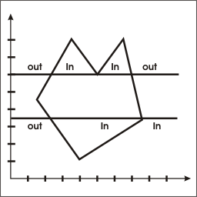
Fill Polygon-defined Region
Ignore horizontal edge
Inside-outside test not true at the vertex which is not local maximum, minimum
  Move down the point of the edge 1 pixel

Slide 65
Fill Polygon-defined Region
Active Edge List (AEL)
  The edges intersected by scanline y, mostly intersected by scanline y+1.
  Can predict the value of intersection
type
  edge_ptr = ^edge_info
  edge_info = record
  y_upper : row;
  x_int : real;
  recip_slope : real;
  next : egde_ptr;
  end;

Slide 66
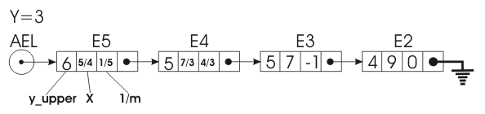
Fill Polygon-defined Region

Slide 67
Fill Polygon-defined Region
update AEL for scanline y+1
  Delete all the edges with y_upper < new_y
  Change x_value by plus recip_slope
  Add new edge with y_lower = new_y
  Sort the intersection

Slide 68
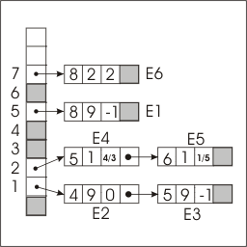
Fill Polygon-defined Region
Build edge_table: array [row] of edge_ptr

Slide 69
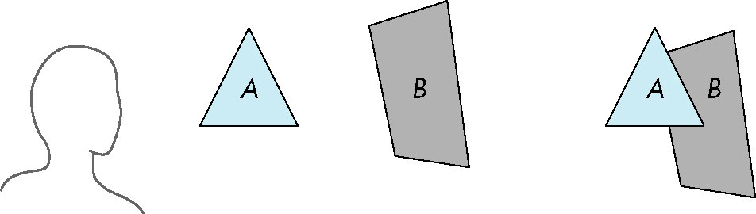
Depth sort & Painter’s Algorithm
Object-space with lower polygon count
Render polygons a back to front order so that polygons behind others are simply painted over
B behind A as seen by viewer
Fill B then A

Slide 70
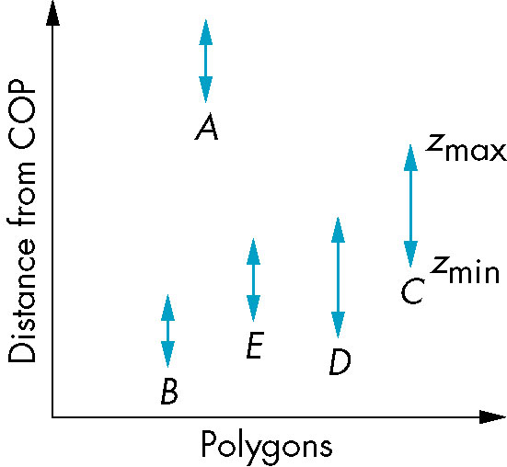
Depth sort & Painter’s Algorithm
Requires ordering of polygons first
  O(n log n) calculation for ordering
  Not every polygon is either in front or behind all other polygons
Order polygons and deal with
easy cases first, harder later
Polygons sorted by
distance from COP

Slide 71
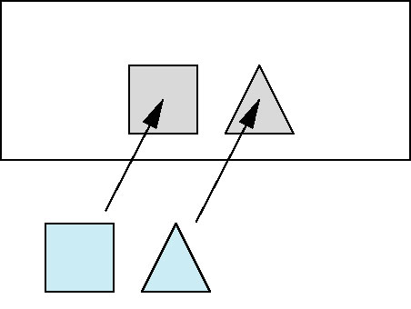
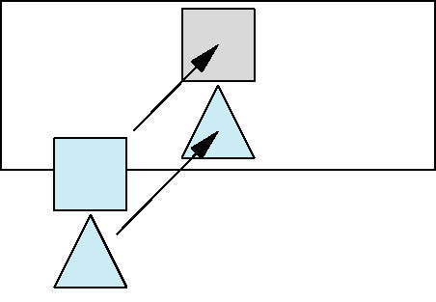
Depth sort & Painter’s Algorithm
A lies behind all other polygons
  Can render
Polygons overlap in z but not in either x or y
  Can render independently

Slide 72
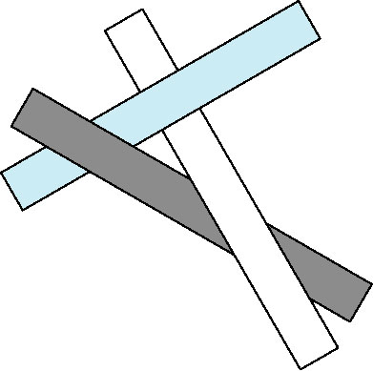
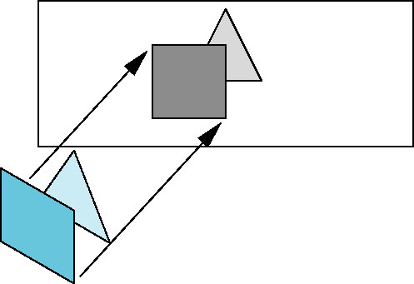
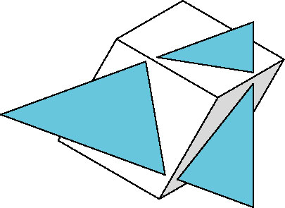
Depth sort & Painter’s Algorithm
cyclic overlap
Overlap in all directions
but can one is fully on
one side of the other
penetration

Slide 73
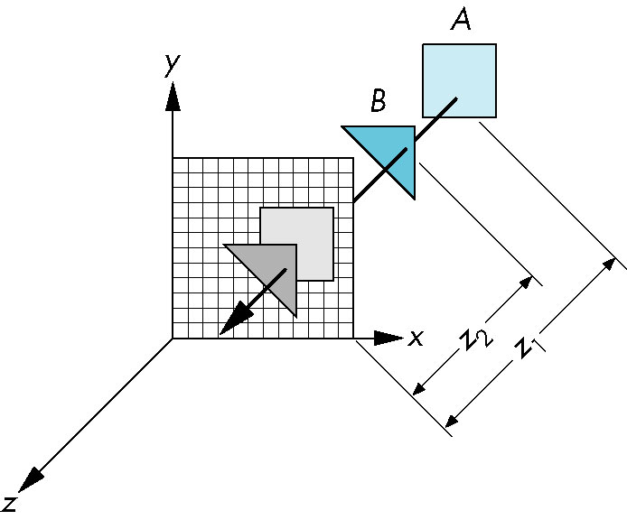
z-Buffer Algorithm
Use a buffer called the z or depth buffer to store the depth of the closest object at each pixel found so far
As we render each polygon, compare the depth of each pixel to depth in z buffer
If less, place shade of pixel in color buffer and update z buffer

Slide 74
z-Buffer Algorithm
It must be
  Requested in main()
    glutInitDisplayMode(GLUT_SINGLE | GLUT_RGB | GLUT_DEPTH)
  Enabled
    glEnable(GL_DEPTH_TEST)
  Cleared in the display callback
    glClear(GL_COLOR_BUFFER_BIT |
    GL_DEPTH_BUFFER_BIT)

Slide 75
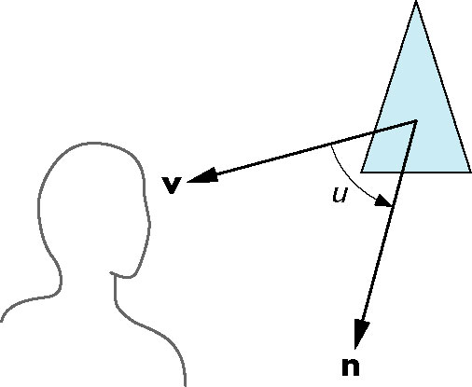
Back-Face Removal (Culling)
face is visible iff 90 ≥ θ ≥ -90
equivalently cos θ ≥ 0
or v • n ≥ 0
Compute the area of polygon

Slide 76
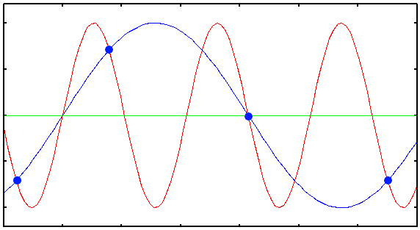
Aliasing
One pattern of pixels ←→ many different continous line
Pixel locations are fixed
Pixels have a fixed size and shape

Slide 77
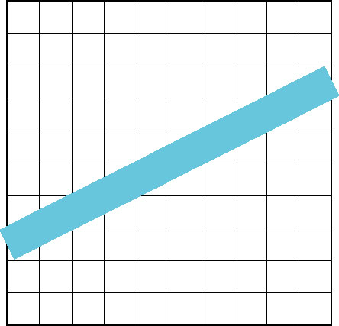
Aliasing
Ideal rasterized line should be 1 pixel wide
Choosing best y for each x (or visa versa) produces aliased raster lines

Slide 78
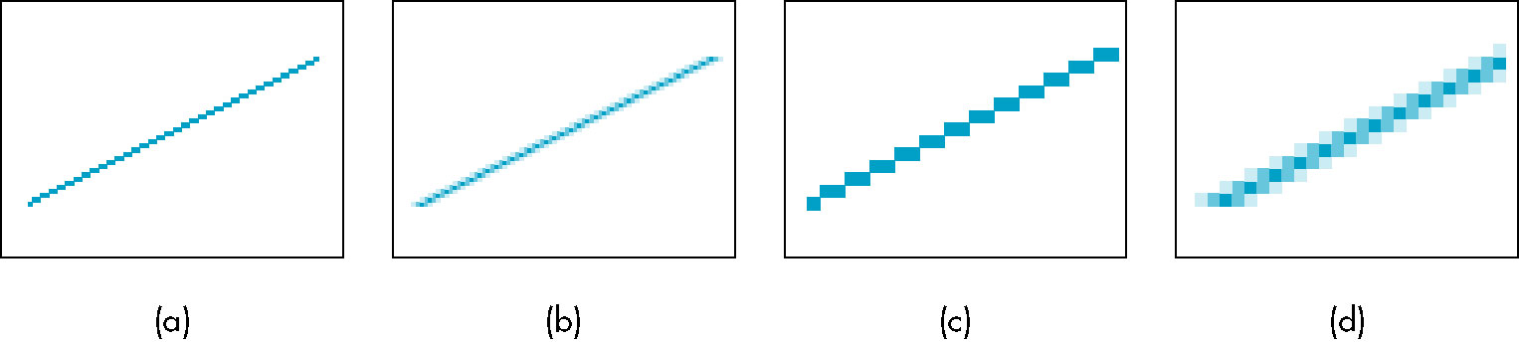
Antialiasing by Area Averaging
Color multiple pixels for each x depending on coverage by ideal line
original
antialiased

Slide 79
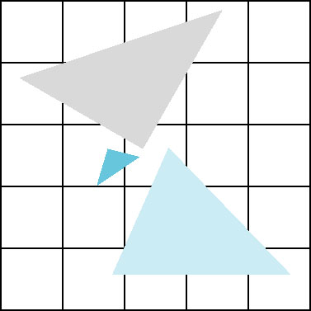
Polygon Aliasing
Aliasing problems can be serious for polygons
  Jaggedness of edges
  Small polygons neglected
  Need compositing so color
  of one polygon does not
  totally determine color of
  pixel
All three polygons should contribute to color

Slide 80
Further Reading
“Interactive Computer Graphics: A Topdown Approach Using OpenGL”, Edward Angel
  Chapter 7: From Vertices to Fragments
“Đồ họa máy tính trong không gian ba chiều”, Trần Giang Sơn
  Chương 5: Xây dựng công cụ cho đồ họa raster

